Slide 1

Django Templates and Views

Slide 2
Previously on Lost
You had a view of student and course that gave you a random student record rather than one based on the URL
You should have found a way to fix this before today.
Let me show you how.

Slide 3
Remember
Request → urls.py → views.py → template.html
Trace everything backwards and make sure changes are correct on all three files.

Slide 4
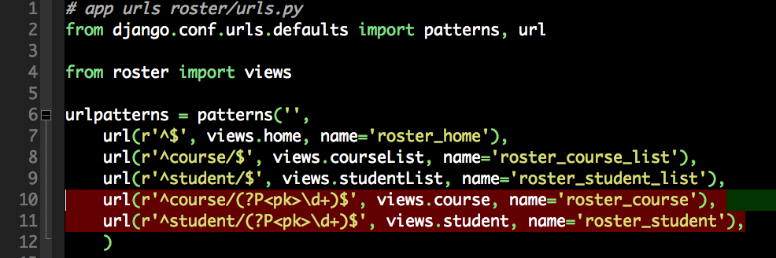
App urls.py
Need to turn on /student/123 and the same for courses.

Slide 5
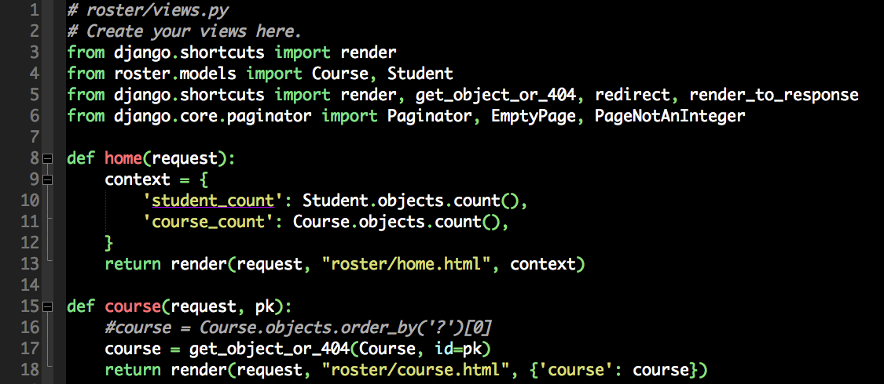
App views.py

Slide 6
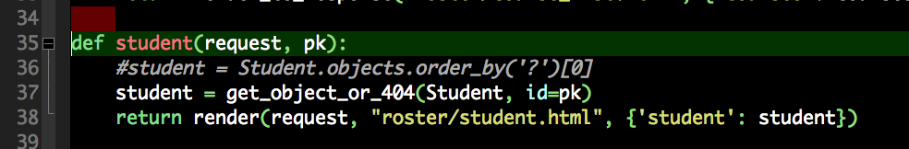
App views.py

Slide 7
Test it!

Slide 8
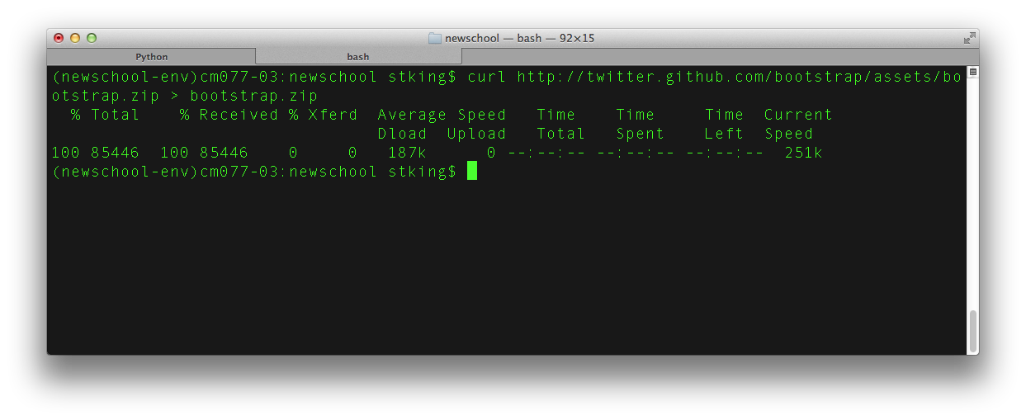
Now for Style! Bootstrap Style
mkdir newschool/static_media
curl http://twitter.github.com/bootstrap/assets/bootstrap.zip > bootstrap.zip

Slide 9
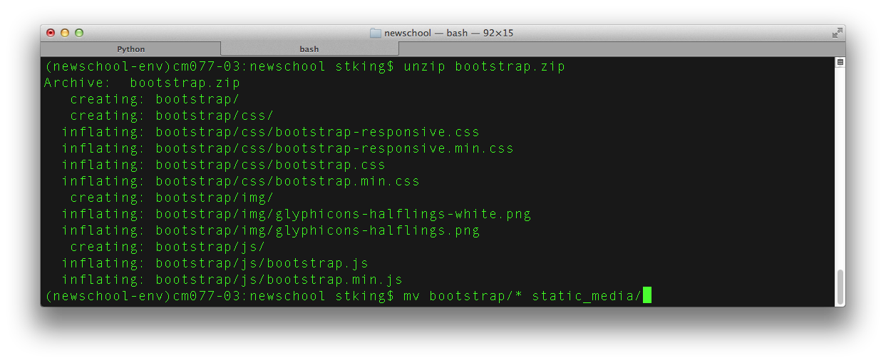
Unzip and Copy Content into static_media
unzip bootstrap.zip
mv bootstrap/* static_media

Slide 10
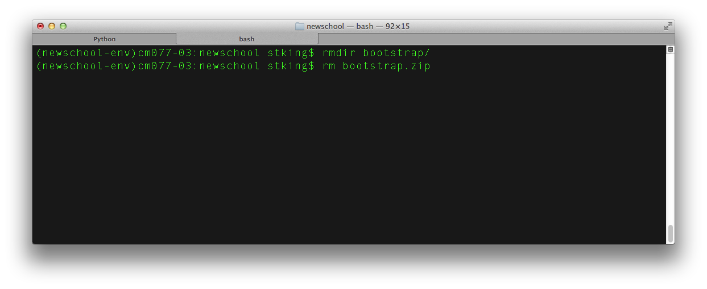
Always clean up after yourself
rmdir bootstrap
rmdir bootstrap.zip

Slide 11
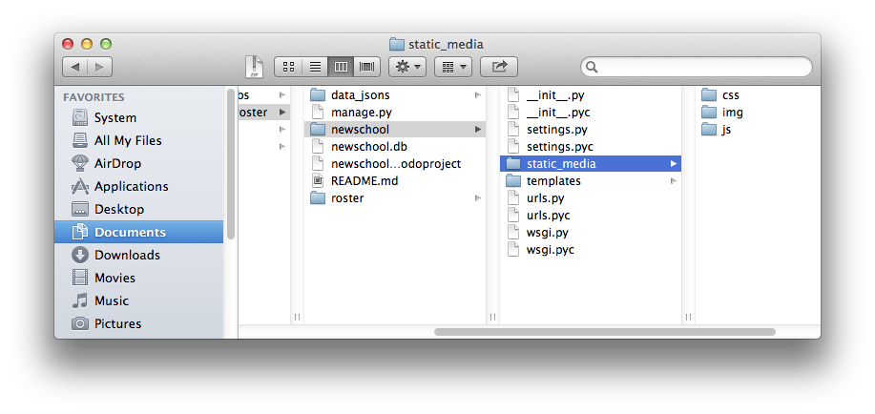
Directory Structure and files

Slide 12
Django Static Server
In production, you would serve static files with Apache or a CDN which would be faster
Django is a dyamic server so it is slower but will work in our case
http://localhost:8000/static/css/bootstrap.css
notice the /static/ comes from the settings.py

Slide 13
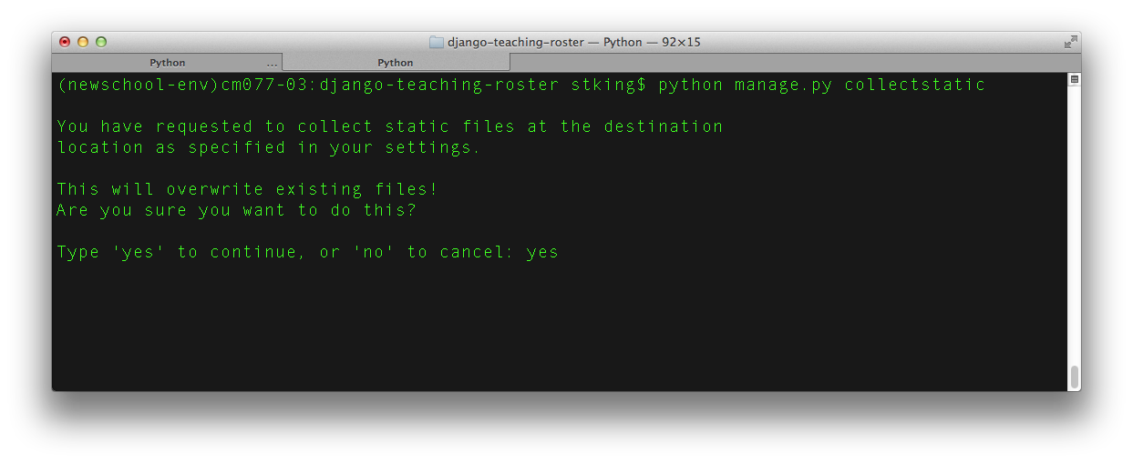
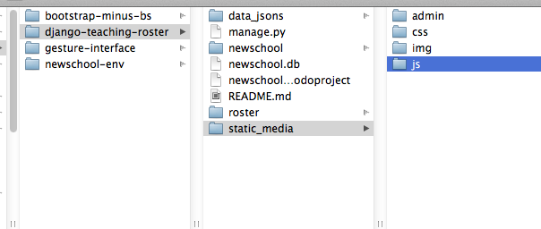
Collect Static Files
For when you need to get all of your static files in one place to put them on a server:

Slide 14
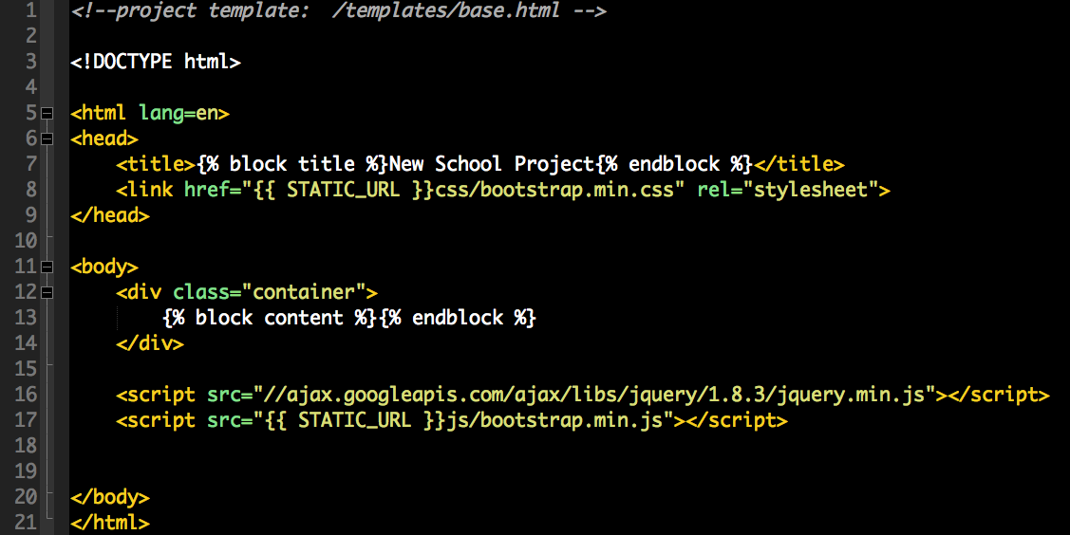
Add bootstrap to base.html

Slide 15
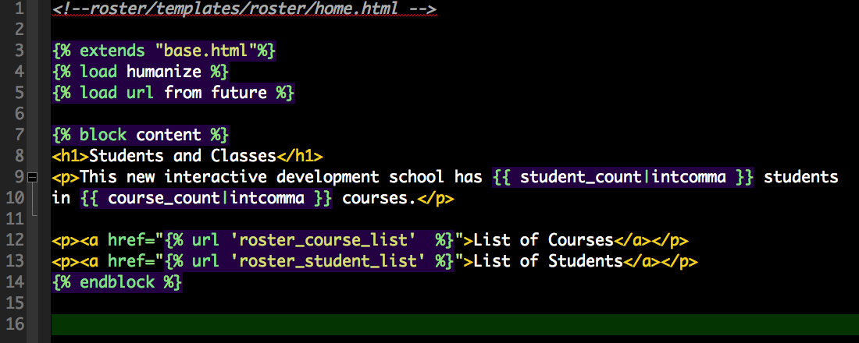
Update home.html links

Slide 16
What are the three files when editing making a new page?

Slide 17
What are the three files when editing making a new page?
urls.py
views.py
template_name.html

Slide 18
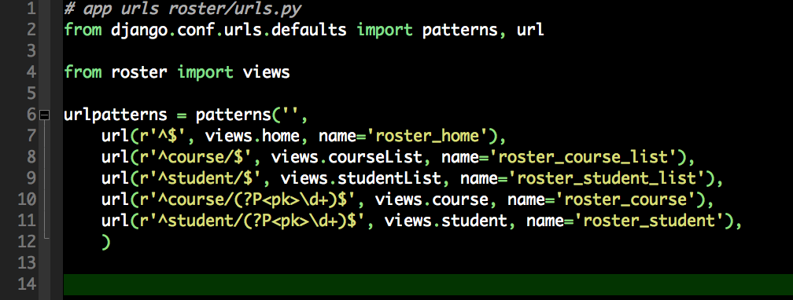
urls.py (setup new view)

Slide 19

Need a list of each model
duplicate course.html and rename course_list.html
duplicate student.html and rename student_list.html
Create new view for listing

Slide 20
But what about 5000 names?
Pagination. I just searched “django pagination”
And got this answer. https://docs.djangoproject.com/en/dev/topics/pagination/
Had to change the model names and make sure everything was imported but it worked pretty easy.

Slide 21
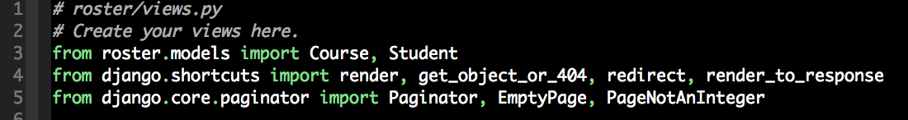
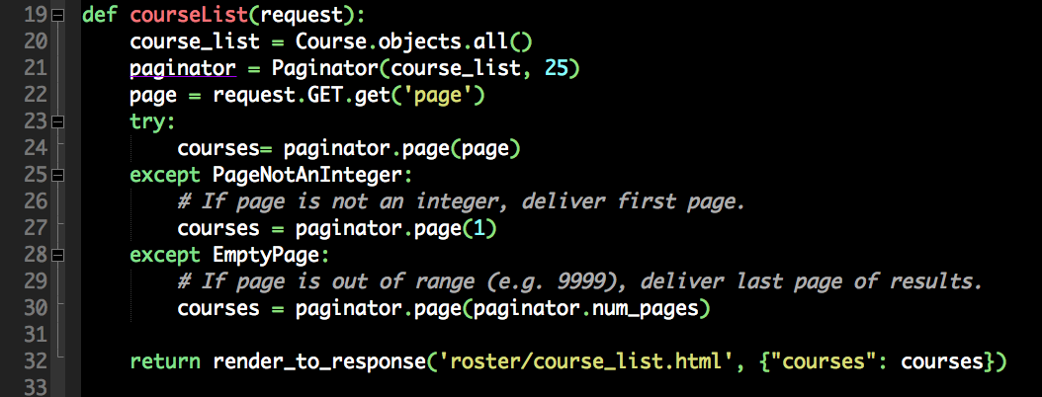
views.py

Slide 22
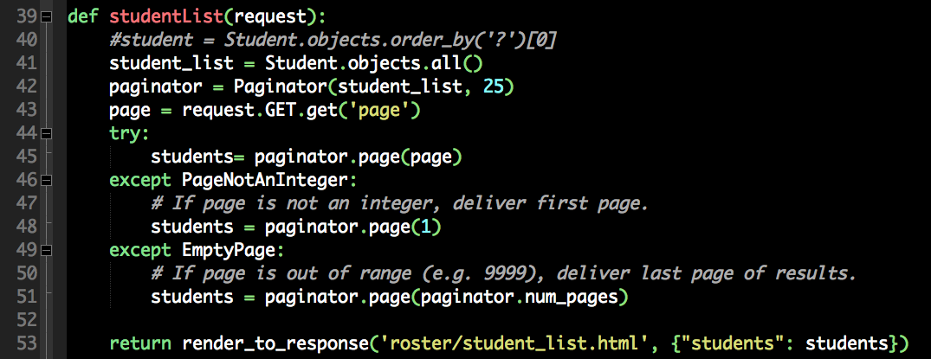
views.py

Slide 23
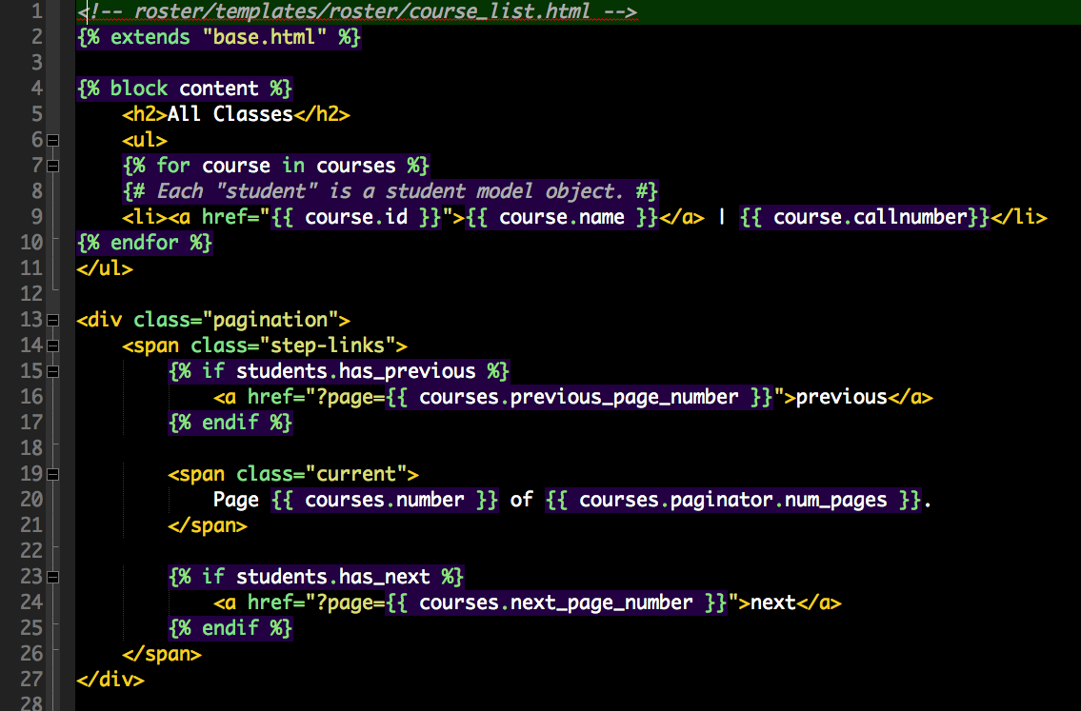
templates course_list.html

Slide 24
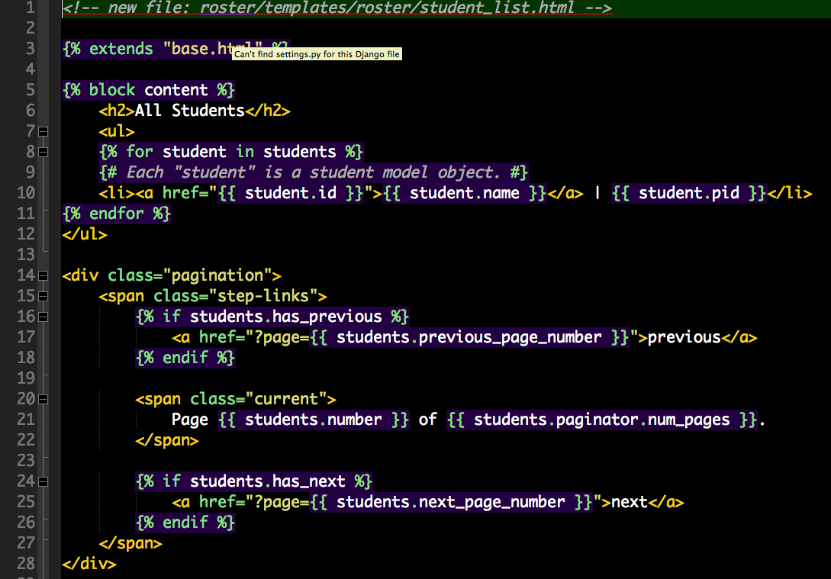
template student_list.html

Slide 25
Static Files Problem
Oops, I Screwed up!

Slide 26
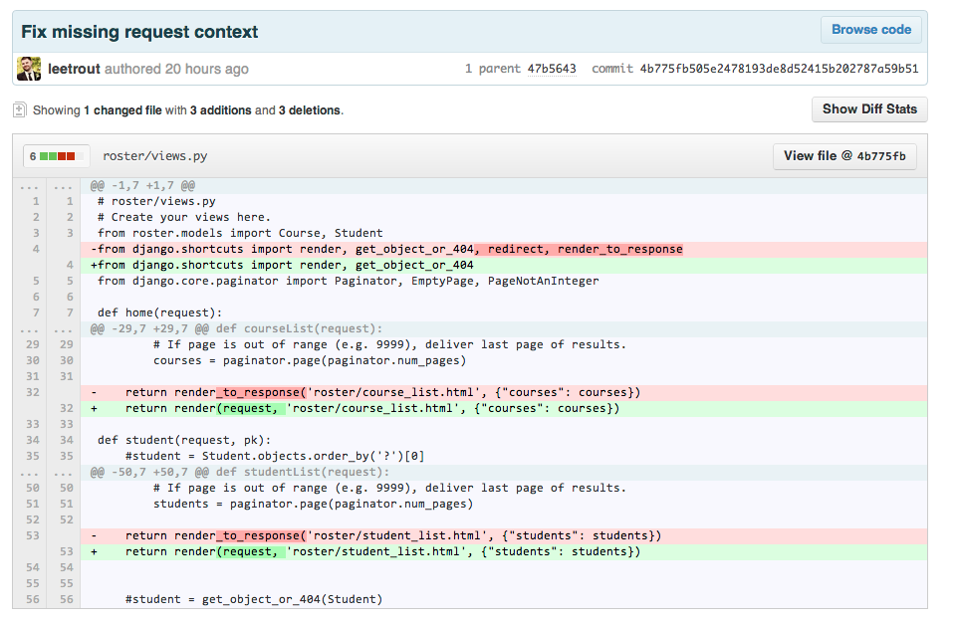
Words to live by
“Always have a friend who is smarter than you.”

Slide 27
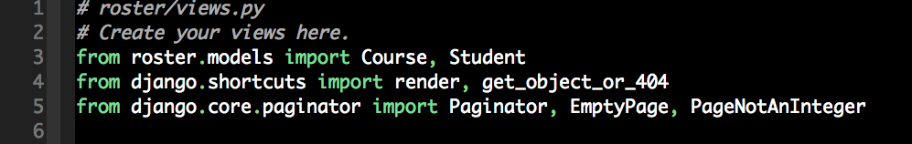
Fix the views
Part 1 of 3

Slide 28
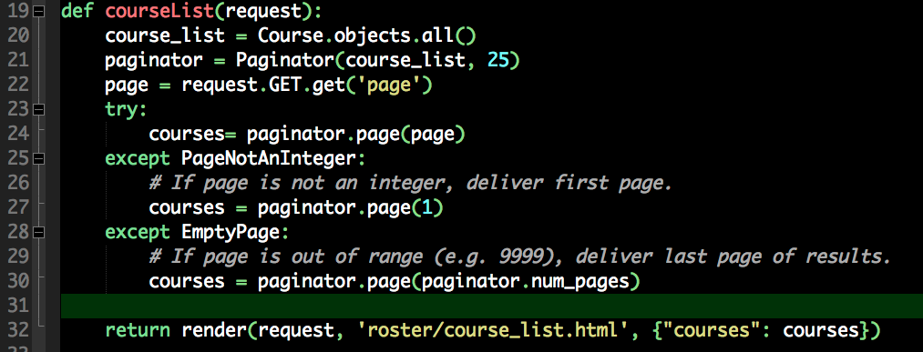
Fix The Views
Part 2 of 3

Slide 29
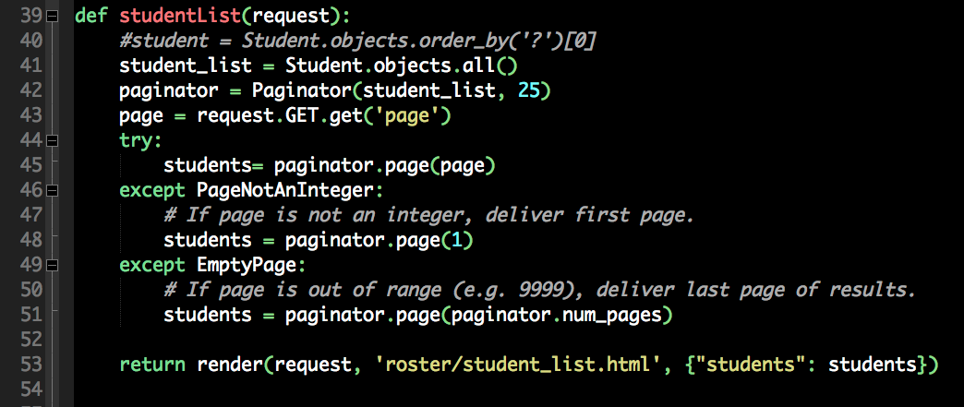
Fix The Views
Part 3 of 3.

Slide 30
Finally!
So, now I want you to add an image to the student model with a urls.
New data file available here:
http://steventking.com/clients/data_students_withimage.json
Change Models, Dump DB, Sync DB, Add to Views, Add to template
Go!

