Slide 1
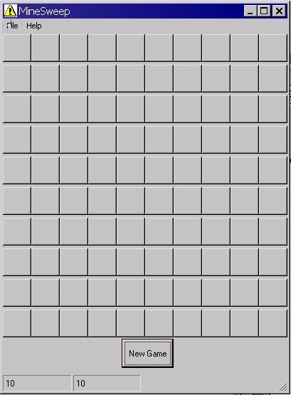
Mine Sweep
Story Board
This Game will always Start
With a Blank form
The user can restart by pressing either
the F2 button, the New Game button or
The New Game From The Menu

Slide 2
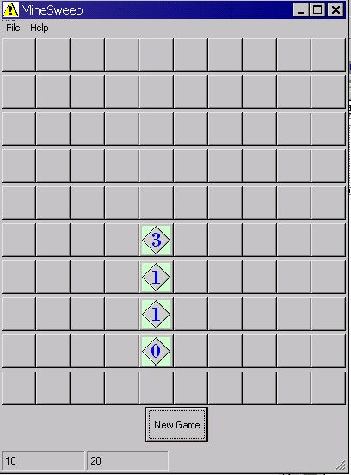
When the user clicks on the screen A number will be displayed to indicate
the proximity of the closest mines

Slide 3
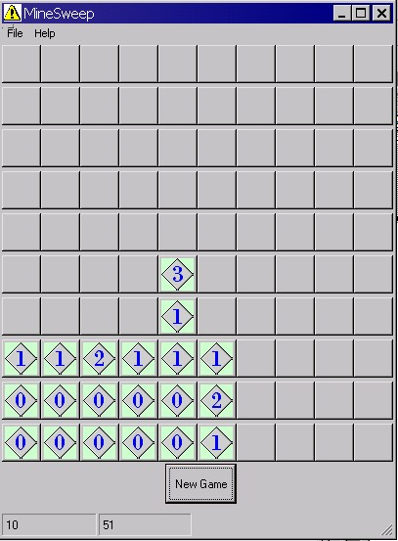

Slide 4
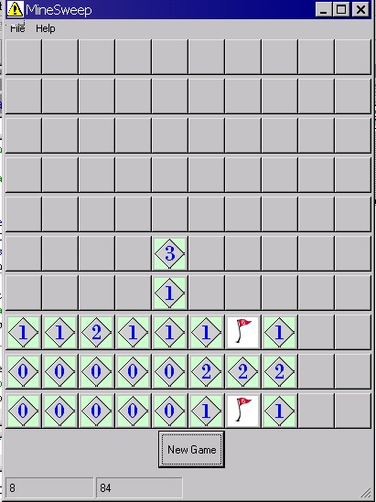
When the user thinks he has found a mine he can right click on a square to indicate that a mine may be there.

Slide 5
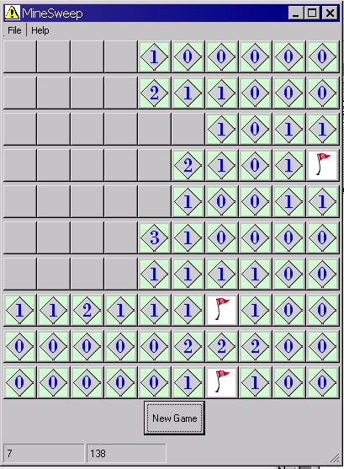

Slide 6
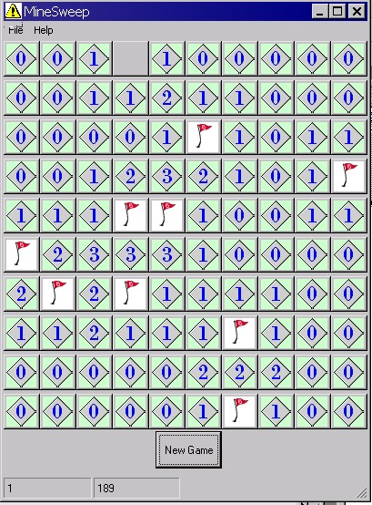
When the user has won a message will appear to say that he has won.

Slide 7
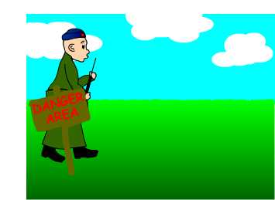
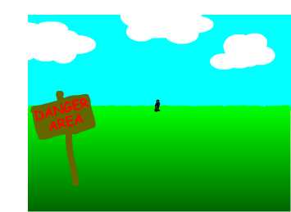
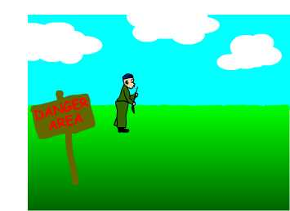
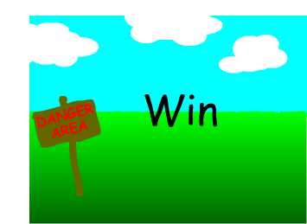
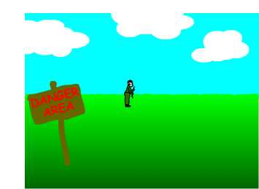
Winning Game Message
This movie will be played for a winning game until the user clicks on the screen or the file finishes.

Slide 8
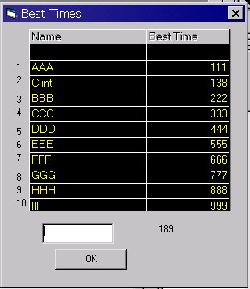
The winning scoreboard will appear requesting input and displaying all other Times.

Slide 9
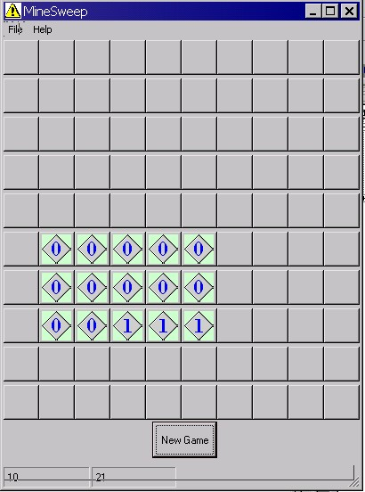
Having already started the form from a blank screen the user may continue his game as before.

Slide 10
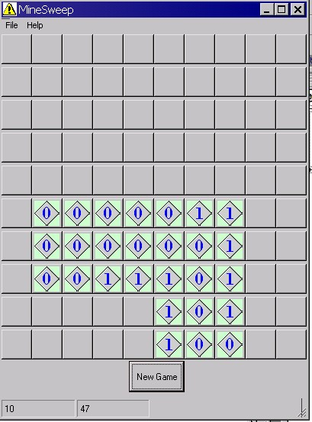

Slide 11
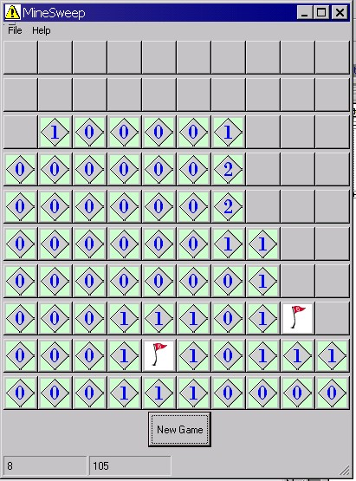
When the user thinks he has found a mine he can right click on a square to indicate that a mine may be there.

Slide 12
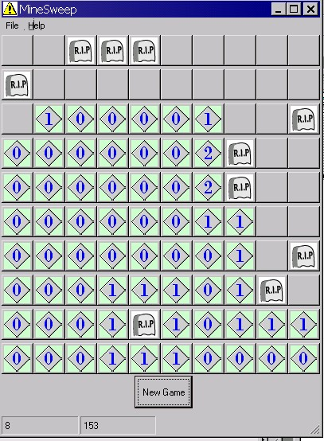
When the user loses the game
all bombs will be displayed
and the game over movie
will be played.

Slide 13
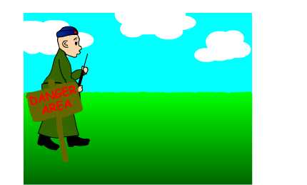
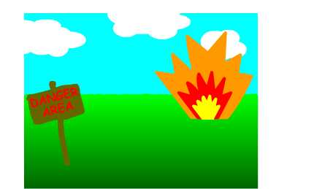
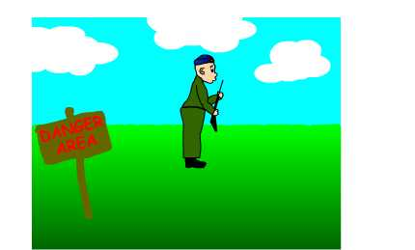

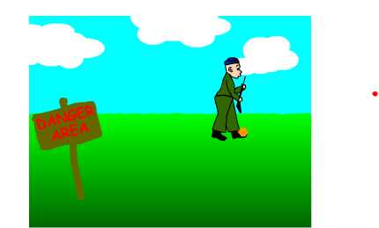
Loser Game Message
This movie will be played for a losing game until the user clicks on the screen or the file finishes.

