Slide 1

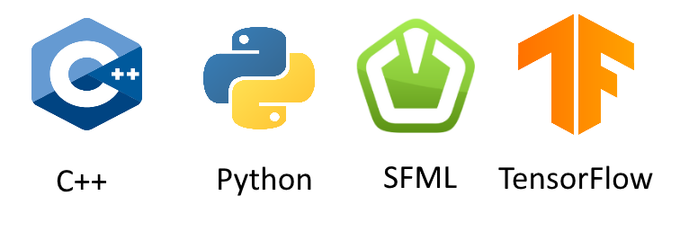
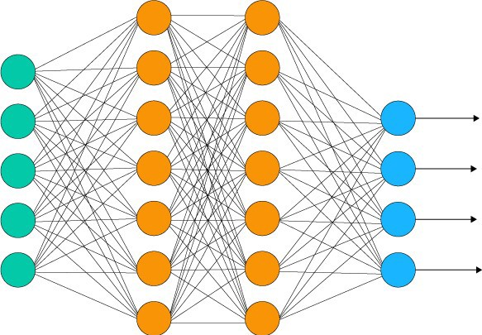
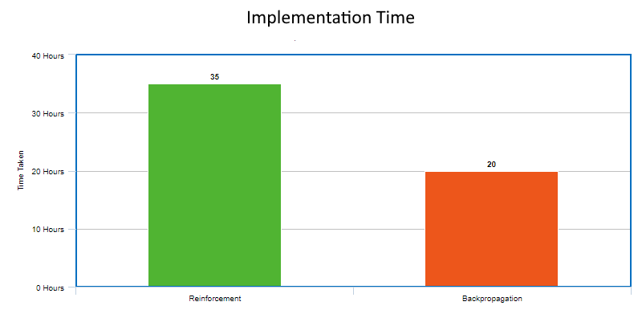
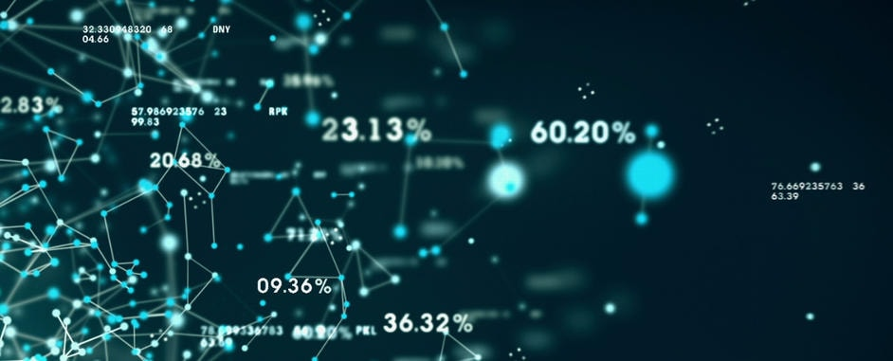
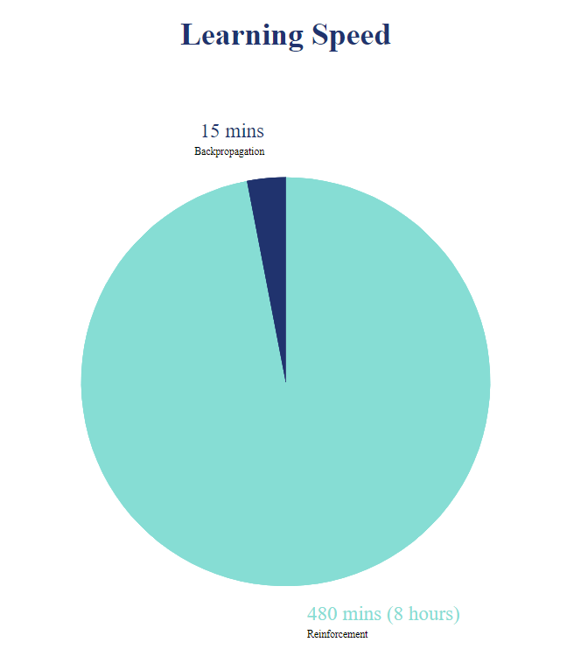
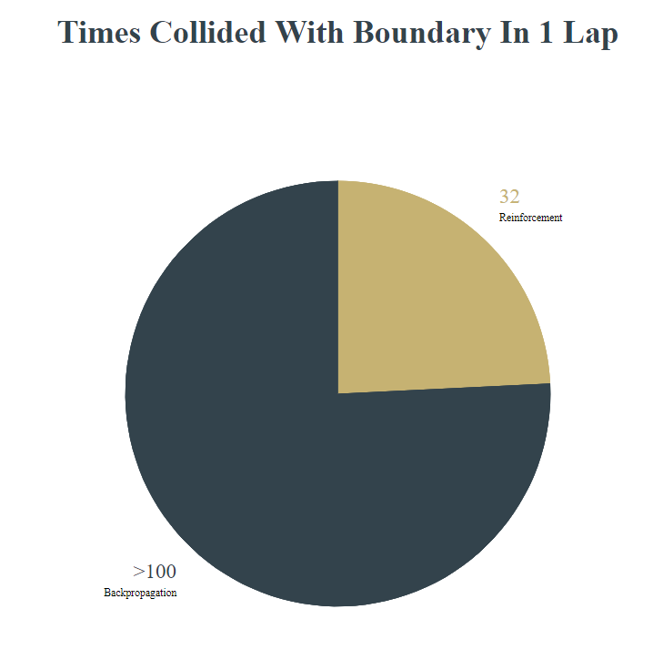
Comparison of Reinforcement Learning and Backpropagation on Controlling a Simulated Car
Cliona Hayden
Supervisor: Dr. Oisin Cawley
B.Sc.(Hons) Computer Games Development
Introduction
Methods
Results
Conclusion
AI and machine learning has been a topic in discussion since the 60’s and now more than ever is being applied to software across the world. From social media to video games to self-driving cars, machine learning is playing a prominent part in our everyday life and will continue to do so for the foreseeable future. With this in mind, my main aim for this paper is to provide an in-depth and realistic comparison between two learning techniques for neural networks, Reinforcement learning and Backpropagation, when applied to moving a car around a track. Comparisons will be made such as time taken to complete a lap, ease of implementation and efficiency.
After fully implementing and testing both machine learning algorithms, there was a clear comparison between the accuracy, learning speed and ease of implementation.
The backpropagation algorithm excelled in learning speed, only having to collect training data for a few minutes before it can calculate accurate outputs. It is also the easier one to implement, thanks to TensorFlow’s powerful machine learning library.
Reinforcement learning took a lot longer to calculate accurately, having to use trial and error to compute its outputs. Despite this, Reinforcement learning resulted in a far more accurate model despite being harder to implement.
In conclusion, both machine learning methods produce an accurate solution to the problem of driving a car around a track. There was clear aspects that one algorithm was better than the other, for example:
Implementation:
Backpropagation was by far the easiest to implement using the TensorFlow library. The ease of access to code documentation really helped as I encountered problems and tried to find solutions.
Reinforcement learning needed access to the entire game environment and there was very few documentation about using reinforcement l earning with neural networks, making implementation a bigger challenge.
Learning speed:
Again, Backpropagation excelled in this category, only needing to collect training data for ~5 minutes before producing accurate results.
Reinforcement learning took significantly longer. So long I decided to leave the application running overnight to get accurate results.
Accuracy:
In terms of accuracy, Reinforcement learning came out on top, producing a model that collided with walls the least.
The backpropagation model tended to hug the walls in order to complete a lap, not the most efficient solution but a solution nonetheless.
The main demo will be programmed in C++, with any graphics rendered with the SFML library. Any vectors contained in classes will also be sf::Vector2f, these will mainly be used for positions.
All Reinforcement Learning algorithms will be programmed in the same project using C++. These algorithms will be contained in its own class and will be called and run by the object it's contained in.
On the other hand, all backpropagation algorithms will be run in a Python file using the same environment as the C++ project. the TensorFlow library will be used to run any necessary algorithms.
Contact:
Cliona Hayden
Phone: 089 422 6133
Email: Cliona.hayden5765@gmail.com

