Slide 1
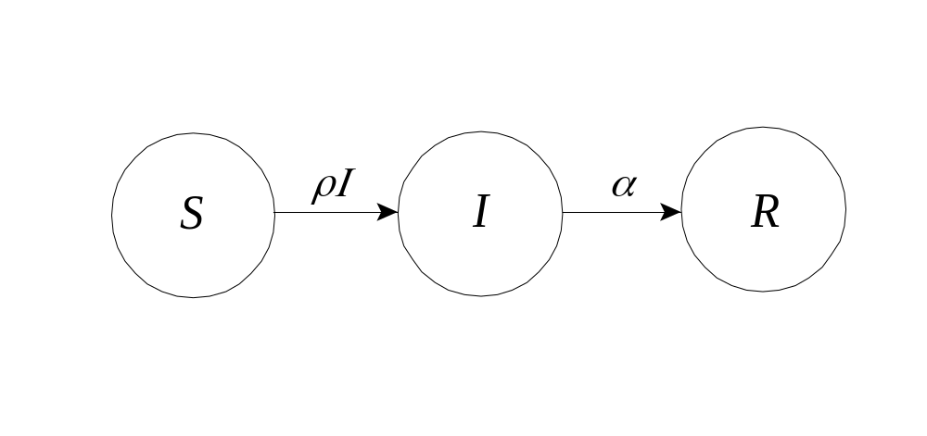
Susceptible, Infected, Recovered: the SIR Model of an Epidemic

Slide 2
What is a Mathematical Model?
a mathematical description of a scenario or situation from the real-world
focuses on specific quantitative features of the scenario, ignores others
a simplification, abstraction, “cartoon”
involves hypotheses that can be tested against real data and refined if desired
one purpose is improved understanding of real-world scenario
e.g. celestial motion, chemical kinetics

Slide 3
The SIR Epidemic Model
First studied, Kermack & McKendrick, 1927.
Consider a disease spread by contact with infected individuals.
Individuals recover from the disease and gain further immunity from it.
S = fraction of susceptibles in a population
I = fraction of infecteds in a population
R = fraction of recovereds in a population
S + I + R = 1

Slide 4
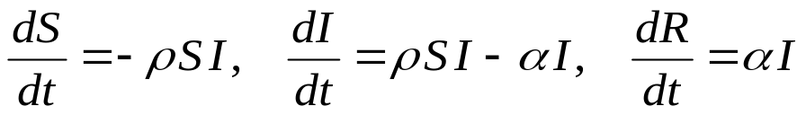

The SIR Epidemic Model (Cont’d)
Differential equations (involving the variables S, I, and R and their rates of change with respect to time t) are
An equivalent compartment diagram is

Slide 5
Parameters of the Model
ρ = the infection rate
α = the removal rate
The basic reproduction number is obtained from these parameters:
N_{R} = ρ /α
This number represents the average number of infections caused by one infective in a totally susceptible population. As such, an epidemic can occur only if N_{R} > 1.

Slide 6
Vaccination and Herd Immunity
If only a fraction S₀ of the population is susceptible, the reproduction number is N_{R}S₀, and an epidemic can occur only if this number exceeds 1.
Suppose a fraction V of the population is vaccinated against the disease. In this case, S₀=1-V and no epidemic can occur if
V > 1 – 1/N_{R}
The basic reproduction number N_{R} can vary from 3 to 5 for smallpox, 16 to 18 for measles, and over 100 for malaria [Keeling, 2001].

Slide 7
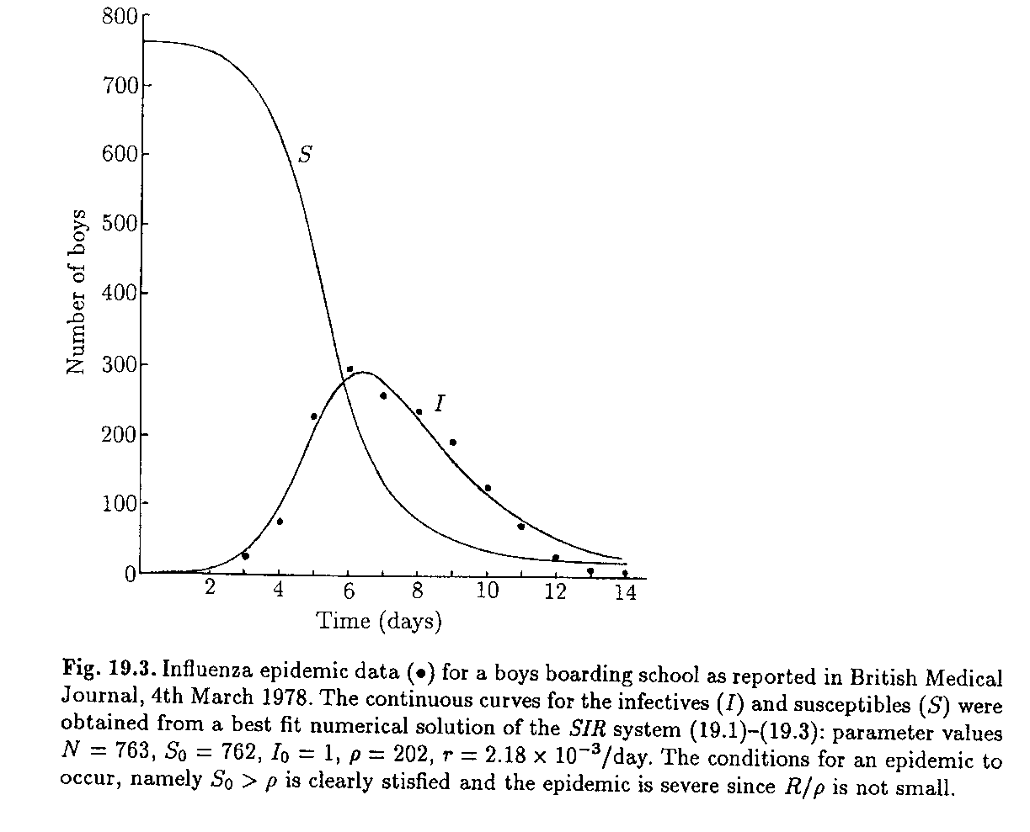
Case Study: Boarding School Flu

Slide 8
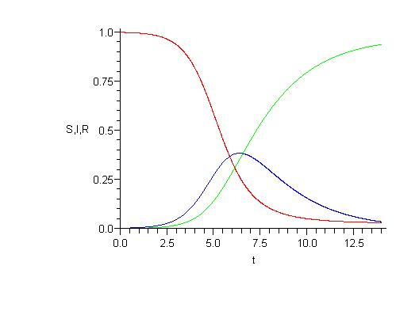
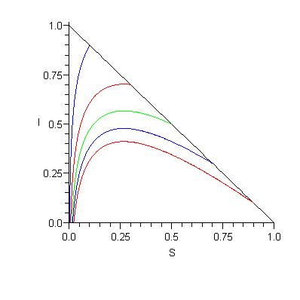
Boarding School Flu (Cont’d)
In this case, time is measured in days, ρ = 1.66, α = 0.44, and N_{R} = 3.8.

Slide 9
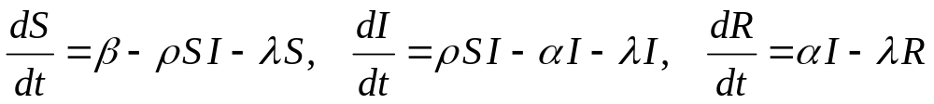
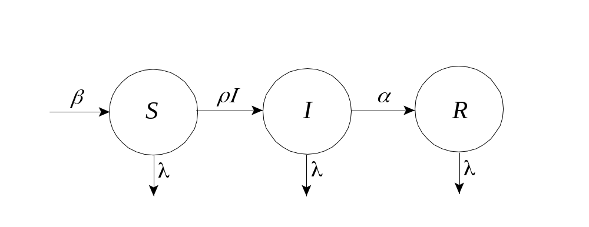
Flu at Hypothetical Hospital
In this case, new susceptibles are arriving and those of all classes are leaving.

Slide 10
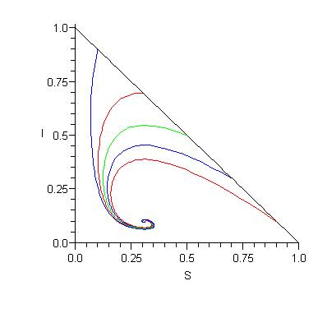
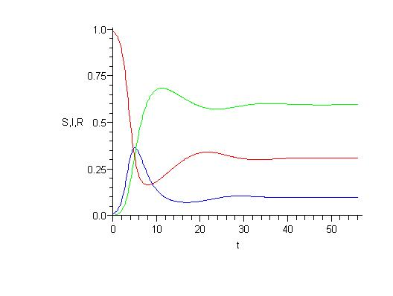
Flu at Hypothetical Hospital (Cont’d)
Parameters ρ and α are as before. New parameters β = λ = 1/14, representing an average turnover time of 14 days. The disease becomes endemic.

Slide 11
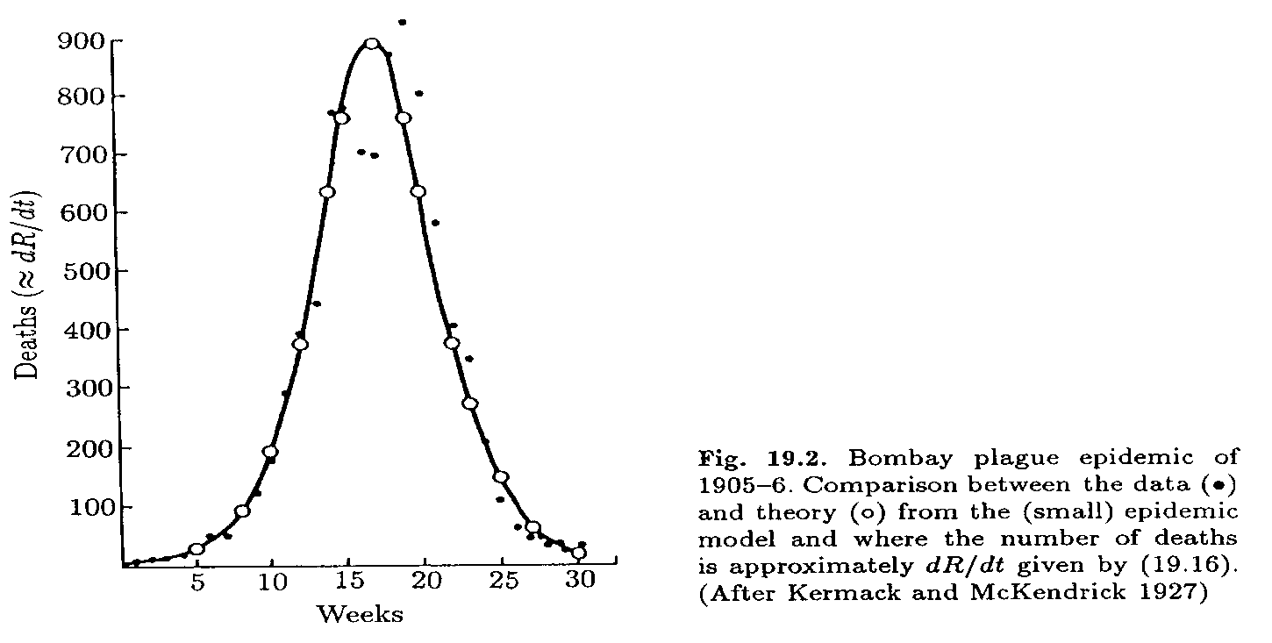
Case Study: Bombay Plague, 1905-6
The R in SIR often means removed (due to death, quarantine, etc.), not recovered.

Slide 12
Eyam Plague, 1665-66
Raggett (1982) applied the SIR model to the famous Eyam Plague of 1665-66.
http://en.wikipedia.org/wiki/Eyam
It began when some cloth infested with infected fleas arrived from London. George Vicars, the village tailor, was the first to die.
Of the 350 inhabitants of the village, all but 83 of them died from September 1665 to November 1666.
Rev. Wm. Mompesson, the village parson, convinced the villagers to essentially quarantine themselves to prevent the spread of the epidemic to neighboring villages, e.g. Sheffield.

Slide 13
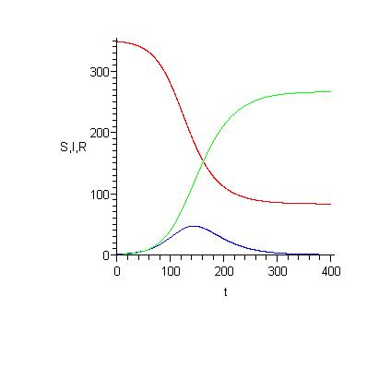
Eyam Plague, 1665-66 (Cont’d)
In this case, a rough fit of the data to the SIR model yields a basic reproduction number of N_{R} = 1.9.

Slide 14
Enhancing the SIR Model
Can consider additional populations of disease vectors (e.g. fleas, rats).
Can consider an exposed (but not yet infected) class, the SEIR model.
SIRS, SIS, and double (gendered) models are sometimes used for sexually transmitted diseases.
Can consider biased mixing, age differences, multiple types of transmission, geographic spread, etc.
Enhancements often require more compartments.

Slide 15
Why Study Epidemic Models?
To supplement statistical extrapolation.
To learn more about the qualitative dynamics of a disease.
To test hypotheses about, for example, prevention strategies, disease transmission, significant characteristics, etc.

Slide 16
References
J. D. Murray, Mathematical Biology, Springer-Verlag, 1989.
O. Diekmann & A. P. Heesterbeek, Mathematical Epidemiology of Infectious Diseases, Wiley, 2000.
Matt Keeling, The Mathematics of Diseases, http://plus.maths.org, 2004.
Allyn Jackson, Modeling the Aids Epidemic, Notices of the American Mathematical Society, 36:981-983, 1989.

