Slide 1
Numerical Study of Traveling Wave Solutions to 2D
Boussinesq Equation
K. Angelow, N. Kolkovska

Slide 2
Posing the problem
The accurate derivation¹ of the Boussinesq system combined with an approximation, that reduces the full model to a single equation, leads to the Boussinesq Paradigm Equation² (BPE):
The equation admits 2D stationary translating solition solution. Unfortunately the propagating soliton in 2D is very 'fragile' and transforms into smaller vawes as time progress.
¹Christov, C. I. 2001, ‘An energy-consistent Galilean-invariant dispersive
shallow-water model’, Wave Motion 34, 161–174.
²Christov, C. I. 1995a, Conservative difference scheme for Boussinesq model of
surface waves, in, In: ‘Proc. ICFD V’, Oxford University Press, pp. 343–349.
³C. I. Christov, J. Choudhury, Perturbation solution for the 2D Boussinesq
equation, Mech. Res. Commun., 38 (2011) 274 - 281.

Slide 3
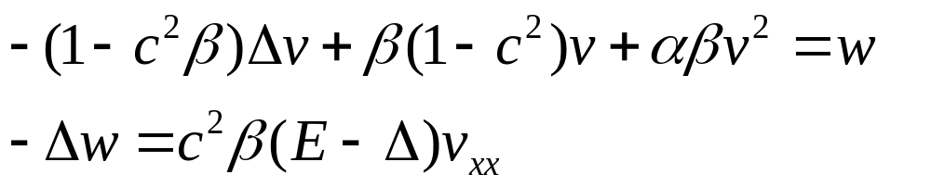
Here, once again, we seek for travelling wave solutions for the BPE in drection y, with phase velocity c, i.e. solutions of type u(x,y,t) = U(x,y-ct):
The variable change
transforms (BE) to:
with β= β₁/ β₂ and α,β>0. Equation (vcBE) can be rewritten as a system of two elliptic equations of second order:

Slide 4
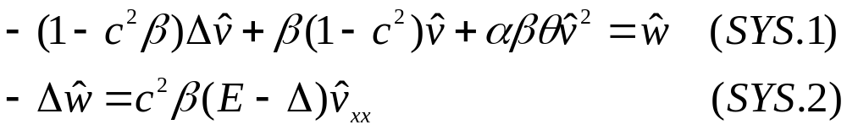
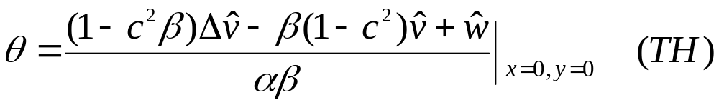
Algorithm
The trivial solution is always present and must be avoided. Thus we proceed as in [4] and fix the value of the function in one point in order to prevent the iterative algorithm of ‘slipping’ into the trivial solution. For definiteness we take v(0,0) = θ and then introduce ṽ = θv and ŵ = θw:
The value of θ is found from the equation
⁴C. I. Christov, Numerical implementation of the asymptotic boundary conditions for steadily propagating 2D solitons of Boussinesq type equation, Math. Computers Simul., 82 (2012) 1079 - 1092.

Slide 5
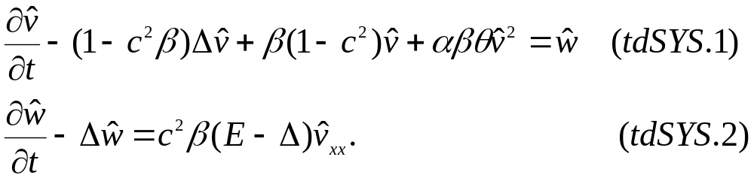
Since, we step into new problem, with further considerations on the new boundary condition, we chose the simple iteration method⁴ (false transients) as one of the simplest possible approaches. Thus we introduce artifical time, and add false time derivatives to get
Now the solution to the steady coupled elliptic system (SYS) is replaced by solving the pertinent transient equations (tdSYS) until their solutions ṽ and ŵ cease to change signifcantly in time.

Slide 6
Milestones:
Use high order finite differences which allow higher accuracy on relatively coarser grids.
Update the existing asymptotics of the solution and implement the new boundary condition
Find algorithm's convergence rate using nested grids
Optimize the algorithm
  Resolve proper time step for each time iteration
  Create a good implementation of the discrete Laplacian operator as more than 50% of the algorithm running time is spent on its calculation

Slide 7
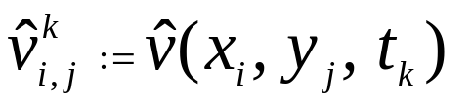
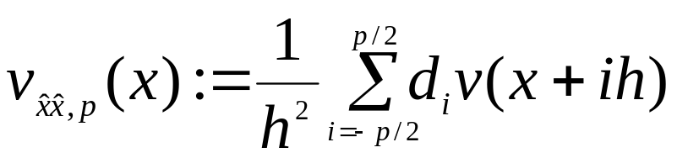
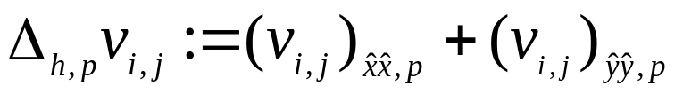
Discretization
For simplicity we use a uniform grid with equal step size h along both x,y-axes directions. The value of the function ṽ at mesh point (x_{i}, y_{j}, t_{k}) is denoted by:
We discretize the spatial derivatives in (tdSYS) using centered finite differences and extending the stencil:
Thus:

Slide 8
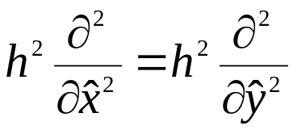

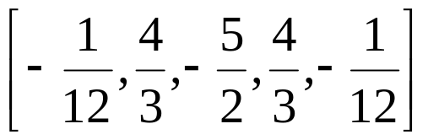
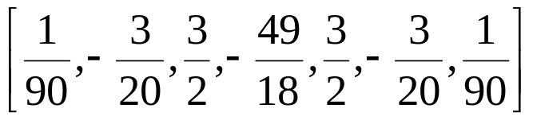
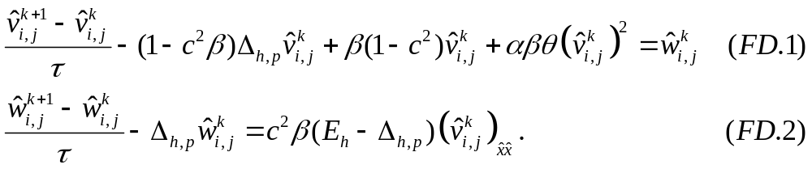
Here p defines the order of the finite difference. The weights d_{i} are defined as follows:
p = 2:
p = 4:
p = 6:
The solutions at the t^{k+1} time level are evaluated directly:

Slide 9
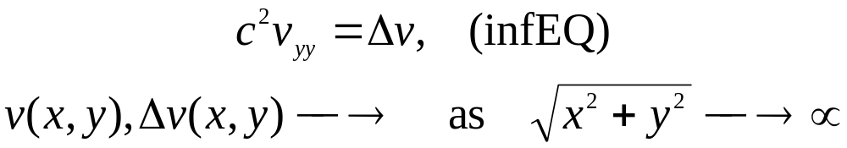
Asymptotic conditions on the boundaries
The behavior of the solutions ṽ and ŵ as r = sqrt(x²+y²) goes to infinity is studied in details in [3, 4]. From the numerical results given there it follows that ṽ and ŵ have O(r ⁻²) asymptotic decay at infinity. We suppose that the second order derivatives of ṽ and ŵ are of order O(r ⁻⁴) whereas fourth order derivatives and the nonlinear term in equation (vcBE) are of order O(r ⁻⁶).
As we consider equation (vcBE) for sufficiently large r and insert the asymptotic values of all terms in it and neglect the higher order in r terms (of order O(r ⁻⁶)). In this way we obtain the following problem valid for large r

Slide 10

yy-Derivative in Polar Coordinates

Slide 11
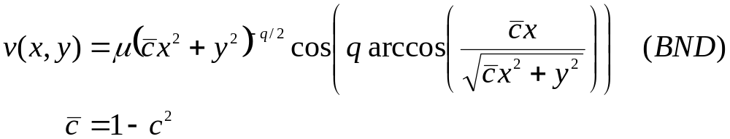
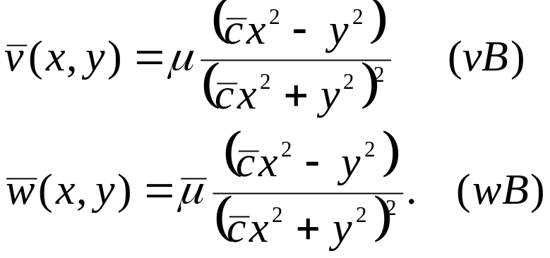
The function that resolves the equation (infEQ) is
with some positive real numbers μ and q. Using the asymptotic decay of the solution and its symmetry with respect to coordinate axes, we obtain q = 2 and thus:

Slide 12
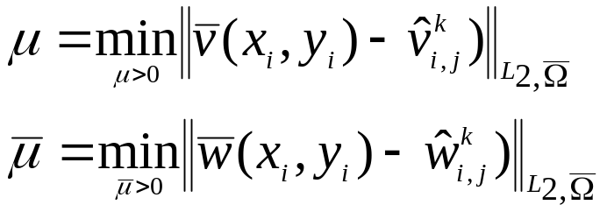
In order to resolve the boundary functions (vB) and (wB) completely one needs the μ parameters. We obtain them iteratively, at each time level of (), by the following minimizatoin procedure. For given solutions ṽ_{i,j} ^{k} and ŵ_{i,j}^{k} at time level t^{k} we choose μ and μ¯ as minimizers of:
Tests and simulations showed that Ω¯ should not solely consist of boundary points but should also include some inner points of Ω_{h} near boundary ∂Ω_{h}. Each minimization problem produces a simple linear equation, which depends on the type of norm used.

Slide 13
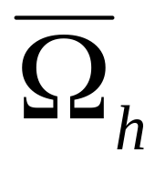
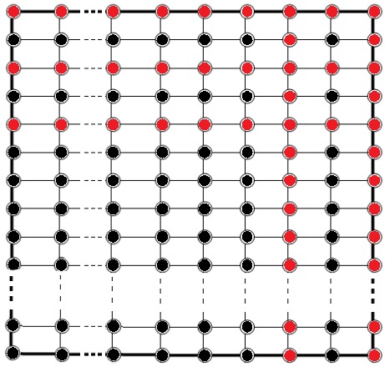


Domain
red points
red and black points

Slide 14
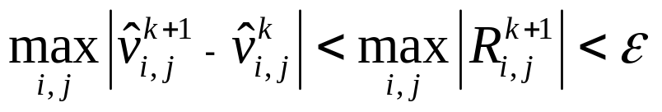
Stop Criteria and time step control
The residual of the discrete approximation to (vcBE) at the mesh point
(x_{i}; y_{j} ; t_{k}) is defined as:
Our numerical computations show that:
It is possible to use varying time step τ to optimize and speed up the algorithm. When the time step becomes too big the solution starts to diverge and becomes jagged. Fortunately these signs appear first in the residual R in (R) i.e. it starts to grow and jag simultaneously while the solution is still fine. This is a clear sign that the time step has to be decreased, otherwise we can increase it.

Slide 15
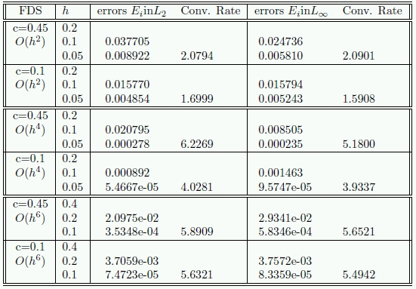
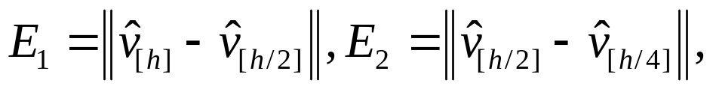
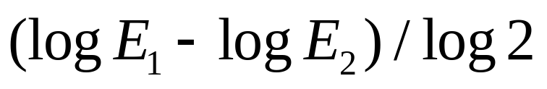
Validation - Algorithm's Convergence
α = 1
β = 3
Ω_{h}= [0,30]x[0,30]
Convergence test for (FD) with different approximation errors. Errors E_{i} are measured in L₂ and L_{inf} norms.
The errors E_{i} are defined as follows:
and the convergence rate (by Runge's formula):

Slide 16
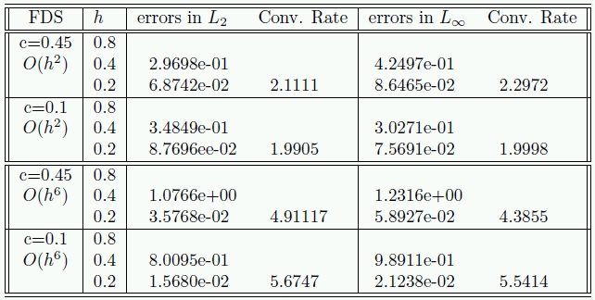
Derivative Convergence
Errors in L₂ and L_{inf} norms and convergence rate for fourth order x-derivatve evaluated by the FDS with O(h²) and O(h⁶) approximation order
Runge's test, evaluating the fourth x-derivative of the solution, show that it converges numerically. Tests for other fourth order derivatives are similar and we do not present them here.

Slide 17
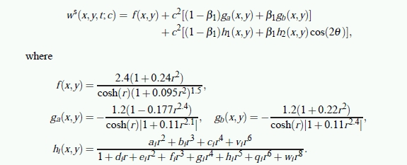
Best-Fitt Approximation formulae

Slide 18
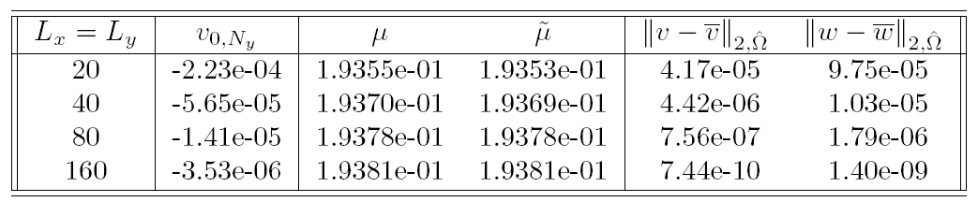
Validation of Boundary Condition
The boundary values in the 2nd column form a geometric progression with common ratio ¼, which is pure sign of 1/r² asymptotics
μ parameters settle down as computational box enlarges
Boundary function becomes more precise for larger domains

Slide 19
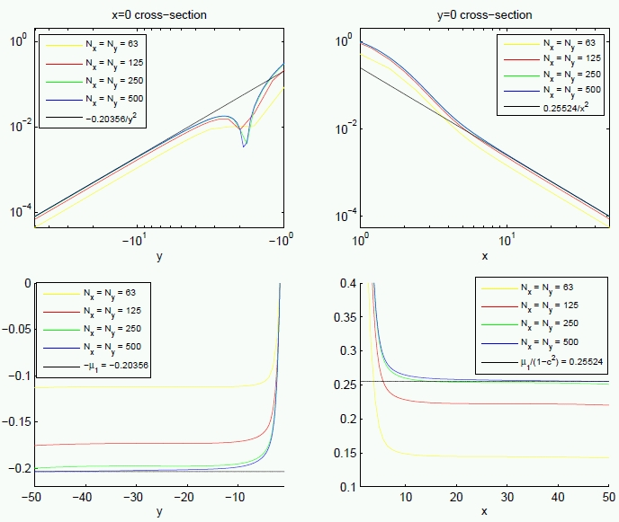
x-y cross-sections of the solution
Upper panels:
-The absolute value of the function on log-log plots.
-Black line describes (vB) function with the respective μ parameter
Lower panels show:
-Plots display vr² values along the vertical z-axis
The solution settles down as the step size h decreases!
The efect of the mesh size. Lower panels: the function scaled by r². N_{x},N_{y} – number of mesh-points along x,y axis.

Slide 20
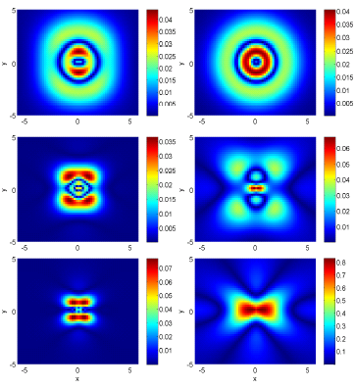
Difference between the numerical solution ṽ and the best fit formulae [3].
c=0.3
β = 1
c=0.1
β = 1
c=0.3
β = 3
c=0.5
β = 1
c=0.3
β = 5
c=0.9
β = 1

Slide 21
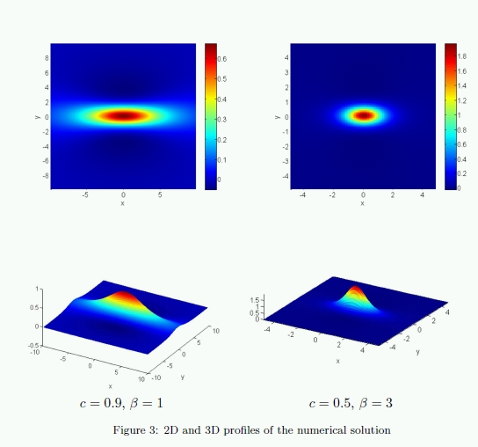

Slide 22
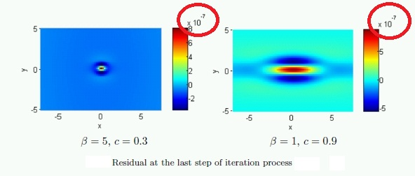
Residual

Slide 23
Thank you for your attention

