Slide 1


YouTube Content-Based Stock Prediction
Team 2: Blue
Dapo Adegbile
Sutianyi Wen
Jiaman Betty Wu
Yiwen Wang
Christopher Oblak

Slide 2
Table of Contents
01
The Idea!
02
Data/Process
03
Model
04
Results
Limitation
05
Content Creators and the Influence on the market...captions!
scrapping, Issues, and how we overcame them...mostly
Feature building, response variables, and THE MODEL!
Can we make money???
Problems the model can’t resolve

Slide 3
01
Introduction

Slide 4
The Idea
Buy?
Hold??
Sell???
+
CC
=
YouTube
Content
Closed
Captions
(Auto Generated)
Financial Security?
YouTube Content seems to correlate with stock fluctuations
Improvements to YouTube’s auto captions has grown significantly
Can we take these ideas and turn them into a predictive model for predicting stock fluctuations?
Note: These was built and trained on Nvidia, a bullish stock that fluctuates frequently due to investors skittish tendencies.

Slide 5
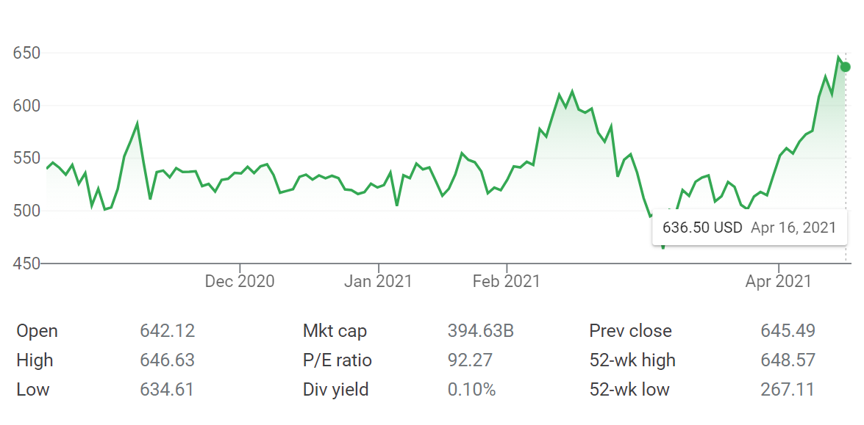
Understanding Nvidia Potential for Prediction
A: + 15%
B: - 6%
C: - 24%
Nvidia has many opportunities to buy and sell in order to beat the market average returns.
We want to catch as many of these as we can…
C
A
B
Source: Google Finance

Slide 6
02
Data

Slide 7


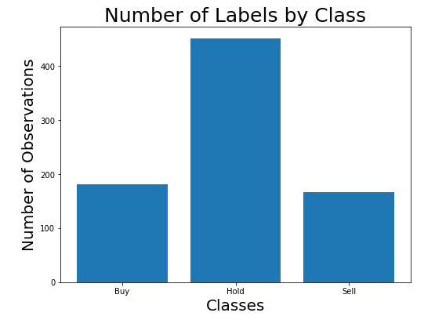
Data
Aggregate
Build Features
Scrap Raw Data
797 Lines, 24 Columns
Aggregate features by hour
Predict actions based on price change :
Buy - > 3%
Sell - < 3%
Hold - others
Daily Top 25 search results related to Nvidia on YouTube by AWS
video title
publication date
Sentiment scores of titles and captions
Number of days since publication
Weighted like/dislikes
Percent of price change in 96 hrs
view count
likes/dislikes
caption

Slide 8
Challenges Prior to Model Building
Stock Market Trading Hours
Caption Sentiment
Inconsistent Intervals
From 9:30 a.m. to 4 p.m
On weekdays excluding holidays
Long strings with much noise
Not formatted for normal NLP
Data for videos were not collected in a time series fashion (incorrect event triggers)
Solution
Solution
Solution
Aggregate features by hour starting at 9:30 a.m.
Use 96 hr percent change
Extract 10, 20, and 35 words surrounding the key word (“nvidia”) from caption for sentiment tests
Treat each observation as a stand alone event with a response variable 96 hrs post data pull

Slide 9
03
Model

Slide 10
Model
Model: LightGBM
Hyperparameter tuning: Grid Search
Best hyperparameters:
{'path_smooth': 3.0, 'num_leaves': 7, 'max_depth': 13, 'max_bin': 21, 'learning_rate': 1.0, 'feature_fraction': 0.9, 'extra_trees': True, 'bagging_freq': 15}
LightGBM is a variation of tree-based gradient boosting algorithm. It is optimized for computational efficiency.

Slide 11
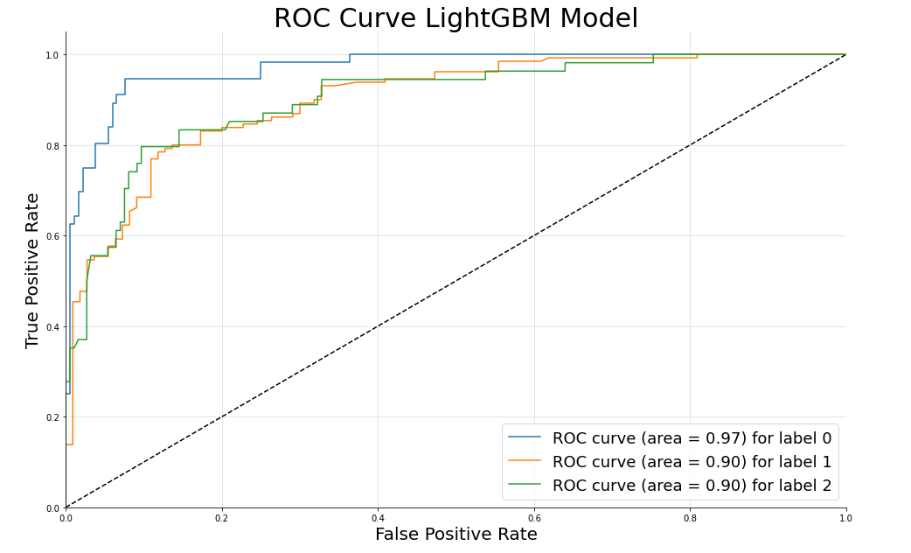
ROC Curve

Slide 12
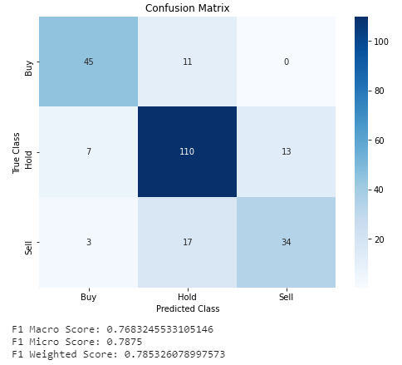
Validation Confusion
Buy accuracy: 80.4%
Hold accuracy: 84.6%
Sell accuracy: 62.9%

Slide 13
04
Results

Slide 14
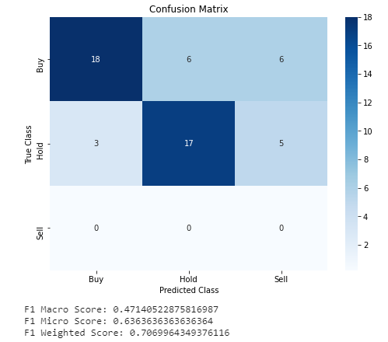
Test Confusion
Test data: Apr 1st - Apr 11th
Buy accuracy: 60%
Hold accuracy: 68%
Sell accuracy: Not Applicable

Slide 15
05
Limitation

Slide 16
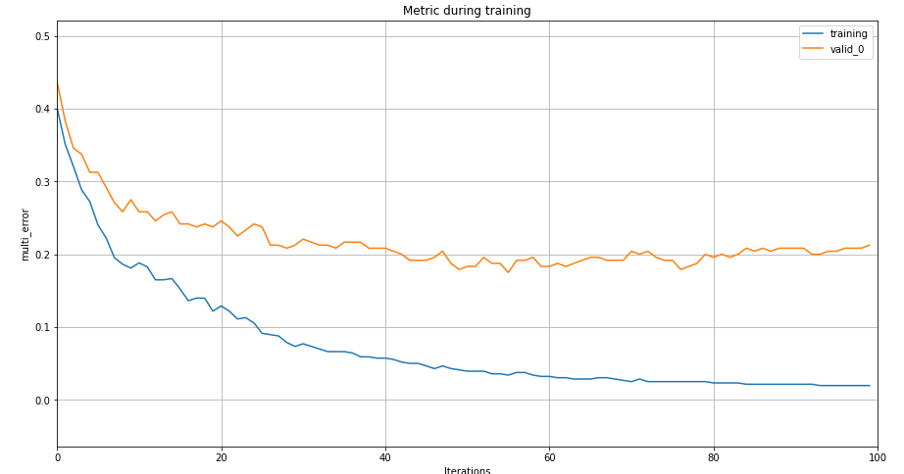
Limitation of our project
Model Overfitting
Problem: Small dataset(~800 data points)
Future solution: Collect more data in the future
Non-sequential time series data
Problem: treating time as independent data point
Future solution_a: Prescribe actions based on consecutive previous action
Buy, buy, buy,buy, __sell___
Future solution_b: collect sequential time series data

Slide 17
Thanks
Do you have any questions?
GitHub: https://github.com/Cloblak/youtube_content_based_stock_prediction

Slide 18
Training Error

Slide 19
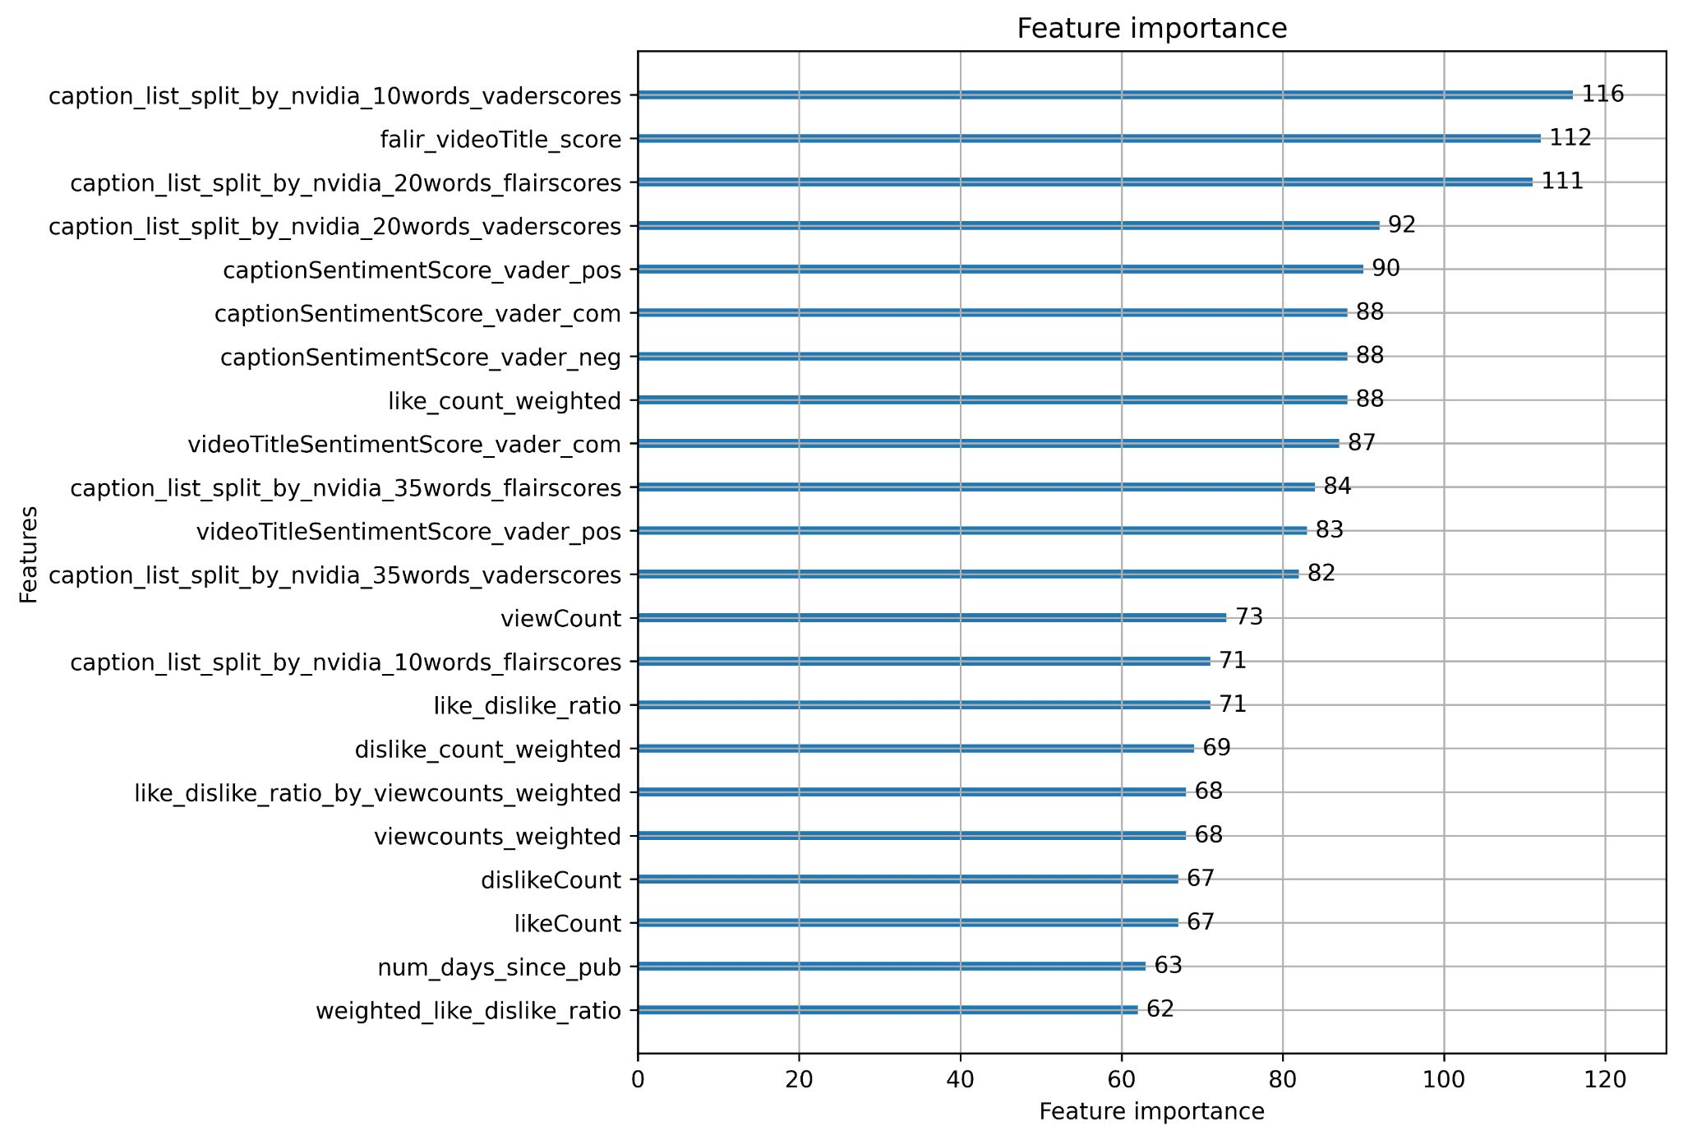
Feature Importance

