Slide 1


Slide 2
Prerequisites

Slide 3
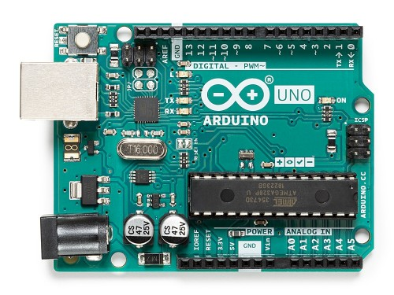
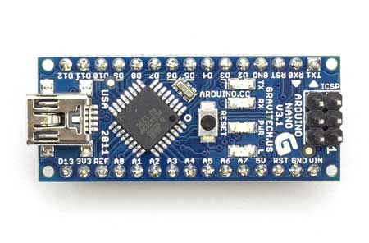
Arduino: The Core of Your Project

Slide 4
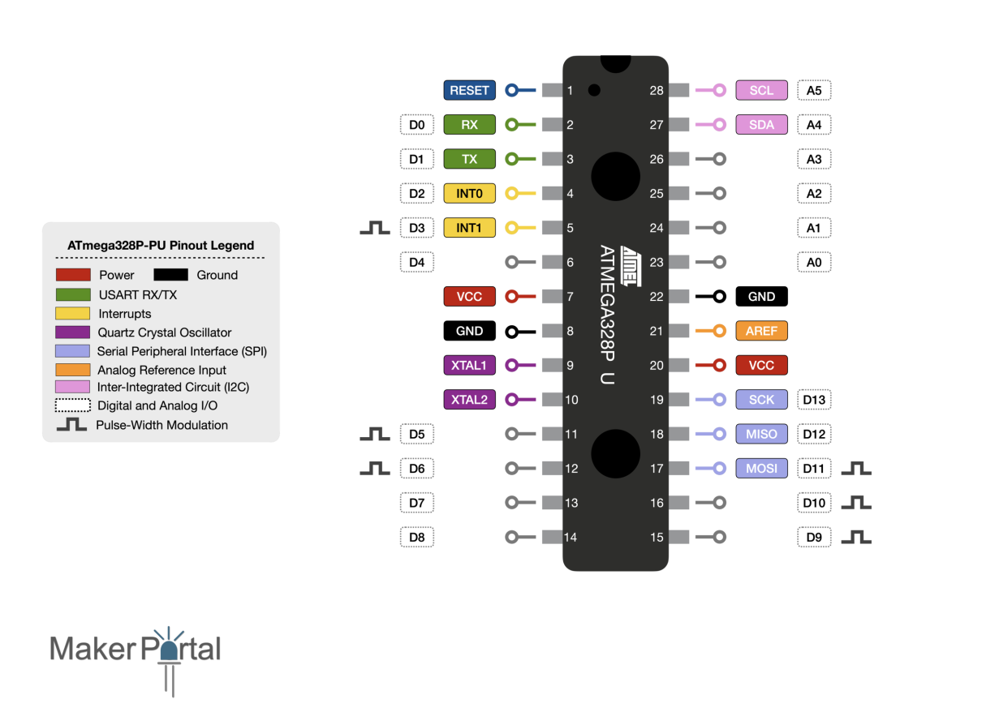
Atmega 328p – Heart of Arduino Uno

Slide 5
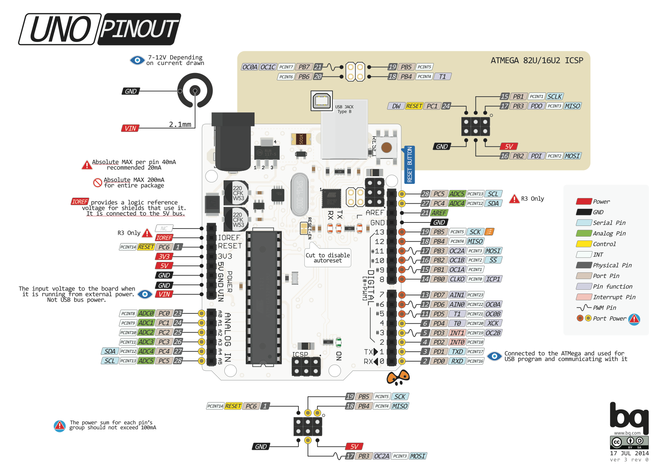

Slide 6
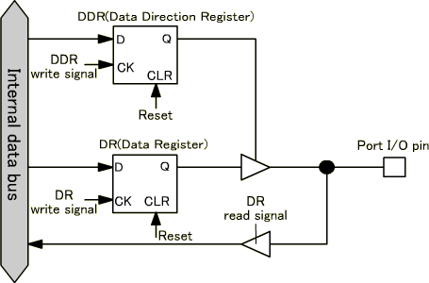
Data Direction (Input – Output)

