Slide 1
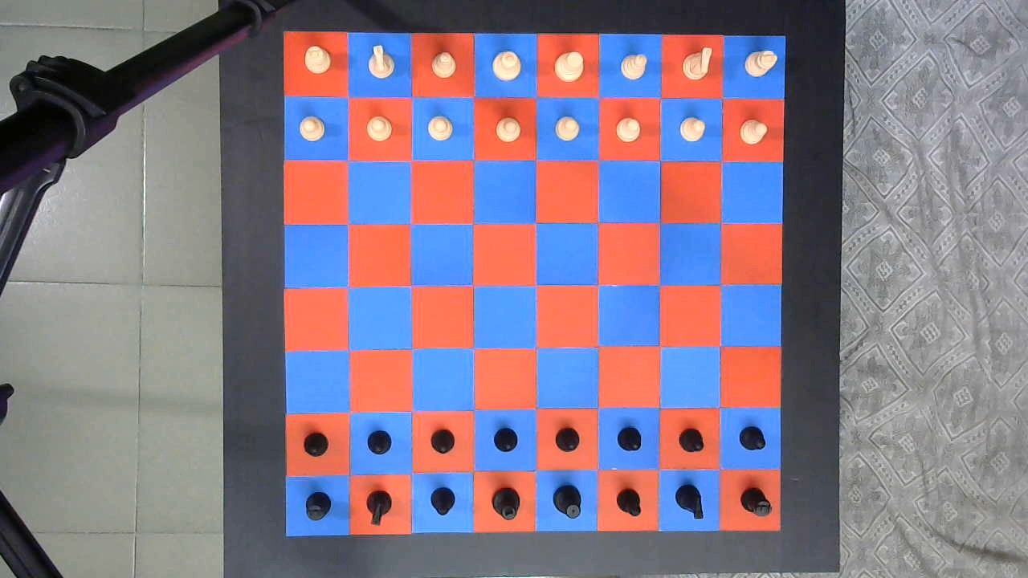
View from camera
Manually cropping initial board region
Board Grid
Cropped Frame
Sampling Red, Blue regions, Black and White pieces
Training
Logistic Regression
Inference
White Pieces Mask
Simplified colors
BW thresh, Opening, Regionprops
Board Layout
Black Pieces Mask
W | W | W | W | W | W | W | W
W | W | W | W | W | W | W | W
B | B | B | B | B | B | B | B
B | B | B | B | B | B | B | B
BW thresh, Opening, Regionprops

Slide 2
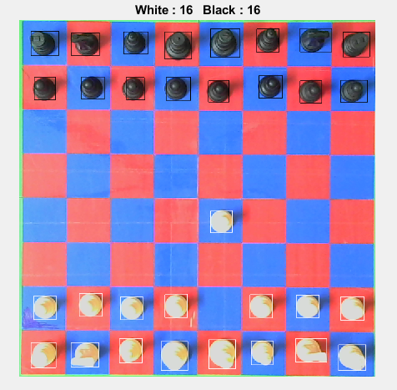
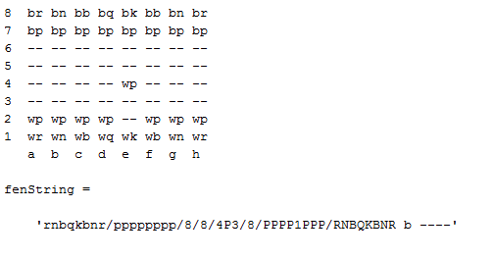

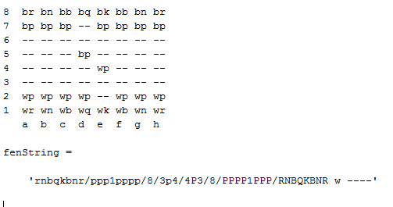

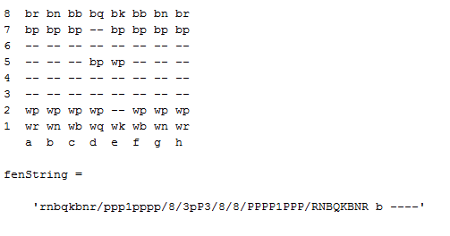
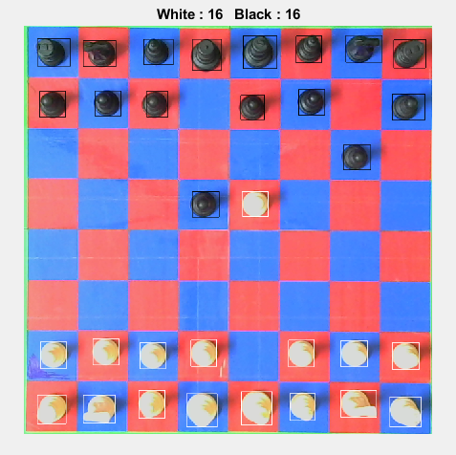


Slide 3
8
7
6
5
4
3
2
1
R
N
B
K
Q
B
N
R
R
N
B
K
Q
B
N
R
1 | 2 | 3 | 4 | 5 | 6 | 7 | 8
d
Notes:
d

