Slide 1
Efficient VLA & World-Action Models
on AMD Strix Halo
Weekly research update · July 9, 2026
Track 1 — Learned vision-token pruning for MolmoAct2 (pre-ViT gate · FastV · distilled ViT)
Track 2 — Bottlenecks, benchmarking & runtime optimization across the WAM family
Target: smooth, real-time robot policies on Ryzen AI MAX+ 395 (gfx1151, ROCm 7.2.2, bf16)

Slide 2
TRACK 1
MolmoAct2 — Learned Vision-Token Pruning

Slide 3
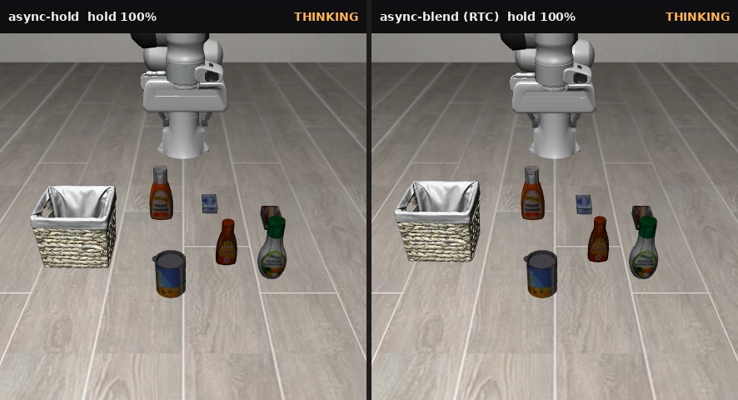
Where We Left Off — and This Week's Step
From random / untrained pruning to a trained, feedback-guided gate
Recap (last week):
– Post-ViT random token drop worked — fewer tokens to the LLM, minimal accuracy loss
– Untrained / attention-guided pruning underperformed — cliffed to 0% at aggressive keep
– Pre-ViT pruning was hardest — dropping patches before the encoder broke the policy
This week — add training + feedback:
– Route A: a learned student gate trained on action-expert attention, pruning patches before the ViT
– Route B: also cut the token count out of the LLM via a FastV stage
– Route C: replace the ViT entirely with a 100× distilled student (FPGA target)
– All routes fine-tuned with LoRA adapters; trained on Radha / Rainier (MI300X-class)
MolmoAct2 closed-loop rollout — full tokens vs pruned ("THINKING" = planning)
Weekly research update · 2026-07-09 · AMD Strix Halo (gfx1151)
Sources: Molmo/FEEDBACK_PRUNING_LORA_REPORT.md
4

Slide 4
The Pipeline & Three Pruning Routes
Where each route cuts compute in the MolmoAct2 stack
Image patches
729 / crop
Vision encoder (ViT)
SigLIP2 · 27 layers
Pool
→ tokens
LLM backbone
Qwen3-4B
DiT action expert
flow-matching → actions
Route A — Pre-ViT student gate
Learned gate prunes patches before the ViT. Saves ViT compute; scatter-back keeps token count unchanged.
Route B — Two-stage FastV
Gate @50% ViT, then FastV drops image tokens inside the LLM (layer 3). Reduces output token count.
Route C — Distilled ViT
Replace the SigLIP2 ViT with a ~114× smaller distilled student. Target: fit on FPGA hardware.
Key idea: the heavy cost is the ViT (≈616 GFLOP/crop) and the LLM prefill over vision tokens. Route A attacks ViT compute, Route B attacks LLM token count, Route C attacks the ViT wholesale.
Teacher signal: cross-attention heatmaps from the DiT action expert tell us which patches the policy actually looks at.
Weekly research update · 2026-07-09 · AMD Strix Halo (gfx1151)
Sources: molmoact2_src/config.json (ViT L=27) · VIT_DISTILL_REPORT.md
5

Slide 5
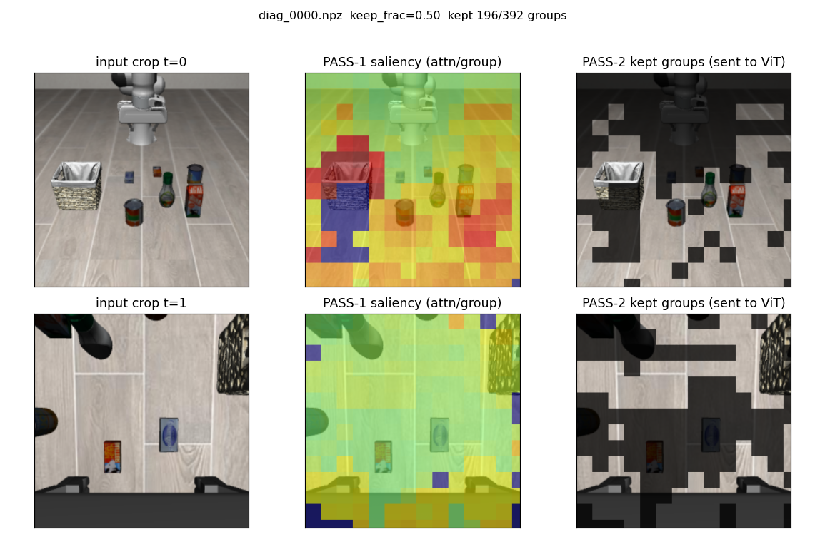
Route A — Learned Pre-ViT Gate (Method)
A student gate distilled from action-expert attention, pruning patches before the ViT
• Teacher: sink-debiased cross-attention from the DiT action expert (layers 9, 20, 21) — the patches the policy attends to.
• Student gate: a lightweight scorer at ViT layer 6 (the most stable seam) predicts patch importance.
• Prune: keep top-K patches, mask the rest for the remaining ViT layers → ViT compute drops after layer 6.
• Token count preserved: encoded features are scattered back onto the full 729-patch grid with a learned mask token, so the downstream LLM sees the same token count.
• Training: LoRA fine-tune (6000 steps) at 3 keep fractions; closed-loop LIBERO eval on Radha (MI300X).
Teacher attention (debiased) → student-predicted keep mask, across keep fractions
Weekly research update · 2026-07-09 · AMD Strix Halo (gfx1151)
Sources: FEEDBACK_PRUNING_LORA_REPORT.md §9 (seam6, teacher L[9,20,21], 6000 steps, MI300X)
6

Slide 6
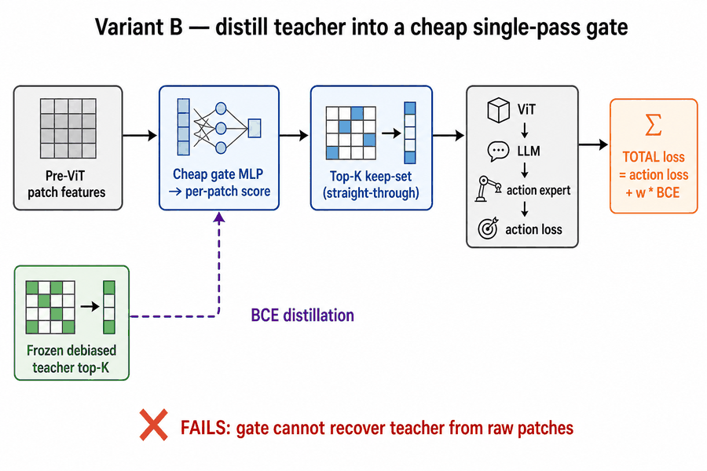
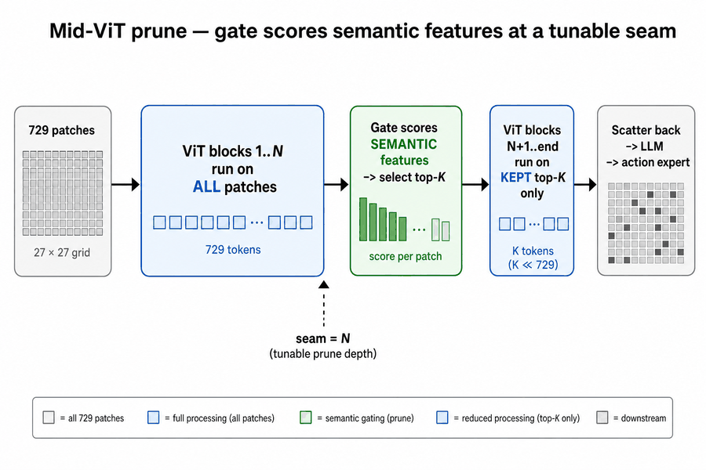
Route A — Gate Design: Failed vs Working
A student gate distilled from action-expert attention, pruning patches before the ViT
Failed approach
Successful approach
Weekly research update · 2026-07-09 · AMD Strix Halo (gfx1151)
7

Slide 7
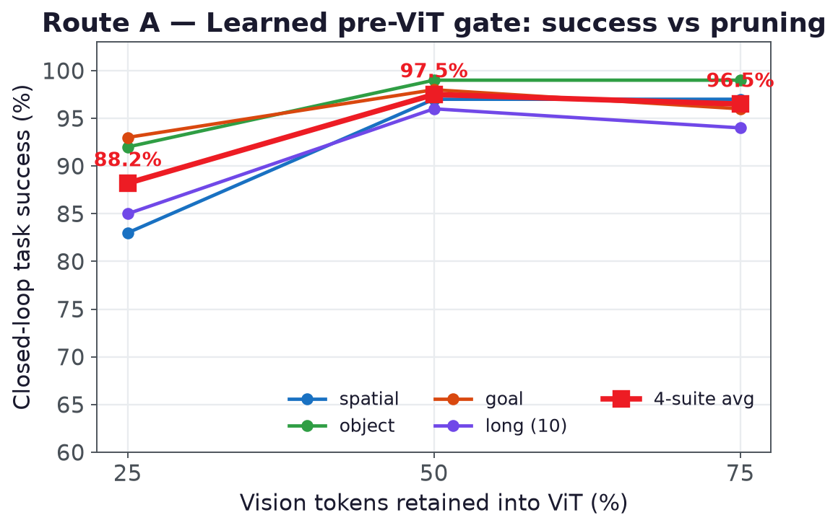
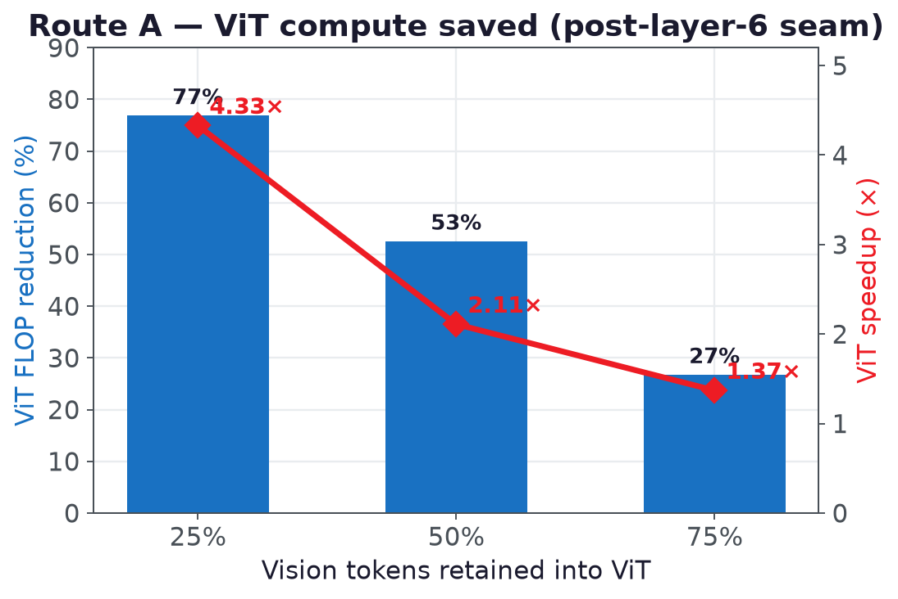
Route A — Results at 25 / 50 / 75% Retained Tokens
Graceful accuracy trade-off for large ViT-compute savings
keep = 25% tokens still holds 88.2% (4-suite avg) for a 4.33× ViT speedup — a ~9-pt drop for 4× fewer patches.
Weekly research update · 2026-07-09 · AMD Strix Halo (gfx1151)
Sources: roi_eval/README.md · roi_training/compute_saved.json (4.33× ViT)
8

Slide 8
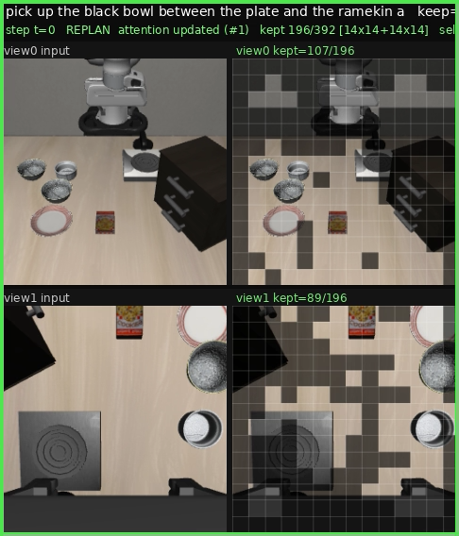
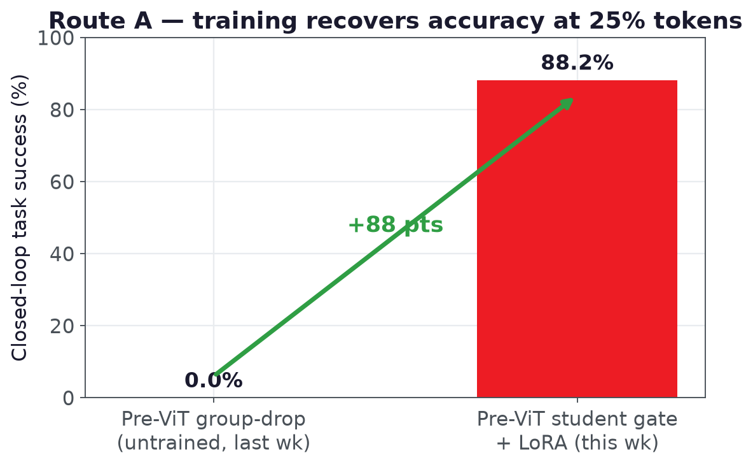
Route A — The Win vs Last Week (25% tokens)
Training turns pre-ViT pruning from unusable into viable
What the model keeps at 25% tokens — input (left) vs retained patches (right)
Untrained pre-ViT group-drop: 0% → learned gate + LoRA: 88.2%
Weekly research update · 2026-07-09 · AMD Strix Halo (gfx1151)
Sources: roi_eval/README.md (88.2% @ keep0.25 vs 0% untrained)
9

Slide 9
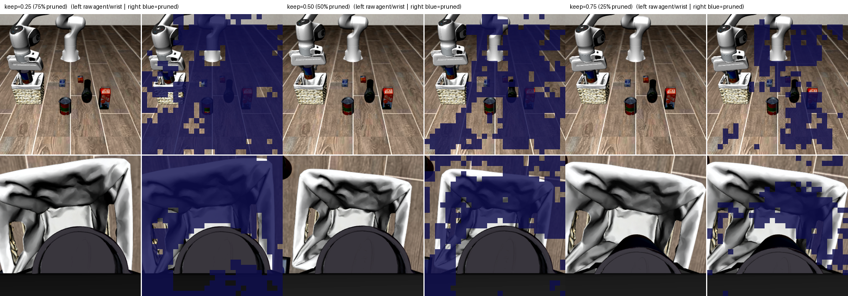
Route A — What the Gate Keeps (25 / 50 / 75%)
Training turns pre-ViT pruning from unusable into viable
Weekly research update · 2026-07-09 · AMD Strix Halo (gfx1151)
Sources: FEEDBACK_PRUNING_LORA_REPORT.md (qualitative keep masks)
10

Slide 10
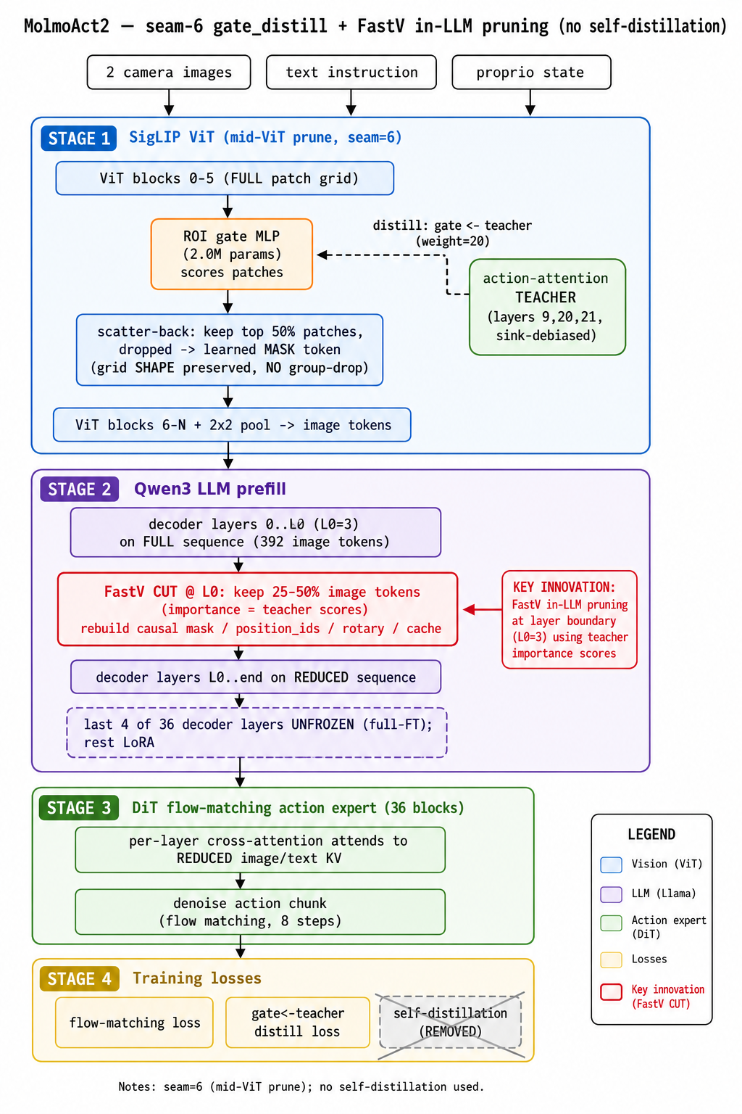
Route B — Two-Stage FastV
Group-pruning at ViT input failed → move the token cut inside the LLM
• Problem: pruning patch groups at the ViT input to reduce output token count collapsed to 0% success.
• Fix: keep Stage-1 gate at 50% ViT patches, then add a FastV stage inside the LLM (layer 3) that progressively drops image tokens through the decoder.
Weekly research update · 2026-07-09 · AMD Strix Halo (gfx1151)
11

Slide 11
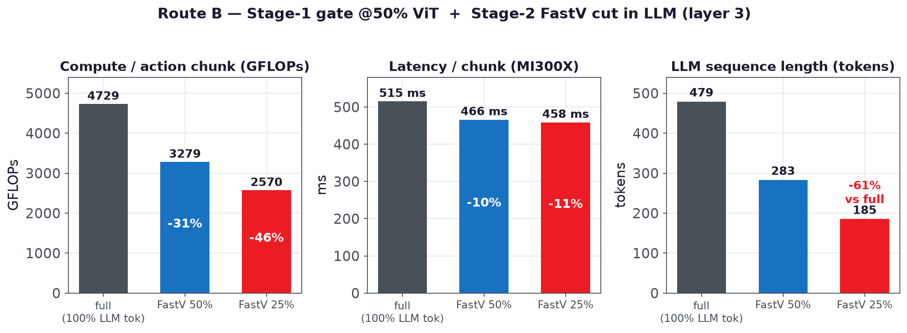
Route B — Two-Stage FastV (cutting LLM token count)
Group-pruning at ViT input failed → move the token cut inside the LLM
• Problem: pruning patch groups at the ViT input to reduce output token count collapsed to 0% success.
• Fix: keep Stage-1 gate at 50% ViT patches, then add a FastV stage inside the LLM (layer 3) that progressively drops image tokens through the decoder.
FastV 25% → 61% fewer LLM tokens, −46% GFLOPs, −11% latency (MI300X). Closed-loop (500 rollouts/config, MI300X): 96.5% at 50% keep (lossless), 84.0% at 25% keep.
Weekly research update · 2026-07-09 · AMD Strix Halo (gfx1151)
Sources: FEEDBACK_PRUNING_LORA_REPORT.md §9.2 (500 rollouts/config, MI300X)
12

Slide 12
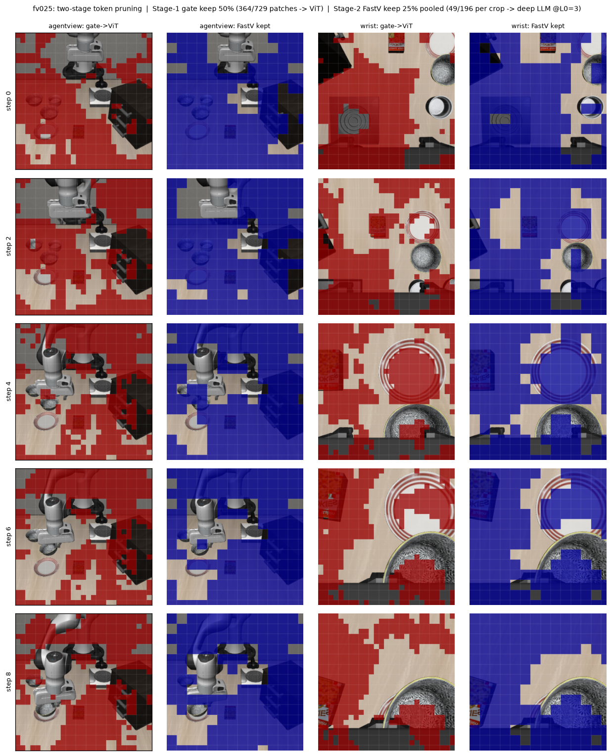
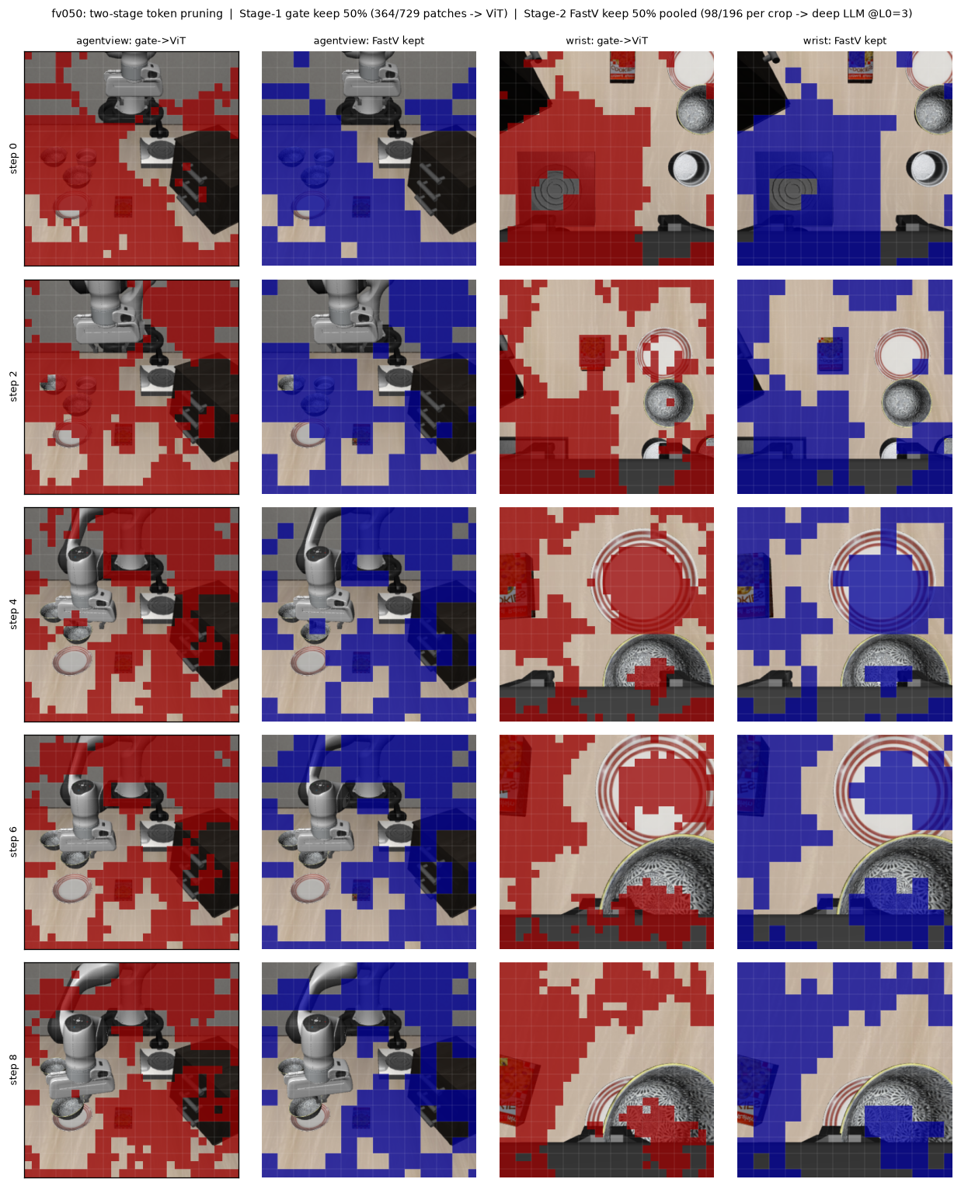
Route B — Qualitative Pruning (25% vs 50%)
Group-pruning at ViT input failed → move the token cut inside the LLM
25 Percent Retention
←
50 Percent Retention
→
Weekly research update · 2026-07-09 · AMD Strix Halo (gfx1151)
Sources: FEEDBACK_PRUNING_LORA_REPORT.md (qualitative 25% vs 50%)
13

Slide 13
Combined Pipeline — Gate+FastV vs Predict+FastV
Stack the pre-ViT selector (keep 50% of patches, seam-6) with an in-LLM FastV cut — closed-loop LIBERO, 4 suites × 10 tasks × 10 ep = 400 ep/run
Two selector variants — gate (teacher-distilled ROI) and predict (past-frame causal ROI, teacher-free at inference) — each run at two in-LLM FastV budgets: keep 50% (cut at L0=3) and keep 25% (cut at L0=9).
Pipeline | Selector | FastV keep | L0 | Spatial | Object | Goal | Long | Overall
gate + FastV | gate_distill | 50% | 3 | 94.0 | 98.0 | 96.0 | 97.0 | 96.2
predict + FastV | gate_predict | 50% | 3 | 97.0 | 99.0 | 100.0 | 94.0 | 97.5
gate + FastV | gate_distill | 25% | 9 | 94.0 | 100.0 | 95.0 | 95.0 | 96.0
predict + FastV | gate_predict | 25% | 9 | 95.0 | 99.0 | 91.0 | 96.0 | 95.2
Token budget (matched between gate & predict within each pair, so accuracy is compared at equal compute):
Pair A (keep 50% / L0=3): pre-ViT gate 364/729 = 49.9% patches · in-LLM FastV 479 → 283 = 59.1% of LLM seq. Pair B (keep 25% / L0=9): pre-ViT 49.9% · in-LLM FastV 479 → 185 = 38.6% of LLM seq.
All four combined configurations land 95.2–97.5% overall; the two selectors stay within ~1 pt of each other at each budget. Moderate-prune predict+FastV is highest at 97.5% (goal 100%); aggressive keep-25 trades a little accuracy for a deeper LLM cut. The deeper FastV layer at keep-25 (L0=9 vs L0=3) lets 6 more decoder layers see the full token set before the cut, recovering the wide-context suites.
Weekly research update · 2026-07-09 · AMD Strix Halo (gfx1151)
Sources: CAUSAL_GATE_PREDICT_REPORT.md (§accuracy, §compute) · artifacts/predict_eval/merged_results.csv (400 ep/run)
14

Slide 14
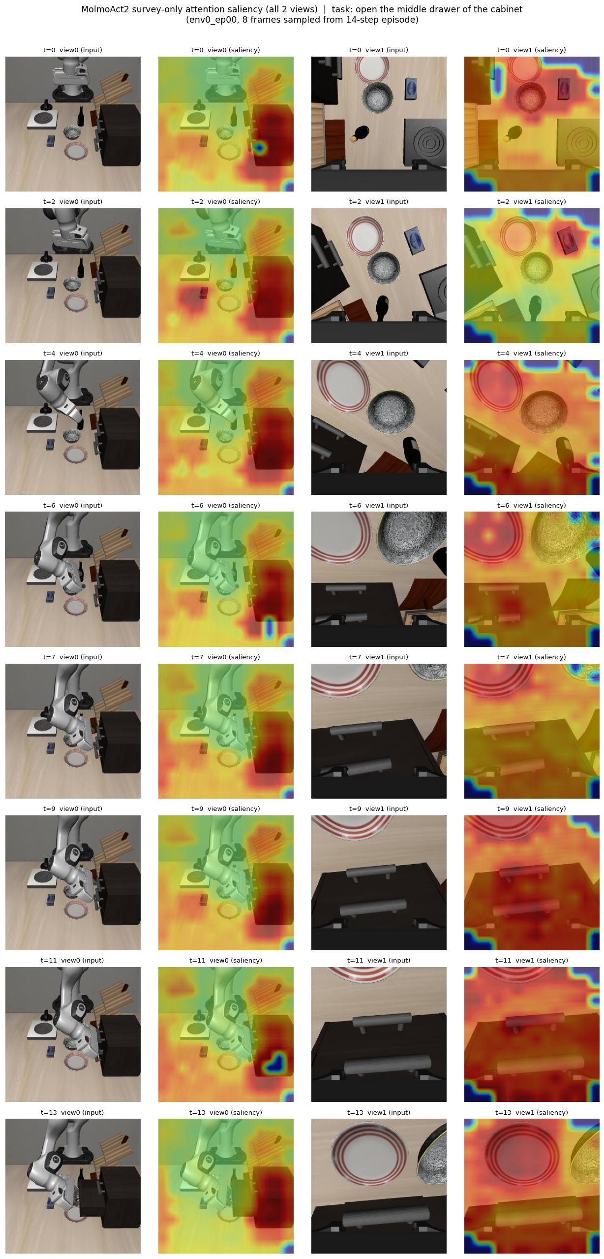
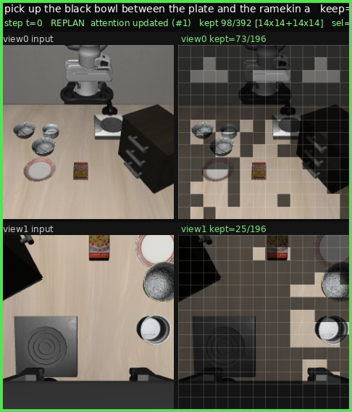
What the Model Sees Under Pruning
Learned gate keeps task-relevant patches; degradation is graceful
keep = 50% tokens (input | kept)
keep = 25% tokens (input | kept)
attention heatmaps
Weekly research update · 2026-07-09 · AMD Strix Halo (gfx1151)
Sources: FEEDBACK_PRUNING_LORA_REPORT.md · VIT_DISTILL_REPORT.md
23

Slide 15
Combined Pipeline — Inference on Strix Halo
ViT encode (2 crops) + LLM prefill on the Radeon 8060S iGPU — excludes the flow-matching action expert
Regime | ViT (ms) | LLM prefill (ms) | Total (ms) | vs full
Full (no pruning) | 170.6 | 173.0 | 343.6 | —
Random pre-ViT (keep 50%) | 59.1 | 110.4 | 169.5 | −50.7%
Two-stage FastV, keep 50% | 59.1 | 115.6 | 174.7 | −49.2%
Two-stage FastV, keep 25% | 59.1 | 97.6 | 156.7 | −54.4%
Reading the numbers
• Pre-ViT gating cuts ViT encode 2.9× (170.6 → 59.1 ms) — same for every pruned regime.
• The FastV depth sets LLM prefill cost: the deeper keep-25 cut (L0=9) trims prefill to 97.6 ms, giving the best total 156.7 ms (−54.4%).
• keep-50 (L0=3) totals 174.7 ms (−49.2%); it prefills slightly more than the random baseline because it cuts one layer later.
• Latency is identical for gate vs predict within a pair (matched token budget), so one curve covers both selectors.
• Excludes the flow-matching action expert; LIBERO wall-clock eval time is render-dominated and not used as a latency metric.
Total latency (ViT + LLM prefill), ms
Full
343.6
Random keep50
169.5
FastV keep50
174.7
FastV keep25
156.7
Weekly research update · 2026-07-09 · AMD Strix Halo (gfx1151)
Sources: artifacts/rollouts/pruning/strix_latency.json (Radeon 8060S) · pruning_stats.csv · CAUSAL_GATE_PREDICT_REPORT.md
15

Slide 16
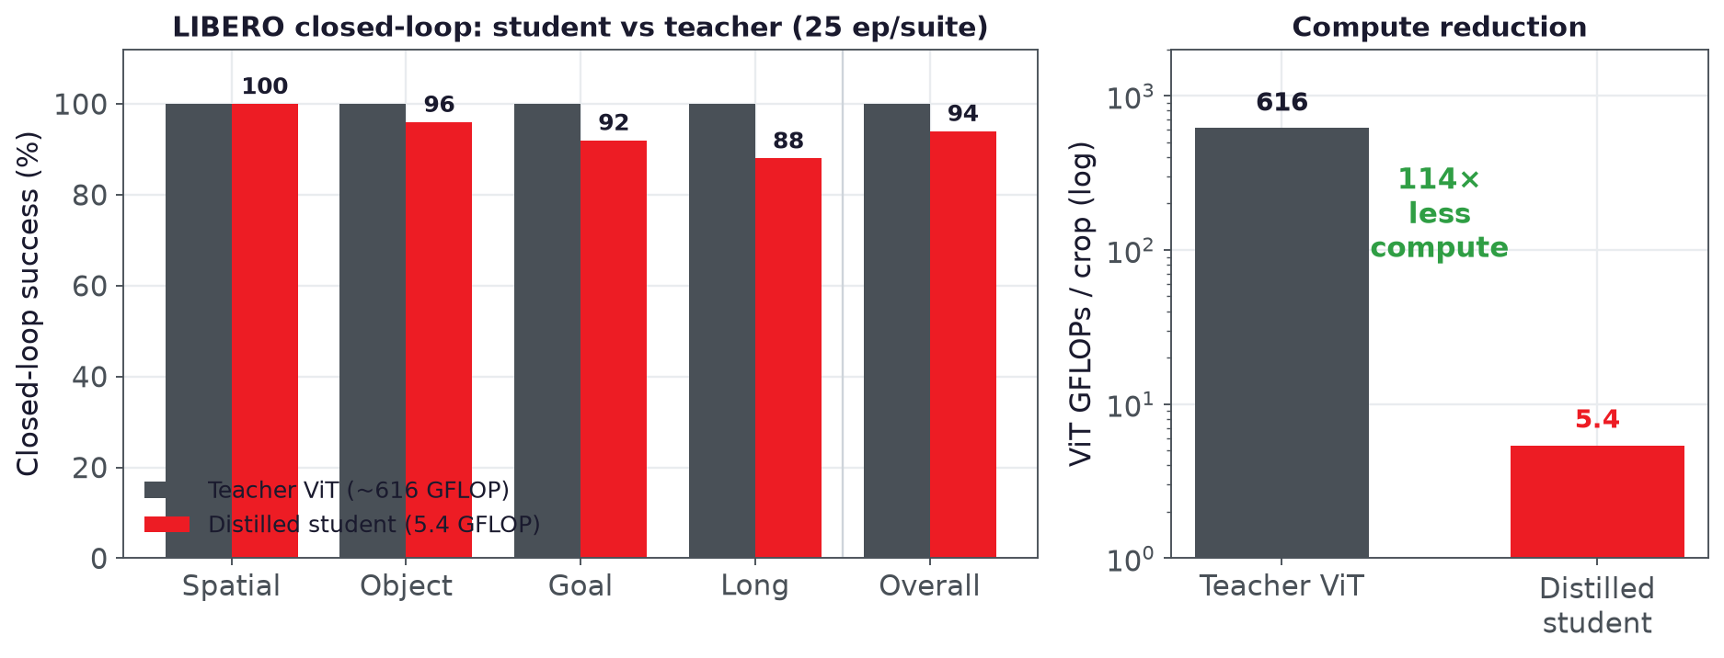
Route C — Distilled ViT (~114× less compute)
Replace the SigLIP2 ViT with a tiny student — toward FPGA deployment
• Distill SigLIP2 ViT (~616 GFLOP/crop) → hybrid student 5.4 GFLOP
• 114× less ViT compute
• Feature fidelity: seam cosine 0.885 on held-out frames
• Closed-loop: 94% overall vs 100% teacher (−6 pts)
• Goal: fit the tiny encoder on FPGA hardware (ongoing)
Trained on Radha (MI210)
Weekly research update · 2026-07-09 · AMD Strix Halo (gfx1151)
Sources: VIT_DISTILL_REPORT.md · artifacts/vit_distill/pipeline_3x_status.md (MI210/Radha)
16

Slide 17
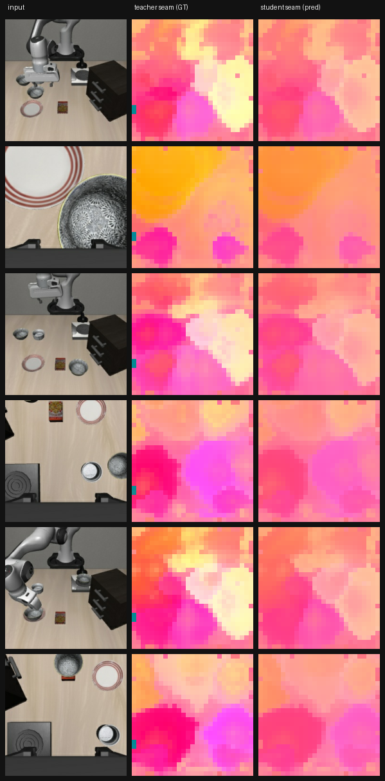
Route C — Seam Fidelity: Teacher vs Student
Replace the SigLIP2 ViT with a tiny student — toward FPGA deployment
Weekly research update · 2026-07-09 · AMD Strix Halo (gfx1151)
Sources: VIT_DISTILL_REPORT.md §7 (m4_metrics.json, seam cosine 0.885)
17

Slide 18
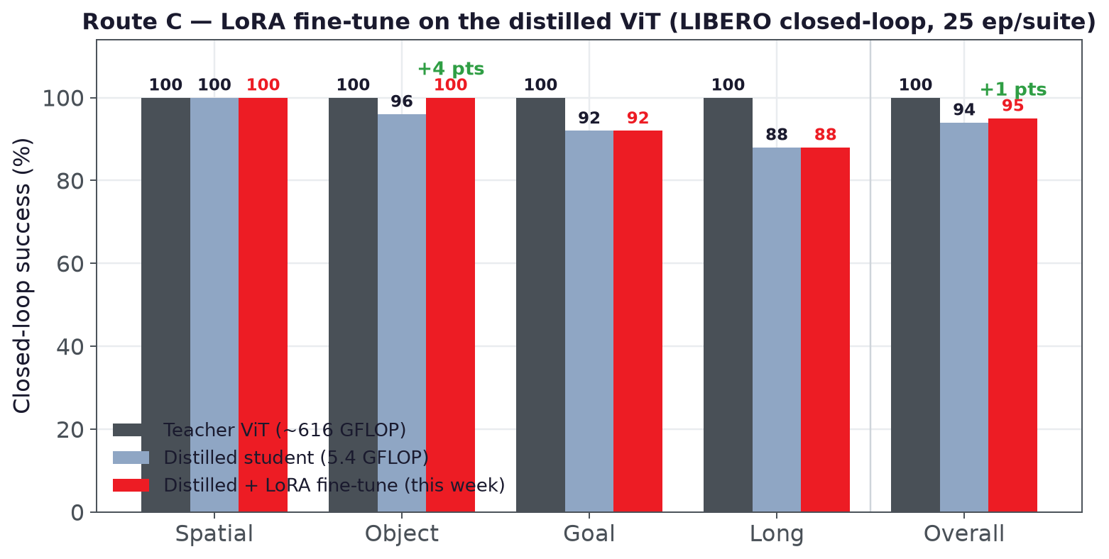
Route C — Distillation + LoRA Fine-Tune
Fine-tuning on top of the distilled ViT recovers task success toward the teacher
Key results
• Overall 94% → 95% with LoRA fine-tune
• Object fully recovered 96% → 100% — matches teacher
• Spatial stays 100%; Goal 92% / Long 88% unchanged
• Now only −5 pts vs teacher (was −6) at 114× less ViT compute
• LoRA adapters on the distilled encoder; closed-loop LIBERO, 25 ep/suite
Weekly research update · 2026-07-09 · AMD Strix Halo (gfx1151)
Sources: artifacts/vit_distill/pipeline_3x_status.md (compare_nway.csv)
18

Slide 19
Route C — Three Distilled-ViT Variants (~100–120×)
Same seam-retention distill + LoRA finetune, three student architectures — all ≥ 98% closed-loop, all beat the finetuned-hybrid 95% baseline
Variant | Student architecture | Params | GFLOPs/crop | Comp. | Spatial | Object | Goal | Long | Overall
Teacher (SigLIP2 ViT) | — | — | 617.15 | 1.0× | 100 | 100 | 100 | 100 | 100
distill-only hybrid | conv+attn, no finetune | 2.79M | 5.40 | 114× | 100 | 96 | 92 | 88 | 94
finetuned hybrid | conv+attn + LoRA | 2.79M | 5.40 | 114× | 100 | 100 | 92 | 88 | 95
A · siglip_nano | attention-only tinyvit | 2.73M | 5.74 | 107× | 100 | 100 | 96 | 96 | 98
B · hybrid_droid | conv+attn + DROID real | 2.79M | 5.40 | 114× | 100 | 96 | 100 | 100 | 99
C · cnn_fpga | pure-CNN (FPGA-friendly) | 3.83M | 5.14 | 120× | 100 | 96 | 96 | 100 | 98
▸ B (hybrid_droid, +DROID real frames) is best overall at 99% — the only variant that fully recovers the hardest long-horizon suite (Long 100%).
▸ A (siglip_nano) matches 98% with the fewest params (2.73M) despite being attention-only; C (cnn_fpga) reaches 98% while staying pure-CNN (no attention op) — the most FPGA-friendly at ~120×.
▸ The LoRA finetune on top of the distilled encoder recovers the Goal/Long regressions of the distill-only (94%) and finetuned-hybrid (95%) baselines. +DROID real-data recipe (B) is the recommended default.
Weekly research update · 2026-07-20 · AMD Strix Halo (gfx1151)
Sources: artifacts/vit_distill/pipeline_3x_status.md (compare_nway.csv, 100 ep/arm) · VIT_DISTILL_REPORT.md
19

Slide 20
LLM Backbone Distillation — qwen06w + KV-Anchor → DAgger
The first non-zero LLM-backbone result: a Qwen3-0.6B-width student, 6.4× fewer decoder FLOPs, plugged into the frozen action expert
Why it is hard
The flow-matching action expert cross-attends the LLM's per-layer K/V (one DiT block per LLM layer, 1:1). So depth is fixed at 36 — distillation can only cut width — and the KV interface must match the teacher exactly (8×128 = 1024).
The pipeline that worked
Stage 0 · warm-start
qwen06w warm-started from Qwen3-0.6B; 28→36 depth stretch, new down/up interface layers.
 | Teacher backbone | qwen06w student
Layers | 36 | 36 (fixed)
Hidden | 2560 | 1024
Q / KV heads × dim | 32 / 8×128 | 16 / 8×128
MLP intermediate | 9728 | 3072
KV interface (kv_dim) | 1024 | 1024 (identical)
Backbone params | 3.65 B | 0.57 B
Stage 1 · all-layer teacher-KV anchoring
flow + λ·anchor (λ=1, β=0.1) across all 36 layers — fixes the orthogonal collapse.
0% → 30%
Stage 2 · LLM + AE co-adaptation
co-adapt the pair, then LoRA base — trades raw score for a flexible base the on-policy stage can move.
30% base → 9.2%
Naive backbone distillation collapses to 0%:
• Pure representational (match KV only): 0.99 KV cosine but 0% closed-loop — a deceptive target that starves the task.
• Functional-only (flow loss, KV free): student KV goes orthogonal to teacher (cos ≈ 0), never grasps — 0%.
Stage 3 · on-policy DAgger + AE-LoRA
roll out student, relabel visited states with teacher, finetune on 50/50 on-policy/demo with a LoRA-adapted action expert.
→ 47.5% ◀ deliverable
Weekly research update · 2026-07-20 · AMD Strix Halo (gfx1151)
Sources: research/llm_distill/DISTILLATION_SUCCESS_REPORT.md §1–2 · HYBRID_DISTILL_REPORT.md (Workstreams A–E)
20

Slide 21
LLM Backbone — Results & Compute Wins
47.5% closed-loop — +17.5 pts past the 30% teacher-forced ceiling — at 6.4× smaller, 2.2–3.2× faster, 5.4× less memory
Stage trajectory (winning expd arm, qwen06w)
Compute wins vs teacher backbone
Stage | Closed-loop success
Stage-2 co-adapted base | 9.2%
+ on-policy DAgger, frozen action expert | 16.67%
+ on-policy DAgger, LoRA-adapted action expert | 47.5%
Parameters
3.65 B → 0.57 B 6.38× smaller
Weights (bf16)
7.29 → 1.14 GB 6.38× smaller
Per-suite at 47.5% (120 rollouts: 4 suites × 10 tasks × 3 ep)
Prefill latency, batch 1
61.6 → 27.5 ms 2.24× faster
libero_spatial | libero_object | libero_goal | libero_10 (long) | Overall
50.0% | 80.0% | 33.3% | 26.7% | 47.5%
Prefill latency, batch 8
350.7 → 108.6 ms 3.23× faster
Peak inference mem, batch 1
7.73 → 1.42 GB 5.45× less
The unlock (Stage 3): letting the action expert co-adapt cheaply (LoRA) to the shifted student features on the student's own on-policy state distribution is what breaks the 30% teacher-forced ceiling — especially strong on object manipulation (80%).
Benchmark: LIBERO closed-loop, fixed seeds 1000+. Teacher = MolmoAct2-LIBERO (36-layer Qwen3 backbone + flow-matching action expert). Single AMD Instinct MI210, bf16.
Decoder FLOPs / token
— 6.42× fewer
Peak memory drops 5.4× — backbone from ~7.7 GB into edge / small-accelerator budgets.
Weekly research update · 2026-07-20 · AMD Strix Halo (gfx1151)
Sources: research/llm_distill/DISTILLATION_SUCCESS_REPORT.md §3–4 (bench_backbone.py, MI210 bf16)
21

Slide 22
LLM Backbone — Why Each Stage (Negative Controls)
Every design choice is here because the cheaper alternative was measured to fail — closed-loop rollout, not flow loss, is the only reliable gate
Choice tested | Measured outcome
Pure representational (match per-layer KV only) | 0.99 KV cosine but 0% closed-loop — deceptive target
Functional-only (flow loss, KV free) | student KV orthogonal to teacher (cos ≈ 0) → 0%
Thin-twin student (hidden 208, head_dim 26, 5× KV bottleneck) | loss floor ~24, 0% on all 4 suites — over-compressed on width
Flow + all-layer teacher-KV anchor | 0% → 30% — the enabling lever
Frozen action expert during on-policy DAgger | caps at 16.67%
LoRA-adapt action expert during on-policy DAgger | → 47.5% — the unlock
Full-AE unfreeze under teacher-forced objective (Exp-D) | best flow loss 0.061 but only 9.2% — more freedom hurt
Naive DAgger round-2 (no data aggregation) | regressed 47.5% → 31.67% — non-aggregated forgetting
LoRA-on-LLM finetune of the width-reduced student | floors ~0.29 flow — needs a fully-unfrozen LLM
Bottom line: representational anchoring is what makes width-reduced distillation trainable (0→30%); closing the closed-loop covariate-shift gap needs BOTH on-policy data AND a co-adaptable (LoRA) action expert (30→47.5%). Open-loop flow loss never predicted closed-loop success.
Weekly research update · 2026-07-20 · AMD Strix Halo (gfx1151)
Sources: HYBRID_DISTILL_REPORT.md (Workstreams A–F) · DISTILLATION_SUCCESS_REPORT.md §5 · artifacts/vit_distill/pipeline_3x_status.md (Run D)
22

