Slide 1
Challenges of managing CoreFX repo
@dotnetfringe 2017
by Karel Zikmund (@ziki_cz)

Slide 2
What is CoreFX repo?
https://github.com/dotnet/corefx
Core Framework of .NET Core
BCL (Base class libraries) – 50 namespaces:
System.Collections
System.IO
System.Linq
System.Data
System.Net
System.Reflection
System.Runtime
System.Xml
and more …
Not included:
ASP.NET Core
WCF, EF
Namespaces, which are not part of .NET Core (e.g. UI / System.Xaml)
Notes:
.NET Core together with CoreCLR repo

Slide 3
Who are people behind CoreFX repo?
CoreFX team (20 engineers)
10 satellite teams (~20 engineers)
Beyond .NET Core:
.NET Framework
.NET Native (UWP)
More teams form E2E
Runtime/JIT, infrastructure, CLI, SDK, project system, NuGet, VS, etc.
Notes:
6 teams further away (aligning challenge)
.NET Framework – imagine number of satellite teams

Slide 4
CoreFX
Mono
Notes:
Goes both ways
Mono linker
Netstandard 2.0

Slide 5

Notes:
Trivia (not so much known): Mono = monkey in Spanish

Slide 6
Karel Zikmund
Engineering manager on CoreFX team
.NET team since 2005
https://github.com/karelz
https://twitter.com/ziki_cz
Goals:
Behind the scenes knowledge = better collaboration
Seeking feedback, alternatives, ideas
Notes:
CoreFX team, open-source – 1 year
* Beside Networking, Security, Collections and few smaller areas
* Community manager
Humans on the other side, not just large corporation with infinite resources

Slide 7
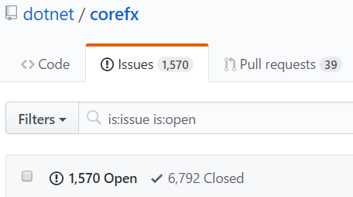
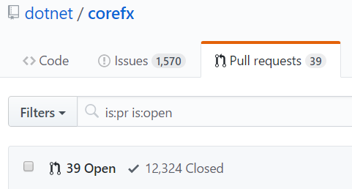
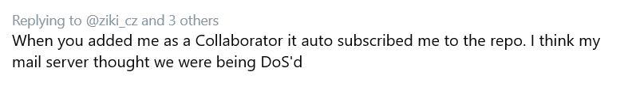
Issues and PRs
Incoming last month: 600 issues, 700 PRs
Notifications: guess 10K+ (300+ per day)
Notes:
Issues are not only external, we have test issues from test lab
PRs are also from team members
Notifications limitations – no label changes, no milestone changes

Slide 8
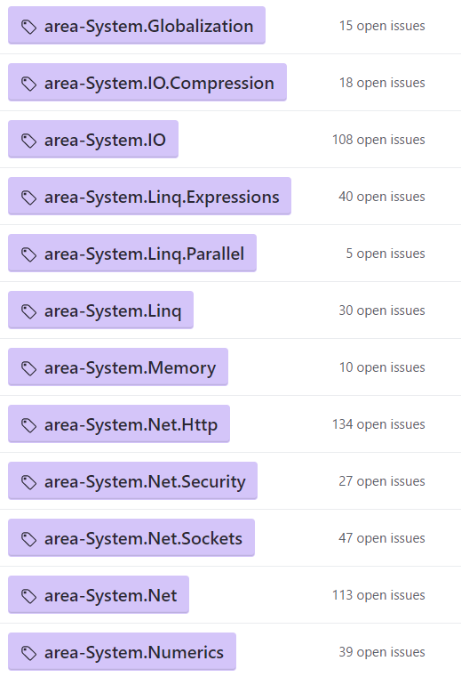
Slicing large repo
Area labels
Tooling – incoming / outgoing
Per area / query
Limitations (no replies, user-configuration, etc.)
Similar problem for community:
New issues/PRs into Twitter feeds @corefxissues
Similar tooling exists …
Notes:
Area labels are per namespace
Each area has owner / owners
Area owners manually subscribe to issues/PRs
Helps engineers to focus
Limitations: You have to subscribe manually to get replies
No configuration / web UI

Slide 9
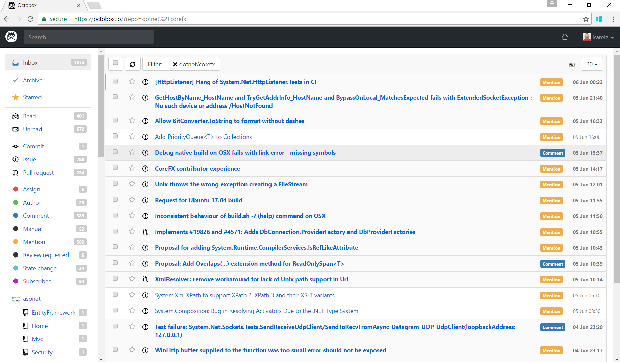
octobox.io
Notes:
Mail inbox (important / deleted)
Filters per repo, kind of notifications
Great for many repos together, not designed for large repo slicing
Limitation: Uses only GitHub notifications – missing: per area-label / GH query scoped
Andrew Nesbitt – maintainer of the repo

Slide 10
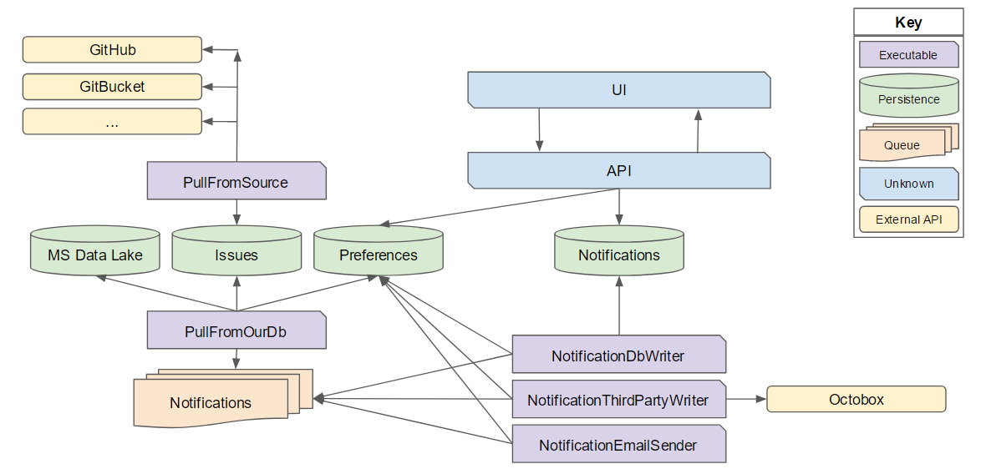
Next gen tooling
https://github.com/karelz/GitHubIssues
Notes:
Designing the tooling with help from community

Slide 11
Triage rules
One area-* label
Empty Assignee
Use up-for-grabs with next steps & complexity description
Set Milestone as 95% commitment
One issue type label
bug / enhancement / api-needs-work / documentation, etc.
Don't be afraid to say no, or close issues - just explain why and be polite
Don't be afraid to be wrong - just be flexible when new information appears

Slide 12
Adding new APIs
~100 unique APIs in .NET Core
Dictionary.GetValueOrDefault
Decision tree:
Is it existing BCL type?
Will it be used by CoreFX itself?
Can it live somewhere else? (PowerCollections)
API approval process is slow by design
APIs are forever

Slide 13
Changes
Performance changes
Performance trade-offs
Code complexity vs. value
Compatibility breaking changes
vs. 1.x or .NET Framework / UWP / Mono
Is the value worth the risk someone will get hurt?
API usage
Obsolete APIs
TreatAsWarnings = breaking change
Notes:
Trade-offs – rarely clear win. How do you choose which scenario to compromise. Have to thin about all scenarios.

Slide 14
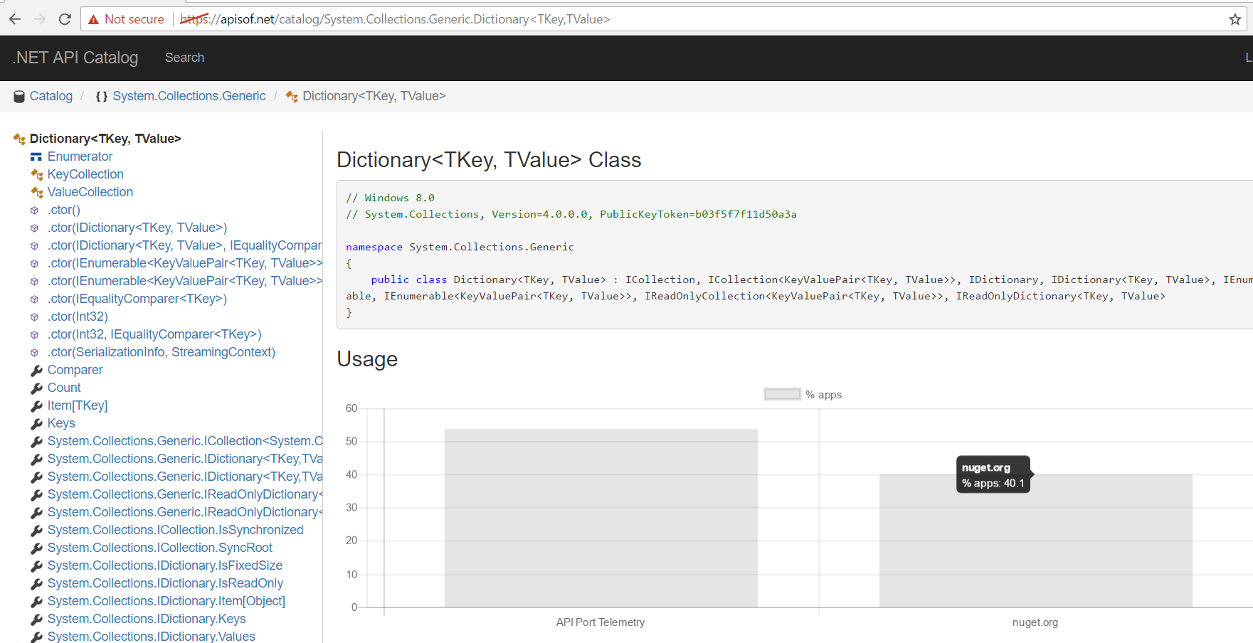
API usage information / telemetry

Slide 15
Team Culture Changes and Challenges
Discussions in the open
Onboarding new contributors (docs, tooling, attitude)
Communication – polite, welcoming, patient – making it constructive
Unclear language (e.g. ESL = English as Second Language)
Missing/incomplete/complex repro steps
Frustration
Abuse (aggressiveness)
Own opinion vs. driving consensus
Notes:
Discussions in the open – it is easier to talk than to write (API reviews)
Docs – Microsoft employees know how to take the pain
* Repro steps – minimal repro
* Frustration – you didn’t invest in last 10 years
* Abuse – You have to fix it, swearing/anger, attacks on team members / other community members

Slide 16
Plans
Dialog with CoreFX contributors (standups)
CLR Foundations Talks videos

Slide 17
Thank you
Seeking:
Feedback
Alternative / existing solutions
Ideas (incl. above & beyond CoreFX, Microsoft)
Karel Zikmund
karelz@microsoft.com
https://github.com/karelz
https://twitter.com/ziki_cz

