Slide 1
Text Mining Project on Toyota Dealership Survey
Phase 1 (Clustering) Results Delivery

Slide 2
Previous Methods
Based on Word2Vec, compute similarity between comments using Word Mover’s Distance (WMV).
Cluster all the comments using Spectral clustering / K-means clustering / Affinity Propagation clustering based on the similarity matrix computed earlier.
Bad clustering results due to:
Errors introduced by Word2Vec the similarity between two words is not optimal, hence affect document similarity.
Many typos in this dataset Cannot find the vector that match the words.
Words not relevant to the cluster keywords will affect the similarity score.

Slide 3
New Methods Explored
Automatic pre-processing
Split long comments into multiple sentences using sentence tokenizer (if necessary).
Filter out non-informative words based on the stop words list and part of speech tag.
Rule-based pre-processing
Extract keywords from each sentence based on the rules constructed from each question.
Rules are used for merging/adding/splitting keywords.
Rule-based post-processing
Select the most representative keywords based on the rules constructed from each question (with keyword ranking).

Slide 4
New Methods Explored
Automatic Sentence Representation Methods
Bag of Words (BOW):
Term-Document matrix where we use tf-idf to represent each term.
Latent Semantic Indexing (LSI):
A matrix containing word tf-idf per sentence is constructed and singular value decomposition (SVD) is used to reduce the number of keywords while preserving the similarity structure among sentences.
Latent Dirichlet Allocation (LDA):
A topic model where each document is viewed as a mixture of various topics where each document is considered to have a set of topics that are assigned to it via LDA.
Given a collection of documents, LDA then tries to backtrack from the documents to find a set of topics that are likely to have generated the collection.
Non-negative Matrix Factorization (NMF)
A group of algorithms in multivariate analysis and linear algebra where a matrix V (tf-idf matrix) is factorized into two matrices W and H, with the property that all three matrices have no negative elements.
NMF significantly reduces the dimension of the original matrix while keeping the most useful features.

Slide 5
New Methods Explored
Automatic Clustering Methods
Automatic clustering is performed based on the similarity matrix calculated from the result of the sentence representation models described previously. Three methods are explored:
K-means clustering:
The algorithm clusters data by trying to separate samples in n groups of equal variance, minimizing a criterion known as the inertia or within-cluster sum-of-squares. This algorithm requires the number of clusters to be specified.
Spectral clustering:
Spectral clustering does a low-dimension embedding of the affinity matrix between samples, followed by a KMeans in the low dimensional space. It requires the number of clusters to be specified.
Affinity Propagation
Affinity propagation creates clusters by sending messages between pairs of samples until convergence. A dataset is then described using a small number of exemplars, which are identified as those most representative of other samples. It can automatically decide the number of clusters.

Slide 6
How to identify the main topic of each cluster?
For the clusters clustered by rules:
The main topic is summarized from the keywords of every sentence in the cluster, with the aid of the cluster name.
For the automatic clustered clusters:
To achieve accurate summarization of the cluster, we suggest to read the sentences in the cluster and summarize the main topic by human. This is not tedious if the cluster purity is high.
The reason why we don’t use centroid sentence of each cluster is that the centroid may not be representative or can not cover all aspects of the cluster.

Slide 7
Statistics of 10 survey questions
 | # of comments | # of sents (cleaned) | Method | # of clusters | Sents ratio | Comm. ratio
Q1 | 168 | 395 (326) | Pure rules | 17 | 73.3% | 80.5%
Q2 | 478 | 1060 | Information Extraction | 51 （time-specified） | 62.5% | 83.1%
Q3 | 309 | N.A. | Rule-based + LIS + Spectral Clustering | 16 | N.A. | N.A.
Q4 | 1146 | 2725 (2213) | Pure rules | 14 | 77.4% | 85.8%
Q5 | 455 | N.A. | NMF+KMEANS | 10 | N.A | N.A
Q6 | 1377 | 3366 (2559) | Rule-based + LIS + Spectral Clustering | 13 | N.A. | N.A.
Q7 | 463 | 1067 (879) | Rule-based+NMF | 14 | 67.3% | 78.4%
Q8 | 774 | 1978 (1106) | Pure rules | 20 | 69.3% | 65.2%
Q9 | 1833 | 3986 (3444) | Pure rules | 11 | 80.5% | 89%
Q10 | 445 | N.A. | NMF+KMEANS | 10 | N.A | N.A

Slide 8
Statistics of 10 survey questions
Notes on the statistics table:
“# of sents (cleaned)” means number of single sentences separated from comments. “cleaned” indicates number of informative sentences filtered after keywords extraction. “N.A.” means we don’t perform sentence separation on the comments.
“N.A.” in the “comm. ratio” means automatic clustering is performed. The clustering results is evaluated by the cluster purity of each cluster.
We randomly chose 30 samples (for large clusters) and the percentage of the sentences with similar topic is computed to be the purity of the cluster. Please refer to the clustering results of each question in the following slides.

Slide 9
Question 1
Question content:
Your satisfaction towards arranging service appointment/visits to the dealership.
Comment ratio: 80.5%
Clustering method:
Rule-based keyword extraction (11 pre-processing rules + 12 post-processing rules) on 326 sentences, each sentence is represented by a most representative keyword (Noun/Adjective).
Rationale:
Automatic clustering algorithms failed to cluster the sentences that contains multiple keywords. For example, “difficult when making appointment”, “wait long time after making appointment”, “should make appointment on the phone” shall be three different clusters.
Task-specific rules are employed to boost the clustering performance.

Slide 10
Clustering Result:
Cluster name (#) | Cluster aspect | Estimated purity | Cluster name (#) | Cluster aspect | Estimated purity
App (7) | Mobile app should be available | 86% | On time (16) | Should serve at the appointed time | 100%
Appointment (46) | Difficult to get an appointment / not giving preferred time. | 83% | Online (5) | Online appointment booking should be available | 100%
Call (32) | Call facility should improve | 80% | Pick (15) | Pick up and drop facility should be available/ improve | 87%
Delivery (6) | Should deliver the car on time | 83% | Receive (8) | Not receiving customers properly | 87%
Emergency (11) | Should give convenience for emergency situation | 100% | SMS (5) | Should inform customer through SMS | 80%
Fix (6) | Appointments should be fixed | 100% | Staff (10) | Increase staff/ staff should work properly | 90%
Inform (10) | Should inform customers time/details | 100% | Wait (44) | It takes long time for servicing. | 93%
Location (10) | Dealership location is not convenient | 80% | Without appointment (3) | Should service the car without appointments also | 100%
Number (5) | Queue number issue | 80%
We find the rule-based method achieves good performances in terms of clustering purity.

Slide 11
Question 2
Question content:
Your satisfaction towards dealership opening/closing days and time
Clustering method:
Time Sensitive Words Extraction .
Time Sensitive Words Extraction.
Split into two scales: day and time.
Extraction Method:
Day-scale: dictionary-based matching.
Time-scale: regex based on time-format.

Slide 12
Clustering Result:
Cluster name (#) | Cluster aspect
Day-scale | It includes three subclusters: Sunday, Weekend, Holidays
Time-scale | Extract exact time including opening hours (am) and closed hours (pm).
Time-related information can define cluster. But how to define the range of time? Need some disscussion.

Slide 13
Question 3
Question content:
Your satisfaction towards the explanations given by dealership staff (e.g., helpful/detailed) during your service visit.
Clustering method:
Keyword extraction on 309 comments, perform rule-based clustering first, then using LSI (Latent Semantic Indexing) and Spectral Clustering to cluster the remaining sentences.
Rationale:
We don’t split comments into single sentences as this will introduce more noise sentences.
To achieve better performance, some obvious clusters are clustered by rules first.
Other comments not clustered by rules are processed with automatic clustering method.
Experiments shows LSI + Spectral Clustering performs better than other methods on this dataset.

Slide 14
Clustering Result:
Cluster name (#) | Cluster aspect | Estimated Purity | Cluster name (#) | Cluster aspect | Estimated Purity
Advise (32) | Should provide correct advices to customers | 97% | Respond (7) | Should listen and respond to customers | 86%
Behavior (9) | Staffs’ behavior/ politeness /manner should improve | 89% | Train (8) | Should give training to staff | 88%
Commit (4) | Should fulfill commitments to customers | 100% | Update (7) | Should provide update to customers | 86%
Detail (29) | Should give detail information /explanation | 86% | Auto_explanation (7) | Should give proper explanations | 86%
Guide (7) | Should guide customers | 100% | Auto_advisor (13) | Advisor should be responsible | 85%
Inform (34) | Should inform customers | 83% | Auto_understand (9) | Should understand customer’s problem | 67%
Information (29) | Should provide correct /clear /proper information | 93% | Auto_problem (19) | Staff should solve the problems properly | 69%
Knowledge (16) | Staff should be knowledgeable | 94% | Auto_Others (55) | N.A | 10%
Question (10) | Should give proper answer to customer’s questions/queries | 90%

Slide 15
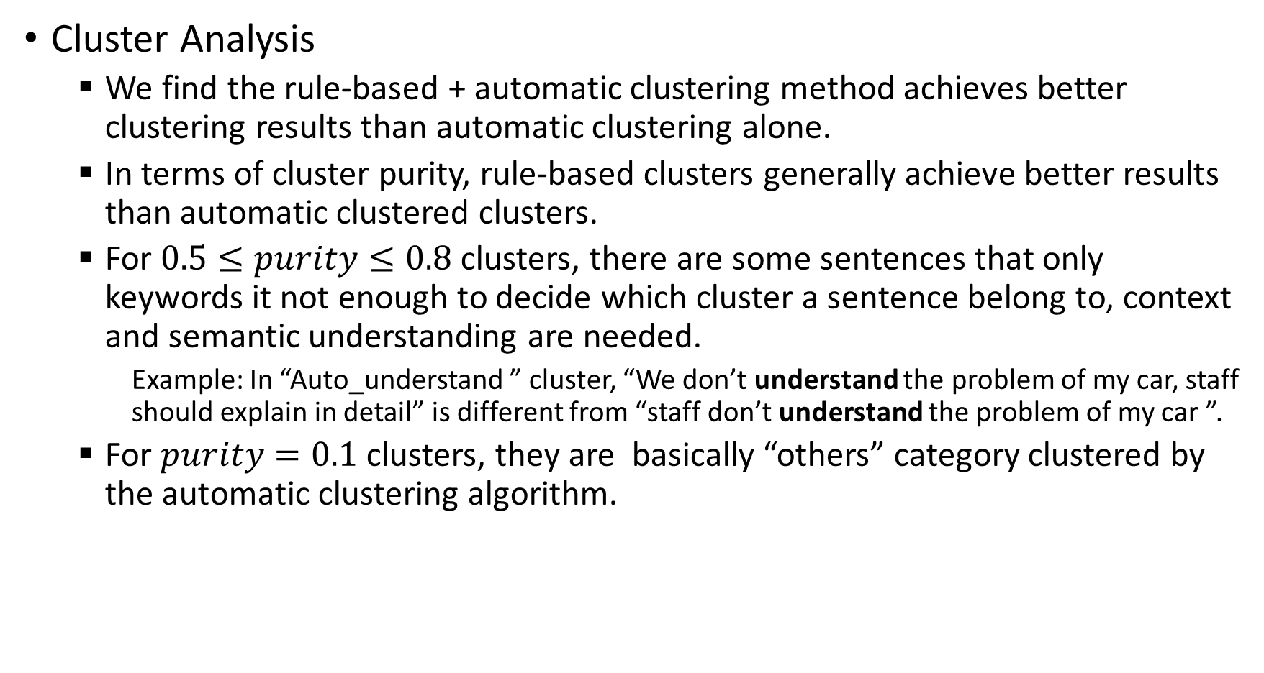
Cluster Analysis
We find the rule-based + automatic clustering method achieves better clustering results than automatic clustering alone.
In terms of cluster purity, rule-based clusters generally achieve better results than automatic clustered clusters.
For $0.5≤purity≤0.8$ clusters, there are some sentences that only keywords it not enough to decide which cluster a sentence belong to, context and semantic understanding are needed.
Example: In “Auto_understand ” cluster, “We don’t understand the problem of my car, staff should explain in detail” is different from “staff don’t understand the problem of my car ”.
For $purity=0.1$ clusters, they are basically “others” category clustered by the automatic clustering algorithm.

Slide 16
Question 4
Question content: Your satisfaction towards the cleanliness of vehicle when you received your vehicle.
Comment ratio: 85.8%
Clustering method:
Rule-based (20 rules) keyword extraction (freq. > 10) on 2213 sentences.
Rationale:
The challenge of this question is the highly frequent words such as ‘cleaning’, ‘washing’ are scattered throughout the comments.
Automated clustering algorithms can hardly separate the sentences by the real sensitive words, e.g., ‘interior’, ‘engine’, ‘glass’, and etc.
Task-specific rules are employed to boost the clustering performance.

Slide 17
Clustering results:
Cluster analysis:
We find the rule-based method achieve good performances in terms of clustering purity.
Cluster name (#) | Cluster aspect | Estimate purity | Cluster name (#) | Cluster aspect | Estimate purity
Charge (65) | Charged but clean improperly | 85% | Interior (262) | Interior clean not properly | 95%
Check (104) | Should check before handover | 95% | Mat (13) | Mat is not clean | 90%
Clean (860) | Should clean properly | 95% | Polish (48) | Should polish the car properly | 100%
Dry (34) | Drying is not proper | 95% | Seat (17) | Seat and surroundings are not clean | 100%
Dust (18) | Dust remains on the car (generally) | 95% | Staff (196) | Increase staff/ staff should work properly | 85%
Engine (22) | Should clean the engine properly | 85% | Stain (28) | Stain remained after cleaning | 100%
Glass (34) | Clean the windows improperly | 100% | Tire (12) | Damage/ not clean the tires | 80%

Slide 18
Question 5
Question content: Your satisfaction towards quality of the work performed on your vehicle .
Clustering method: automatic method (NMF + K-means)
No. Cluster: 10
In this question, the reviews are quite diversified. Some of them belong to general complains and some of them are talking about very specified aspects.
Currently, we use automatic way to do clustering. After manual checking, NMF + k-means is chosed.

Slide 19
Clustering Result (See attached result_5):
Cluster name (#) | Cluster aspect | No of Comment | Cluster name (#) | Cluster aspect | Estimated Cluster Purity
Index 0 | Clean/Wash | 16 | Index 7 | Parts issues | 27
Index 1 | Oil problem | 5 | Index 8 | Quality improvement | 8
Index 2 | Work/explain properly mixed | 272 | Index 9 | alignment | 5
Index 3 | Noise problem | 9
Index 4 | Properly | 5
Index 5 | Time magagement mixed | 81
Index 6 | Provide service with high quality | 10
* mixed indicate low cluster purity and can be treated as “others” cluster.

Slide 20
Question 6
Question content: Your satisfaction towards dealership location.
Clustering method:
Keyword extraction on 3366 sentences, perform rule-based clustering first, then using LSI (Latent Semantic Indexing) and Spectral Clustering to cluster the remaining sentences.
Rationale:
To achieve better performance, some obvious clusters are clustered by rules first.
Other comments not clustered by rules are processed with automatic clustering method.
Experiments shows LSI + Spectral Clustering performs better than other methods on this dataset.

Slide 21
Clustering Result:
Cluster name (#) | Cluster aspect | Estimated Purity | Cluster name (#) | Cluster aspect | Estimated Purity
Bus (40) | Location should near bus stop / | 90% | Auto_inside (70) | Should inside city | 83%
Food (21) | No canteen/food facility | 100% | Auto_city (205) | Far from city / should be in/near city | 87%
Shop (22) | No shops nearby dealership | 69% | Auto_highway (69) | Should near / on highway | 95%
Board (13) | Should have sign board indicating dealership location | 92% | Auto_pick_drop(99) | Should have pick up and drop facility | 93%
Transport (16) | Transportation facility should be available | 94% | Auto_specific_area (237) | Should be in certain location / area / district /city | 77%
Auto_km (189) | Long distance from customer | 97% | Auto_showroom (90) | Should have showroom also | 80%
Auto_road (137) | bad road condition/location/ should be on certain road | 87% | Auto_town (66) | Should near/in town | 87%
Auto_Others (1283) | Should be in certain location / area / district /city | 50%

Slide 22
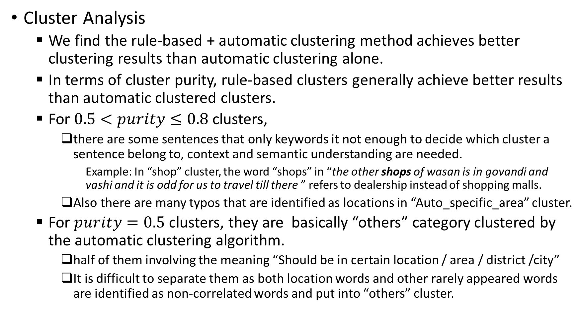
Cluster Analysis
We find the rule-based + automatic clustering method achieves better clustering results than automatic clustering alone.
In terms of cluster purity, rule-based clusters generally achieve better results than automatic clustered clusters.
For $0.5<purity≤0.8$ clusters,
there are some sentences that only keywords it not enough to decide which cluster a sentence belong to, context and semantic understanding are needed.
Example: In “shop” cluster, the word “shops” in “the other shops of wasan is in govandi and vashi and it is odd for us to travel till there ” refers to dealership instead of shopping malls.
Also there are many typos that are identified as locations in “Auto_specific_area” cluster.
For $purity=0.5$ clusters, they are basically “others” category clustered by the automatic clustering algorithm.
half of them involving the meaning “Should be in certain location / area / district /city”
It is difficult to separate them as both location words and other rarely appeared words are identified as non-correlated words and put into “others” cluster.

Slide 23
Question 7
Question content: Your satisfaction towards the waiting area
Comment ratio: 78.4%
To enhance the comment ratio, we can simply increase the keyword freq. threshold, but more clusters will be introduced in return.
Clustering method:
Rule-based (15 rules) keyword extraction (freq. > 5) + “space” sub-aspects division on 879 sentences.
Rationale:
For the largest cluster “space”, we’ve found few sub-aspects in it. Thus, we use NMF-based method to perform automated clustering and obtain 4 sub-aspects.
The other 11 clusters are roughly separable by setting Noun-based rules.

Slide 24
Clustering result:
Cluster analysis:
We find the rule-based method achieve good performances in terms of clustering purity.
We got the smallest purity score on the “space1” cluster, some sentences like “the waiting area should be improved” and “the waiting area is too small” are clustered together. It is because ‘area’ is the only keyword extracted.
Cluster name (#) | Cluster aspect | Estimate Purity | Cluster name (#) | Cluster aspect | Estimate Purity
AC (25) | AC not available/ not using | 100% | Seat (52) | Seats should be arranged properly | 100%
Cleanliness (43) | Waiting area must be clean | 100% | Staff (18) | Staff should be increased/helpful | 100%
Drink (108) | Tea/coffee/water should be provided | 100% | Hour (16) | Waiting time too long | 100%
Driver (18) | Drivers and customers should be divided | 100% | Space1 (211) | Waiting area should be increased | 70%
Food (27) | Food/canteen should be there | 100% | Space2 (12) | Sitting area not good | 100%
Readings (15) | Magazine/newspaper should be provided | 100% | Space3 (14) | Should provide separate areas | 100%
TV (27) | TV should be provided | 100% | Space4 (5) | Waiting area is not comfortable | 100%

Slide 25
Question 8
Question content:
Your satisfaction towards the total time taken to service the vehicle.
Comment ratio: 65.2%
Clustering method:
Rule-based keyword extraction ( 8 pre-processing rules ) on 1978 sentences, each sentence is represented by a most representative keyword. Then perform clustering based on the frequency of the keywords.
Rationale:
The challenge of this problem is that we need both nouns, verbs and adjectives to distinguish each cluster. Hence, keywords extraction before automatic clustering is problematic, resulting in bad clustering results.
Task-specific rules are employed to boost the clustering performance.
Low comment ratio of this question is due to many comments are not informative/reverent. They are filtered out either during rule-based keyword extraction or during frequency-based clustering. For example: “they should do their work quickly.”, “there is no wheel allotment facility , we have to visit the other town for wheels.”, “they should not take too much time for servicing” etc.

Slide 26
Clustering Result:
Cluster name (#) | Cluster aspect | Estimated Purity | Cluster name (#) | Cluster aspect | Estimated Purity
Bill (11) | Billing procedure takes long time | 91% | Inform (48) | Should inform/ communicate with customers properly | 83%
Charges (14) | Charges should be reduced | 85% | Issue (12) | Take long time to resolve small issues | 67%
Clean (6) | Should clean the car properly | 100% | Oil (8) | Take too much time for oil servicing | 88%
Commit (166) | Should complete service within committed time / not on time | 90% | Repair (28) | Take too much time for repairing/fixing the car | 89%
Delivery (239) | Should deliver the car fast and on time | 90% | Spare (9) | Accessories / spare parts should be available | 78%
Distance (21) | Location is far away from customer | 90% | Staff (125) | Should increase stuff/ stuff should do the service properly and fast | 93%
Exact (8) | Should tell customer the exact time for car service . | 88% | Wait (40) | Waste customers time/ wait long time | 97%
Facilities (8) | Should provide all kinds of facilities | 100% | Wash (21) | Take long time to wash the car | 76%

Slide 27
Clustering Result:
We find the rule-based method achieves good performances in terms of clustering purity.
For clusters whose purity lower than 80% (“issue”, “spare” and “wash” ), the main reason is that the keyword may not indicate the meaning of the cluster main topic. They may refer to something else or just appears in the sentence but not important in that sentence.
For example: In “issue” cluster, “0pm would be not issues for us but the timeline of 1” is non-relevant.; In “spare” cluster, “they should have knowledge of the each spare part 's price and they should not take to much time in paperwork”, the sentence doesn’t mean spare parts should be available.
To deal with this problem, more sophisticated rules shall be constructed.

Slide 28
Question 9
Question content: Your satisfaction towards the charges you paid for the last service
Comment ratio: 89%
Clustering method:
Rule-based (13 rules) keyword extraction (freq. > 10) on 956 sentences.
Rationale:
The challenge of this question is the multi-expression and aspect diversity of charge complaint (e.g., ‘charge is high’ and ‘payment should be reduced’, labor and tax charges).
Task-specific rules are employed to boost the clustering performance.
The charge complaints involving labor/tax and other different charges can be firstly wrapped into a generic cluster using rule-based method, and then divided into sub-aspects using automated approach such as NMF or K-means clustering.

Slide 29
Clustering results:
Cluster analysis:
We find the rule-based method achieve good performances in terms of clustering purity.
Cluster name (#) | Cluster aspect | Estimate purity | Cluster name (%) | Cluster aspect | Estimate purity
Charge (1311) | Charge is too high (generally) | 90% | Free (70) | Free services should be truly given | 80%
Labor (342) | Labor charge is too high | 95% | Reasonable (65) | Charges should be reasonable | 95%
Tax (143) | Tax charge is too high | 95% | Extra (53) | Should not take extra charges | 85%
Spare (435) | Spare charge is too high | 95% | Check (39) | Checking too costly/not properly | 100%
Compare (164) | Costly compared to other dealership | 100% | Insurance (28) | Insurance is too high | 95%
Discount (124) | More discounts should be provided | 95%

Slide 30
Question 10
Question content: Your satisfaction towards the follow-up calls made by the dealership post servicing of your vehicle to check your service experience and car condition
Clustering method: automatic method: NMF+K-means
After manual check, it seems that all reviews are talking about the same thing. Therefore, the automatic method: NMF+ K-means is applied. However, some cluster has some meaning.

Slide 31
Clustering Result (See attached result_10):
Cluster name (#) | Cluster aspect | No of Comment | Cluster name (#) | Cluster aspect | Estimated Cluster Purity
Index 0 | Contact on time | 17 | Index 7 | Communicate on parts issues | 7
Index 1 | mixed | 60 | Index 8 | Through text/emails | 5
Index 2 | mixed | 6 | Index 9 | Call on time | 13
Index 3 | Call before check | 14
Index 4 | mixed | 40
Index 5 | Follow up calls should be informative and solve problems | 60
Index 6 | General follow up calls mixed | 190
* mixed indicate low cluster purity and can be treated as “others” cluster.

Slide 32
More on “others” cluster
For pure rule-based method,
Comments in the “others” are either not included in the rules or the words in the comment have low document frequency.
When the “others” keep growing, we may consider construct new rules/modify existing rules based on the relative high frequency words in the “others” cluster.
Another efficient method is to perform automatic clustering on the “others” cluster, and look for the clusters with high purity. If the cluster is same as rule-based clusters, merge them into one cluster; If different, either construct new rules to add new cluster or directly separate this cluster from “others”.
For automatic clustering method,
Low purity clusters include sentences with low similarity /co-relation with sentences in other clusters. This may due to the noise (non-relevant) terms are included in the sentences and influence the similarity between sentences.
We may further filter out noise (non-relevant) terms and perform clustering again to separate new informative clusters from “others” cluster.

