Slide 1
The Battle of the neighborhoods
Battling for the bus in Nantes – a Capstone project

Slide 2
Introduction
Focus: Nantes
  5th biggest French city
  A million tourists per year
  Developing public transports
Problem: Improving traffic through public transport services
Potential client: public bodies

Slide 3
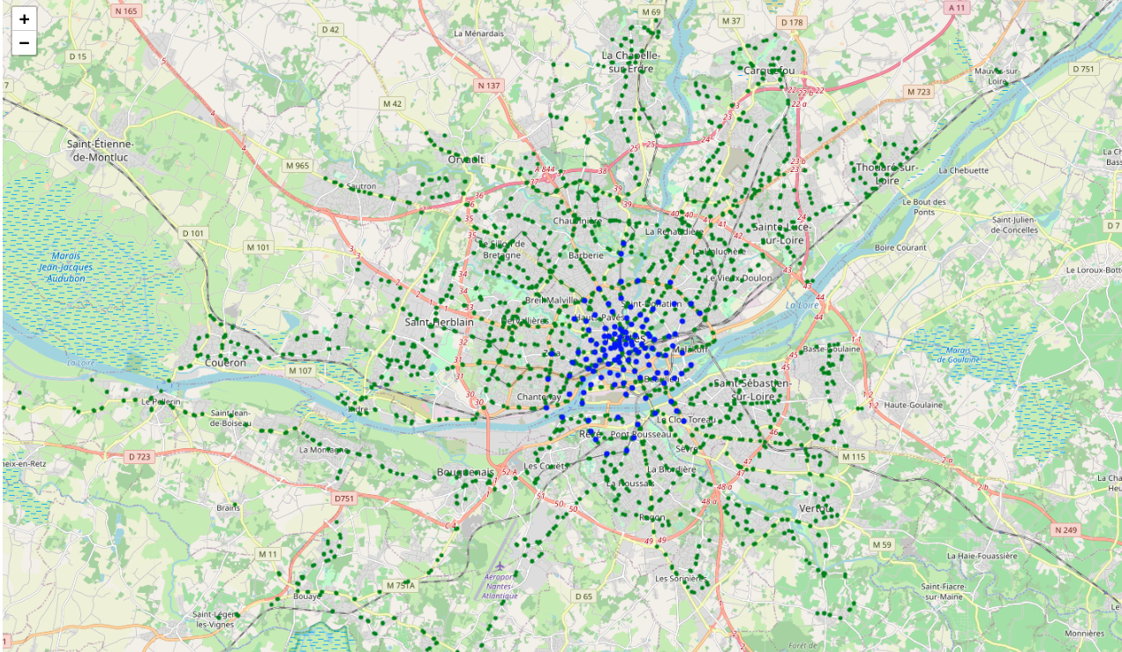
Data sources
Bus and tram stops (green)
Bike stations (blue)

Slide 4
Data sources
Bus and tram stops (green)
Bike stations (blue)

Slide 5
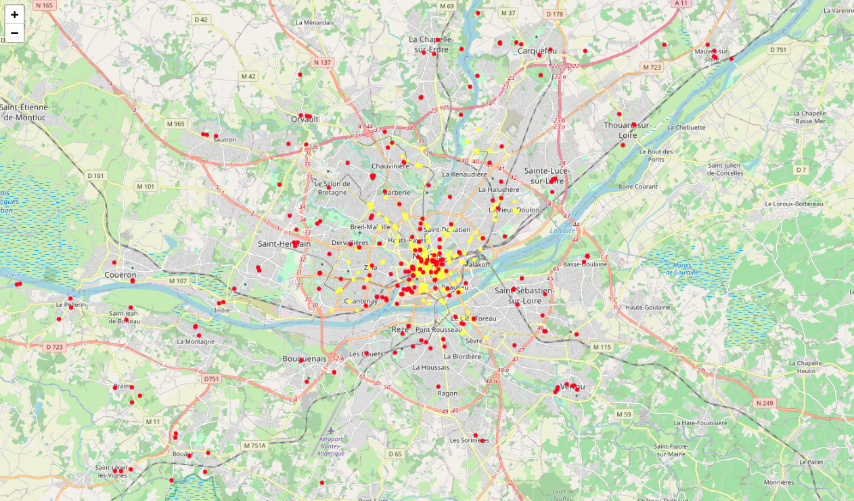
Venues: Foursquare API (yellow) and cultural places & swimming pools (red)

Slide 6
Data cleaning
Dealing with duplicated and missing data
  13 venues missing geolocation
  13 Foursquare duplicate couples
  506 venues after this step
Cleaning boroughs
  Re-assigning boroughs using Point and Polygon from Shapely
  139 venues outside of the boundaries of Nantes
  367 venues after this step

Slide 7
Data preparation
Computing distances
  Using “distance as the crow flies” as proxy
  Geodesic / Haversine distance
  Distance from transports and from city centre
Finding the nearest stop
  Use cKDTree module of SciPy for efficiency
  Distance goes from 3.7m to 398.3m
Creating new overarching categories
  92 categories to 11 categories (deleting transportation venues)
  328 observations left

Slide 8
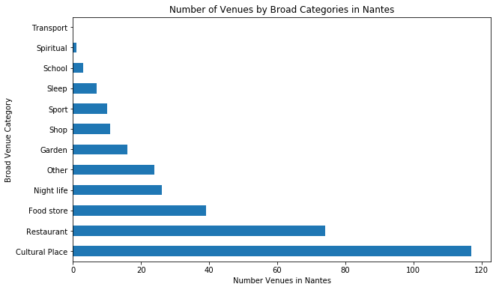
Methodology
Exploratory data analysis

Slide 9
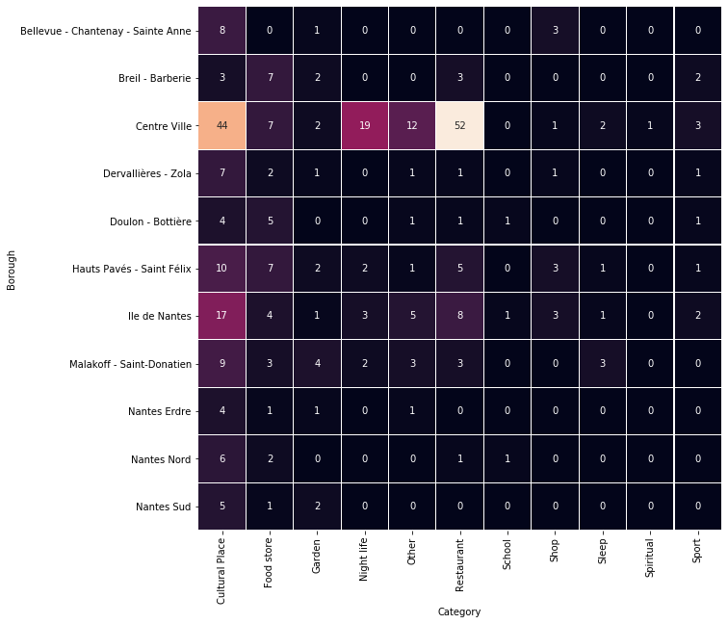
Methodology
Exploratory data analysis

Slide 10
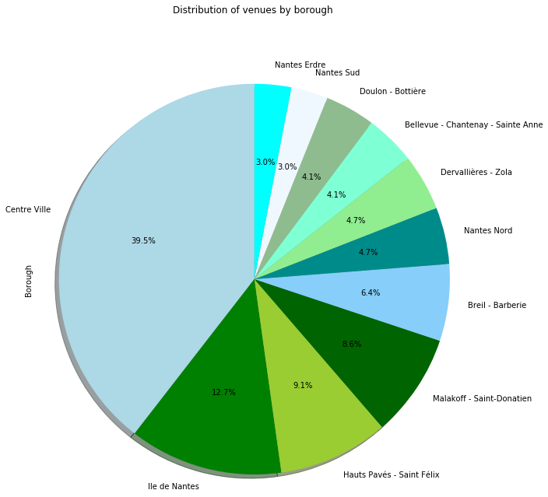
Methodology
Exploratory data analysis

Slide 11
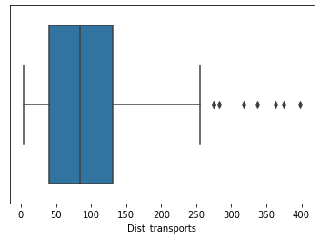
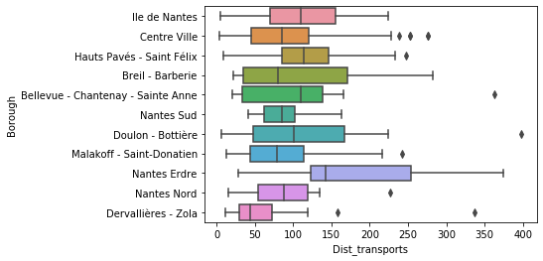
Methodology
Exploratory data analysis

Slide 12
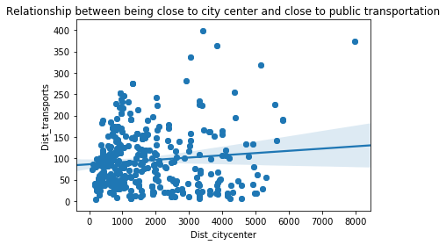
Methodology
Exploratory data analysis

Slide 13
Methodology
Density-based clustering
  Unsupervised learning method
  locating regions of high density in a data space and regions of lower density separating them
  Martin Ester, Hans-Peter Kriegel, Jörg Sander et Xiaowei Xu (1996) algorithm: “density-based spatial clustering of applications with noise” (DBSCAN)
  2 inputs: eps (distance) and MinPts (minimum number of points
  Use distance=Haversine, eps=0.15 (km), MinPts=3

Slide 14
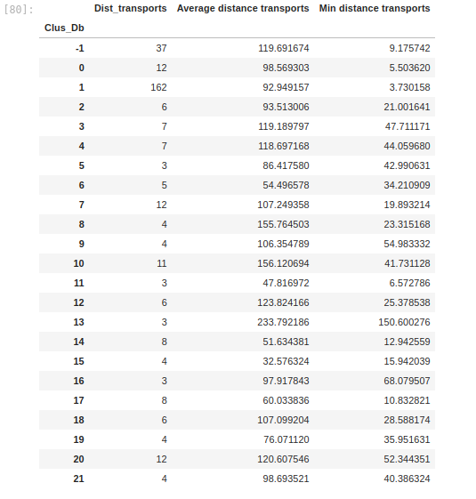
Results
22 clusters:

Slide 15
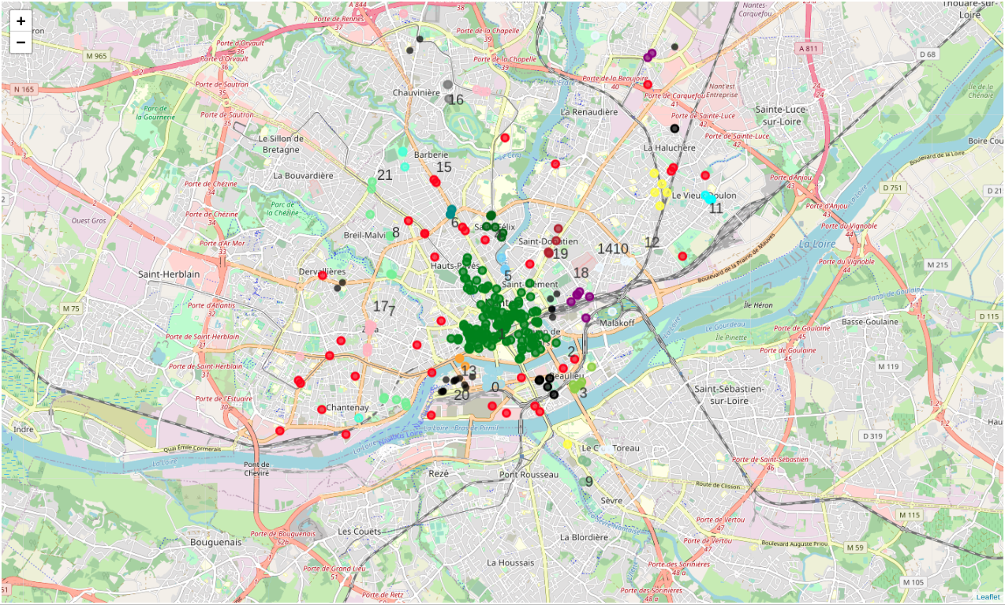
Results
22 clusters:

Slide 16
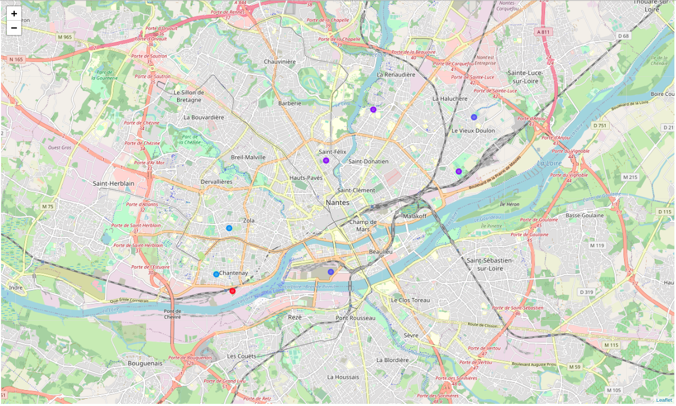
Results
10 isolated venues (far from other venues AND transports:

Slide 17
Discussion
Poorly connected clusters:
  Cluster 13: 3 venues, 234m away from transports on average, 150.6m away minimum
  Cluster 10: 11 venues, 156m away from transports on average
  Cluster 8: 4 venues, 156m away from transports on average

Slide 18
Discussion
10 isolated venues:
  Considered as outliers by DBSCAN (thus in lower density areas)
  Further from transportation than 75% of venues (more than 135m away)
  Costly to access (since cost solely born by one venue)
  Likely to be accessed by car and then generate traffic in other (denser) areas that people visit next

Slide 19
Conclusion
Recommendations:
  Better connect the 3 clusters
  More research into the number and characteristics of visitors for the 10 isolated places
  NB: This project is the final assignment of the “Applied Data Science Capstone” and IBM Data Science Professional Certificate. There are many caveats to this study and bias in the data, the sole purpose of this study was to use data and methods discovered during the lessons.

Slide 20
Q&A?

