Slide 1
ClojureBridge

Slide 2
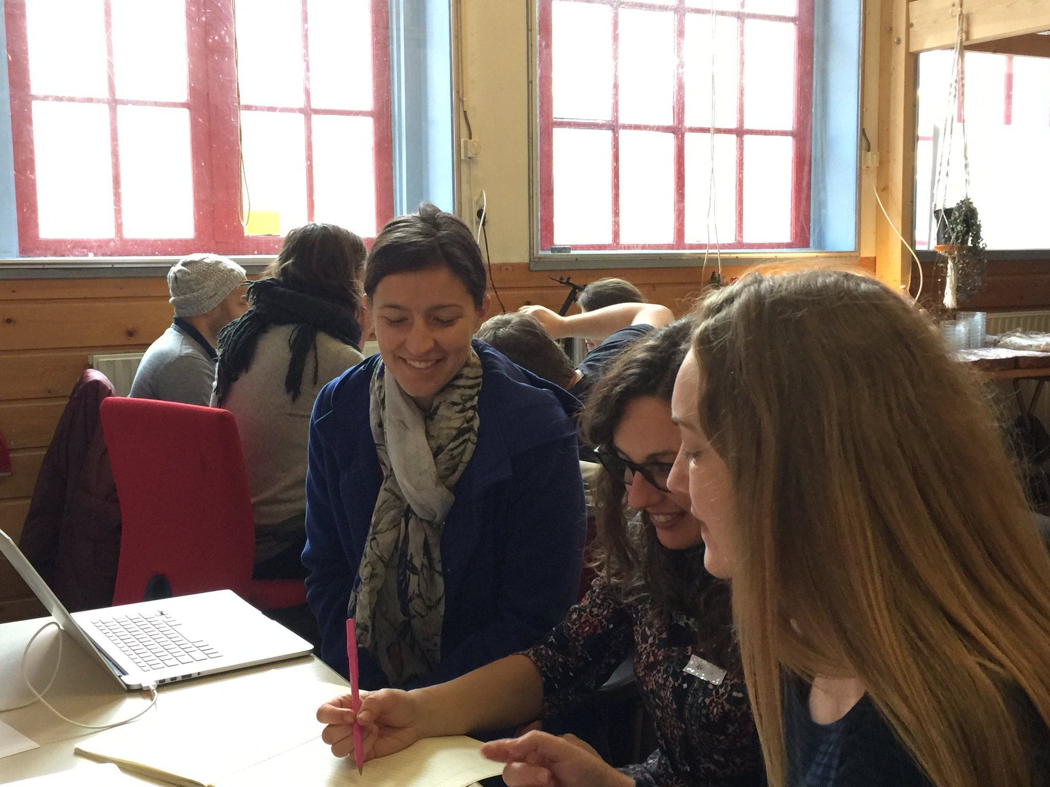
Coding is Fun!

