Slide 1
SQLite: Local database on Android
SEG2105 - Introduction to Software Engineering – Fall 2026
Lab Exercise – SQLite Product Manager

Slide 2
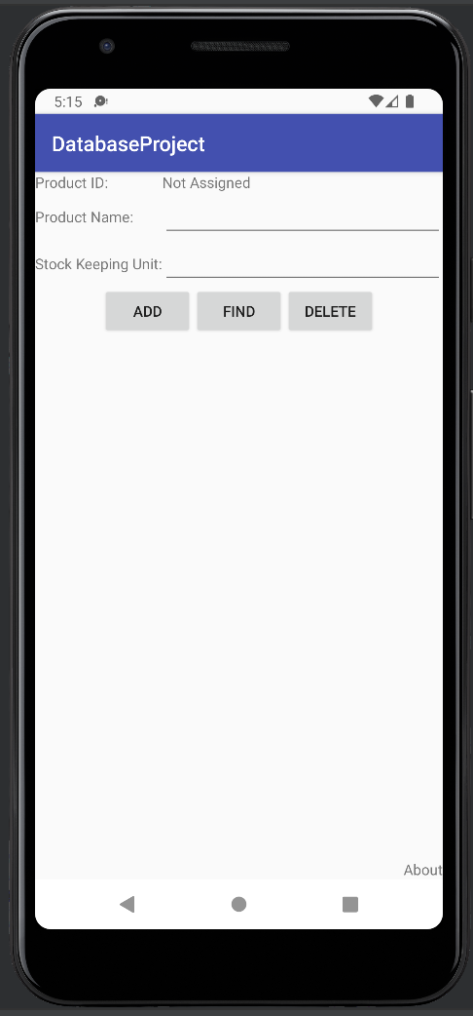
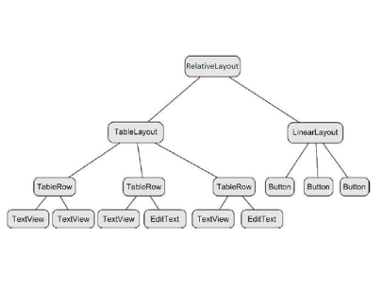
User Interface

Slide 3
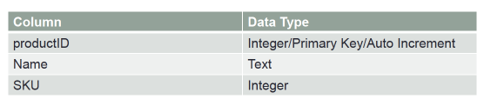
Product Table

Slide 4
Import the Project
Import the project in Android Studio: Click File > New > Import Project.
Implement the code by following the steps to add, read and delete from the database.

Slide 5
First Steps
Create a class that extends SQliteOpenHelper to perform the following operations in Sqlite
Insert
Read
Delete
public class MyDBHandler extends SQLiteOpenHelper {}

Slide 6
Libraries to be Imported
import android.content.Context; import android.content.ContentValues; import android.database.Cursor; import android.database.sqlite.SQLiteDatabase; import android.database.sqlite.SQLiteOpenHelper;

Slide 7
Define the Schema
public class MyDBHandler extends SQLiteOpenHelper { private static final int DATABASE_VERSION = 1; private static final String DATABASE_NAME = "productDB.db"; public static final String TABLE_PRODUCTS = "products"; public static final String COLUMN_ID = "_id"; public static final String COLUMN_PRODUCTNAME = "productname"; public static final String COLUMN_SKU = "SKU"; }

Slide 8
MyDBHandler constructor must call the super class constructor
public MyDBHandler(Context context) { super(context, DATABASE_NAME, null, DATABASE_VERSION); }

Slide 9
Override onCreate() method to create the table
@Override public void onCreate(SQLiteDatabase db) { String CREATE_PRODUCTS_TABLE = "CREATE TABLE " + TABLE_PRODUCTS + "(" + COLUMN_ID + " INTEGER PRIMARY KEY," + COLUMN_PRODUCTNAME + " TEXT," + COLUMN_SKU + " INTEGER" + ")"; db.execSQL(CREATE_PRODUCTS_TABLE); }

Slide 10
Override onUpgrade() method to drop old tables and create new ones
@Override public void onUpgrade(SQLiteDatabase db, int oldVersion, int newVersion) { db.execSQL("DROP TABLE IF EXISTS " + TABLE_PRODUCTS); onCreate(db); }

Slide 11
Inserting into Database
Create a method to add to a database
public void addProduct(Product product){}
Get the data repository in write mode
SQLiteDatabase db = this.getWritableDatabase();
Creating a new map of values, where column names are the keys
ContentValues values = new ContentValues(); values.put(COLUMN_PRODUCTNAME, product.getProductName()); values.put(COLUMN_SKU, product.getSku());
Insert
db.insert(TABLE_PRODUCTS, null, values);
Close
db.close();

Slide 12
Reading from a Database
Create a method to read from a database
public Product findProduct(String productName) {}
Getting reference to readable database
SQLiteDatabase db = this.getReadableDatabase();
Run your query
String query = "Select * FROM " + TABLE_PRODUCTS + " WHERE " + COLUMN_PRODUCTNAME + " = \"" +productName +"\""; Cursor cursor = db.rawQuery(query, null);
Create object and then to get results
Product product = new Product(); if (cursor.moveToFirst()) { product.setID(Integer.parseInt(cursor.getString(0))); product.setProductName(cursor.getString(1)); product.setSku(Integer.parseInt(cursor.getString(2))); } else { product = null; } db.close(); return product;

Slide 13
Deleting Info from the database
Create a method to delete information from the database
public boolean deleteProduct(String productname) {}
Declare
boolean result = false;
Getting reference to writable database
SQLiteDatabase db = this.getWritableDatabase();
Run your query and delete
String query = "Select * FROM " + TABLE_PRODUCTS + " WHERE " + COLUMN_PRODUCTNAME + " = \"" + productname + "\""; Cursor cursor = db.rawQuery(query, null); if (cursor.moveToFirst()) { String idStr = cursor.getString(0); db.delete(TABLE_PRODUCTS, COLUMN_ID + " = " + idStr, null); cursor.close(); result = true; } db.close(); return result;

Slide 14
Final Steps
Call addProduct in Main in the method newProduct to finish adding to the database
Call findProduct in Main in the method lookupProduct to read from the database
Call removeProduct in Main in the method deleteProduct to delete from the database
MyDBHandler dbHandler = new MyDBHandler(this); dbHandler.addProduct(product);
MyDBHandler dbHandler = new MyDBHandler(this); Product product = dbHandler.findProduct(productBox.getText().toString());
MyDBHandler dbHandler = new MyDBHandler(this); boolean result = dbHandler.deleteProduct(productBox.getText().toString());

Slide 15
Lab Demo
Add & Lookup a Product
Enter a product name (e.g. "Laptop") in the Product Name field and a SKU (e.g. 1001) in the SKU field
Press ADD — newProduct() creates a Product object and calls dbHandler.addProduct()
Clear the SKU field, leave the name as-is
Press FIND — lookupProduct() queries by name and populates both the Product ID and SKU fields from the database
To answer: Why does the ID field now show a number? Where did it come from?
Lookup a Non-Existent Product
Type a name that was never added (e.g. "Ghost")
Press FIND
The Product ID field shows "No Match Found”
Delete a Product
First add a product ("Keyboard", SKU 2002) via ADD
Type "Keyboard" in the Product Name field
Press DELETE — Product ID shows "Record Deleted" and both fields clear
Now press FIND for "Keyboard" again — shows "No Match Found"

Slide 16
THANK YOU!

