Slide 1
SEG2105 – Lab 6
Spring/Summer 2026

Slide 2
Create the application
Download the lab6.zip on Brightspace
The lab uses a small Java app with a single Login screen:
Username field (R.id.edtUsername)
Password field (R.id.edtPassword)
Login button (R.id.btnLogin)
A validate(username, password) method that returns a result message

Slide 3
Two kinds of Android tests
Local unit tests
Instrumented tests
src/test/ · run on your computer's JVM · milliseconds
src/androidTest/ · run on a device/emulator · seconds
No device or emulator
Best for pure logic (e.g. validate())
JUnit 4 + Mockito
Robolectric when you need the Android framework
Exercises the real UI + Android framework
Espresso (in-app UI), UI Automator (system UI)
AndroidX Test libraries
Runner: AndroidJUnitRunner
Rule of thumb (the test pyramid): test logic locally because it is fast and cheap; reserve device tests for UI and integration. This lab writes one of each.

Slide 4
Exercise
Write a JUnit test case that validate the name, lastname and password
Write a espresso test case where we will validate the when the User types invalid name, textview should contain the text "Name is invalid”
Write a espresso test case where we will validate the when the User types invalid last name, textview should contain the text "Last name is invalid

Slide 5
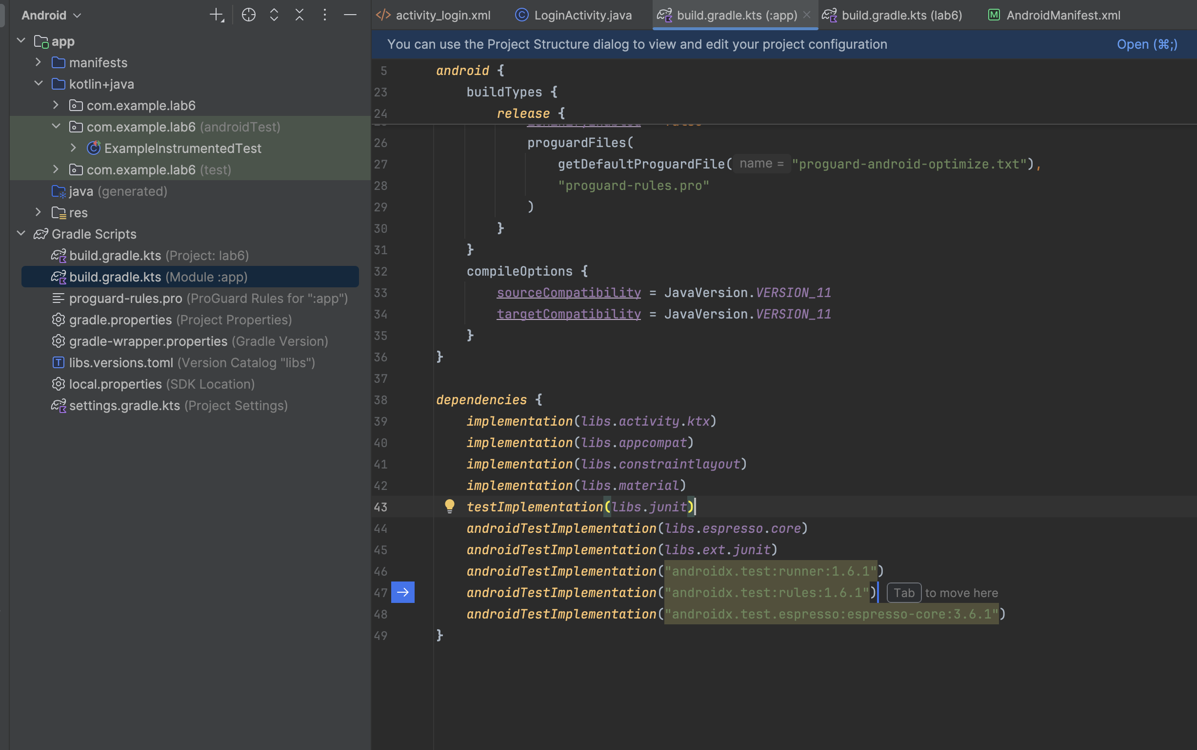
Once the app builds, add the dependencies

Slide 6
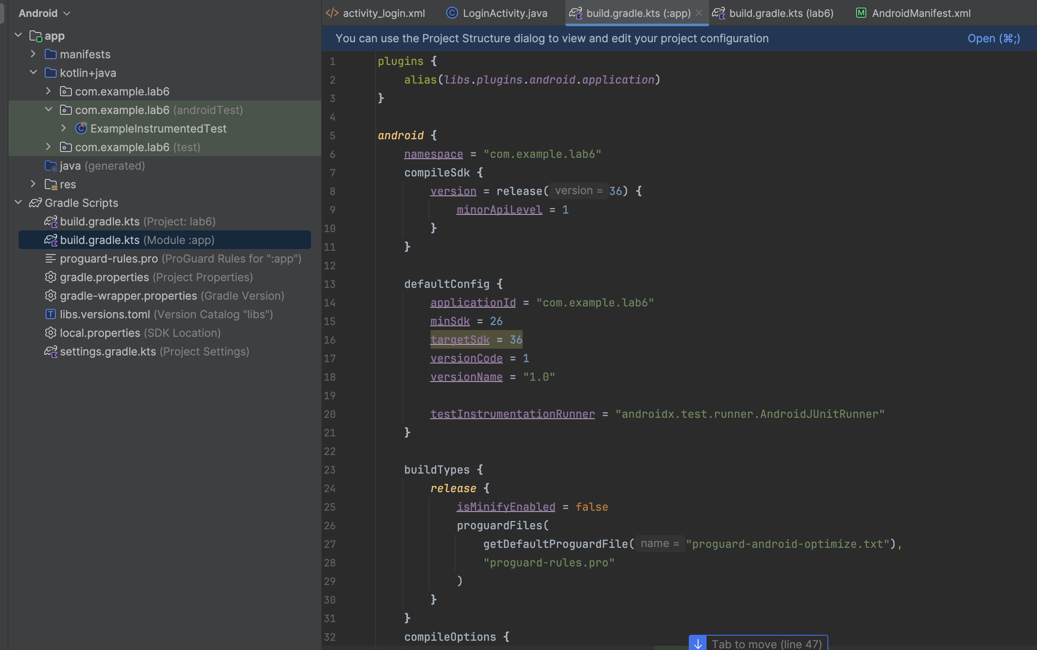
Set the instrumentation runner

Slide 7
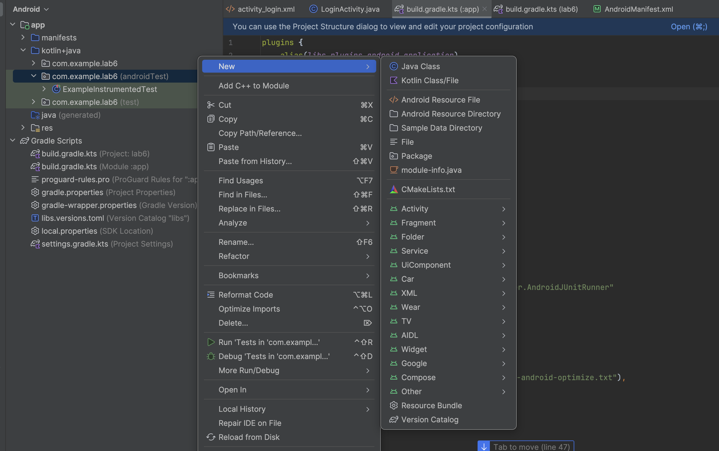
Add the test class under androidTest
Right click on androidTest and create a new Java class

Slide 8
JUnit test case for user first name sample
public class LoginActivityTest { @Rule public ActivityScenarioRule<LoginActivity> loginActivityTestRule = new ActivityScenarioRule<LoginActivity>(LoginActivity.class); private LoginActivity loginActivity = null; private TextView text; @Before public void setUp() throws Exception { loginActivityTestRule.getScenario().onActivity(activity -> { loginActivity = activity; }); } @Test @UiThreadTest public void checkFirstName() throws Exception { assertNotNull(loginActivity.findViewById(R.id.edtUsername)); text = loginActivity.findViewById(R.id.edtUsername); text.setText("user1"); String name = text.getText().toString(); assertNotEquals("user", name); } }

Slide 9
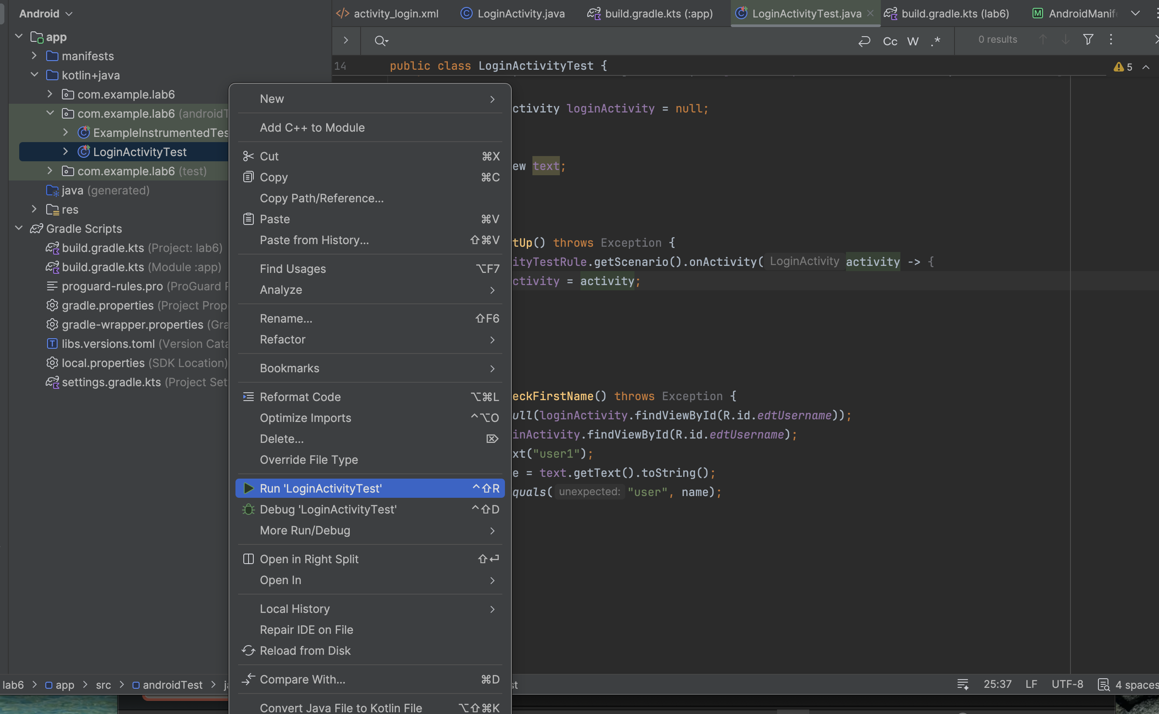
Run the unit test case
Right click on androidTest and run

Slide 10
Add another test class for Espresso UI test
For example, to validate correct error message on UI when wrong email is entered.
public class LoginActivityTest2 { @Rule public ActivityScenarioRule<LoginActivity> loginActivityScenarioRule = new ActivityScenarioRule<>(LoginActivity.class); @Test public void loginIsInvalid() { onView(withId(R.id.edtUsername)).perform(typeText("user")); onView(withId(R.id.edtPassword)).perform(typeText("test")); closeSoftKeyboard(); onView(withId(R.id.btnLogin)).perform(click()); onView(withId(R.id.loginTxt)) .check(matches(withText("Invalid login!"))) .check(matches(isDisplayed())); } }

Slide 11
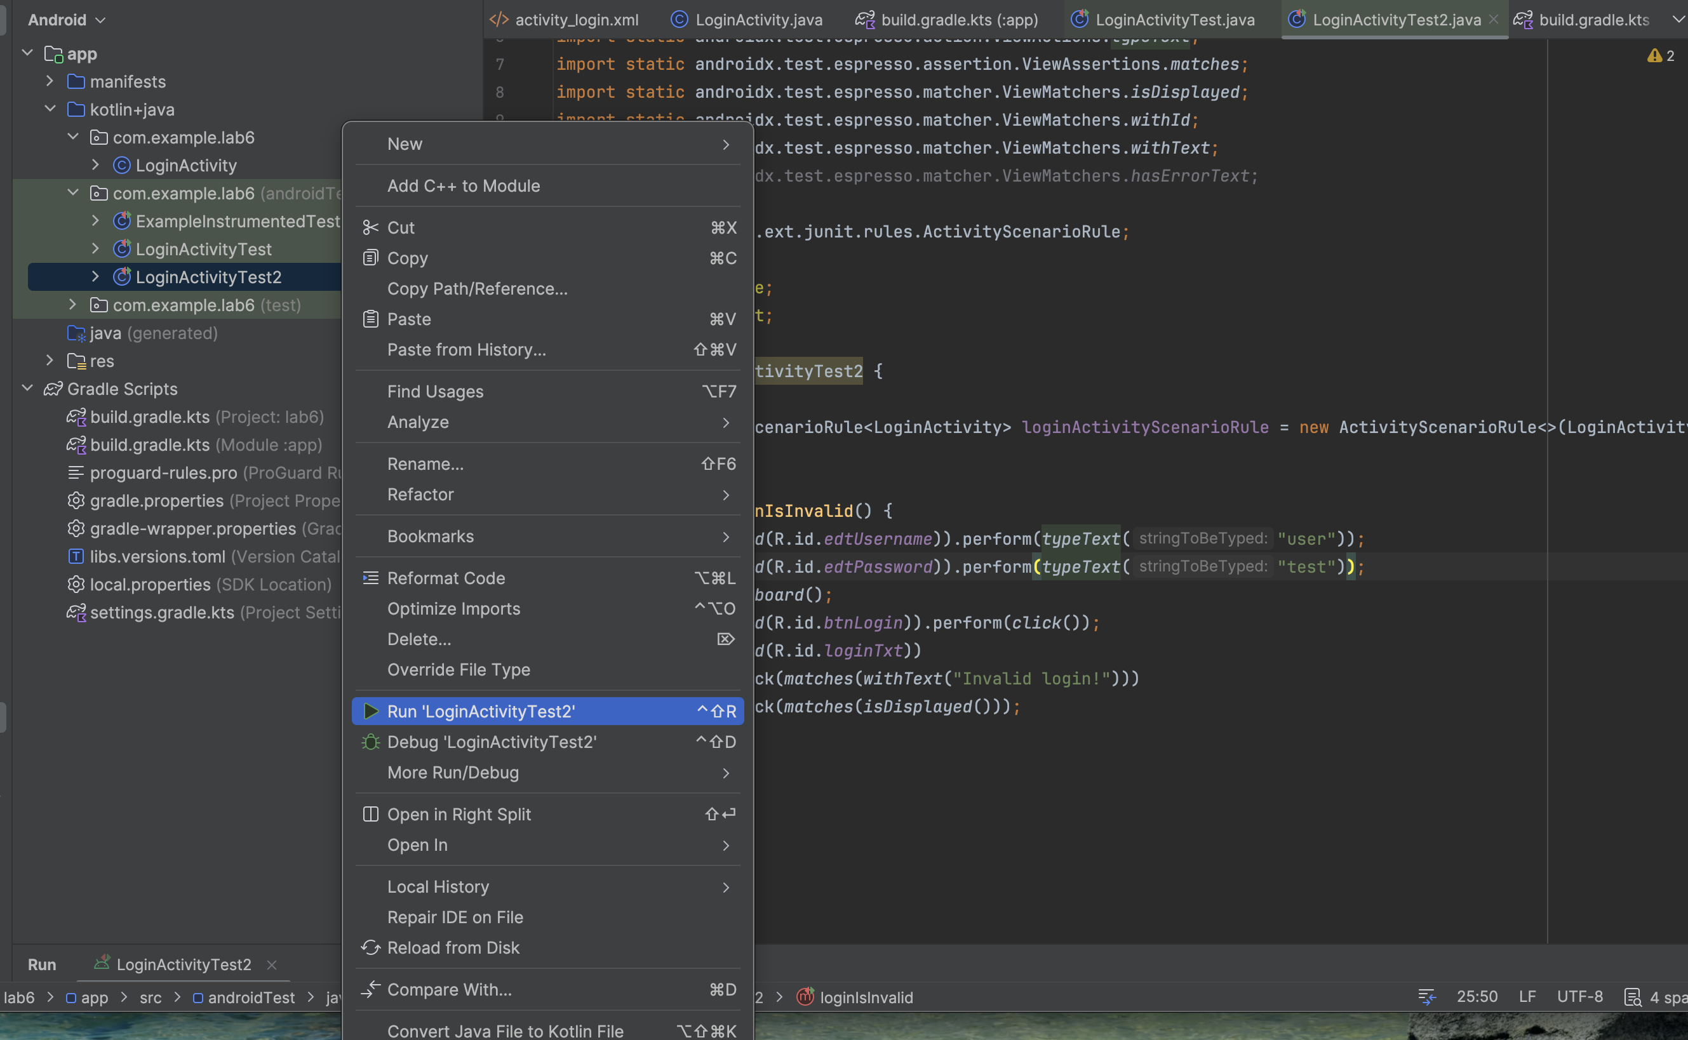
Run the test
Once the test class is created, right click on the androidTest and run.

Slide 12
Thank you!

