Slide 1

</
CloseSpan
>
AI-ASSISTED FEEDBACK-TO-FIX OPERATIONS
Turn fragmented customer complaints into governed, evidence-backed product fixes.
A shared operating layer for Support Ops, Product Ops, and Engineering.
PRIVATE-BETA PRODUCT OVERVIEW
closespan.com
Design-partner conversation • July 2026

Slide 2
THE OPERATING GAP
02
The customer context disappears before engineering can act
Support, product, and engineering each hold only part of the story. The handoff loses the evidence needed to make a confident decision.
TODAY
WHAT OPERATORS NEED
The report becomes a relay race
One decision record, not another inbox
1
A ticket is copied into chat or a planning board.
1
Original customer evidence stays linked and reviewable.
2
Account, revenue, and recurrence context drops away.
2
Related signals become one canonical problem.
3
Duplicates compete as separate product requests.
3
Impact includes customer, account, and severity context.
4
A shipped change is rarely tied back to the customer.
4
Approval, outcome, and follow-up stay attached.
CLOSESPAN • PRIVATE BETA
02

Slide 3
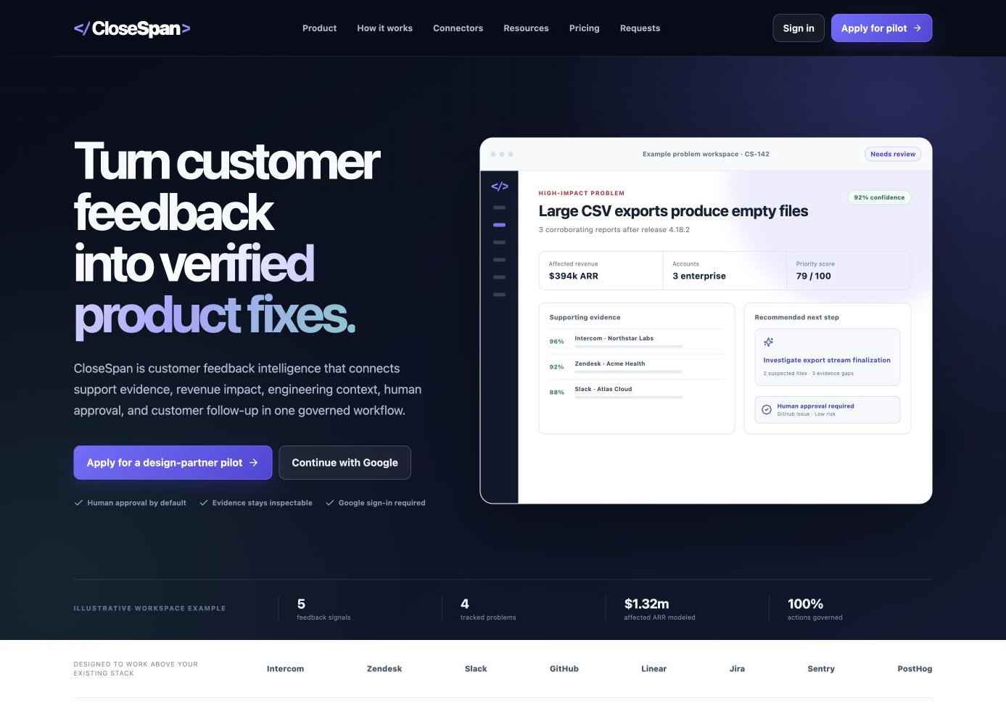
THE PRODUCT
03
One evidence chain from signal to outcome
CloseSpan connects support evidence, product impact, engineering context, human approval, and customer follow-up without replacing the systems teams already use.
One workspace answers four questions
1
What are customers actually reporting?
2
Which problem is worth solving now?
3
What evidence should engineering receive?
4
Did the fix resolve the customer issue?
Illustrative workspace with sample data. Not customer results.
CLOSESPAN • PRIVATE BETA
03

Slide 4
WORKFLOW
04
The operating loop has three accountable decisions
Automation prepares the evidence. People own prioritization, action, and release confidence.
01
02
03
SEE
DECIDE
CLOSE
Listen + cluster
Rank + investigate
Approve + verify
Ingest reports, preserve source links, and propose recurring problem clusters with confidence.
Combine customer impact, recurrence, severity, and technical context into a reviewable brief.
Approve the next action, attach release evidence, and follow up with affected customers.
CLOSESPAN • PRIVATE BETA
04

Slide 5
EVIDENCE CHAIN
05
Every problem becomes a persistent, correctable record
The model can propose a structure. The organization keeps a durable record that people can review and correct.
01
Original report
02
Customer + account
03
Problem cluster
04
Impact score
Raw message, source, timestamp, and evidence link.
Requester, company, segment, and commercial context.
A canonical issue that related reports can join.
Frequency, severity, customer reach, and confidence.
05
Technical hypothesis
06
Approval decision
07
Release evidence
08
Follow-up status
Likely surface, ownership, and uncertainty.
Who approved, rejected, or redirected the work.
Issue, pull request, deployment, or verification note.
Who needs an update and whether the loop is closed.
CLOSESPAN • PRIVATE BETA
05

Slide 6
TEAM VALUE
06
One workspace aligns the teams that own the outcome
Each role keeps its domain expertise while sharing the same problem record.
SUPPORT OPERATIONS
PRODUCT OPERATIONS
ENGINEERING
Preserve the voice
Govern the decision
Receive usable evidence
WHAT THEY SEE
WHAT THEY SEE
WHAT THEY SEE
Original reports, repeat complaints, customer details, and source quality.
Problem clusters, reach, account impact, severity, and confidence.
Reproduction details, linked reports, ownership hints, and uncertainty.
WHAT CHANGES
WHAT CHANGES
WHAT CHANGES
Stops rebuilding the same context for every escalation.
Turns anecdotes into a transparent prioritization record.
Starts from an evidence-backed brief instead of a forwarded ticket.
CLOSESPAN • PRIVATE BETA
06

Slide 7
GOVERNED INTELLIGENCE
07
AI prepares the work. Managers keep the authority.
Model output stays a proposal until a person reviews the evidence and chooses the next action.
✓
✓
✓
EVIDENCE VISIBLE
SCOPE VISIBLE
DECISION VISIBLE
Sources, confidence, and assumptions remain attached to the recommendation.
The UI states which systems, data, and permissions an action would use.
Approve, reject, or redirect before an external action can leave CloseSpan.
THE MANAGER DECIDES
The system records who decided, what evidence they saw, and what happened next.
Approve • Reject • Redirect
CLOSESPAN • PRIVATE BETA
07

Slide 8
ARCHITECTURE
08
Built above the stack, with durable state in PostgreSQL
CloseSpan separates authorization, import, intelligence, synchronization, and external action so teams can see what is truly live.
01
02
03
04
Feedback + auth
Structured intelligence
Durable source of truth
Engineering handoff
Pipedream-hosted authorization. Signed webhook and bounded Zendesk pull can ingest now.
Model output is parsed, redacted, and saved as reviewable proposals.
Organization-scoped PostgreSQL stores problems, decisions, and audit events.
Approval-ready briefs today. Live provider writes are a planned production gate.
STATE MODEL
Connected ≠ imported ≠ synchronized ≠ authorized to write
Capability labels stay explicit.
CLOSESPAN • PRIVATE BETA
08

Slide 9
DESIGN-PARTNER OFFER
09
Start with one recurring defect and prove the workflow
The pilot is designed to test the operating model before either side assumes a broad production rollout.
EVALUATION
DESIGN-PARTNER PILOT
SCALE PATH
$0
$1,500
Custom
Seeded workspace
Six weeks, one real workflow
Validated requirements
Explore the operating model with sample evidence and no customer data.
Validate one recurring defect from source evidence through review and a verified outcome.
Define connector, security, governance, and workflow needs before a broader rollout.
Fit check
Recommended starting point
After pilot evidence
CLOSESPAN • PRIVATE BETA
09

Slide 10
MATURITY AND ROADMAP
10
Private beta is intentionally narrow
The product demonstrates the operating model today. The remaining work is production hardening, not a hidden claim of autonomy.
CURRENT CAPABILITY
NEXT PRODUCTION GATES
Working private-beta foundation
Required before broader rollout
✓
PostgreSQL-backed workspace and durable records
1
Continuous connector workers and recovery paths
✓
Google identity and organization-aware application logic
2
Repository and release ingestion for technical verification
✓
Governed AI review with explicit confidence and assumptions
3
Approval-bound provider writes for issues and pull requests
✓
Pipedream authorization, webhook ingestion, and Zendesk manual pull
4
Row-level isolation, retention, deletion, and audit hardening
CLOSESPAN • PRIVATE BETA
10

Slide 11
</
CloseSpan
>
Let one customer problem prove the operating model.
Bring the recurring defect that keeps crossing teams. CloseSpan will help turn it into a reviewed evidence chain, an approved action, and a verifiable outcome.
DISCUSS A DESIGN-PARTNER PILOT
closespan.com
shanmukhsain@gmail.com

