Slide 1


Machine Learning Hackathon
Team Name – Vishwa Clusters
Team Leader Name – Omkar Jadhav
Team Leader Email Address - rajesh.omkar211@vit.edu

Slide 2
Brief Description of the Problem at hand:
The problem at hand is to develop a robust model that can accurately classify whether a user, based on their behavior and other features extracted from ad server logs, belongs to the category of Healthcare Professionals (HCPs) and predict their specialization (taxonomy). The ad server logs contain valuable information such as browser details, IP addresses, geographic locations, search patterns, site URLs, and other relevant data.
Addressing this problem requires a combination of data preprocessing, feature engineering, model selection, training, and validation. Additionally, it may involve creating a labeled dataset for training the model, either through explicit indications of HCP status in the ad server logs or by using external data sources and manual labeling.

Slide 3
Solution proposed and description:
The proposed solution uses a Random Forest classifier for a binary classification problem. The Random Forest classifier is created with a specified number of estimators (200) and a random state of 42 for reproducibility.
The classifier is trained on the training data (X_train and y_train) using the fit() method.
The feature importances are calculated using the feature_importances_ attribute of the trained Random Forest classifier.
The mean importance of all features is calculated.
Based on the importance threshold, the features with importances greater than or equal to the mean importance are selected.
The training and testing datasets are filtered by selecting only the columns (features) that are present in the selected features.
Another Random Forest classifier. Is trained on filtered training data.
Finally, predictions are made on the test set using the trained classifier.

Slide 4
Approach:
1. Data Preprocessing:
Extract relevant features from the ad server logs, including DEVICETYPE, PLATFORM_ID, PLATFORMTYPE, USERCITY, URL, KEYWORDS, and IS_HCP.
Drop irrelevant columns such as ID, BIDREQUESTIP, USERPLATFORMUID, USERZIPCODE, USERAGENT, CHANNELTYPE, and TAXONOMY.
2. Feature Engineering:
Applied label encoding string type columns.
Applied MultiLabelBinarizer to KEYWORDS.
Applied Model
Extracting relevant columns
Handle missing values in numeric columns by filling them with 0 and fill missing values in object columns with empty strings.
Render Forest on fine tuned X_train
Preprocessing URL column, to extract names of website.
Render Forest

Slide 5
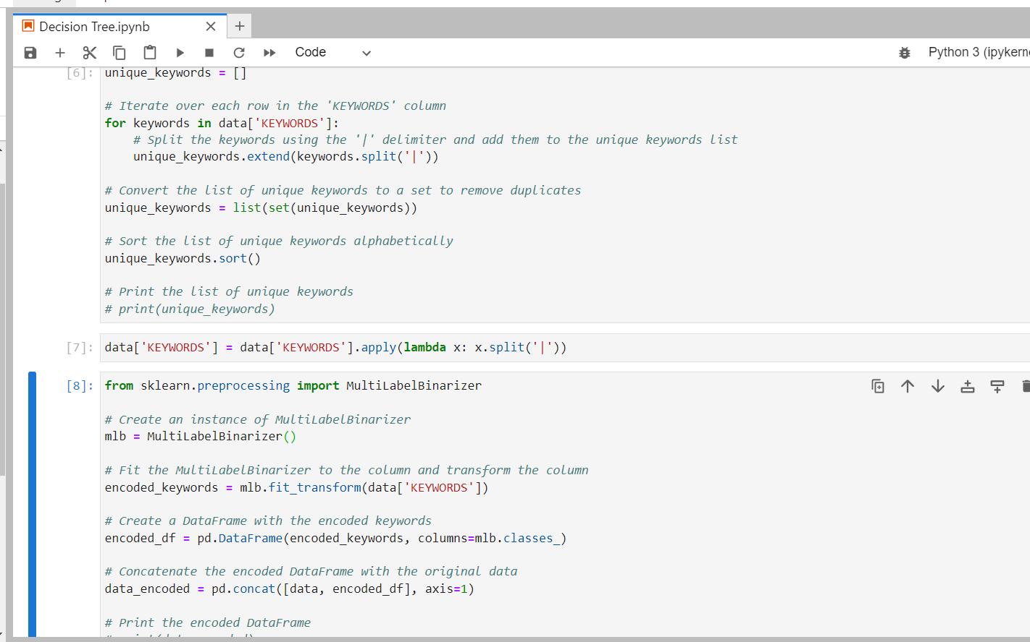
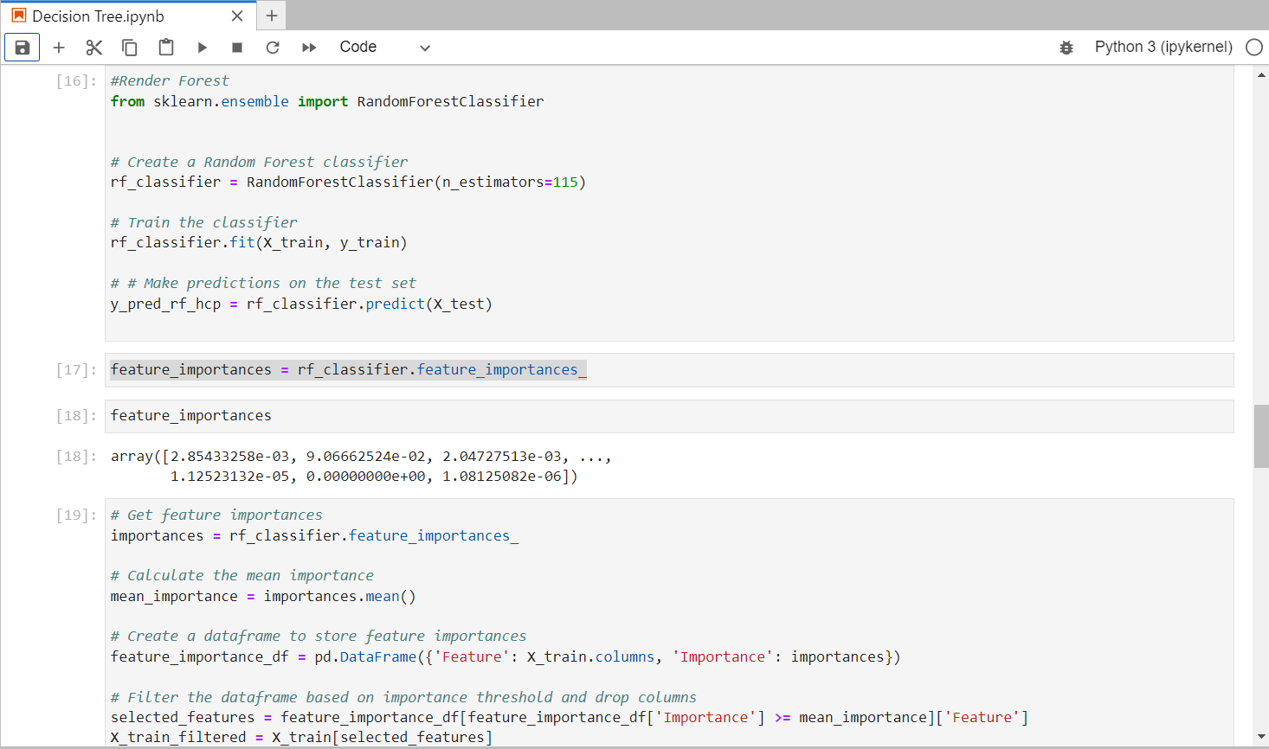
Execution Demo (Video/ Screenshots) of the solution:

Slide 6
Source code in ZIP file/Github URL:
ClosedAi in Docree ml Hackathon

Slide 7
THANK YOU!

