Slide 1


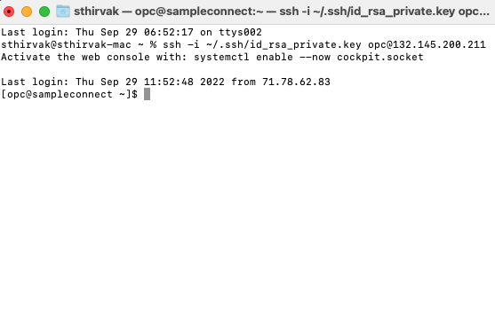

Notional Architecture
Private subnet
Developer
Visual Builder Studio
Autonomous Transaction Processing
Run Shell Script
Identity and access management
Instant Client
(SQLPlus)
Public subnet
Public subnet
Approver
Compute
Build Executor

