Slide 1
Day Two production ops
Michael Levan

Slide 2
AGENDA
Introduction​
Quick PowerPoint for best practices
Demo with best practices and Day Two Ops

Slide 3
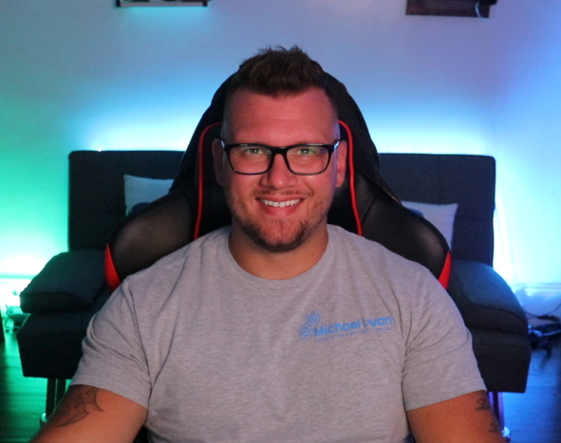
Introduction
Michael Levan – Published Author, Consultant, International Public Speaker, and Kubernetes Engineer

Slide 4
Liveness and readiness probes
Liveness Probes
Determines if a Pod is healthy
Determines if a Pod is running as expected
Kubelet uses the livenessProbe to know when it should restart a container inside of a Pod
Readiness Probes
Determine if a Pod should receive a request
Kubelet uses a readinessProbe to know when it should start accepting traffic

Slide 5
Namespaces
Segregate resources (not for security, just for organization)

Slide 6
Autoscaling
Scale your infrastructure and your apps
3-5 worker nodes
Ensure min and max counts for replicasets
Quotas, Limits, and Requests

Slide 7
API’s Used
Ensure your Kubernetes versions are up to date
Keep track of Beta and Alpha APIs for k8s resources

Slide 8
Security
- Proper RBAC
- CIS Benchmarks
- Scanning (cluster and container image)
- Secrets
- Authentication

Slide 9
Monitoring & observability
Control Planes and Worker Nodes
- Monitoring and observability for apps are just as important as the cluster itself

Slide 10
Proper networking
Pod networking
Cluster networking
Encrypted traffic (service mesh or security-centric CNI)

Slide 11
Make the process repeatable
Automate the process of creating clusters (Terraform for example)
Automate the process of deployments (GitOps is the current standard)

Slide 12
Testing
Policy enforcement (OPA, Kyverno)
Cluster scanning
Container image scanning
Manifest scanning

Slide 13
Backup and storing data
Backups are still important even for managed k8s services
Ensure that volumes are backed up and in a proper location

