Slide 1

IssueOps
Continuous AI for GitHub Issues.
“We already burn countless unpaid hours triaging issues and dealing with duplicates instead of writing code.”
— Mike McQuaid, Lead Maintainer of Homebrew
Team: VaaS
DS 252 : Introduction to Cloud Computing
September 13, 2025

Slide 2
Developer productivity is being drained by GitHub Issues.
The Problem
7.3 hours lost per week
per developer to triage, duplicates, and notifications
3+ day delays
before issues are even categorized or routed
59% of maintainers
consider quitting due to burnout and overhead

Slide 3
Market Research & Strategic Opportunity
Market Opportunity
150M+ developers on GitHub
420M+ repositories hosted
$37.45B automation market by 2030
$21.6M TAM (GitHub-specific)
9.52% CAGR growth rate
Revenue Potential
Team Subscriptions:
$14.4M/year
Individual Freemium:
$6.0M/year
Enterprise Plans: $1.2M/year
Total TAM: $21.6M annually
Competitive Gaps
GitHub Projects: Limited AI
Linear: Poor GitHub integration
Actions: Requires expertise

Slide 4
Our Solution
IssueOps: An AI-powered platform that automates the GitHub issue lifecycle using the following agent pipeline:
Intake → Triage → Assignment → Notification
Our Core Ideas:
  Connected Workflow: Keeps track of each issue as it moves from one agent to the next.
  Smart Triage: Mixes the power of large AI models with our own simple rules to make better decisions.
  Elastic Scaling: Built with Docker and Kubernetes so it can automatically handle any number of incoming issues.
Key Value Proposition:
Cut issue triage time from over 2 days to under 4 hours.
Reduce developer notification noise by more than 60%.

Slide 5
Intake Agent
Intake Agent
The Intake Agent is the first gatekeeper. It cleans, organizes, and enriches every incoming issue so only actionable work reaches developers.
Key functions
Spam Shield: Blocks bots, junk, and irrelevant noise before it clutters the repo.
Duplicate Finder: Detects similar issues and links them into one clear thread.
Stale Detector: Flags outdated or abandoned issues, keeping the backlog lean.
TODO Tracker: Scans code for TODO notes and turns them into GitHub issues automatically.
Repo Validator: Ensures bug reports include clear steps for reliable reproduction.
Spam Detection
Duplicate Detection
Stale Issue Identification
TODO Tracking
Reproduction Validation

Slide 6
Triaging Agent
Triaging Agent
The Triage Agent quickly classifies issues, sets priority, and routes uncertain cases to humans.
Key functions
Smart Labeling: AI + rules map issues to components and labels instantly.
Priority Scoring: Assigns P0–P3 based on impact and urgency.
Review Trigger: Flags low-certainty classifications and routes them for human review.
Metadata Enrichment: Adds context like environment, dependencies, severity, and history to speed up fixes.
Smart Labeling
Priority Scoring (P0–P3)
Review Trigger
Metadata Enrichment

Slide 7
Assignment Agent
The Assignment Agent maps triaged issues to the best person or team, respecting skill, availability, and SLA constraints.
Key functions
Skill Match: Maps labels and components to contributors’ expertise so the right person gets the job.
Workload Balance: Distributes assignments to avoid overload and keep throughput steady.
Availability Check: Respects calendars, on-call status, and recent activity when choosing assignees.
SLA Escalation: Automatically escalates or reassigns when timeouts or priority SLAs are breached.
Assignment Agent
Skill Match
Workload Balance
Availability Check
SLA Escalation

Slide 8
Notification Agent
The Notification Agent delivers alerts with precision and gives teams a live dashboard to track who got which issue, when, and how it’s progressing.
Key functions
Smart Channeling: Routes updates through Slack, Email, or GitHub based on context.
Noise Control: Batches and rate-limits alerts to prevent fatigue.
Personalized Digests: Curates updates and escalates urgent items instantly.
Agent Dashboard: Shows issue ownership, notification history, and response times in real time.
Notification Agent
Smart Channeling
Noise Control
Personalized Digests
Agent Dashboard

Slide 9
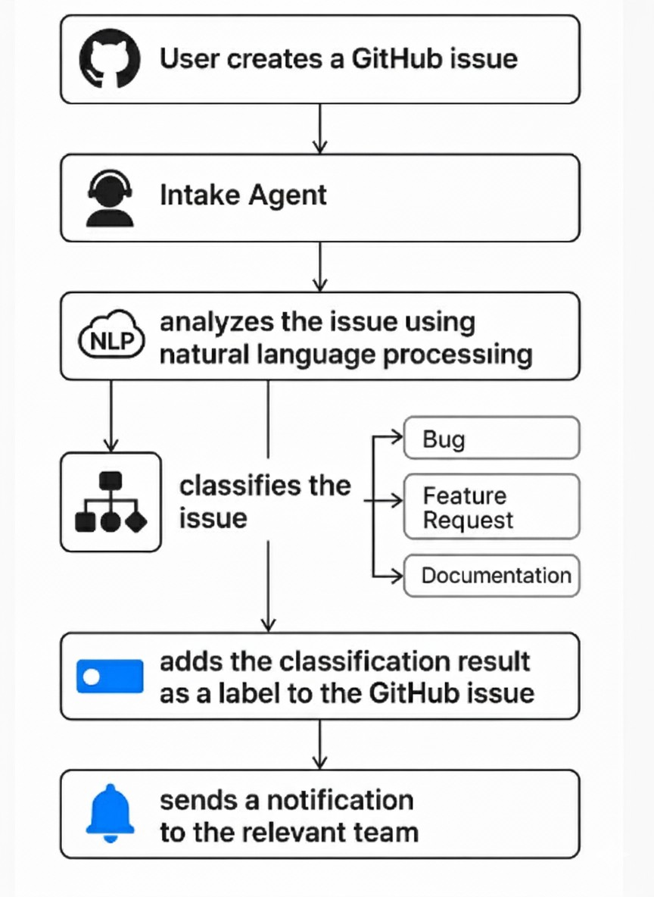
Workflow
Figure 1: Workflow

Slide 10
Project Timeline and Assignments
Weeks 1-2: Foundational Agent Development
Ashwin: Build Intake (Core). | Vinay: Build Triage and Intake (TODO). |
Anmol: Design Assignment. | Sai Harsh: Build Intake (Repro Validation).
↓
Weeks 3-4: Full Agent Suite Development
Ashwin: Refine Intake. | Vinay: Refine Triage. | Anmol: Build Assignment Agent. | Sai Harsh: Build Notification Agent.
↓
Weeks 5-6: Full Pipeline Integration
Ashwin: Integrate Intake. | Vinay: Integrate Triage. | Anmol: Integrate Assignment. | Sai Harsh: Integrate Notifications.
↓
Weeks 7-8: Verification and Documentation
Ashwin: Document Intake. | Vinay: Document Triage. | Anmol:
Document Assignment. | Sai Harsh: Document Notifications.
10

Slide 11
THANK YOU
10

