Slide 1

Predicting and Classifying Interests of Users based on Direct Interactions
Compiler Design Project
Team - 3
Vivek Ramkumar, 2018103082
Kariketi Tharun Reddy, 2018103034
G. R. Srikanth, 2018103603

Slide 2
Abstract
The basis of our project is to provide a textual analysis of the interactions between multiple users, and predict their interests, as well as categorize them.
This is an important function of recommendation systems, that is, to offer a personalized experience for each user, by understanding their preferences.
Direct interactions between users will be subject to lexical, syntax and semantic analysis, from which we will obtain their preferences to items, as well as actions and hobbies.

Slide 3
Literature Survey
No | Publication | Author, Year | Methodology | Advantages | Limitations
1. | Short systematic review on e-learning recommender systems | W.M.Chugtai, A.B.Selama, Imran Ghani (2013) | Content-Based Filtering, Hybrid-Based Filtering, Knowledge-Based Filtering | Useful insight on the cold-start issue in e-learning recommender systems. | Limited to four types of filtering approaches.
2. | A systematic review of scholar context-aware recommender systems | Z.D.Champiri, S.R.Shahamirib, S.S.B.Salima (2015) | Kitchenham Systematic Review Methodology | Categorises recommendations into user's context, document context and env. context. | Requires tracking and analyzing previous students' interactions.
3. | Recommender Systems: Review | Akshita.J, Smita.A (2013) | Content-Based Filtering | Discusses various techniques. | Requires combination with hybrid recommenders.
4. | A literature review and classifications of recommender systems research | D.H.Park, H.K.Kim, I.Y.Choi, J.K.Kim (2012) | Data Mining Techniques (K-Means, Link Analysis, etc.) | Provides insight about future trends in the field of recommender systems. | Limited to eight types of data mining techniques.
5. | The use of machine learning algorithms in recommender systems | Ivens Portugal, Paulo Alencar, Donald Cowan (2015) | Bayesian and Decision Tree Algorithms | Identifies research opportunities for software engineering research. | Nowadays, DL algorithms surpass ML algorithms in speed and power.

Slide 4
Problem Description
We can understand that we now have pre-trained deep learning models to work with, over machine learning models.
We will try to separate the tokens and tag them, whilst filtering out useless words.
The sentiment of the user's statement also needs to be considered while recommending.
To obtain the raw recommendations, we need to check for correlations between the tokens and the product names.
Organizing the recommendations and allocating them to each user will give us our final set of recommendations.

Slide 5
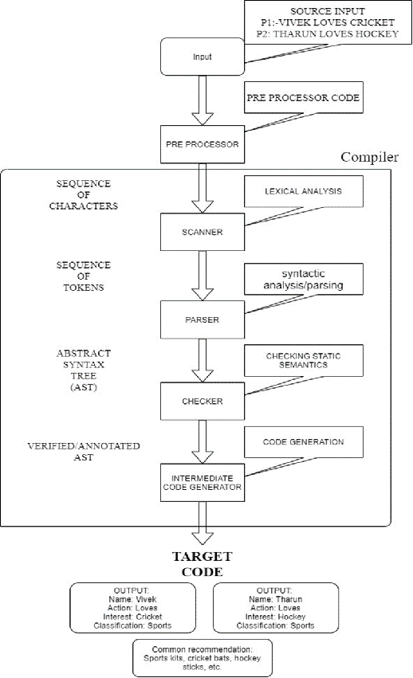
Architecture Diagram

Slide 6
Module I - Tokenization
Pseudocode:
For each dialogue in conversation:
Split dialogue in tokens and store them
doc = nlp(dialogue)
For each token in token_list:
if tag == 'NOUN', add to noun_list
else if tag == 'VERB' add to verb_list
End for loop...
#Using Spacy's functions, we can identify entities.

Slide 7
Module I - Tokenization
For entity in doc.ents:
Append entity to users
Append entity_lab to user_types
End for loop...
End for loop....
#Remove any leftover stop words in the nouns list
nouns = [word for word in nouns if not word in stopwords.words()]
Store all tokens in a dataframe, and return the dataframe

Slide 8
Module II - Dialogue Parsing
Pseudocode:
#Obtain sentiments using the NLTK Vader Sentiment Analyzer
Create a dataframe to store sentiment values
sid = SentimentIntensityAnalyzer()
For each dialogue in conversation:
Calculate polarity scores for each dialogue
Append values to sentiments dataframe corresponding
to each sentiment
Return the sentiment values dataframe
End for loop....

Slide 9
Module II - Dialogue Parsing
#Displaying the dependency trees....
For each dialogue in conversation:
#Use loaded dictionary of English words from Spacy library
nlp = spacy.load('en_core_web_md')
doc = nlp(dialogue)
#Displacy is a visualization library for NLP
displacy.render(doc, style = 'dep')
End for loop...

Slide 10
Module III - Initial Recommendation
Pseudocode:
For each noun in noun_list:
For each item in complete_list:
If lower(noun) is present in lower(item name):
Append item name to temp_list
End for loop...
Append temp_list to init_rec
End for loop...
Return the list init_rec

Slide 11
Module IV – Final Recommendation
Pseudocode:
For index in the range of length of init_rec:
If sentiment for user[index] is positive:
Append random items to final_rec[index]
If sentiment for user[index] is negative:
Choose random items from other user interests
Append those to final_rec[index]
#We have chosen to recommend 5 items per user

Slide 12
Module IV – Final Recommendation
If sentiment for user[index] is neutral:
Append random items to final_rec[index]
End for loop...
Return the list of lists final_rec
#This has been done by using 2 functions:
#get_actual_rec() for positive and neutral sentiments
#mixed_rec() for negative sentiments

Slide 13
Input
The sample input is in the form of a one-line conversation between any number of users.
Rahul : I like to play on my tablet. Gokul : My dog does not enjoy using dog shampoo. Ankita : I love to wear a kurta. Badrinath : I frequently wear a shirt. Vijay : I am searching for a nice watch. Srikanth : I like to play cricket.

Slide 14
Output
The sample output is in the form of a list of recommendations for each user.
Rahul -> Amazon Kindle Tablet 16GB, iBall MovieZ Pro 25.5cm 64GB, etc. Gokul -> Kookaburra Kahuna Prodigy 100 Kashmir Willow Cricket Bat, Jeet Boy's Kurta and Pyjama Set, etc.
Ankita -> Lajo Women's Kurta, Pyjama & Dupatta Set, Noor Embroidered Women's Straight Kurta, etc. Badrinath -> YK Printed Boy's Round Neck Dark Blue T-Shirt, Norwood Striped Men's Polo Neck Reversible T-Shirt, etc. Vijay -> Perucci PC-303 Analog Watch - For Men, Timewel 1100-N147W_1 Analog Watch - For Men, etc. Srikanth -> SS Ton Professional English Willow Cricket Bat, Metro Sports Leather Cricket Ball, etc.

Slide 15
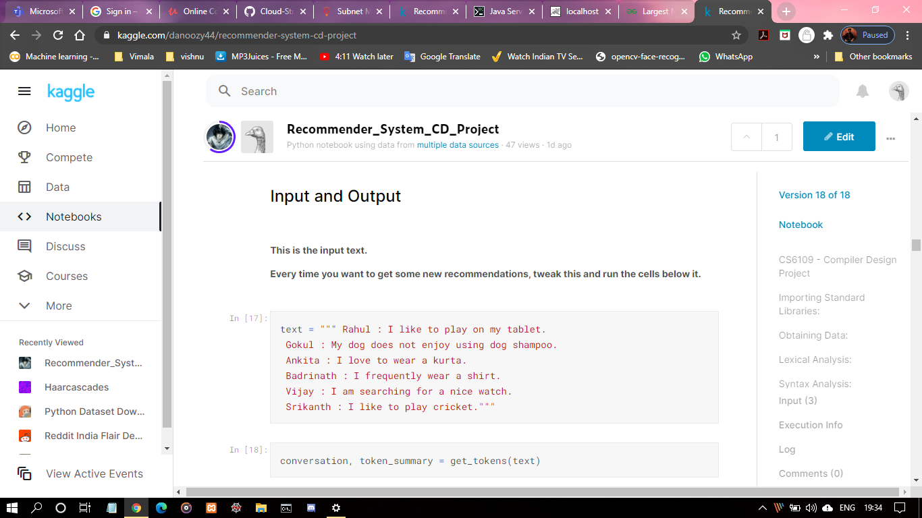
Screenshots - Input

Slide 16
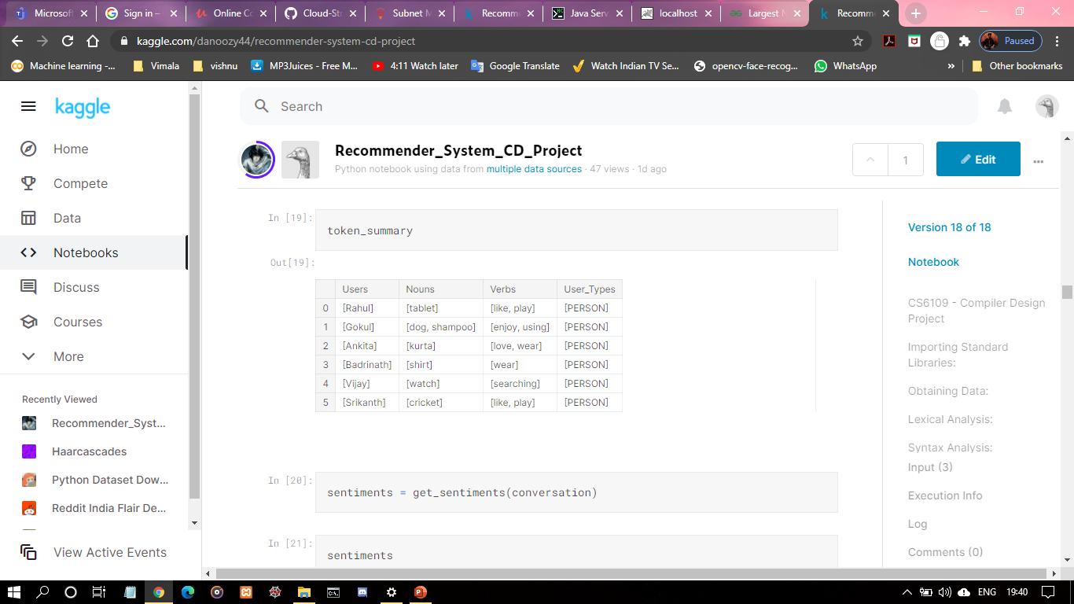
Screenshots – Module I

Slide 17
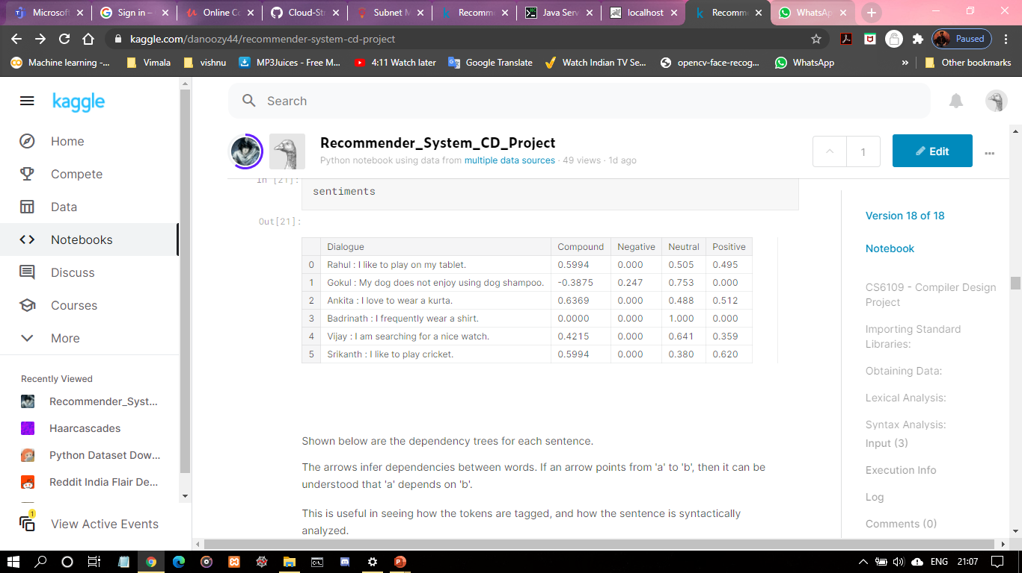
Screenshots – Module II

Slide 18
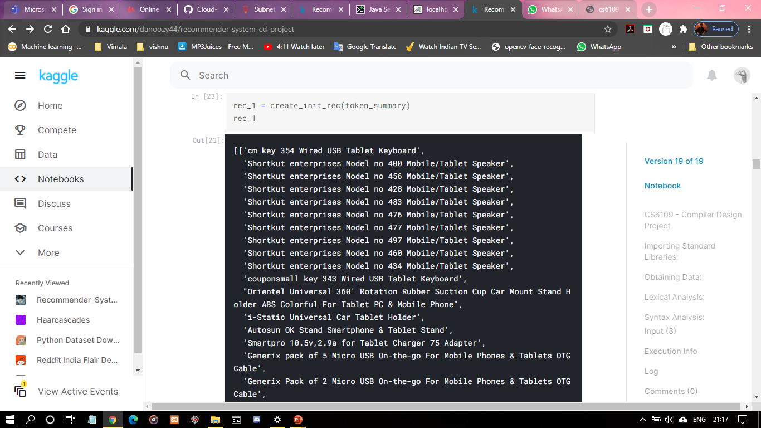
Screenshots – Module III

Slide 19
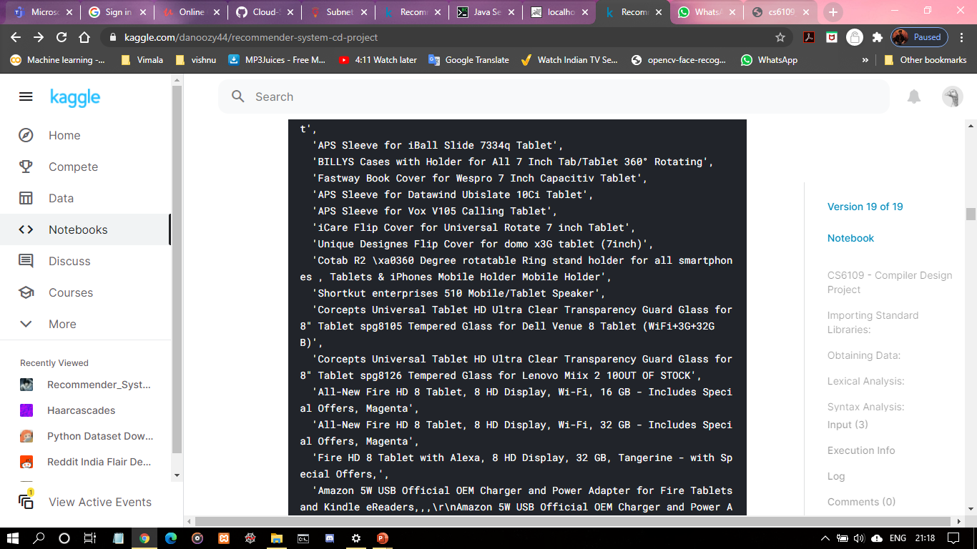
Screenshots – Module III

Slide 20
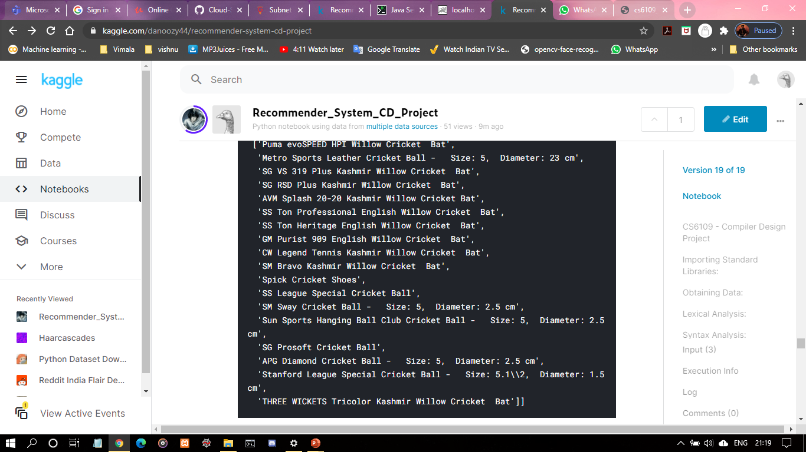
Screenshots – Module III

Slide 21
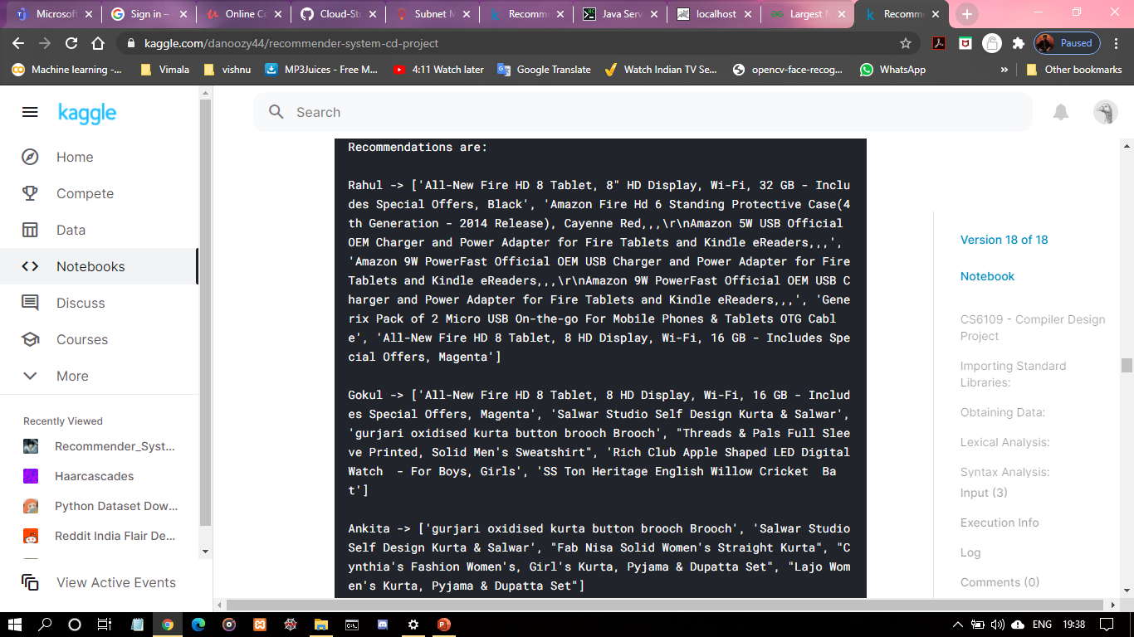
Screenshots – Module IV

Slide 22
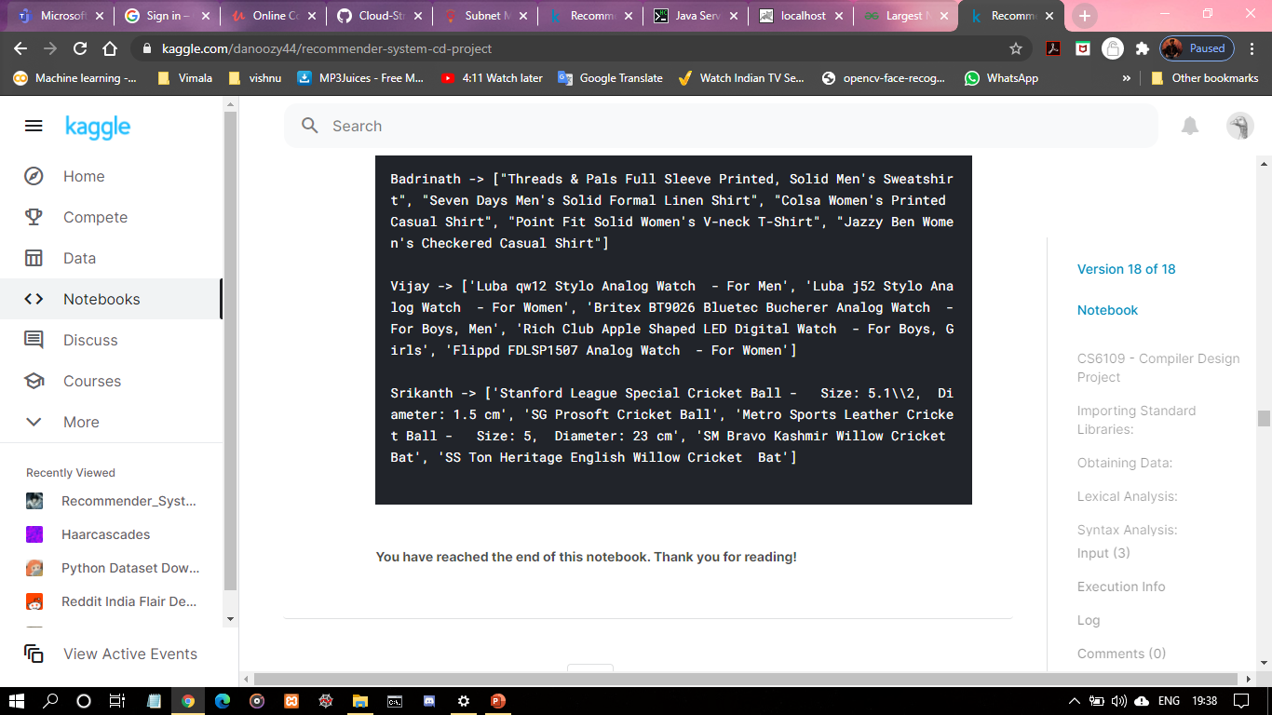
Screenshots – Module IV

Slide 23
References
C.Li, F.Xiong, “Social Recommendations with Multiple Influence from Direct User Interactions”, Aug. 2017.
C. Pan, W. Li, Research paper recommendation with topic analysis in Computer Design and Applications IEEE, 4 (2010), pp. V4-264
J.A. Konstan, J. Riedl, Recommender Systems: From Algorithms to User Experience User Model User-Adapt Interact, 22 (2012), pp. 101-123

Slide 24
The End
Thank you for watching!

