Slide 1
Cloud Surf Inn
A modern take on improving the hotel experience.
01
Finding a Room
See how a customer’s preferences are matched to a room and a key is generated to the room instantly.
02
Placing a Housekeeping Call
Housekeeping has never been easier to schedule at the right time.
03
Power Saving
Automation does not have to be only for the home. As soon as customer checks out, watch how the thermostat is lowered.
Notes:
Today we will be showcasing Cloud Surf Inn. This is a comprehensive hotel software that is intended to improve the hotel experience for managers, employees, and guests. Some of the key features we will be showcasing today include finding a room, placing a housekeeping call, and automatic power saving, all done through one, simple interface.

Slide 2
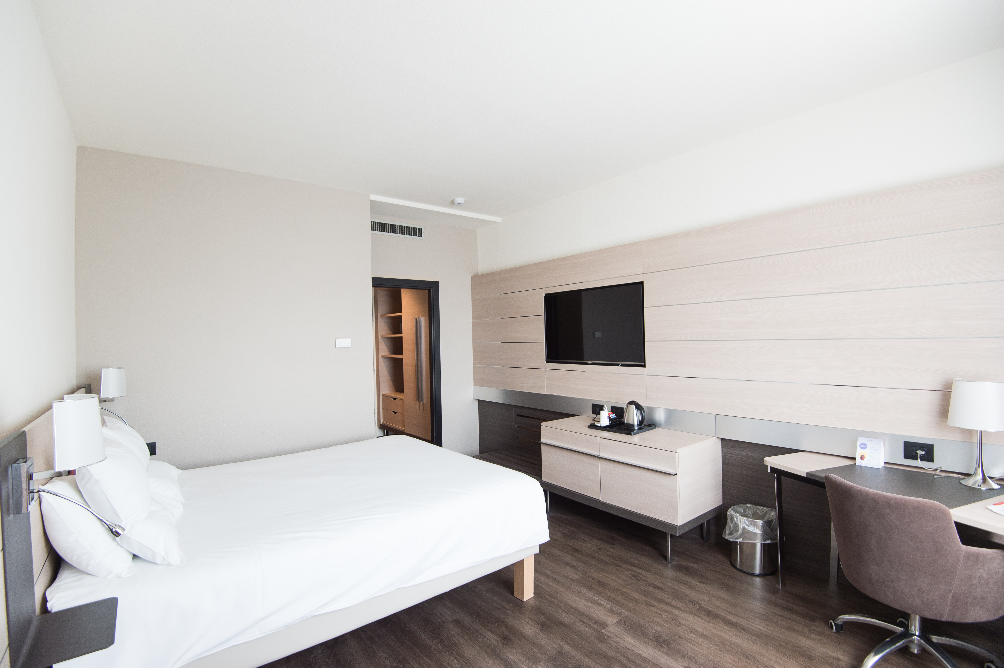
UC-1 and UC-10, Finding a Room and Receving a Mobile Key
Customers want a room that aligns with their needs.
Here they can:
Input their preferences
Find a room
Book the room and receive their key
Notes:
TALK ABOUT IT FIRST:
Customers always want a room that aligns with their preferences when they stay at a hotel. Our system allows customers to input the desired number of beds and which amenities they would like included with their room. Another problem, emphasized by the pandemic, is receiving a key to your room without interacting with any staff. Our system allows customers to book their room and receive their key almost instantly after, allowing them to enter the hotel and proceed straight to their room.
NOW GO THROUGH A SCENARIO:
For example, the user will first login with their credentials. They then can navigate to the “book a room” tab where they can list their preferences, find a room, and book it. They then receive their key right after booking.
HIGHLIGHTING IMPORTANT ASPECTS:
While talking about selecting preferences, talk about how the system processes the data that is coming from the preferences, and matches it to a room based on the algorithm (don’t go too in depth). Also talk about how the key is generated what is happening there on the back end.
ALOGIRTHM IS NOT GOOD DISCUSSION

Slide 3
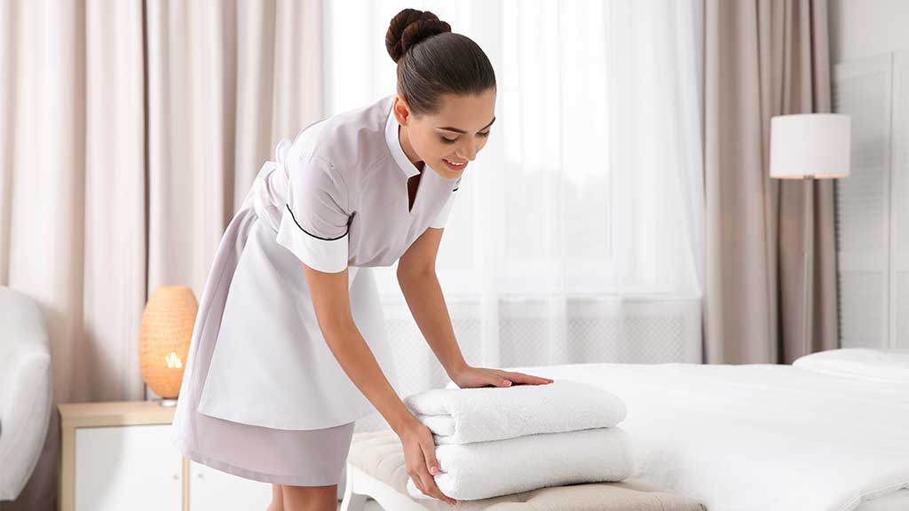
UC-16 and UC-25, Customers Place a Housekeeping Request, and Maids View It
Customers want easy housekeeping scheduling.
Here users can:
Schedule housekeeping for a specific time
Maids view the request and can complete it
Notes:
TALK ABOUT IT FIRST:
Customers want to be able to schedule housekeeping on their terms, not the maids. With our system, they can precisely schedule a time they would like housekeeping to come, and the maids can view the times selected and fulfill requests at their earliest convenience.
NOW GO THROUGH A SCENARIO:
For example, the user will first login with their credentials. They then can navigate to the “housekeeping” tab where they can choose a day and time for housekeeping. Now, if we log in as the housekeeper and navigate to the same tab, we see the scheduled housekeeping come up. (I would suggest making 2 requests and looking at how the priority is made)
HIGHLIGHTING IMPORTANT ASPECTS:
While viewing the requests from the housekeeping side, talk about the algorithm that is assigning a priority to the housekeeping schedules. (don’t go too in depth)
Storing this information in the database as well

Slide 4
UC-13, Automatic Power Saving
Energy efficiency is paramount to a modern system.
When a customer checks out:
The heat/cooling is automatically turned off to conserve energy.
No manual input is required.
*Estimates based on EPA ENERGY STAR Programmable Thermostat Research Findings (source)
Notes:
TALK ABOUT IT FIRST:
In this day and age, saving energy and being efficient could not be more important. Both customers and managers would like to see a hotel that is more efficient. Customers will feel better about the energy and climate impact of big hotels, and managers can save on energy expenses and be seen as a climate-conscious company.
NOW GO THROUGH A SCENARIO:
For example, here we are as the user, we are logged in and at the end of our stay. All we do then is navigate to the “x” tab and select check-out. What the customer doesn’t see, however, is that their check-out has triggered our automatic system to lower the thermostat for the room. (show that this happened somehow).
HIGHLIGHTING IMPORTANT ASPECTS:
Talk about how upon check-out the system automatically messages the thermostat device to lower the heat and turn it off in order to save energy. (and talk about any technical problems that have been solved here)

Slide 5
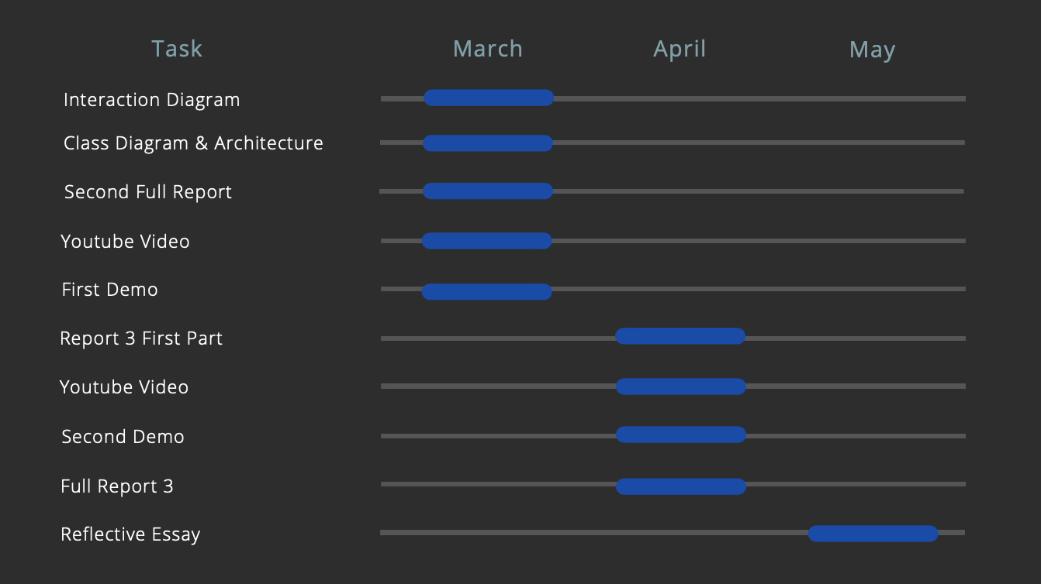
Plan for the Rest of the Semester
Notes:
Here we have our product roadmap, an outline for the rest of the semester. We would like to improve the usability of our program for the next demo and make sure that it is as simple as possible for our customers. We would like to finish implementing our use cases described in Report 1, such as providing a key pin for housekeepers to access rooms, allowing staff and managers to view all room information and employee schedules, implementing payment options, and enabling ordering.

