Slide 1
Cloud Surf Inn
A modern take on improving the hotel experience.
01
Booking a Room
You can choose your own room or be automatically suggested one, pay for it, and view our services, all in one place.
02
Ease of Employee Use
Housekeepers will have an easier time entering rooms to clean and managers can access rooms with a secure, digital key.
03
Room Controls and Power Saving
Automation does not have to be only for the home. Now you can carry your hotel room controls in your pocket and save energy doing it.
Notes:
Today we will be showcasing Cloud Surf Inn. This is a comprehensive hotel software that is intended to improve the hotel experience for managers, employees, and guests. We have several new features to show, as well as improvements to our existing ones. Booking a room now includes selecting from a list of available rooms instead of just being matched to one and paying for it in the same place. Employees can now access rooms with a secure digital key provided by our system. And we have an improved power controls system with the guest able to control more devices in their room, right from the comfort of their bed.

Slide 2
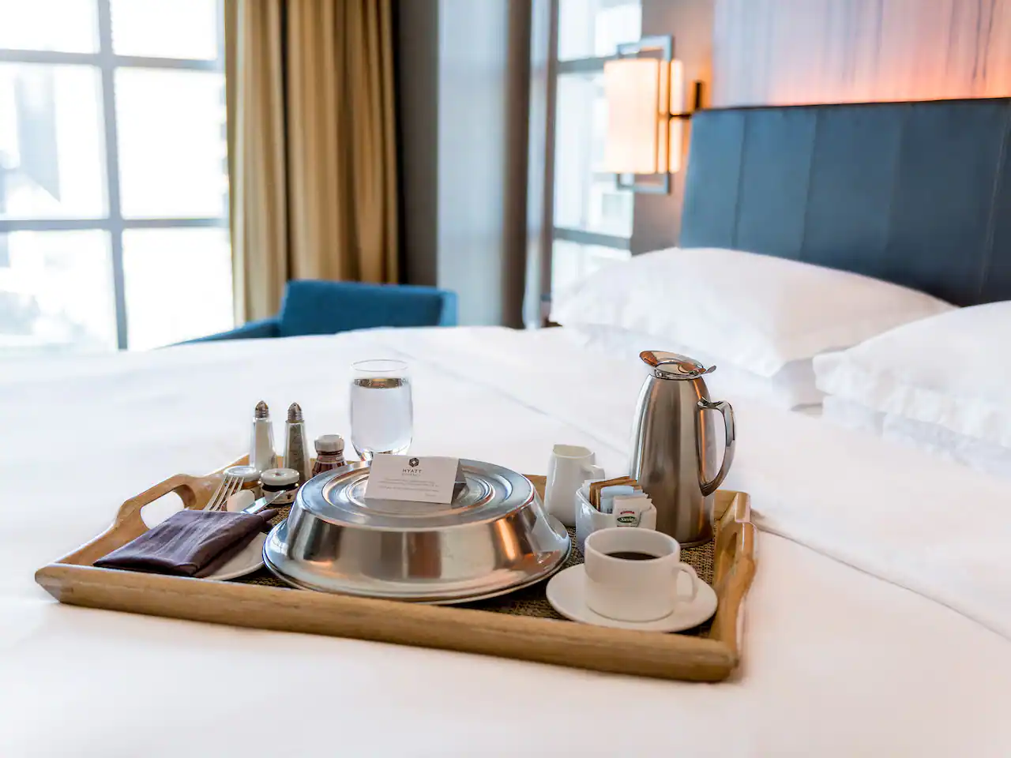
UC-19, UC-23, UC-24: Ordering Services
Customers want to book a room and request services from one place.
Here they can:
View our service menu
Order services
Receive live status updates

Slide 3
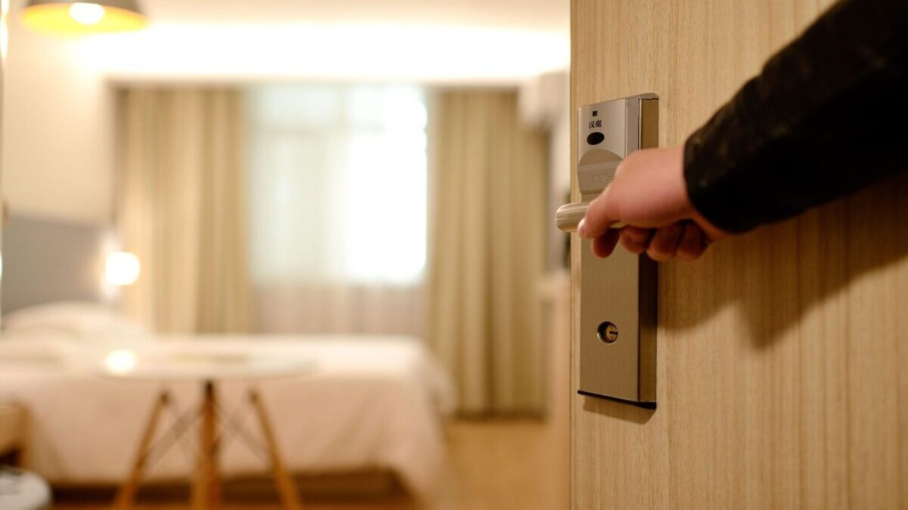
UC-6, UC-10: Master and Temporary Keys for Staff
Managers and housekeepers need easy access to rooms.
Here:
Managers receive a master key to access any room
Maids receive a temporary key to clean rooms

Slide 4
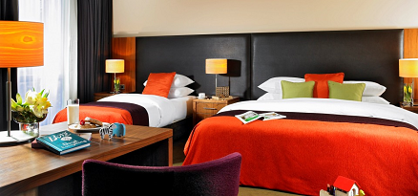
UC-2, UC-3, UC-5: Viewing all Rooms, Booking a Room, and Paying for it
Customers want to book a room and pay for it in the same step.
Now:
They can pick their own room from a list of options
Pay for the room digitally
And managers can view information about any room

Slide 5
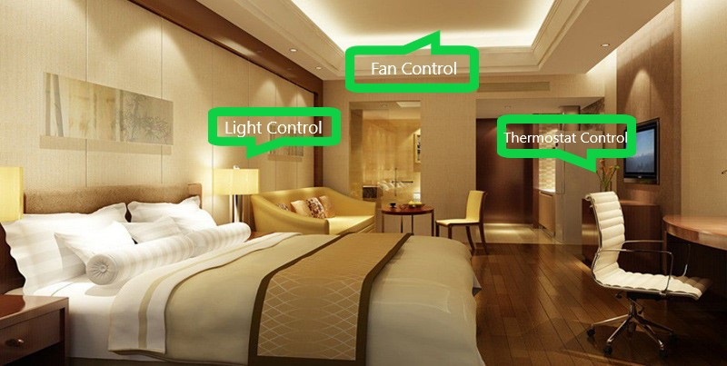
UC-11, UC-12, UC-13, UC-14, UC-15: Advanced Power Saving and Device Control
Automation is the future. Our smart system:
Detects a customer leaving and automatically turns the power to the room off
Detects a customer entering and turns the power back on
Allows for easy control of thermostat, fan, and lights
Notes:
~~ Script ~~

