Slide 1




Scaling NServiceBus
Jimmy Bogard
@jbogard
github.com/jbogard
jimmybogard.lostechies.com

Slide 2
The Daily AS/400 Dump
Processing bulk data

Slide 3
Characteristics
1/day dump of entire SKU catalog
Flat file
1.4M rows daily and growing
Fill in details for support website

Slide 4


Consuming Files
Data
Importer
Deadlock
DB
Rollback
What made it through?

Slide 5

Consuming Files
Data
Parser
Process File
Process Line
Commit
Commit
Processor
DB

Slide 6
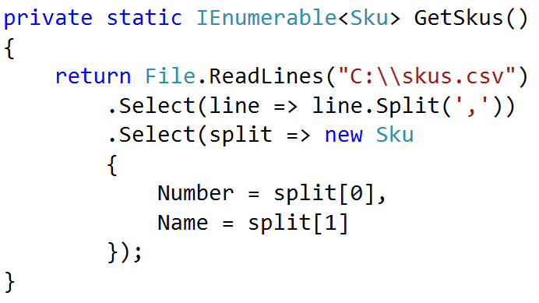
Streaming Bulk Copy

Slide 7
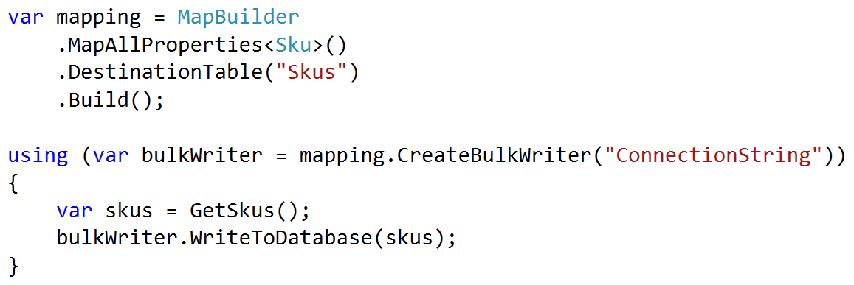
Streaming Bulk Copy

Slide 8
Data Warehouse Exports
Exporting Bulk Data

Slide 9
Producing Files
Id | Name | Changed
1 | Walter | Y
2 | Cora | N
3 | Alejandro | N
4 | Carlton | Y
5 | Janice | N
Id | Name | Changed
1 | Walter | Y
2 | Cora | N
3 | Alejandro | N
4 | Carlton | Y
5 | Janice | N
Id | Name | Changed
1 | Walter | Y
2 | Kiera | Y
3 | Alejandro | N
4 | Carlton | Y
5 | Janice | N
Exporter
File
SELECT Name
WHERE Changed = ‘Y’
UPDATE People
SET Changed = ‘N’
We’re missing a change

Slide 10
Producing Files
Id | Name | BatchId
1 | Walter | NULL
2 | Cora | 1
3 | Alejandro | 1
4 | Carlton | NULL
5 | Janice | 2
Id | Name | BatchId
1 | Walter | 3
2 | Cora | 1
3 | Alejandro | 1
4 | Carlton | 3
5 | Janice | 2
Id | Name | BatchId
1 | Walter | 3
2 | Kiera | NULL
3 | Alejandro | 1
4 | Carlton | 3
5 | Janice | 2
Exporter
File
UPDATE People
SET BatchId = 3
WHERE BatchId IS NULL
SELECT Id, Name
FROM People
WHERE BatchId = 3
Mark records to export
Export marked records

Slide 11
Search Database Enrichment
Routing slips

Slide 12
Characteristics
Enriching search data from various sources
Some sources are required, some not
Some dependent on previous steps
Initiated with large batch of initial messages

Slide 13
Option #1: Observer
Publisher
Price
Catalog
Content
Saga
Options
Saga Creation
Notes:
Saga not created yet
Tons of exceptions trying to create saga
Tons of concurrency exceptions trying to modify saga
Huge load on saga O(N * M)

Slide 14
Option #1: Observer
Publisher
Price
Catalog
Content
Saga
Options
Queue Contention
Notes:
Saga not created yet
Tons of exceptions trying to create saga
Tons of concurrency exceptions trying to modify saga
Huge load on saga O(N * M)

Slide 15
Option #1: Observer
Publisher
Price
Catalog
Saga
Price
Content
Catalog
Content
Options
Options
Saga Contention
Notes:
Saga not created yet
Tons of exceptions trying to create saga
Tons of concurrency exceptions trying to modify saga
Huge load on saga O(N * M)

Slide 16
Option #2: Controller
Publisher
Price
Catalog
Content
Saga
Options
Slooooooow
Notes:
No one item would finish until all finished their steps

Slide 17
Option #2: Controller
Publisher
Price
Catalog
Saga
Price
Content
Catalog
Content
Options
Options
Complicated and slow
Notes:
Difficult to maintain routes
Adding a new step meant re-deploying steps
Now 2N endpoints

Slide 18
McDonald’s Sagas
Sandwich
Drinks
Coffee
Shakes
2) Order Accepted
Fries
3) Item Completed
Order #1
Register
4) Order Completed
1) Place Order
Tray Contention
Customer

Slide 19
Subway’s Sagas
2) Prep Meal
3) Pack Meal
Register
Prep
Pack
1) Place Order
Customer
4) Order Completed

Slide 20
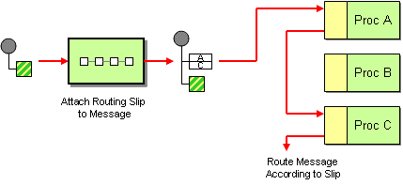
Routing Slip
How do we route a message consecutively through a series of processing steps when the sequence of steps is not known at design-time and may vary for each message?
Attach a Routing Slip to each message, specifying the sequence of processing steps. Wrap each component with a special message router that reads the Routing Slip and routes the message to the next component in the list.

Slide 21
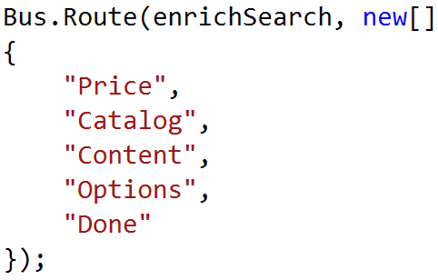
Option #3: Routing Slip
Initiator
Price
Catalog
Content
Options
Notes:
1st one goes through quickly
Additional data stored on routing slip
Adding a new step doesn’t significantly affect process
No step knows about the other

Slide 22
Transaction Processing
Ditching DTC and exactly-once messaging

Slide 23
Characteristics
Processing daily sales transactions for loyalty reward system
Highly cyclical load
Longest observed finish time – 10 hours
New load 4-5X larger on a daily basis

Slide 24
Measuring performance
Current rate: 5 msgs/sec
Target rate: 80-90 msgs/sec
Measured max: 18 msgs/sec

Slide 25
Hardware Upgrade
SSD All The Things
Up the cores
Up the RAM
Upgrade the network
Result: doubled throughput

Slide 26
Theoretical maxes
Test | Transactions | Elapsed Time | Throughput
No-op | On | 75 sec | 133/sec
DB | On | 378 sec | 26/sec
DB + Message | On | 544 sec | 18/sec
No-op | Off | 29 sec | 345/sec
DB | Off | 51 sec | 196/sec
DB + Message | Off | 109 sec | 92/sec
Notes:
SQL transport – gained on transactions but was slower than no-txns w/ MSMQ

Slide 27
2PC in messaging
1. Receive
3. Send
My Service
2. Save
DB

Slide 28
Idempotent handlers
1. Store Txn
Txn Service
DB
2. Already recorded?
3. Record txn

Slide 29
Record intent
1. Store Txn
Txn Service
DB
2. Already recorded?
3. Record txn
4. Issue coupon

Slide 30
Decoupling downstream effects
Coupon Service
2. Send
1. Find unsent message
3. Mark as sent
DB

Slide 31
Caveats
No first-level retries
No second-level retries
Pipeline fixes all these things

Slide 32

Result
8 hours -> 10 minutes
180 msgs/sec

Slide 33
Takeaways
Embrace real-world metaphors
Optimize when needed, not before
Tons of material out there
Clemens Vasters “More features, more cost.”

