Slide 1




From SQL to Azure Cosmos DB
Jimmy Bogard
@jbogard
github.com/jbogard
jimmybogard.com

Slide 2
What is Azure Cosmos DB?

Slide 3
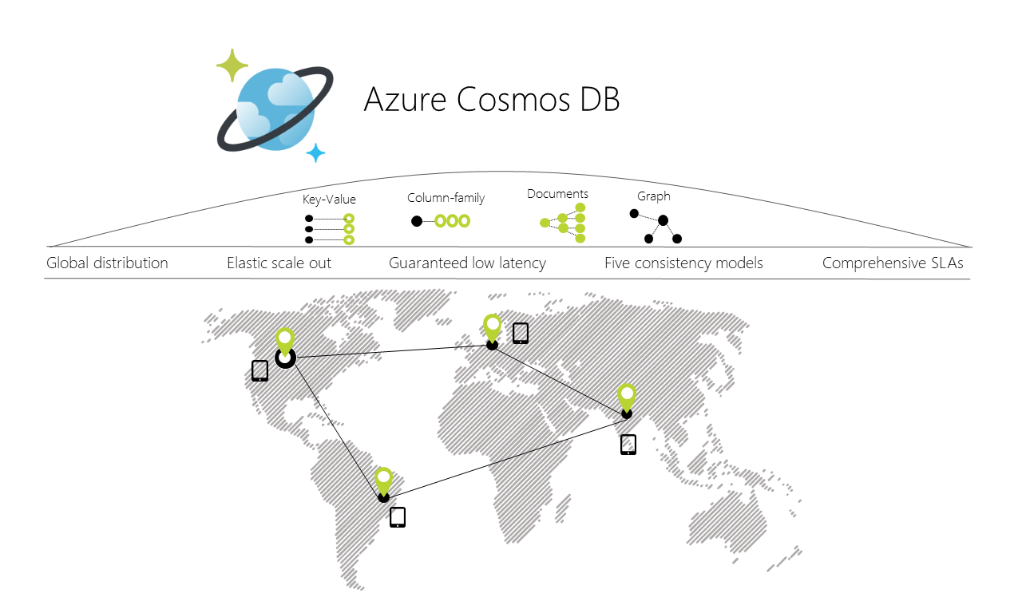
Notes:
globally distributed, multi-model database service

Slide 4
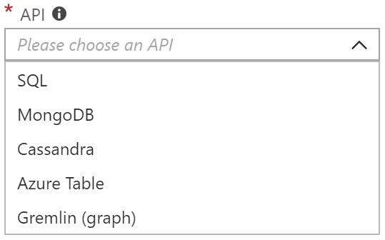
Multi-Model
SQL-over-JSON
Document
Column
Table (Azure Table Storage)
Graph
More to come

Slide 5
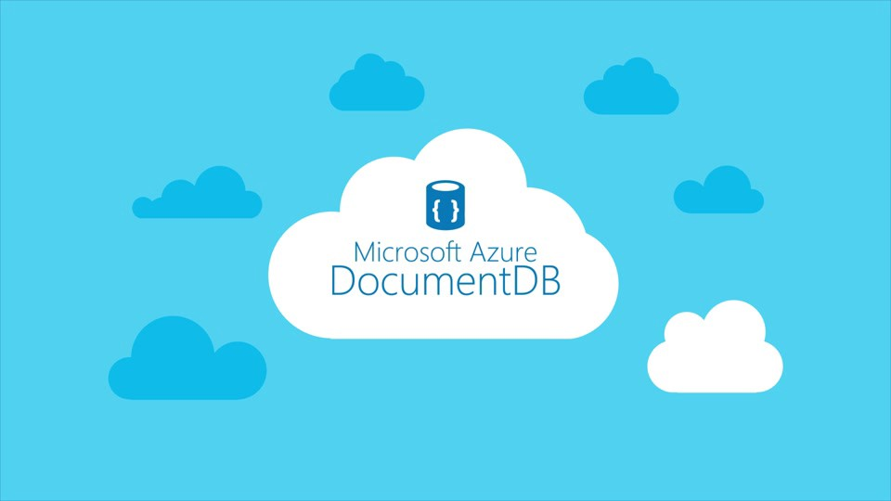

Slide 6
Why should I use it?

Slide 8
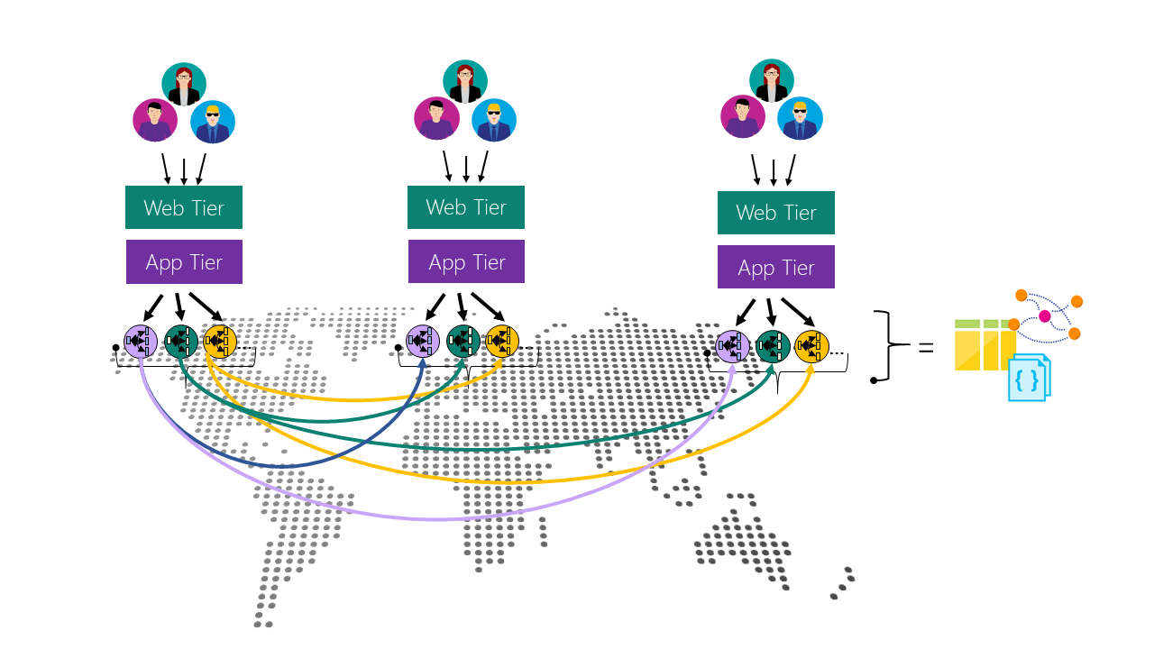

Slide 9



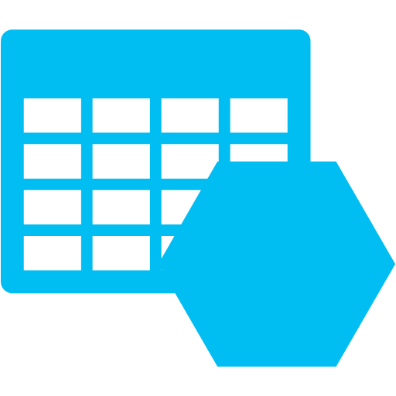

Slide 10
Schema-less in SQL

Slide 11
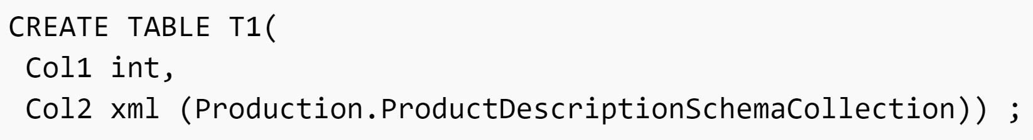

Slide 12
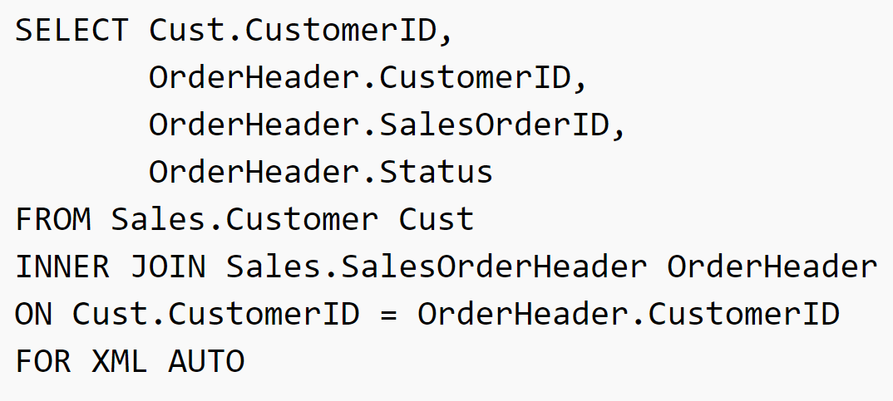

Slide 13
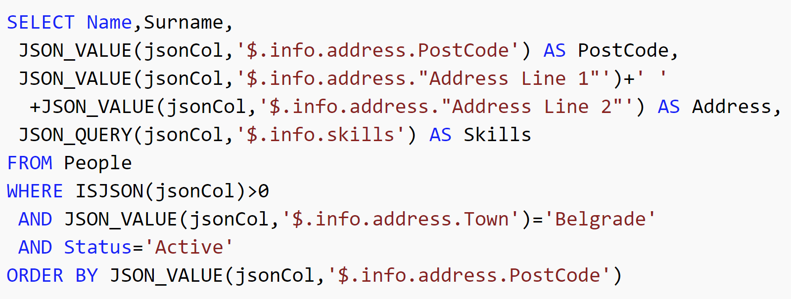

Slide 14
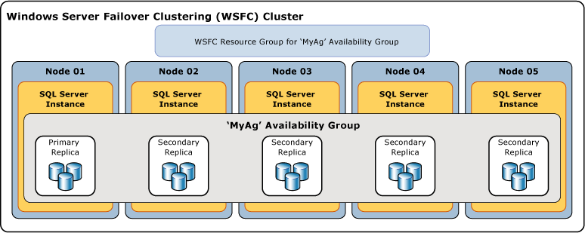

Slide 15
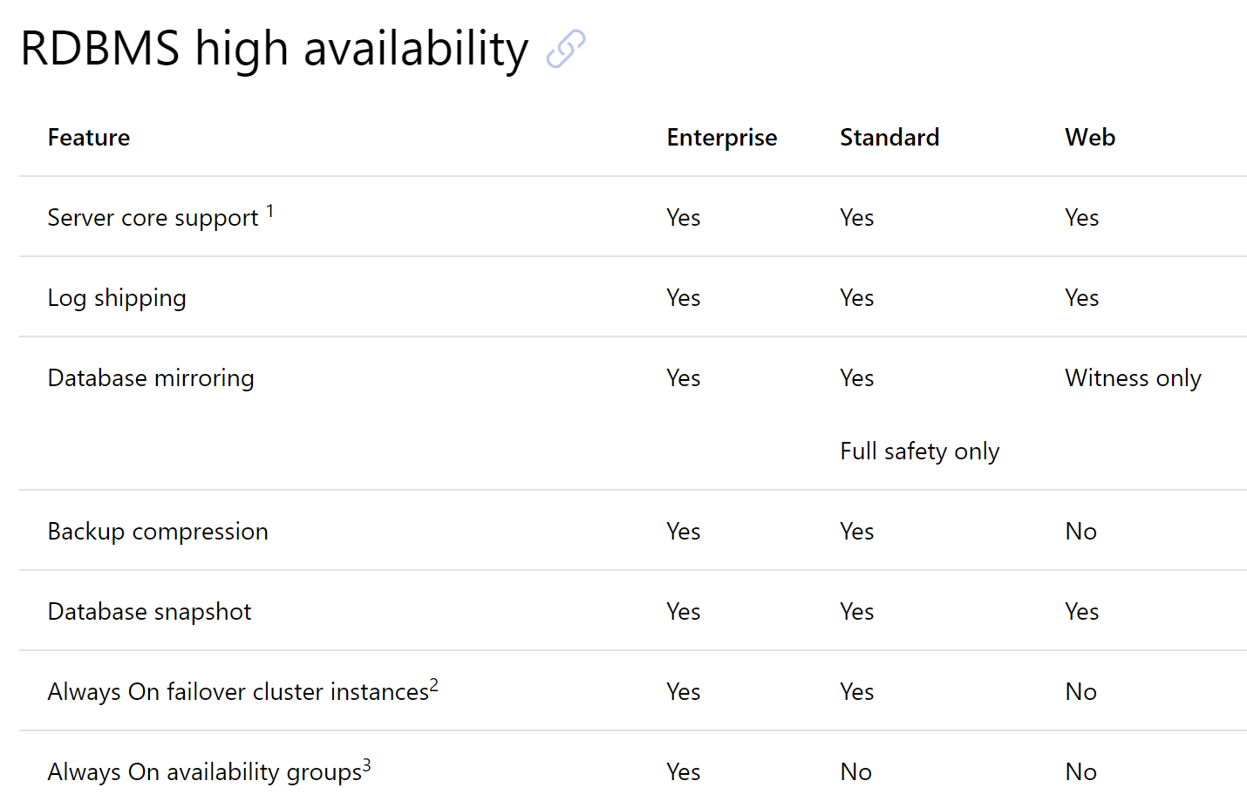

Slide 16
Transitioning from SQL

Slide 18
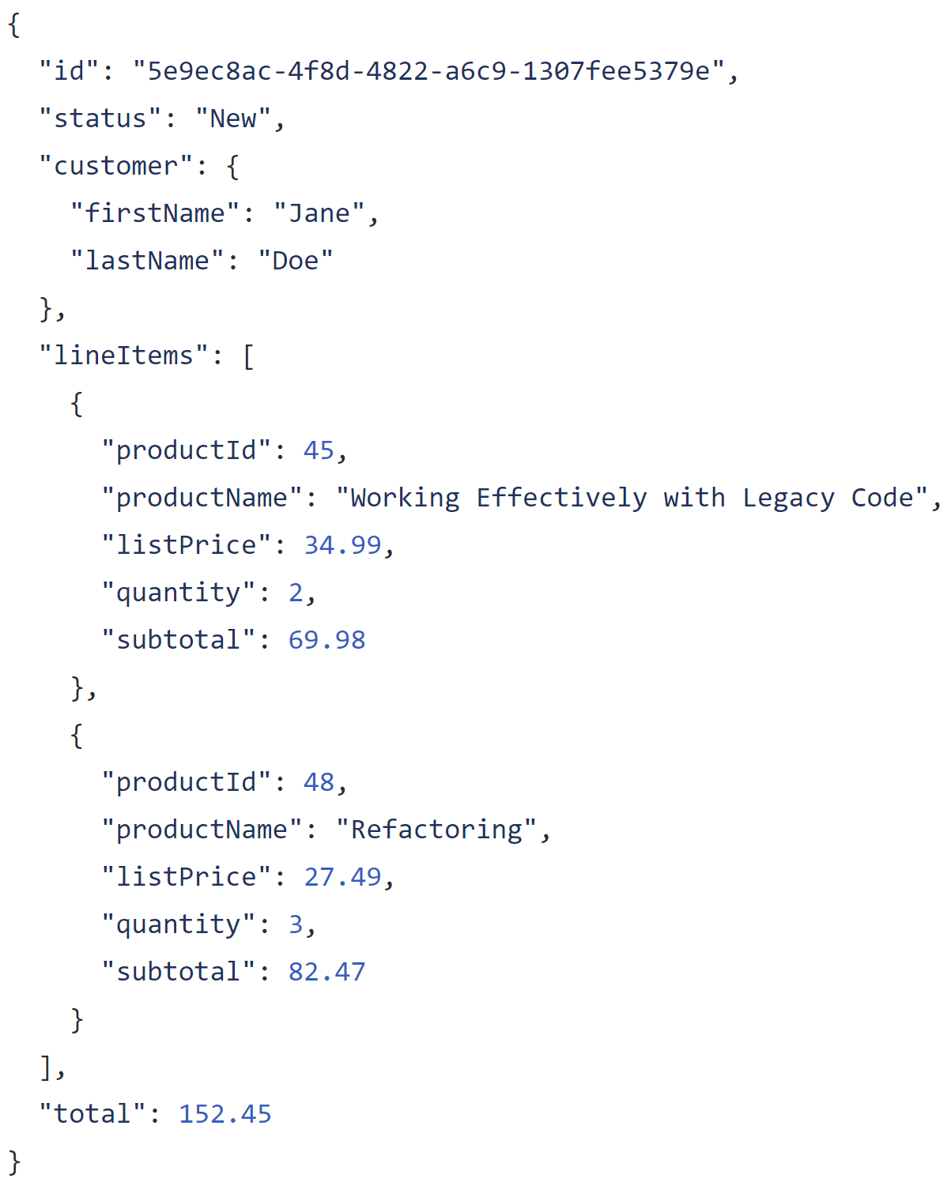

Slide 19
Entire model in one record

Slide 20
Complex structures

Slide 21
Arrays for one-to-many

Slide 22
Store keys for other/external entities

Slide 23
Duplicate data as needed

Slide 24
Not all duplicate data is evil!

Slide 25
Catalog
Cart
Order
Fulfillment
Customer Journey and Value Stream

Slide 26
$24.99
Catalog
Cart
Order
Fulfillment
Customer Journey and Value Stream

Slide 27
$24.99
$24.99
Catalog
Cart
Order
Fulfillment
Customer Journey and Value Stream

Slide 28
$24.99
$24.99
$24.99
Catalog
Cart
Order
Fulfillment
Customer Journey and Value Stream

Slide 29
$24.99
$24.99
$24.99
$24.99
Catalog
Cart
Order
Fulfillment
Customer Journey and Value Stream

Slide 30
$24.99
$25.49
$24.99
$24.99
$24.99
Catalog
Cart
Order
Fulfillment
Customer Journey and Value Stream

Slide 31
?
?
?
$24.99
$25.49
$24.99
$24.99
$24.99
Catalog
Cart
Order
Fulfillment
Customer Journey and Value Stream

Slide 32
$24.99
$25.49
$24.99
$24.99
$24.99
Catalog
Cart
Order
Fulfillment
Customer Journey and Value Stream
Data may move around and when it crosses service boundaries, its meaning can change

Slide 35
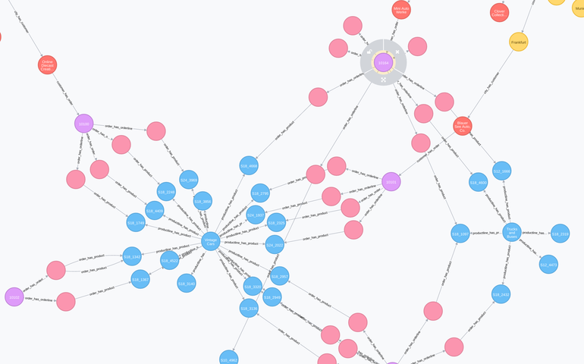

Slide 36
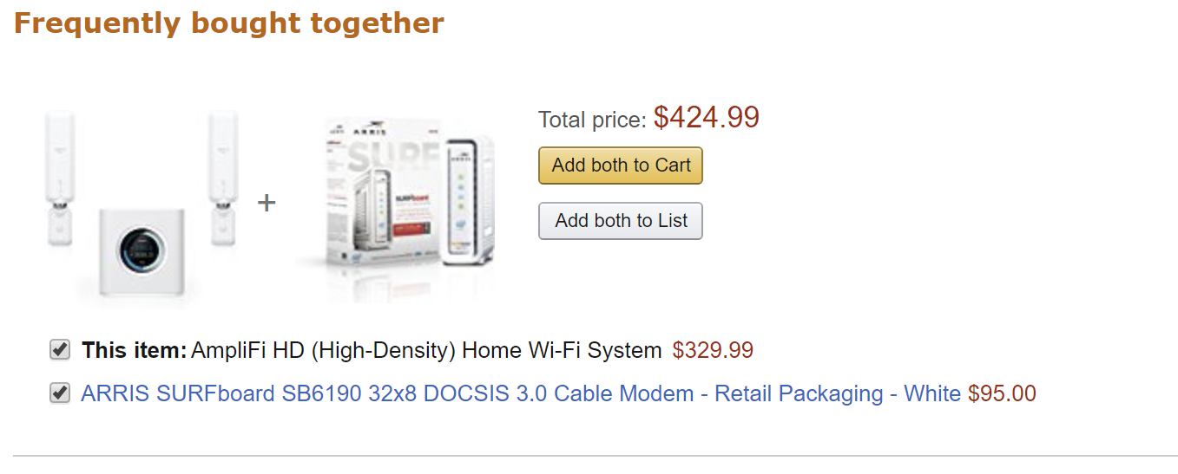

Slide 37
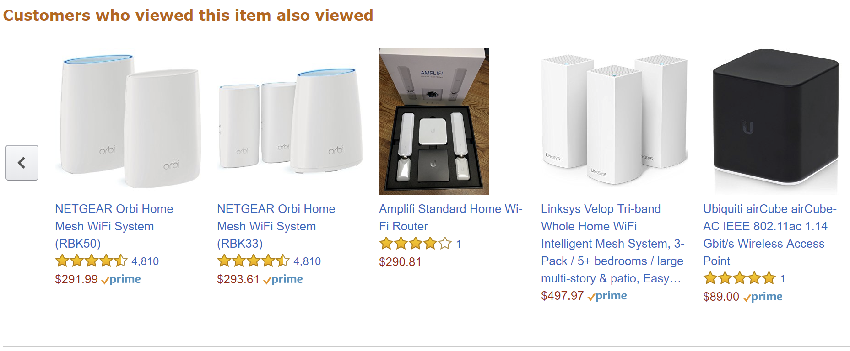

Slide 38
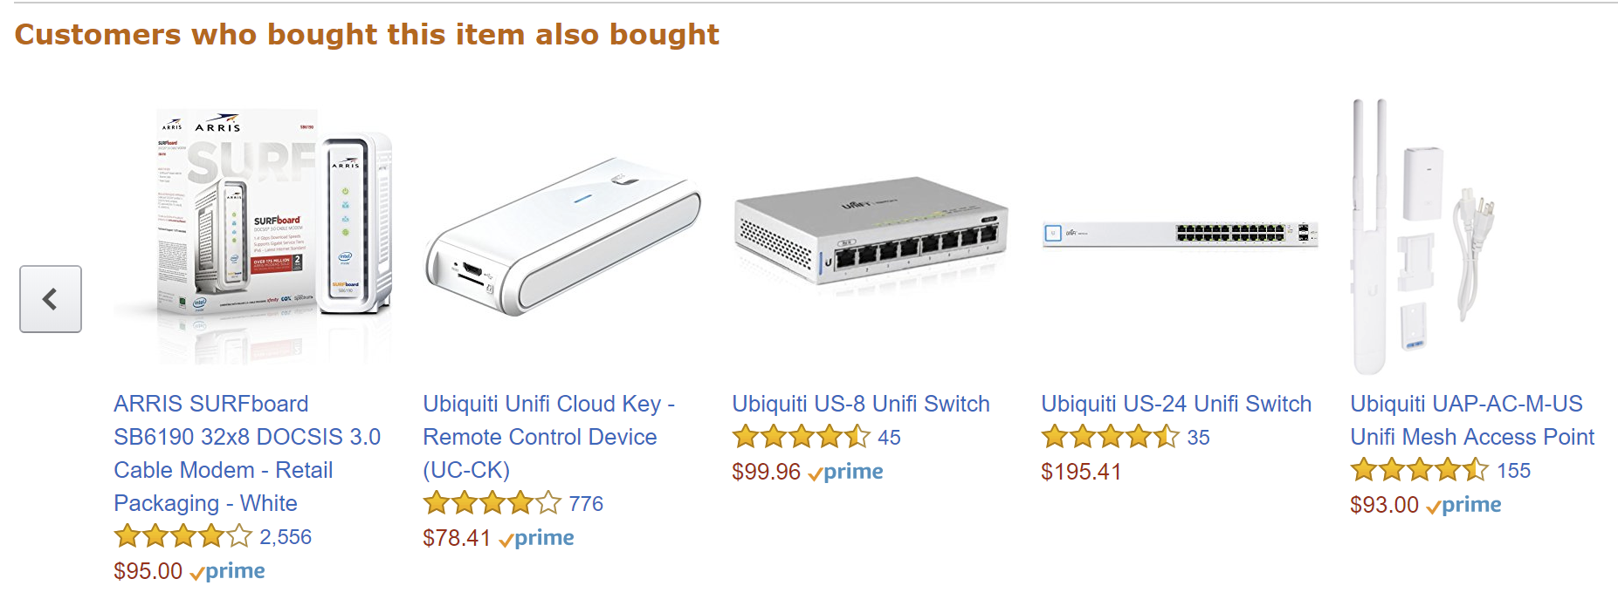

Slide 40
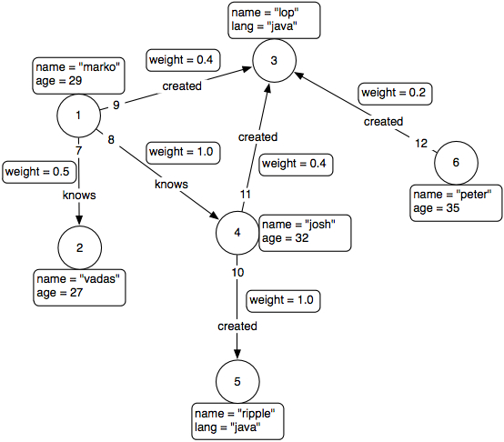
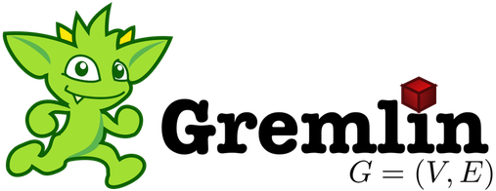

Slide 41
Demo

Slide 42
Transitioning from Transactioning in SQL

Slide 43


Slide 44
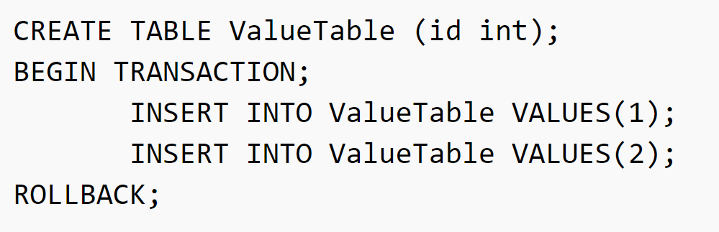

Slide 45
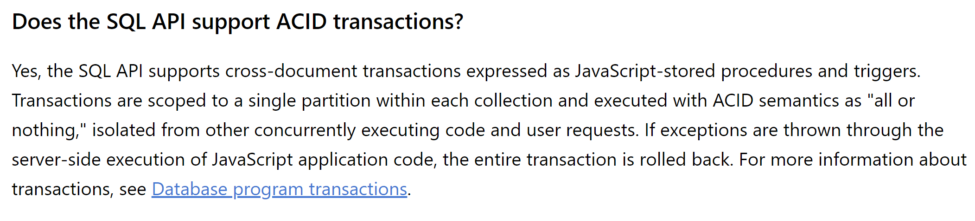

Slide 47
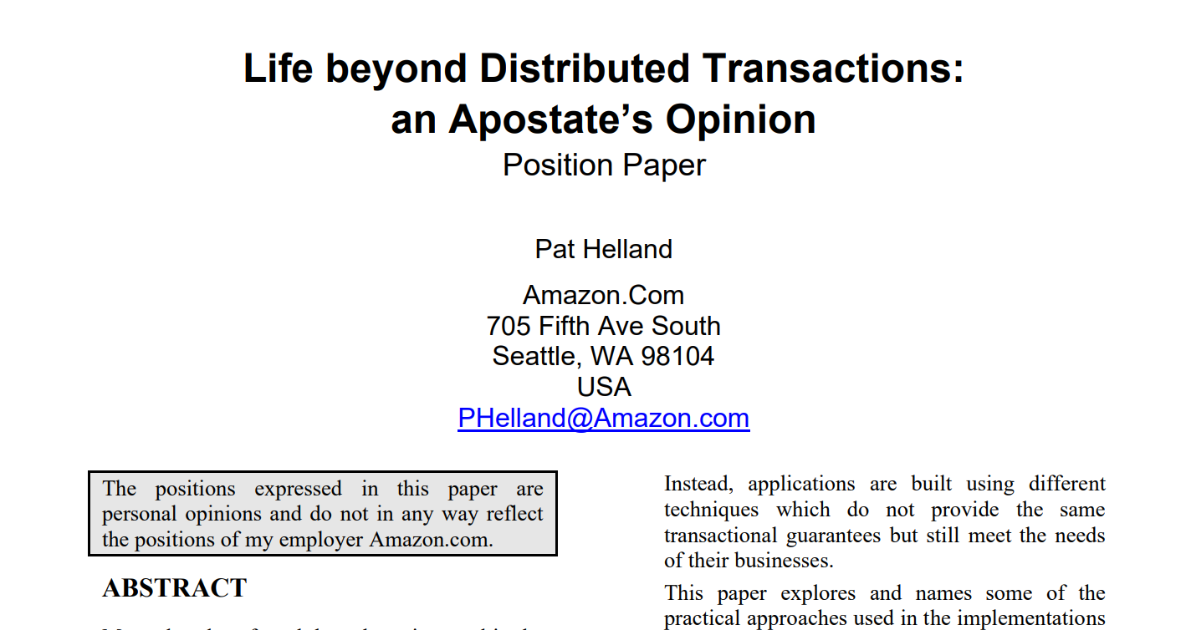

Slide 48
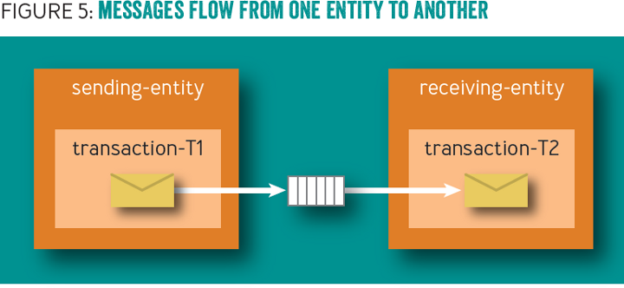

Slide 49
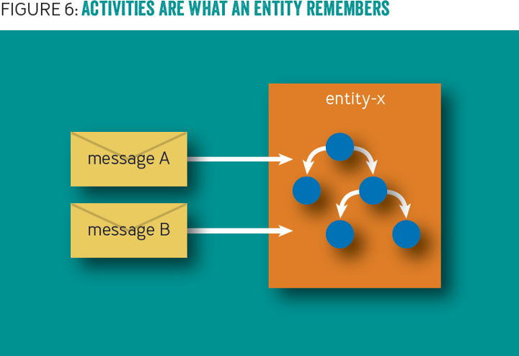

Slide 50
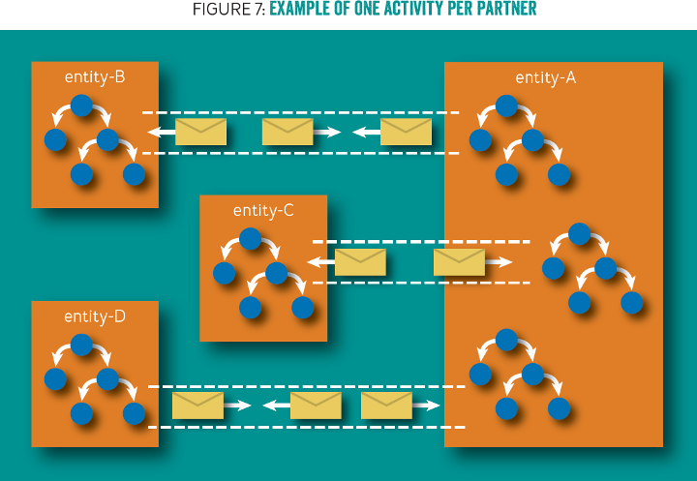

Slide 51
/orders/123
Solution: Domain events!
Check inbox for already received events
Use outbox to "communicate" to other aggregates
Remove events from outbox as they are processed
Inbox
Outbox

Slide 52
Aggregate
Aggregate
Data
Data
In
In
Out
Out
Aggregate
Data
In
Out
Notes:
3 aggregates participating in a single request, but no way to coordinate a transaction between the 3

Slide 53
Aggregate
Aggregate
Data
Data
…
…
In
In
Out
Out
Aggregate
Data
In
Out
Notes:
Initial request initiates changes in the first aggregate. It needs to communicate to the others so it creates a couple of domain events.

Slide 54
✓
Aggregate
Aggregate
Data
Data
…
…
In
In
Out
Out
Aggregate
Data
In
Out
Notes:
The transaction for the first aggregate document commits, including the domain events

Slide 55
✓
Aggregate
Aggregate
Data
Data
…
…
In
In
Out
Out
Aggregate
Data
Dispatcher
In
Out
Notes:
The domain event dispatcher is responsible for taking domain events and dispatching them to event handlers (and eventually other aggregates)

Slide 56
✓
Aggregate
Aggregate
Data
Data
…
…
In
In
Out
Out
Aggregate
Data
Dispatcher
In
Out
Notes:
The dispatcher reads the first event from the aggregate

Slide 57
✓
Aggregate
Aggregate
Data
Data
…
…
In
In
Out
Out
Aggregate
Data
Dispatcher
In
Out
Notes:
And will dispatch it to handlers, who know how to match domain events to aggregates

Slide 58
✓
Aggregate
Aggregate
Data
Data
…
…
…
…
In
In
Out
Out
Aggregate
Data
Dispatcher
In
Out
Notes:
The first domain event is matched to an aggregate, and the aggregate handles it by mutating its data and storing this handled domain event in its inbox

Slide 59
✓
✓
Aggregate
Aggregate
Data
Data
…
…
…
…
In
In
Out
Out
Aggregate
Data
Dispatcher
In
Out
Notes:
This aggregate document transaction succeeds

Slide 60
✓
✓
Aggregate
Aggregate
Data
Data
…
…
…
…
In
In
Out
Out
Aggregate
Data
Dispatcher
In
Out
Notes:
Upon dispatch to the second aggregate however, this one fails, so no data is written and no event stored in the outbox

Slide 61
✓
✓
Aggregate
Aggregate
Data
Data
…
…
…
…
In
In
Out
Out
Aggregate
Data
Dispatcher
In
Out
Retry
Notes:
Detecting a failure, the dispatcher sends a durable message to an aggregate retry queue, noting the aggregate type and ID to retry domain events.

Slide 62
Retries

Slide 63
Aggregate
Aggregate
Data
Data
…
…
…
…
In
In
Out
Out
Aggregate
Data
Dispatcher
In
Out
Retry
Notes:
For retries, the dispatcher reads messages from the aggregate retry queue.

Slide 64
Aggregate
Aggregate
Data
Data
…
…
…
…
In
In
Out
Out
Aggregate
Data
Dispatcher
In
Out
Retry
Notes:
The dispatcher then pulls the aggregate and attempts to re-dispatch its domain events to the relevant handlers

Slide 65
Aggregate
Aggregate
Data
Data
…
…
…
…
In
In
Out
Out
Aggregate
Data
Dispatcher
In
Out
Retry
Notes:
For the first aggregate, it sends the domain event to the handler

Slide 66
Aggregate
Aggregate
Data
Data
…
…
…
…
In
In
Out
Out
Aggregate
Data
Dispatcher
In
Out
Retry
Notes:
The aggregate checks its inbox and compares the ID of the incoming domain event to its inbox of processed events

Slide 67
¯\_(ツ)_/¯
Aggregate
Aggregate
Data
Data
…
…
…
…
In
In
Out
Out
Aggregate
Data
Dispatcher
In
Out
Retry
Notes:
It sees that the message has already been processed, so ignores the event. Handling the domain event maintains idempotency, so that receiving a domain event at-least-once results in the actual processing of the event to only happen once

Slide 68
¯\_(ツ)_/¯
Aggregate
Aggregate
Data
Data
…
…
…
…
In
In
Out
Out
Aggregate
Data
…
…
Dispatcher
In
Out
Retry
Notes:
The dispatcher notifies the next handler of a domain event

Slide 69
¯\_(ツ)_/¯
Aggregate
Aggregate
Data
Data
…
…
…
…
In
In
Out
Out
✓
Aggregate
Data
…
…
Dispatcher
In
Out
Retry
Notes:
However, this aggregate has not processed this domain event before, so it processes the domain event and stores it in its inbox.

Slide 70
¯\_(ツ)_/¯
Aggregate
Aggregate
Data
Data
…
…
…
…
In
In
Out
Out
✓
Aggregate
Data
…
…
Dispatcher
In
Out
Retry
Notes:
Now that all handlers have successfully processed the domain event, the dispatcher tells the originating aggregate that the domain event can safely be deleted (or marked as processed)

Slide 71
✓
¯\_(ツ)_/¯
Aggregate
Aggregate
Data
Data
…
…
…
…
In
In
Out
Out
✓
Aggregate
Data
…
…
Dispatcher
In
Out
Retry
Notes:
The originating aggregate is now saved, and we repeat for all domain events.

Slide 72
Demo

Slide 73
From SQL to Azure Cosmos DB
Jimmy Bogard
@jbogard
github.com/jbogard
jimmybogard.com

