Slide 1




SOLID Architecture: Slices not Layers
Jimmy Bogard
@jbogard
github.com/jbogard
jimmybogard.lostechies.com

Slide 2


Slide 3
Inmates and asylums
ASPX
4 screens
Basic workflow
Role-based security
20K LoC
2 solutions, 12 projects
Code-Behind
ServiceProxy
WCF Service Proxy
WCF Service
BAL
DAL
Stored Procedure

Slide 4
Traditional n-tier
UI Layer
Business Logic Layer
Data Access Layer
Database

Slide 5
DDD-style n-tier
UI Layer
Domain Objects
Repository
Database

Slide 6
Organizing by layer
Person.cs
PersonController.cs
PersonService.cs
PersonRepository.cs

Slide 7
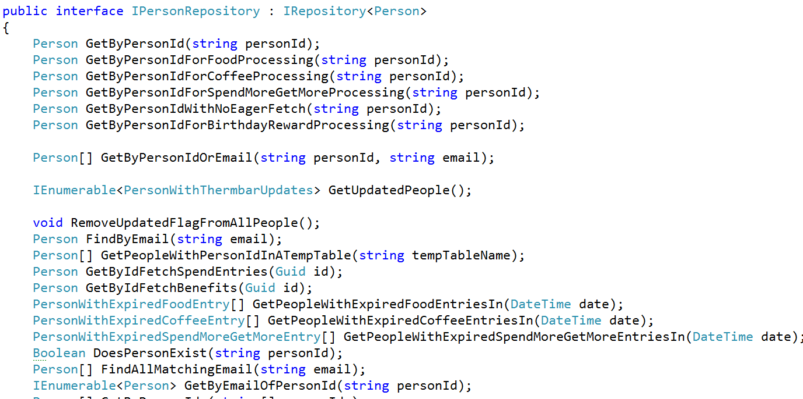
Inmates blew up the asylum

Slide 8
First step to sanity: Collapse layers

Slide 9
Web App Characteristics
Web App
Safe
Idempotent
Unsafe
Not idempotent
GET
Query
POST
Command

Slide 10
CQRS: Two models where once there was one

Slide 11
CQRS to the Rescue
Queries
Commands

Slide 12
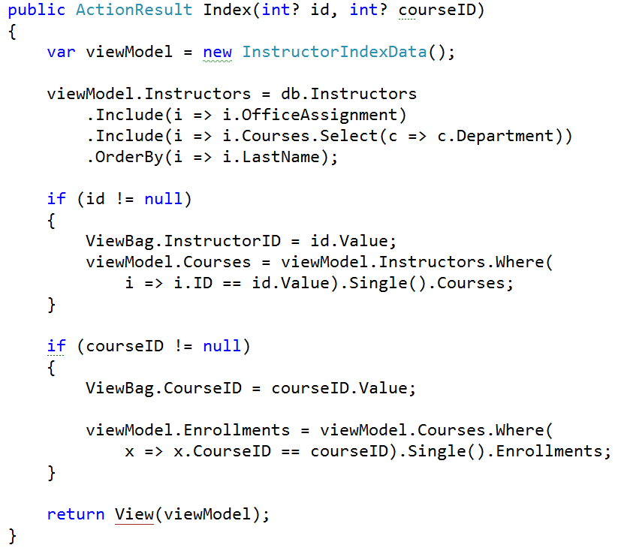
Queries

Slide 13
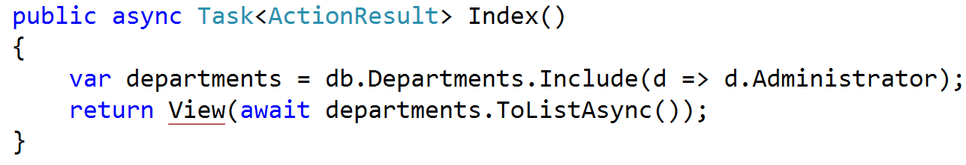
Queries

Slide 14
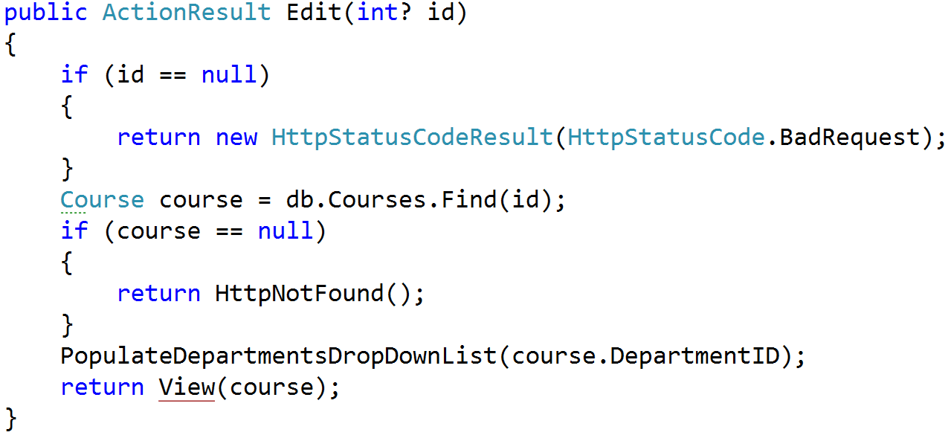
Queries

Slide 15
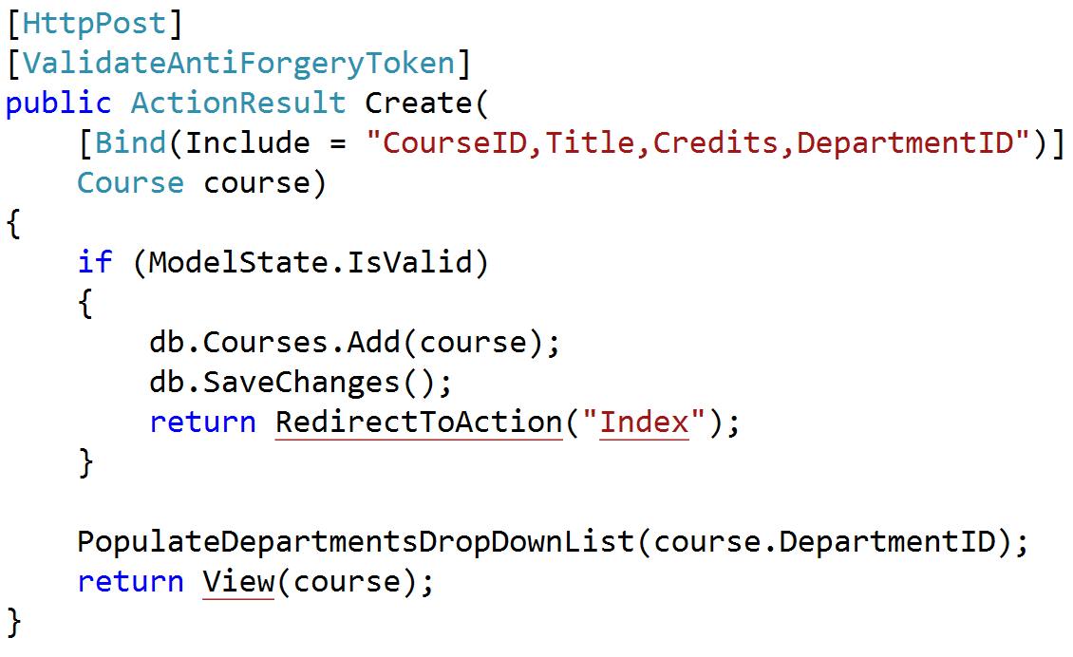
Commands

Slide 16
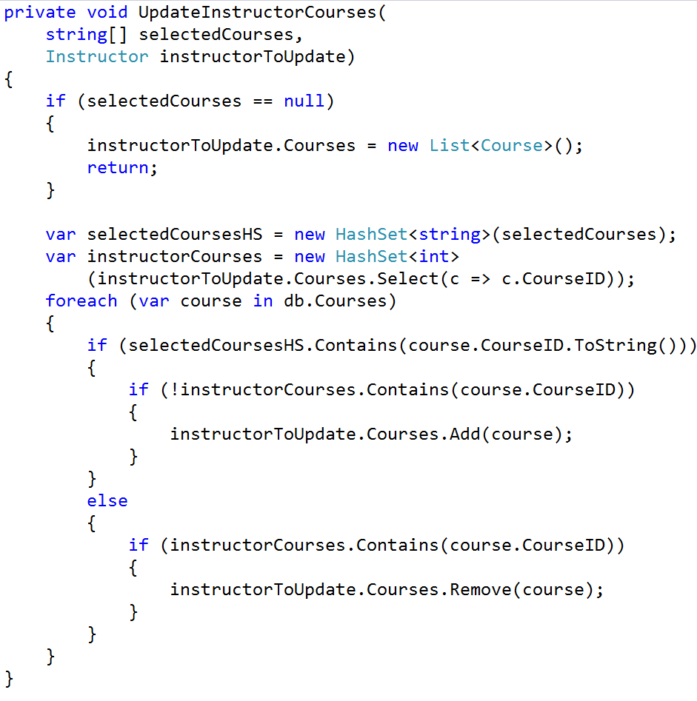
Commands

Slide 17
Creating queries

Slide 18
Modeling requests
Input
Request Handler
Output

Slide 19

Modeling requests with MediatR
Command
Command
Handler
Query
Query Handler

Slide 20
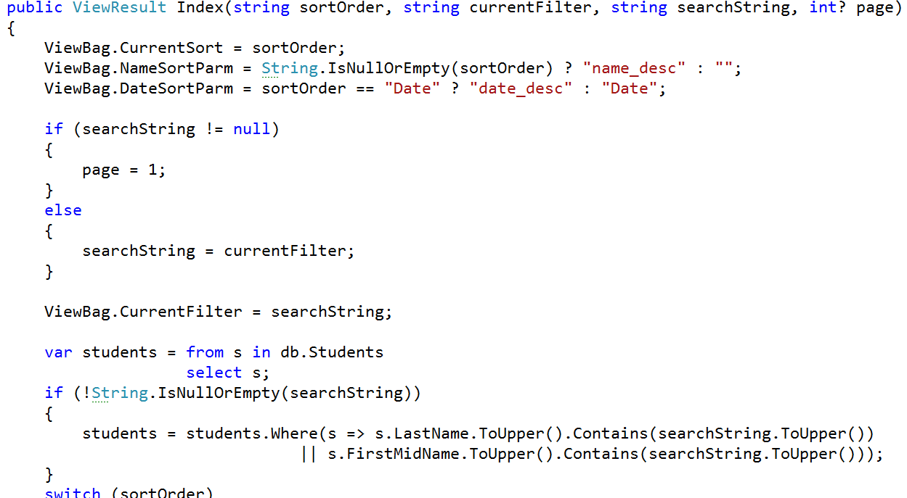
Modeling inputs

Slide 21
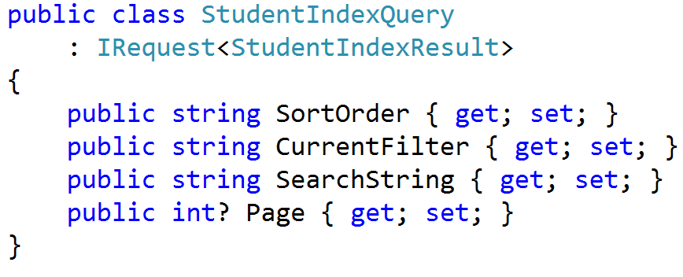
Query Requests

Slide 22
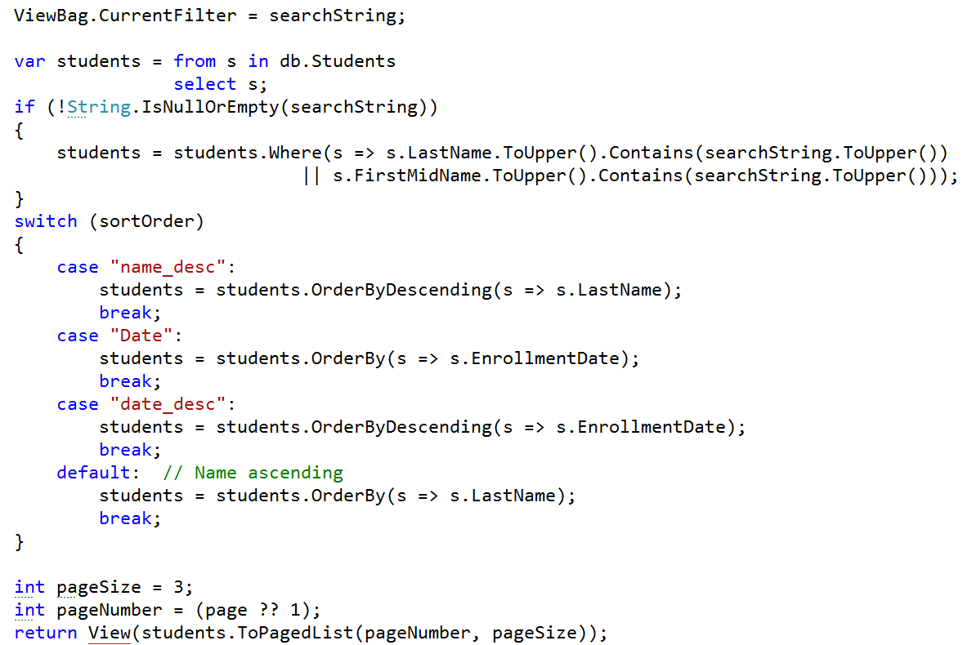
Modeling outputs

Slide 23
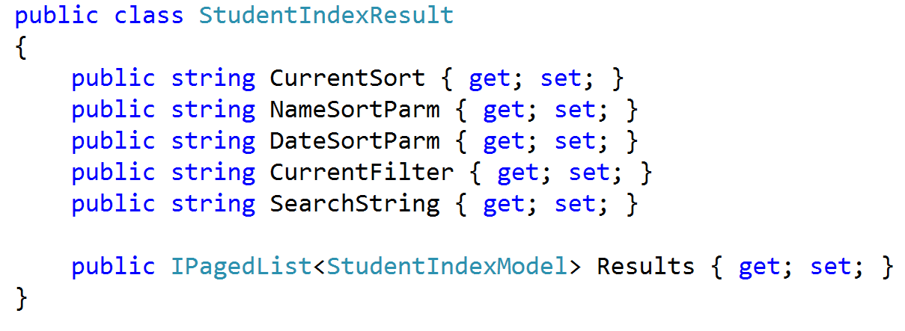
Query Response

Slide 24
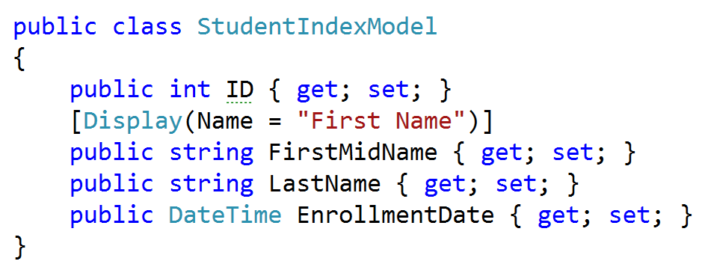
Query Model

Slide 25
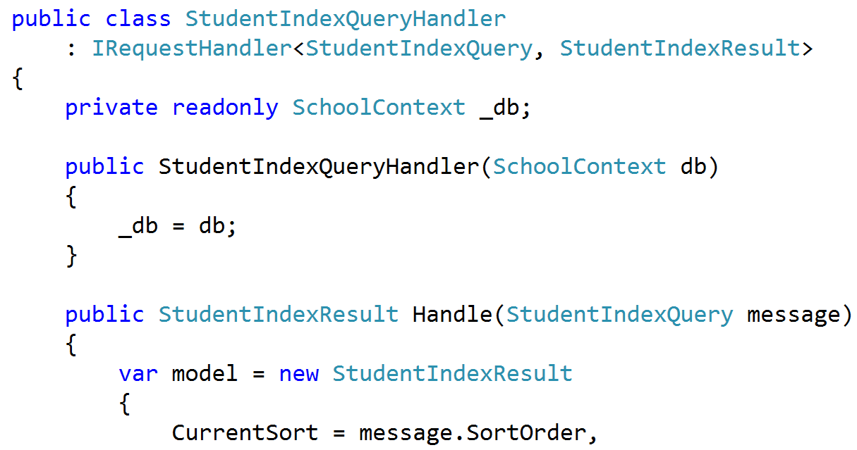
Handling Query Request

Slide 26
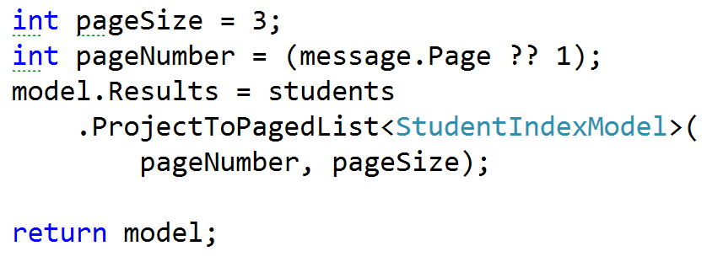
Returning Query Result

Slide 27
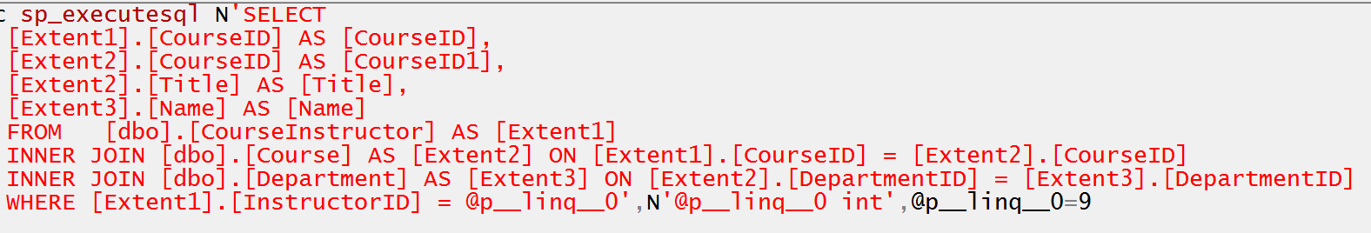
Projecting Query Result

Slide 28
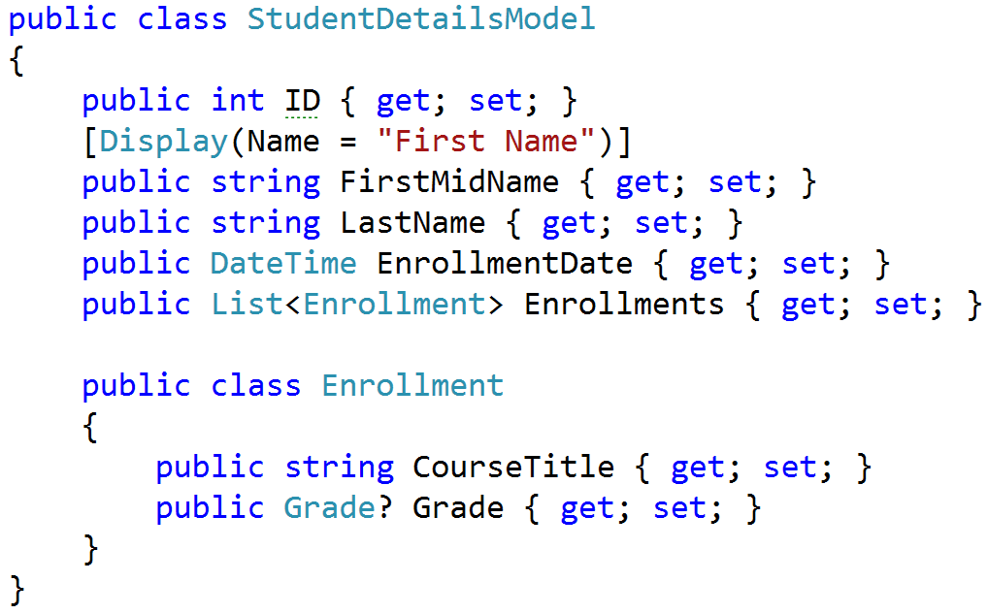
Complex query response

Slide 29
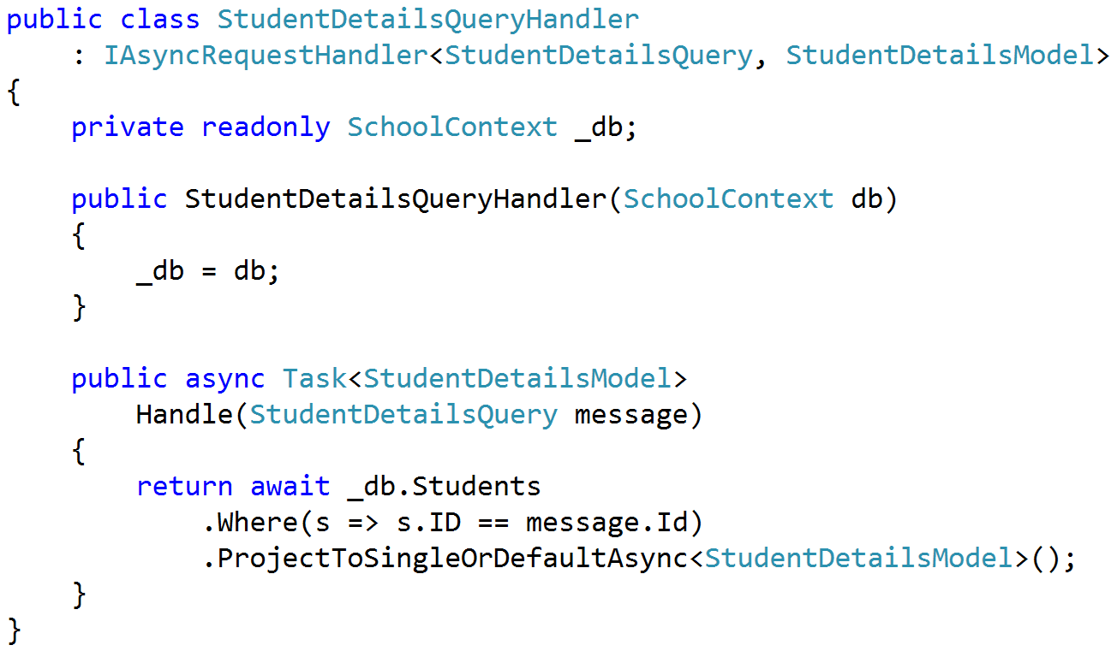
Projecting single model

Slide 30
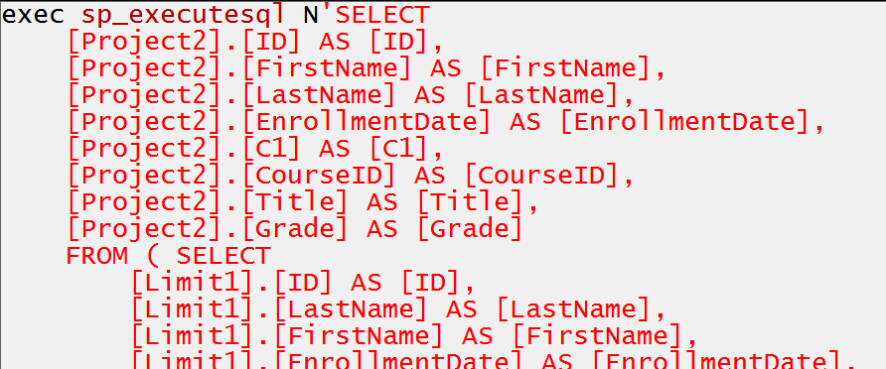
Single projected query

Slide 31
Creating commands

Slide 32
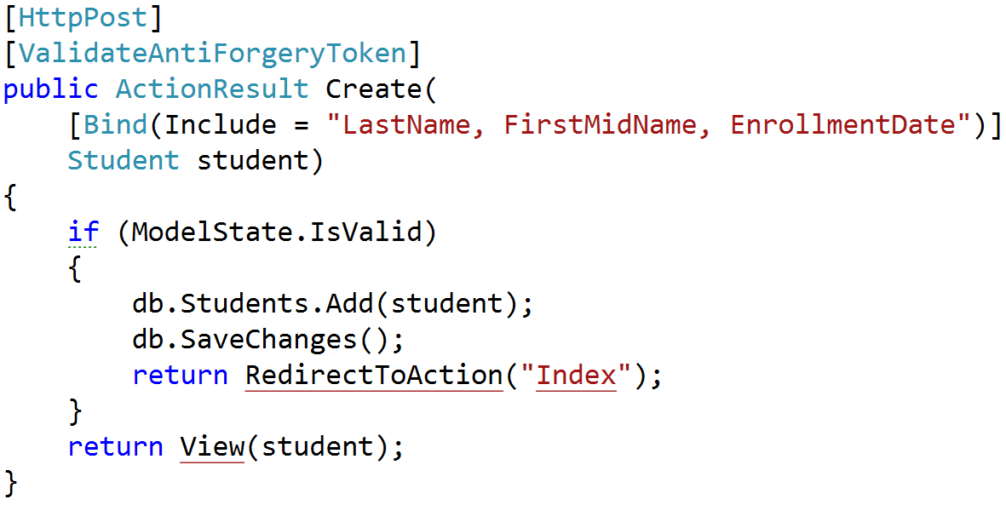
Command modeling

Slide 33
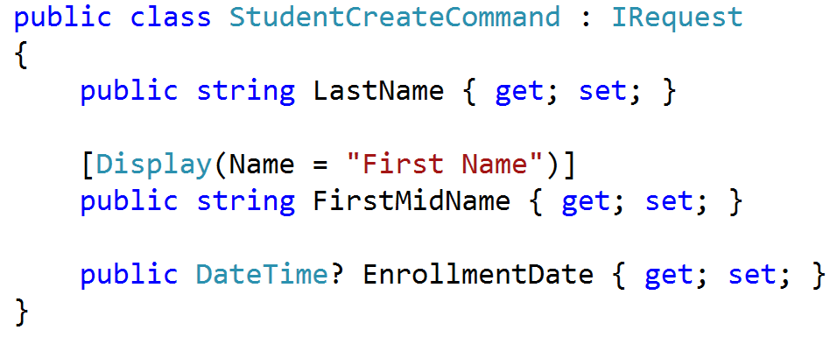
Command Request

Slide 34
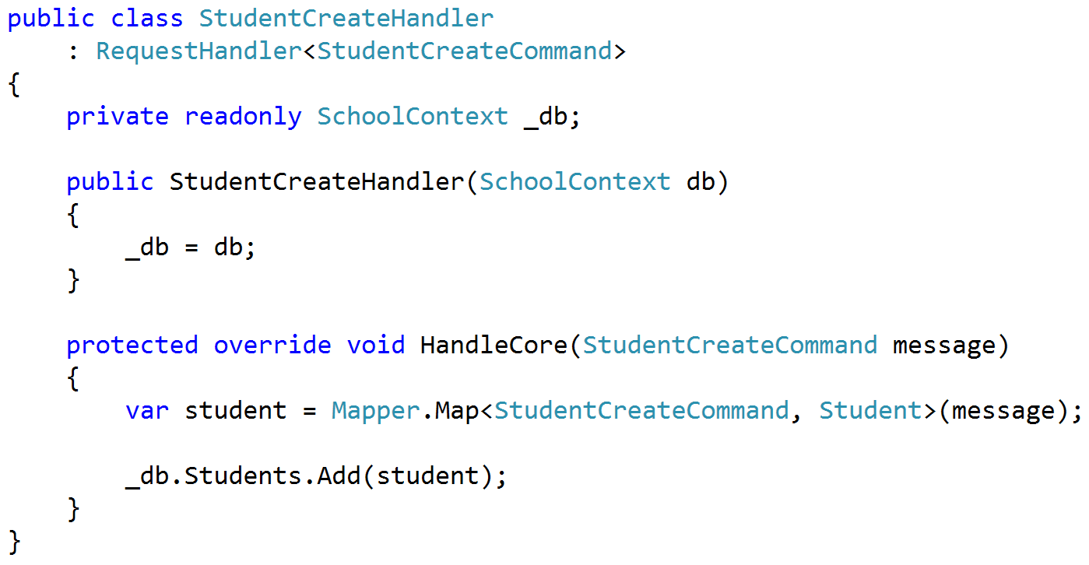
Command Handling

Slide 35
Cross-cutting concerns

Slide 36
Validation

Slide 37
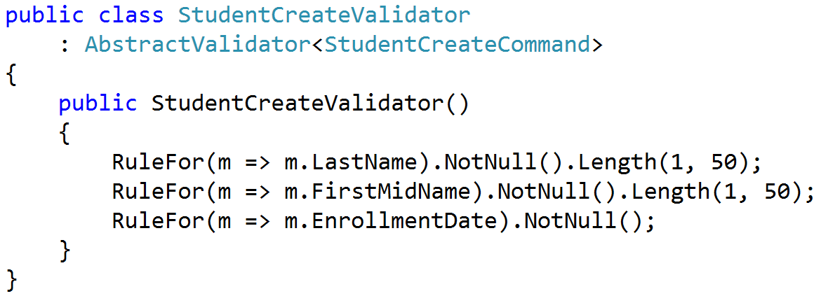
Validate requests, not entities

Slide 38
Organize by feature not layer

Slide 39
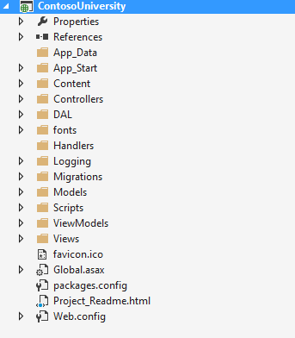
Areas of change

Slide 40
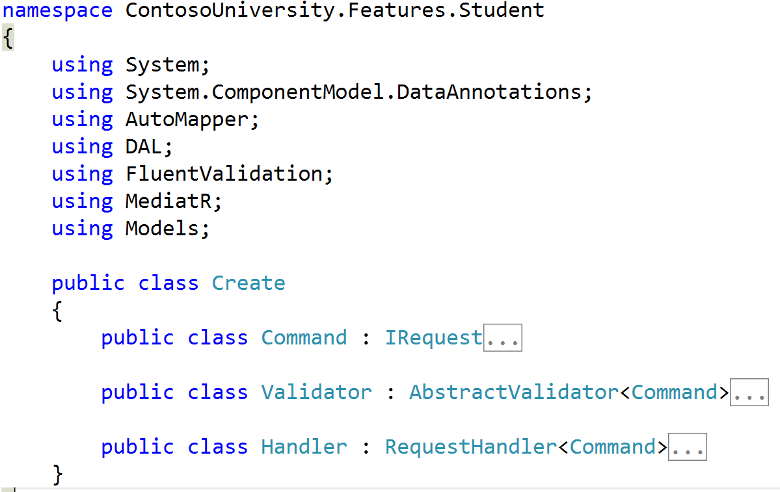
Collapsing Models

Slide 41
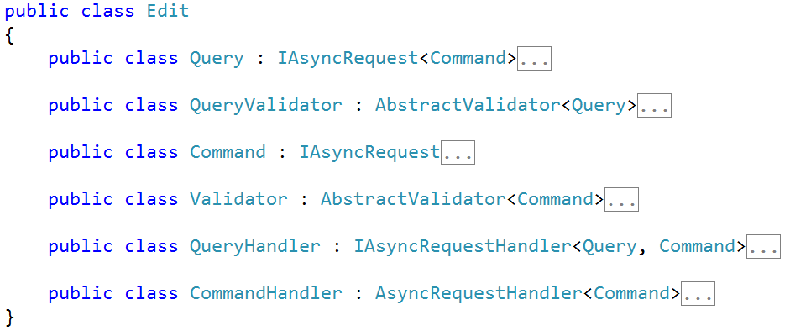
Collapsing Features

Slide 42
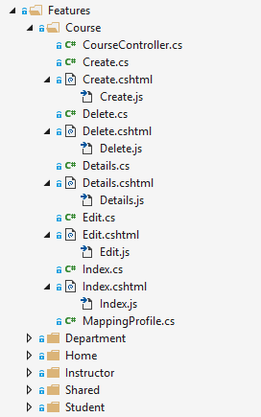
Full-stack organization

Slide 43
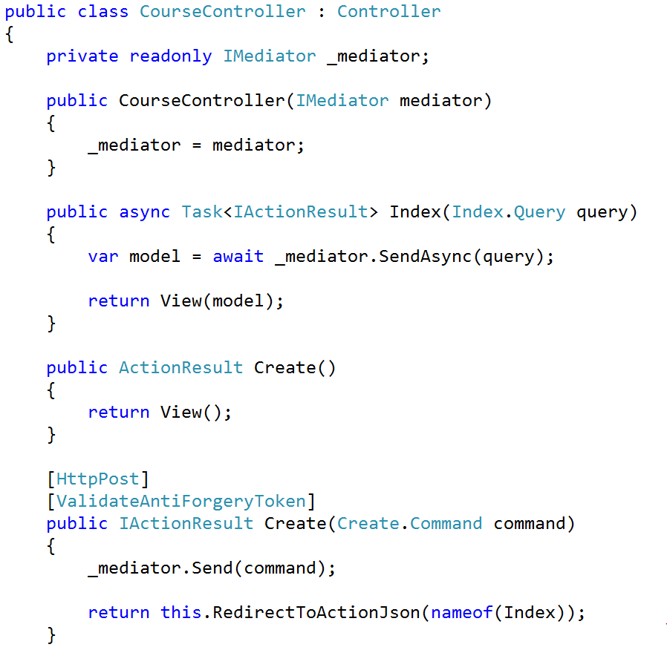
Our Controller

Slide 44
DDD Reinvigorated
Handler
Entity
Retrieve Entity
Actual Work
Actual Work
Save Entity

Slide 45
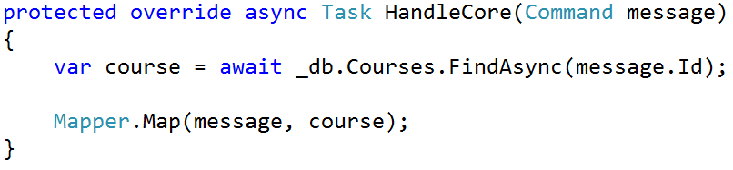
Simple Commands

Slide 46
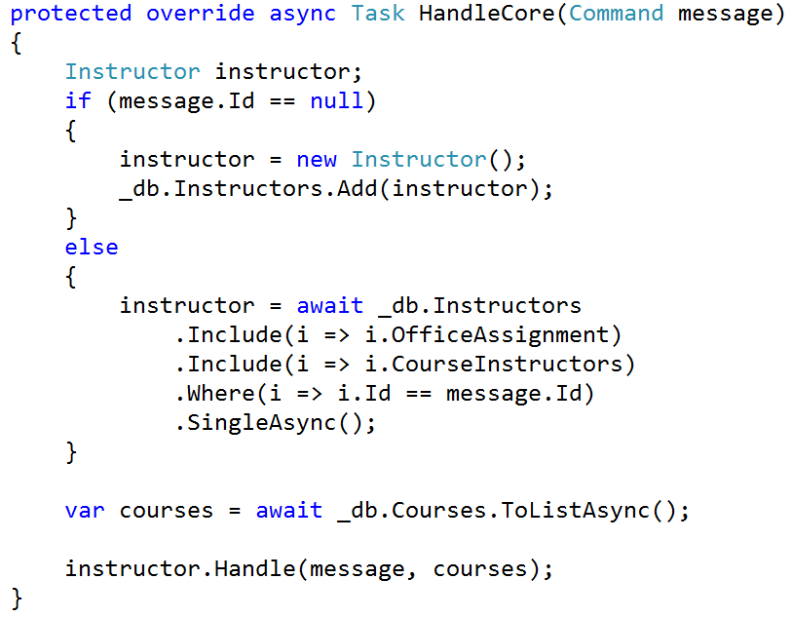
Complex Commands

Slide 47
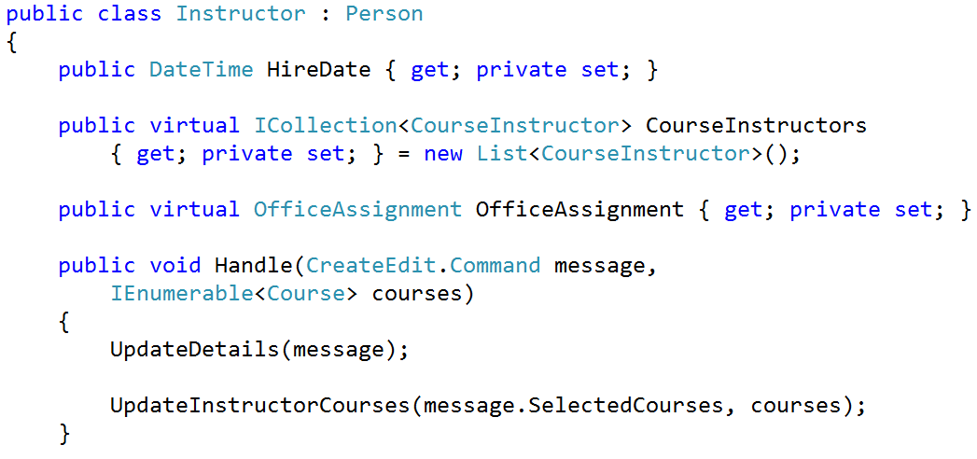
Commands to Aggregates

Slide 48
Architecture in slices
Validation
Domain Agnostic
Authentication
Authorization
Feature
Feature
Feature
Feature
Feature
Feature
Feature
Feature
Feature
Feature
Feature
Feature
Feature
Feature
Domain Specific
Persistence

Slide 49
SOLID Roundup
SRP – One class per feature/concept
OCP – Extend through cross-cutting concerns
LSP – Just don’t do inheritance
ISP – Separating queries from commands
DIP – Save for true external dependencies

Slide 50
SOLID Architecture: Slices not Layers
Jimmy Bogard
@jbogard
github.com/jbogard
jimmybogard.lostechies.com
github.com/jbogard/presentations

