Slide 1




From SQL to Azure Cosmos DB
Jimmy Bogard
@jbogard
github.com/jbogard
jimmybogard.com

Slide 2
What is Azure Cosmos DB?

Slide 3
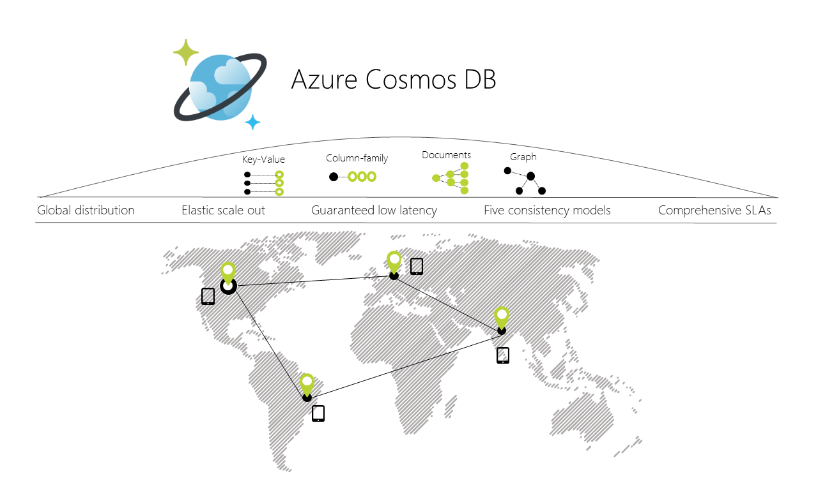
Notes:
globally distributed, multi-model database service

Slide 4
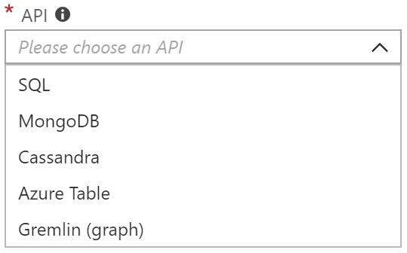
Multi-Model
SQL-over-JSON
Document
Column
Table (Azure Table Storage)
Graph
More to come

Slide 5
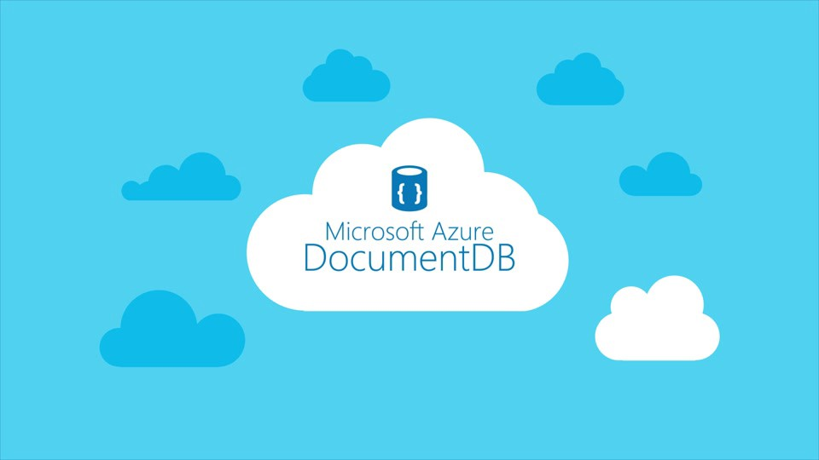

Slide 6
Why should I use it?

Slide 8
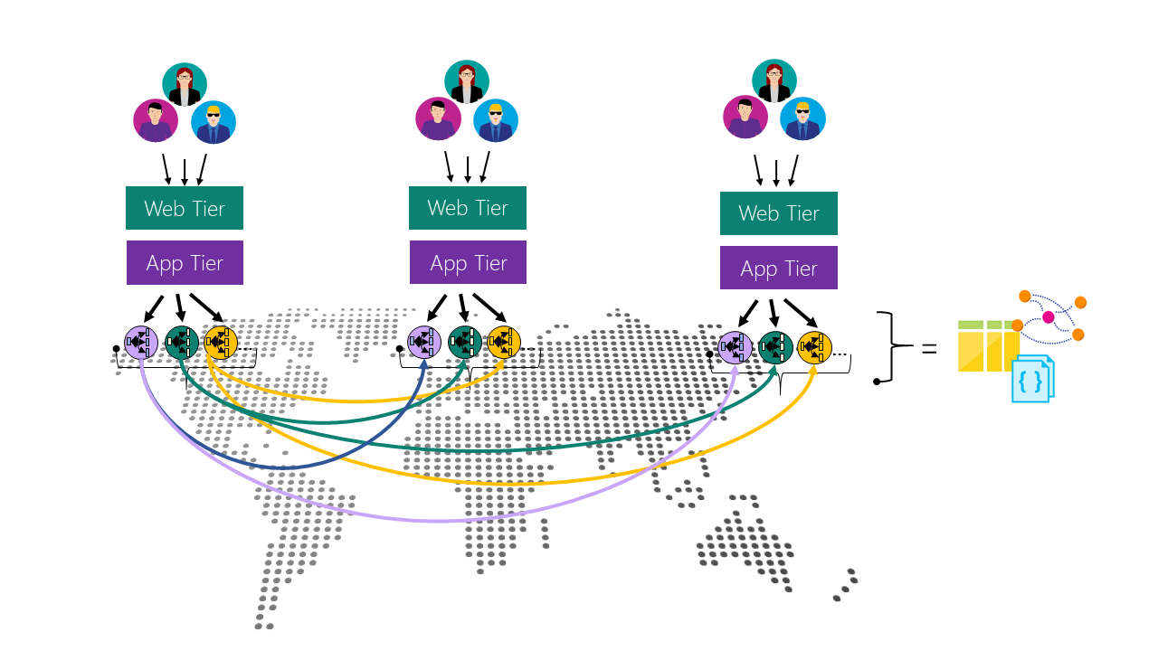

Slide 9





Slide 10
Schema-less in SQL

Slide 11
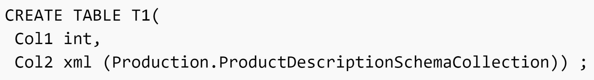

Slide 12
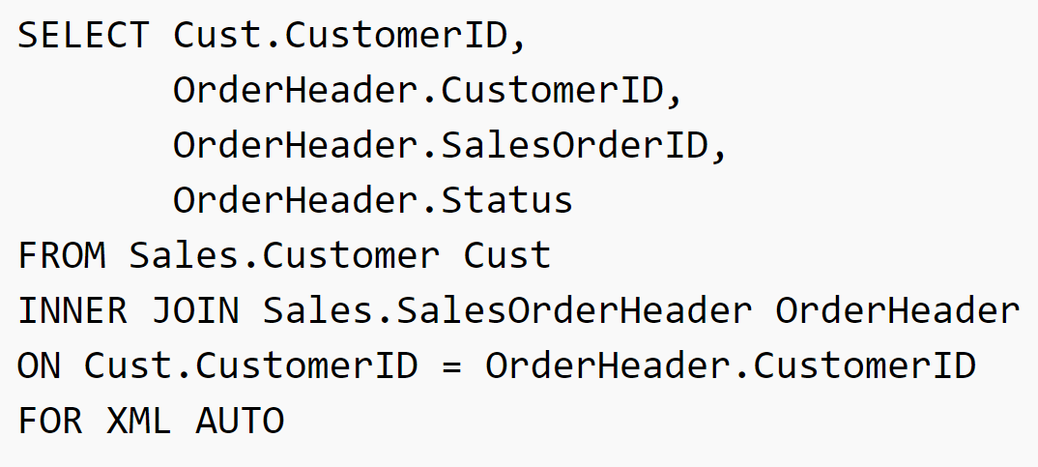

Slide 13
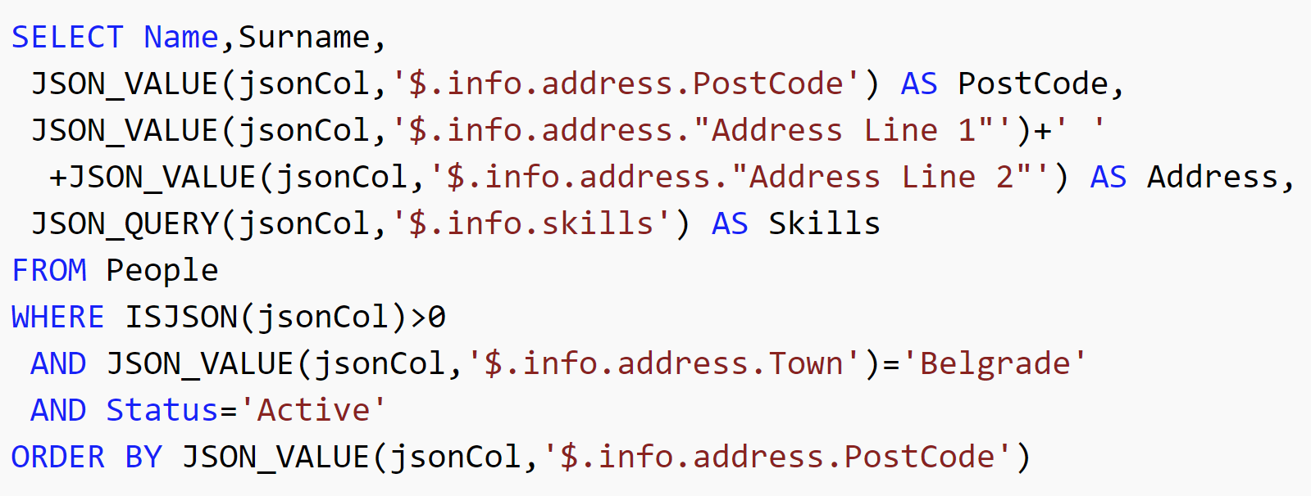

Slide 14
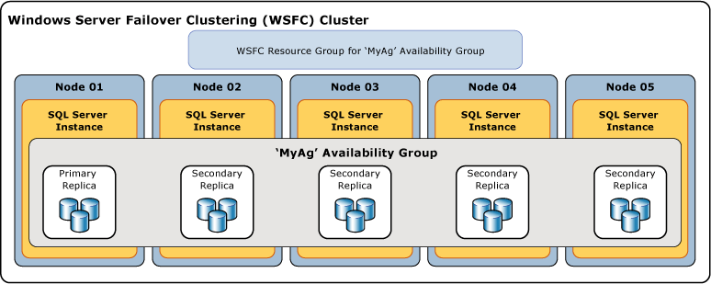

Slide 15
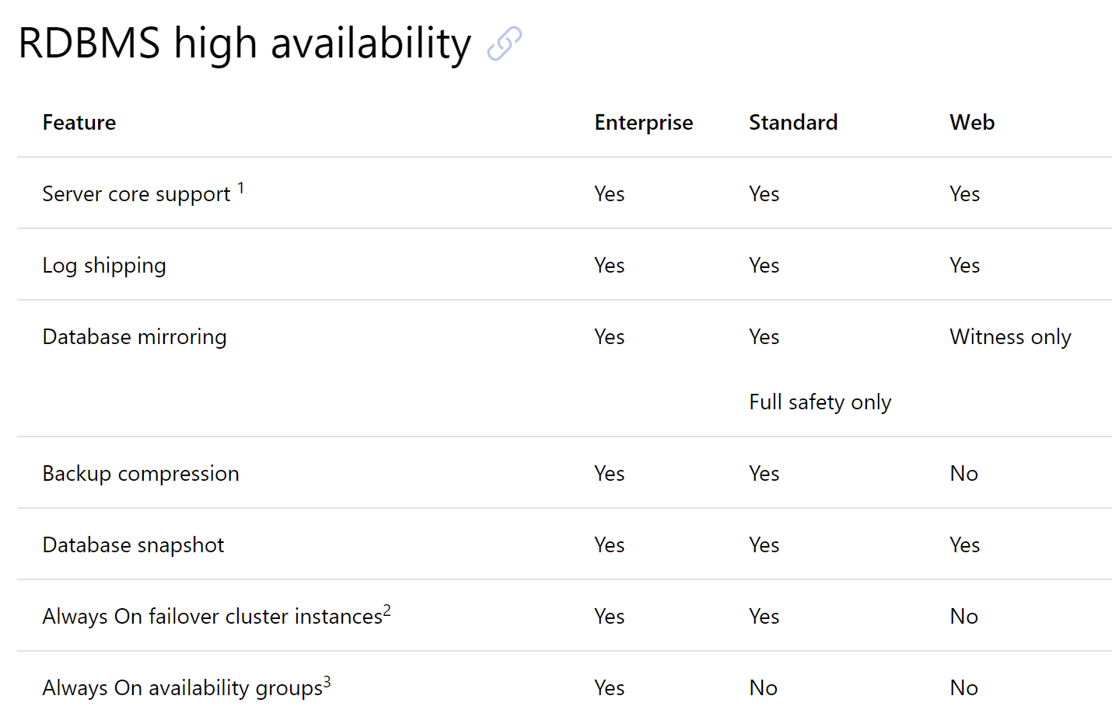

Slide 16
Transitioning from SQL

Slide 18
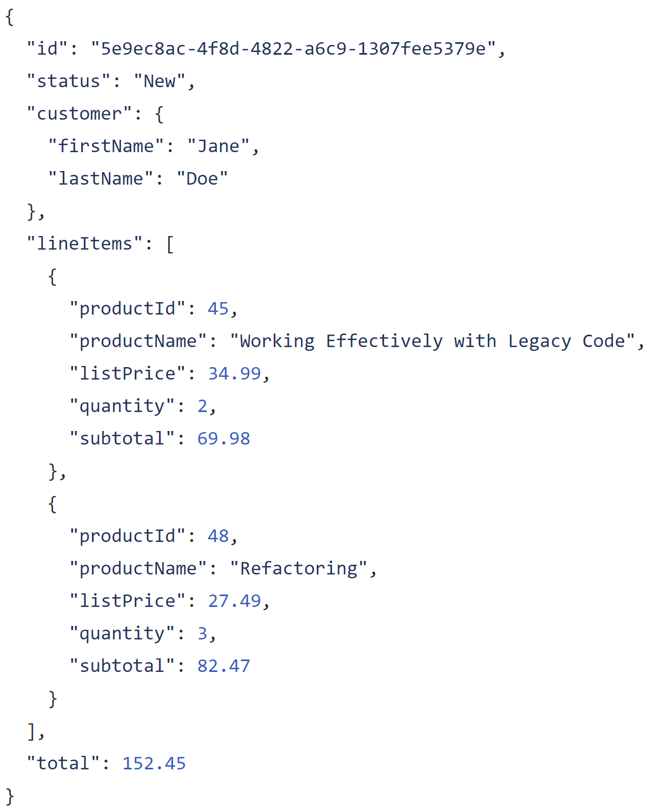

Slide 19
Entire model in one record

Slide 20
Complex structures

Slide 21
Arrays for one-to-many

Slide 22
Store keys for other/external entities

Slide 23
Duplicate data as needed

Slide 24
Not all duplicate data is evil!

Slide 25
Catalog
Cart
Order
Fulfillment
Customer Journey and Value Stream

Slide 26
$24.99
Catalog
Cart
Order
Fulfillment
Customer Journey and Value Stream

Slide 27
$24.99
$24.99
Catalog
Cart
Order
Fulfillment
Customer Journey and Value Stream

Slide 28
$24.99
$24.99
$24.99
Catalog
Cart
Order
Fulfillment
Customer Journey and Value Stream

Slide 29
$24.99
$24.99
$24.99
$24.99
Catalog
Cart
Order
Fulfillment
Customer Journey and Value Stream

Slide 30
$24.99
$25.49
$24.99
$24.99
$24.99
Catalog
Cart
Order
Fulfillment
Customer Journey and Value Stream

Slide 31
?
?
?
$24.99
$25.49
$24.99
$24.99
$24.99
Catalog
Cart
Order
Fulfillment
Customer Journey and Value Stream

Slide 32
$24.99
$25.49
$24.99
$24.99
$24.99
Catalog
Cart
Order
Fulfillment
Customer Journey and Value Stream
Data may move around and when it crosses service boundaries, its meaning can change

Slide 35
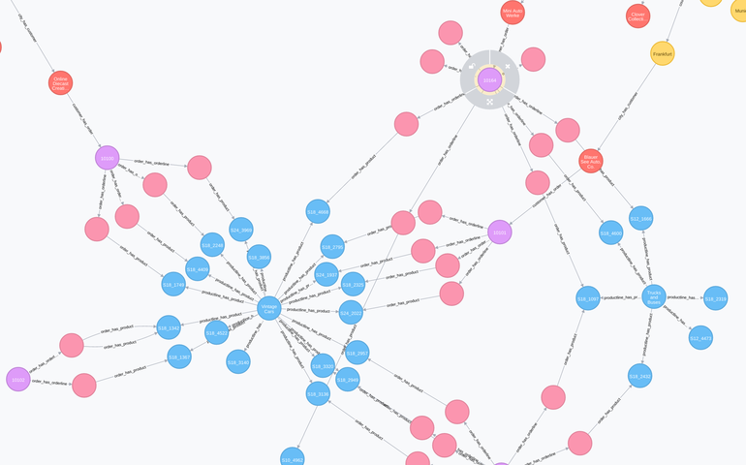

Slide 36
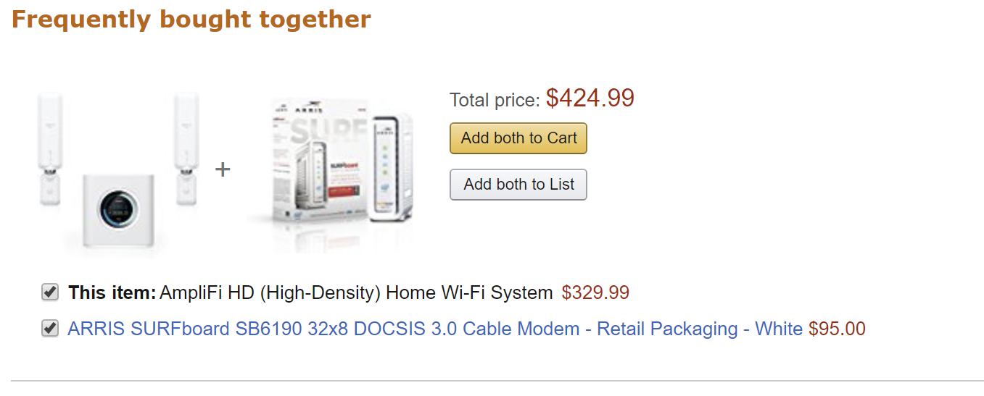

Slide 37
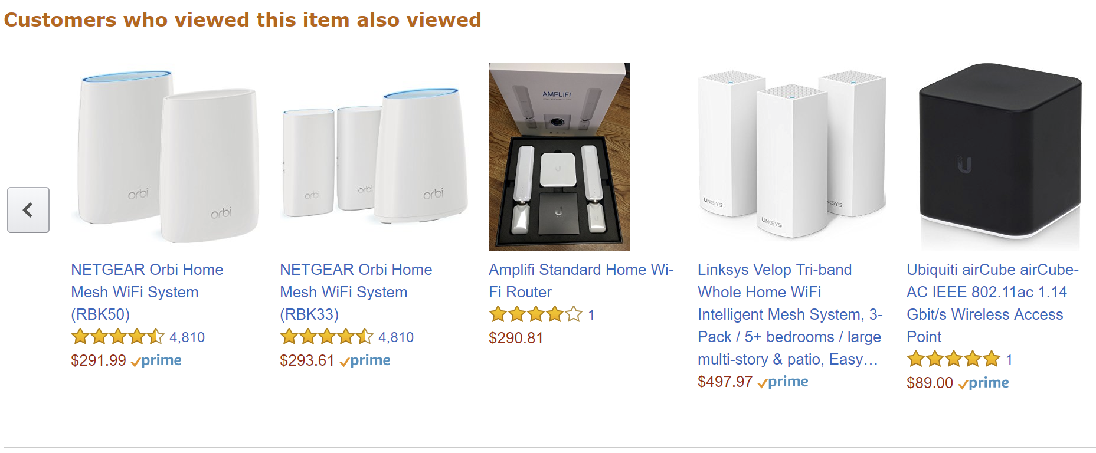

Slide 38
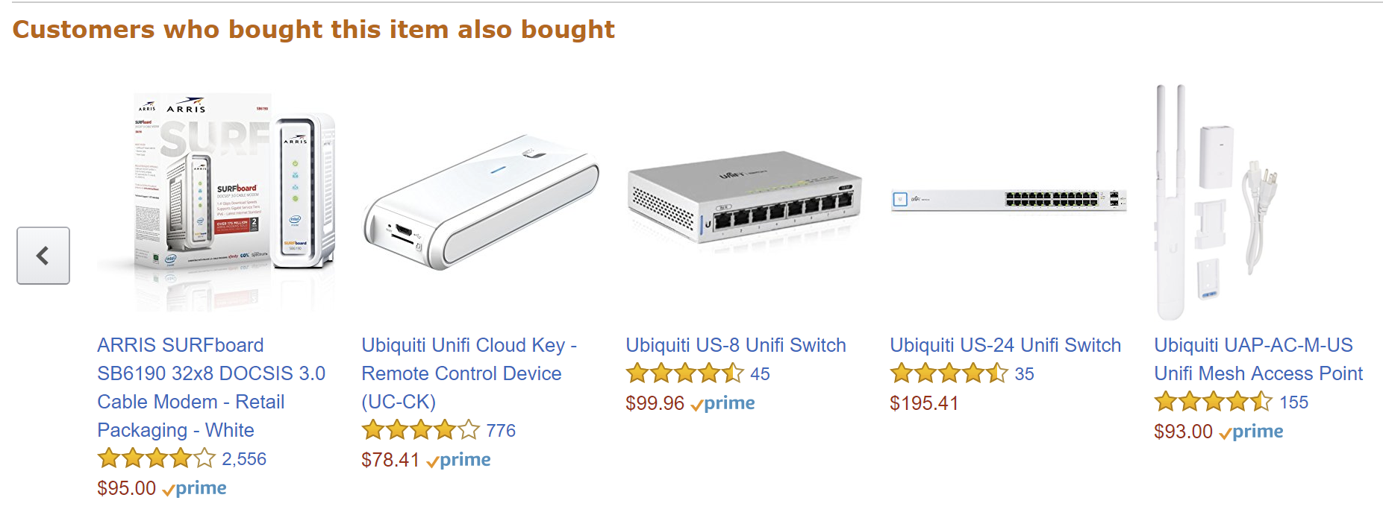

Slide 40
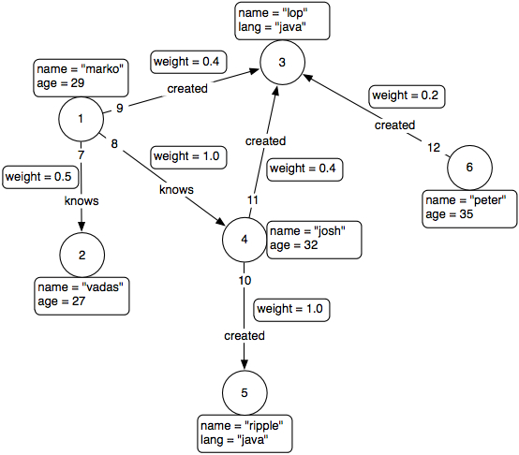
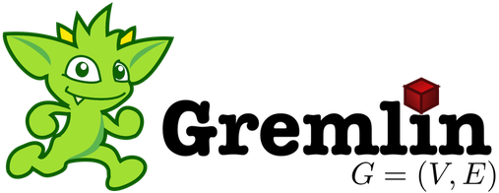

Slide 41
Demo

Slide 42
Transitioning from Transactioning in SQL

Slide 43


Slide 44
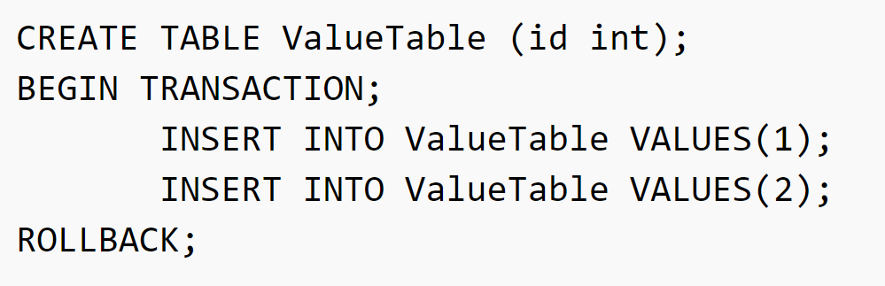

Slide 45
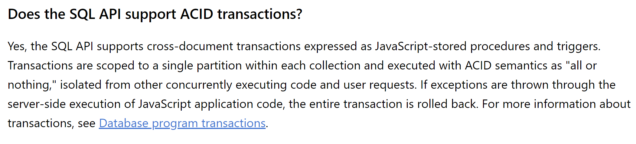

Slide 47
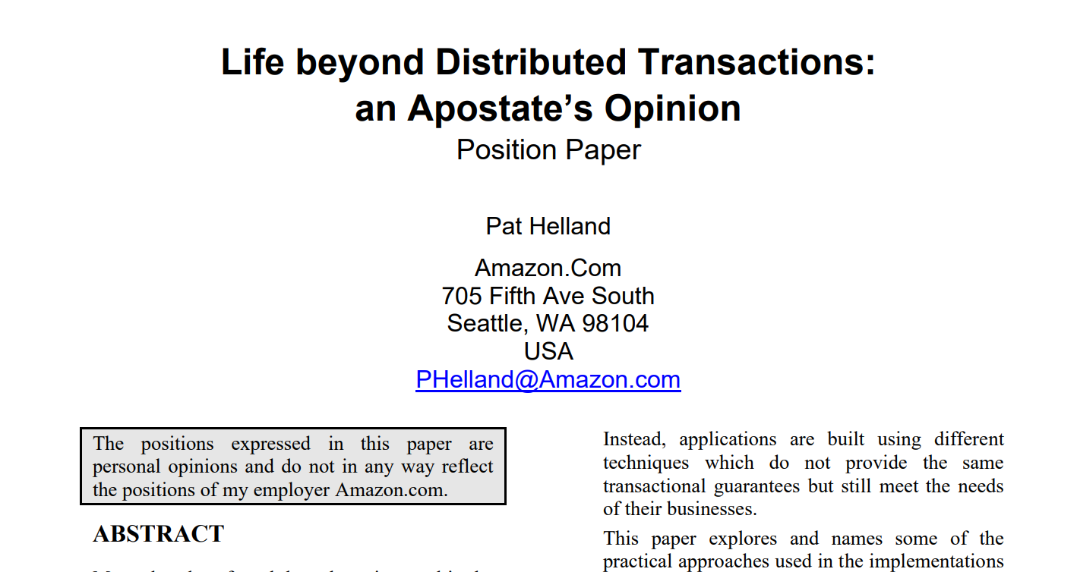

Slide 48
Apostate: One who abandons a previous loyalty or faith

Slide 49
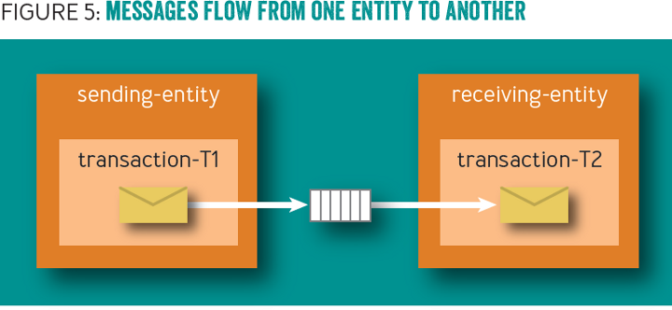

Slide 50
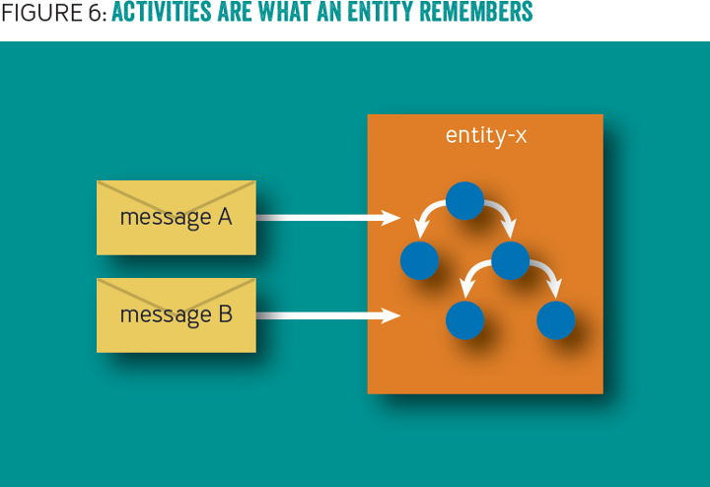

Slide 51
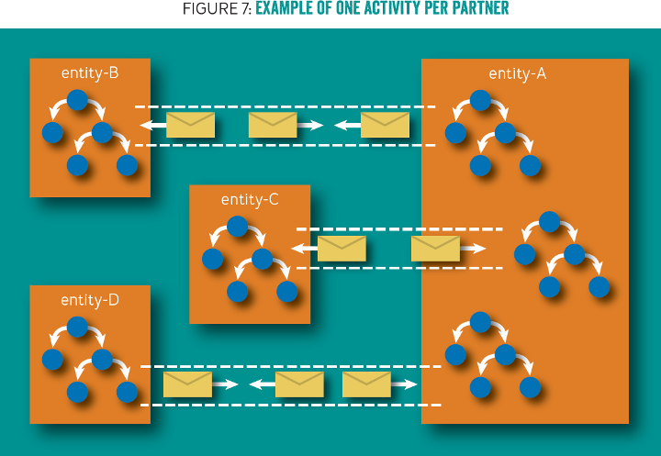

Slide 52
/orders/123
Solution: Domain events!
Check inbox for already received events
Use outbox to "communicate" to other documents
Remove events from outbox as they are processed
Inbox
Outbox

Slide 53
Document
Document
Data
Data
In
In
Out
Out
Document
Data
In
Out
Notes:
3 documents participating in a single request, but no way to coordinate a transaction between the 3

Slide 54
Document
Document
Data
Data
…
…
In
In
Out
Out
Document
Data
In
Out
Notes:
Initial request initiates changes in the first document. It needs to communicate to the others so it creates a couple of domain events.

Slide 55
✓
Document
Document
Data
Data
…
…
In
In
Out
Out
Document
Data
In
Out
Notes:
The transaction for the first document document commits, including the domain events

Slide 56
✓
Document
Document
Data
Data
…
…
In
In
Out
Out
Document
Data
Dispatcher
In
Out
Notes:
The domain event dispatcher is responsible for taking domain events and dispatching them to event handlers (and eventually other documents)

Slide 57
✓
Document
Document
Data
Data
…
…
In
In
Out
Out
Document
Data
Dispatcher
In
Out
Notes:
The dispatcher reads the first event from the document

Slide 58
✓
Document
Document
Data
Data
…
…
In
In
Out
Out
Document
Data
Dispatcher
In
Out
Notes:
And will dispatch it to handlers, who know how to match domain events to documents

Slide 59
✓
Document
Document
Data
Data
…
…
…
…
In
In
Out
Out
Document
Data
Dispatcher
In
Out
Notes:
The first domain event is matched to an document, and the document handles it by mutating its data and storing this handled domain event in its inbox

Slide 60
✓
✓
Document
Document
Data
Data
…
…
…
…
In
In
Out
Out
Document
Data
Dispatcher
In
Out
Notes:
This document document transaction succeeds

Slide 61
✓
✓
Document
Document
Data
Data
…
…
…
…
In
In
Out
Out
Document
Data
Dispatcher
In
Out
Notes:
Upon dispatch to the second document however, this one fails, so no data is written and no event stored in the outbox

Slide 62
✓
✓
Document
Document
Data
Data
…
…
…
…
In
In
Out
Out
Document
Data
Dispatcher
In
Out
Retry
Notes:
Detecting a failure, the dispatcher sends a durable message to an document retry queue, noting the document type and ID to retry domain events.

Slide 63
Retries

Slide 64
Document
Document
Data
Data
…
…
…
…
In
In
Out
Out
Document
Data
Dispatcher
In
Out
Retry
Notes:
For retries, the dispatcher reads messages from the document retry queue.

Slide 65
Document
Document
Data
Data
…
…
…
…
In
In
Out
Out
Document
Data
Dispatcher
In
Out
Retry
Notes:
The dispatcher then pulls the document and attempts to re-dispatch its domain events to the relevant handlers

Slide 66
Document
Document
Data
Data
…
…
…
…
In
In
Out
Out
Document
Data
Dispatcher
In
Out
Retry
Notes:
For the first document, it sends the domain event to the handler

Slide 67
Document
Document
Data
Data
…
…
…
…
In
In
Out
Out
Document
Data
Dispatcher
In
Out
Retry
Notes:
The document checks its inbox and compares the ID of the incoming domain event to its inbox of processed events

Slide 68
¯\_(ツ)_/¯
Document
Document
Data
Data
…
…
…
…
In
In
Out
Out
Document
Data
Dispatcher
In
Out
Retry
Notes:
It sees that the message has already been processed, so ignores the event. Handling the domain event maintains idempotency, so that receiving a domain event at-least-once results in the actual processing of the event to only happen once

Slide 69
¯\_(ツ)_/¯
Document
Document
Data
Data
…
…
…
…
In
In
Out
Out
Document
Data
…
…
Dispatcher
In
Out
Retry
Notes:
The dispatcher notifies the next handler of a domain event

Slide 70
¯\_(ツ)_/¯
Document
Document
Data
Data
…
…
…
…
In
In
Out
Out
✓
Document
Data
…
…
Dispatcher
In
Out
Retry
Notes:
However, this document has not processed this domain event before, so it processes the domain event and stores it in its inbox.

Slide 71
¯\_(ツ)_/¯
Document
Document
Data
Data
…
…
…
…
In
In
Out
Out
✓
Document
Data
…
…
Dispatcher
In
Out
Retry
Notes:
Now that all handlers have successfully processed the domain event, the dispatcher tells the originating document that the domain event can safely be deleted (or marked as processed)

Slide 72
✓
¯\_(ツ)_/¯
Document
Document
Data
Data
…
…
…
…
In
In
Out
Out
✓
Document
Data
…
…
Dispatcher
In
Out
Retry
Notes:
The originating document is now saved, and we repeat for all domain events.

Slide 73
Demo

Slide 74
How do we dispatch?

Slide 75
Document
Document
Document
Document
Document
Document
Document
Document
Notes:
A single activity results in a cascade of interactions with other Documents

Slide 76
Document
Document
Document
Document
Document
Document
Unit of Work
Document
Document
…
…
…
…
Notes:
As Documents are loaded, they get registered in the unit of work

Slide 77
Document
Document
Document
✓
Document
Document
Document
Unit of Work
Document
Document
…
…
…
…
Notes:
The first Document completes with domain events, and registers with the unit of work

Slide 78
✓
Document
Document
Document
✓
Document
Document
✓
Document
Unit of Work
Document
Document
…
…
…
…
Notes:
The unit of work, through the dispatcher, dispatches domain events to other Documents, which also register in the unit of work

Slide 79
✓
✓
Document
Document
Document
✓
Document
✓
Document
✓
Document
Unit of Work
✓
Document
Document
…
…
…
…
Notes:
And continues to the next level, each Document committing independently

Slide 80
✓
✓
✓
Document
Document
Document
✓
Document
✓
Document
✓
Document
Unit of Work
✓
Document
Document
…
…
…
…
Notes:
But at some point we encounter a failure

Slide 81
✓
✓
✓
Document
Document
Document
✓
Document
✓
Document
✓
Document
Unit of Work
✓
Document
Document
…
…
…
…
Retry
Notes:
We can retry the Document directly above the failure. This will put the failed Documents out of the unit of work processing

Slide 82
✓
✓
✓
Document
Document
Document
✓
Document
✓
Document
✓
Document
Unit of Work
✓
Document
Document
…
…
…
…
Retry
Notes:
Or we can retry at the root of the failure. Most of the operations will be no-op, but we would only have marked the domain events as deleted if the entire operation below it succeeds.

Slide 83
Demo

Slide 84
From SQL to Azure Cosmos DB
Jimmy Bogard
@jbogard
github.com/jbogard
jimmybogard.com

