Slide 1




Cross Platform Development with Portable Class Libraries
Jimmy Bogard
@jbogard
github.com/jbogard
jimmybogard.lostechies.com

Slide 2
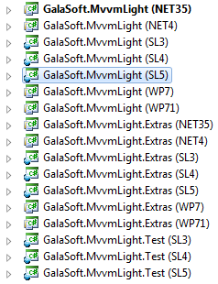
What are Portable Class Libraries?
“The Happy Little Feature that Could”
Enable targeting multiple platforms without recompiling or multiple projects
Save us from #if hell
Abstract away the differences between APIs and available features

Slide 3
Who should care?
2012 – earlier
OSS library developers
Thick client app developers
2013 – today
Mobile app developers (plus all of the above)
People who like testing

Slide 4
What is supported?
VS 2012
.NET 4+
Silverlight 4+
Windows Phone 7+
Windows Store apps
Xbox 360
VS 2013
.NET 4+
Silverlight 5
Windows Phone 8
Windows Store apps

Slide 5

What is supported?
VS 2012
.NET 4+
Silverlight 4+
Windows Phone 7+
Windows Store apps
Xbox 360
VS 2013
.NET 4+
Silverlight 5
Windows Phone 8
Windows Store apps
Xamarin.Android
Xamarin.iOS

Slide 6
What is supported? //build edition
VS 2012
.NET 4+
Silverlight 4+
Windows Phone 7+
Windows Store apps
Xbox 360
VS 2013 Update 2 RC
.NET 4+
Silverlight 5
Windows Phone 8 Silverlight
Windows Phone 8.1
Windows 8
Xamarin.Android
Xamarin.iOS

Slide 7
Licensing
Pre November 2013 – Windows only
After November 2013 - available on all platforms

Slide 8
MVVM (Model-View-ViewModel)
Views
How to display information
Native
View Models
What information to display
Flow of interaction
Models
Data objects
Business objects
Domain models etc
Views
Platform-specific
Databinds
View Model
References
Portable
Model

Slide 9
Windows Universal Apps
Announced at //build
Windows 8.1
Windows Phone 8.1
Xbox One
Views
Databinds
View Model
Portable
References
Model

Slide 10
Cross-Platform App Architecture
Windows Store App
Windows Phone App
Startup
Startup
Views
Views
Platform-specific functionality
Platform-specific functionality
Reference
Reference
Portable Class Library
View Models
Models
Platform abstractions

Slide 11
Demo

