Slide 1




8 Simple TDD Rules
Jimmy Bogard
@jbogard
github.com/jbogard
jimmybogard.lostechies.com

Slide 2
Rule #0 Don’t worry about TDD

Slide 3
Why do we test?
Notes:
Goal is to ship
To know when something breaks
Prototype changes before committing

Slide 4
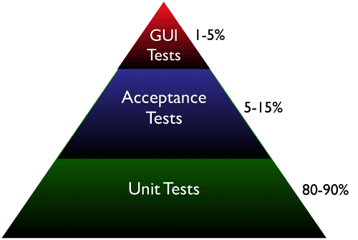
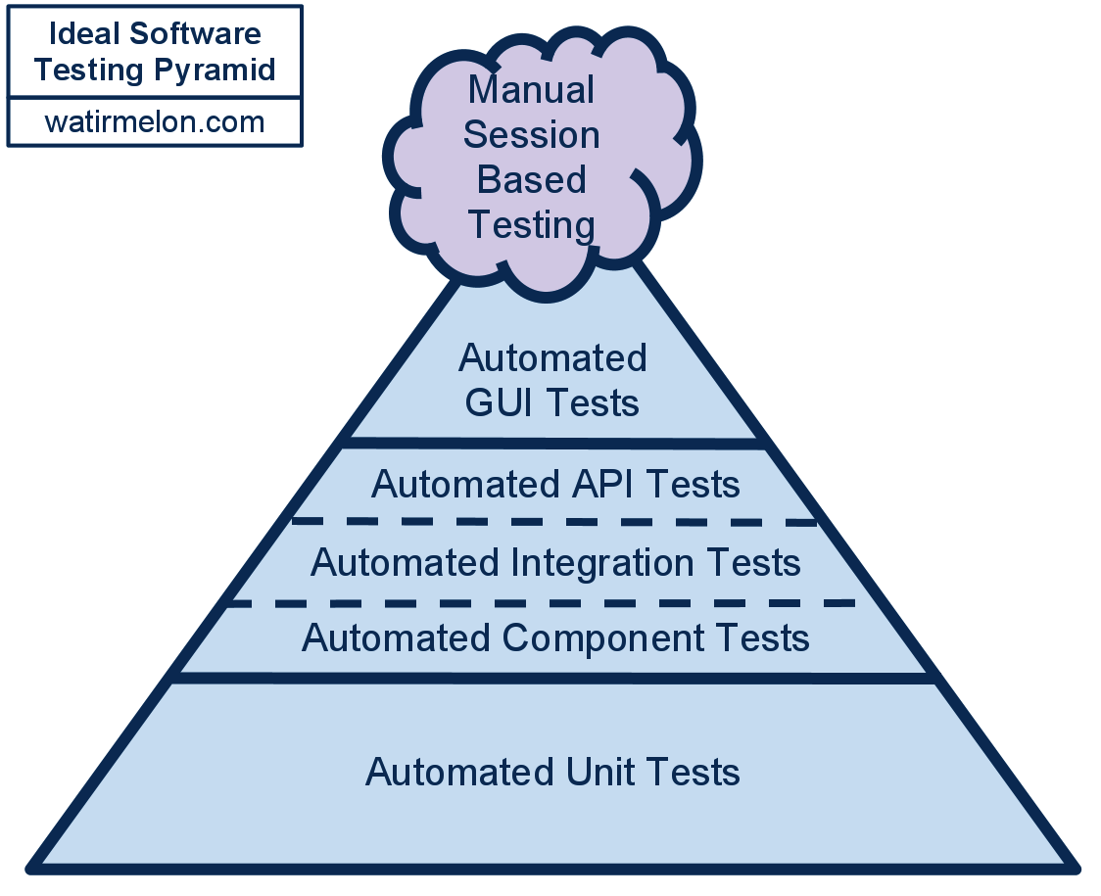
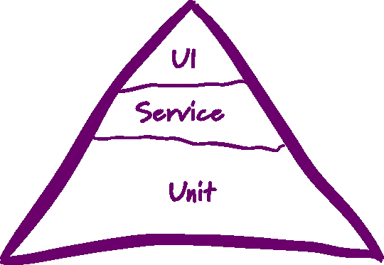
Testing pyramid

Slide 5
Testing pyramid
Slow as
Hell Tests
5-10%
Slow Tests
20%
Fast Tests
80%

Slide 6
Rule #1 Don’t chase coverage

Slide 7
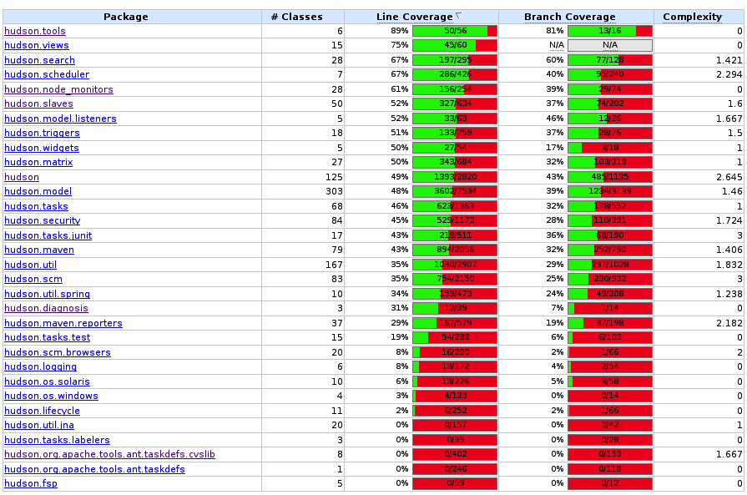
Don’t chase coverage

Slide 8
Rule #2 Test behavior, not implementation

Slide 9
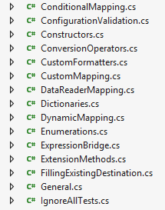

Implementations vs. behavior
High coupling – testing implementation
Low coupling – testing behavior
Not an either/or choice

Slide 10
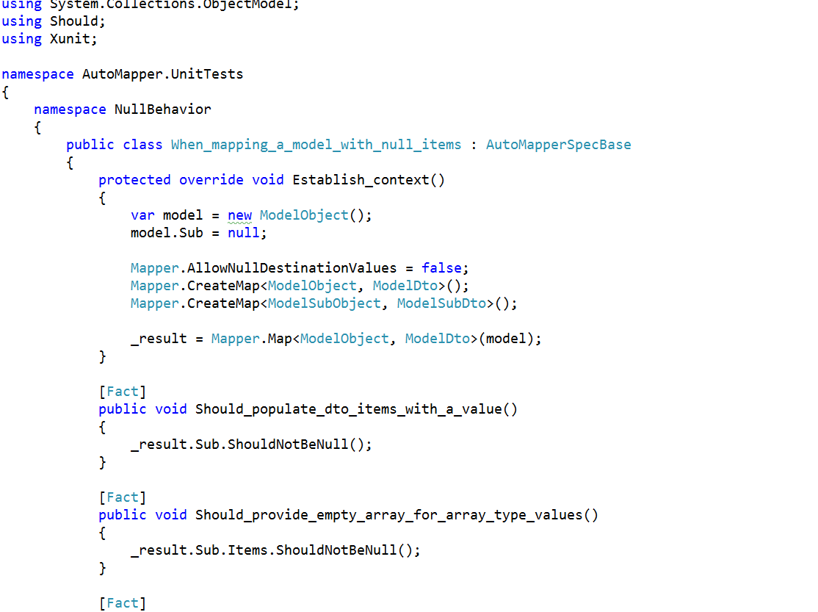
Behavioral tests

Slide 11
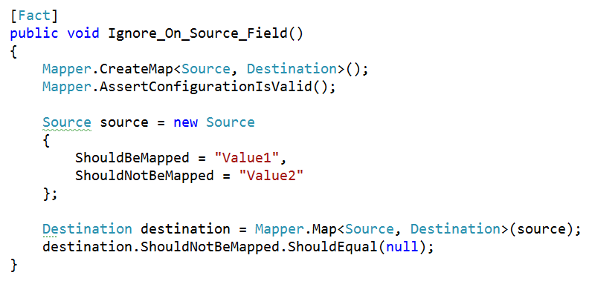
Procedural tests

Slide 12
Rule #3 Composition over inheritance

Slide 13
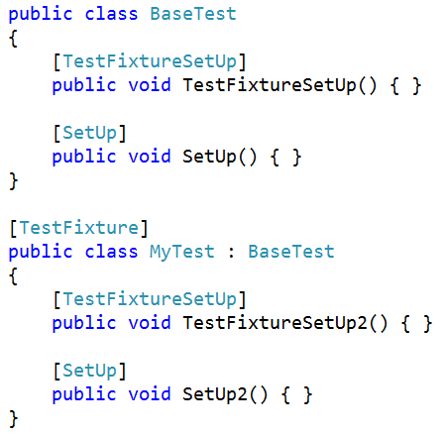
Complex hierarchies

Slide 14
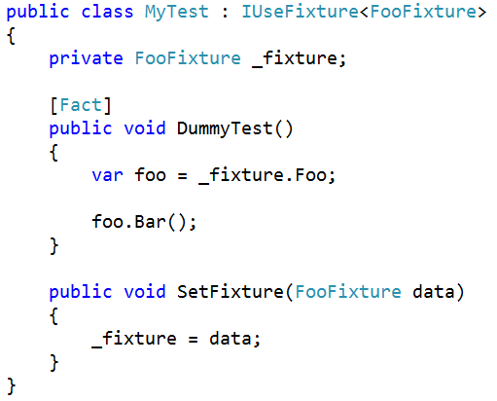
Composition through fixtures

Slide 15
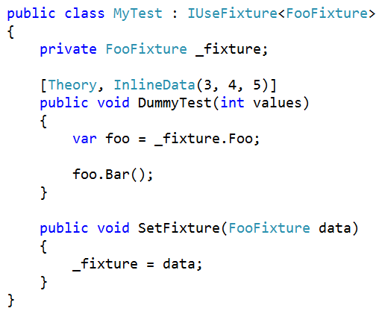
Composition through parameterization

Slide 16
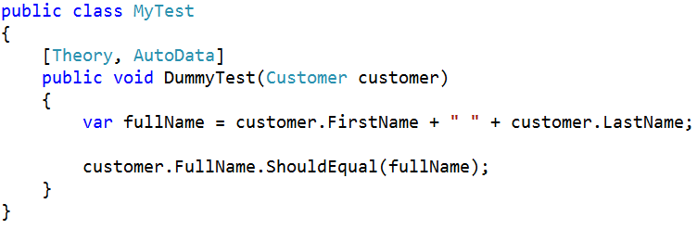
Composition through AutoFixture

Slide 17
Rule #4 Tests are documentation

Slide 18
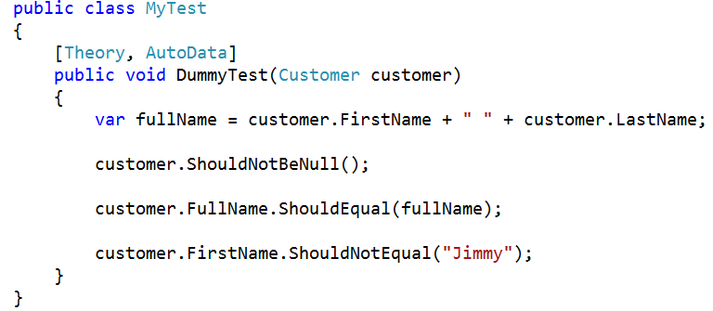
Readable tests

Slide 19
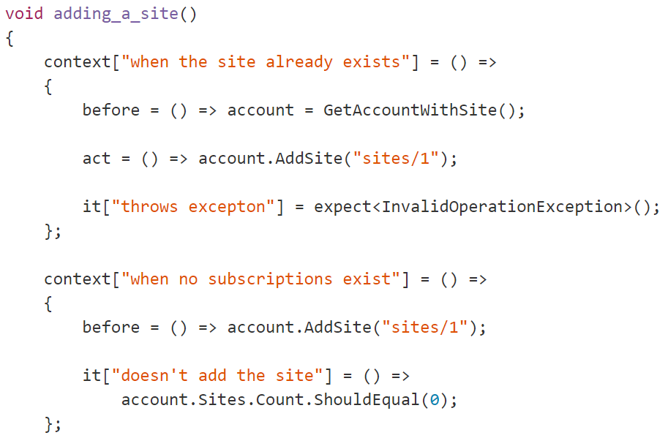
Don’t be clever

Slide 20
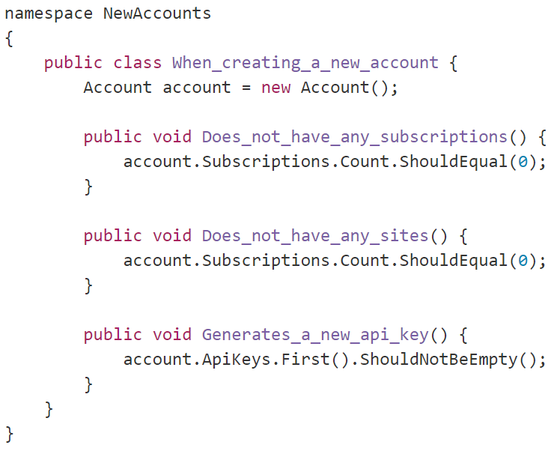
Common setup

Slide 21
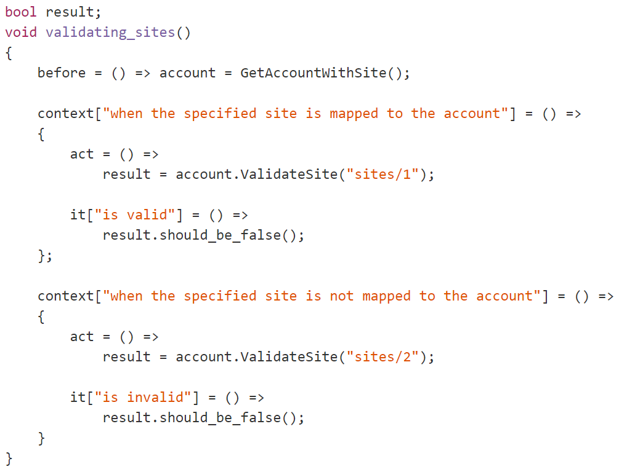
Setup should be obvious

Slide 22
Rule #5 Don’t mock your friends

Slide 23
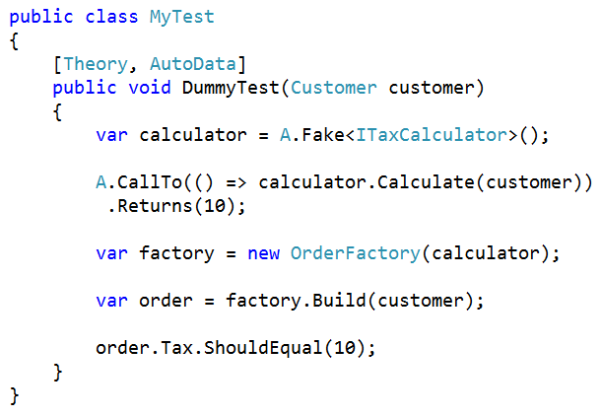
Don’t mock internals

Slide 24
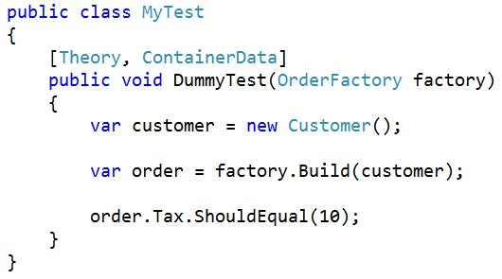
Do test behavior

Slide 25
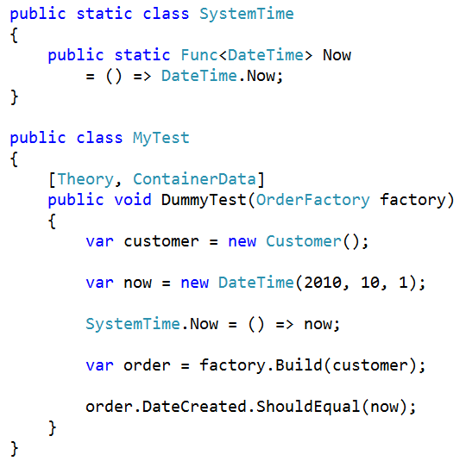
Create seams for the uncontrollable

Slide 26
Mock things you don’t own
Databases (maybe)
Web services
File systems (maybe)
Anything that crosses the process boundary

Slide 27
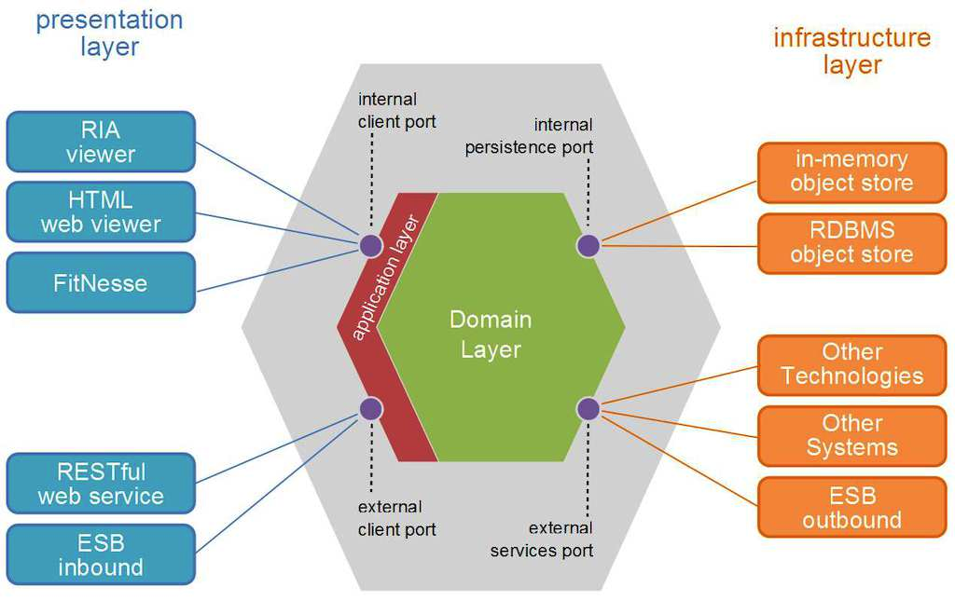
Getting to 80%
DDD/Hexagonal Arch.
Commands and queries

Slide 28
Rule #6 Test against reality

Slide 29
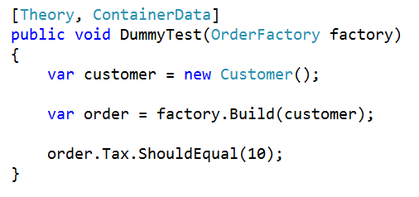
Do use the container

Slide 30
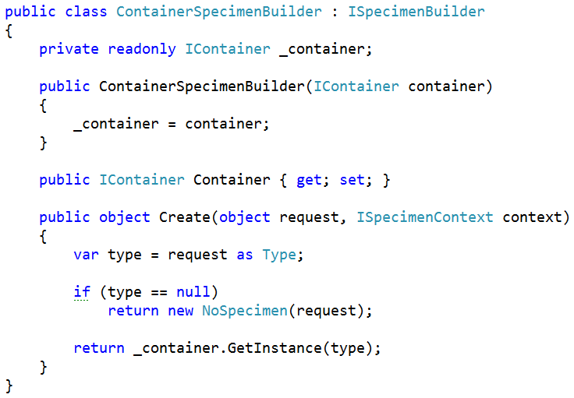
Do use the container

Slide 31
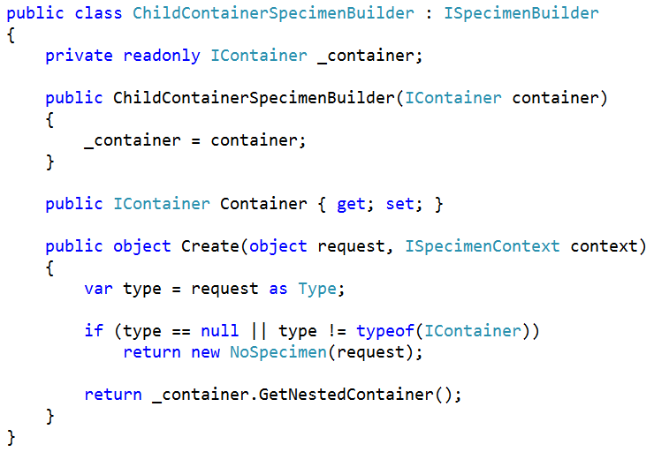
Isolating the container

Slide 32
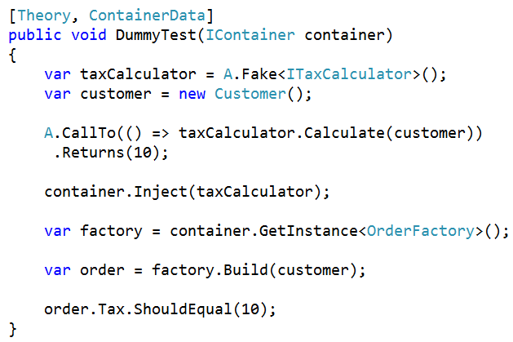
Isolating the container

Slide 33
Rule #7 Isolation over faking

Slide 34
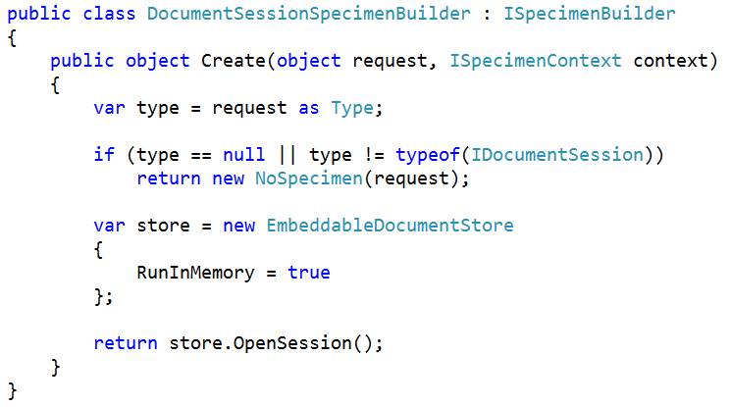
Isolating the database (RavenDB edition)

Slide 35
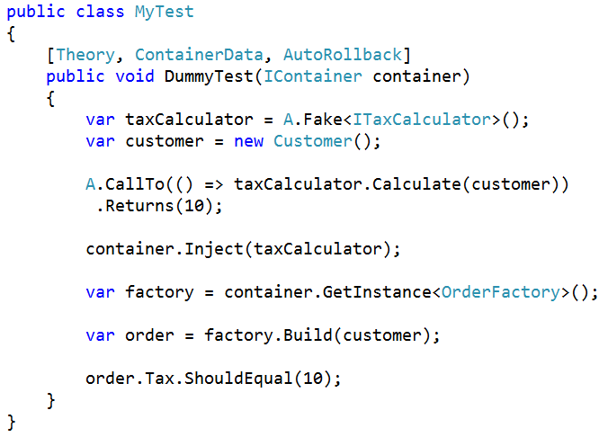
Isolating the database (Relational edition)

Slide 36
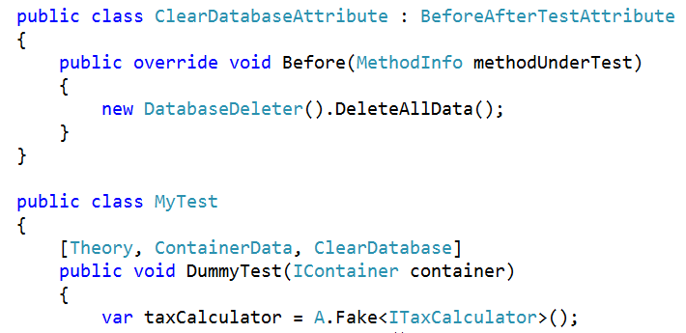
Isolating the database (debuggable edition)

Slide 37
Rule #8 Knowledge is power

Slide 38
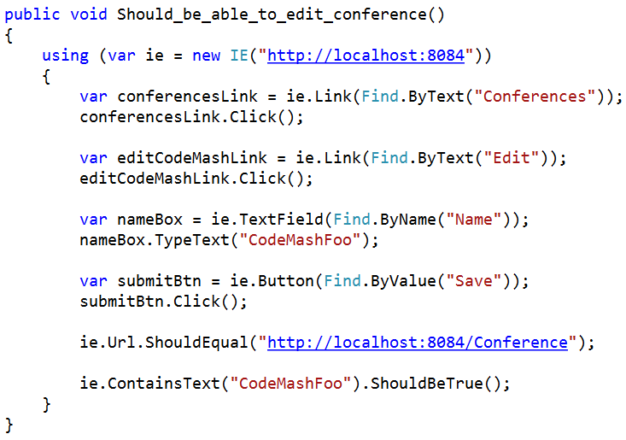
A bad UI test

Slide 39
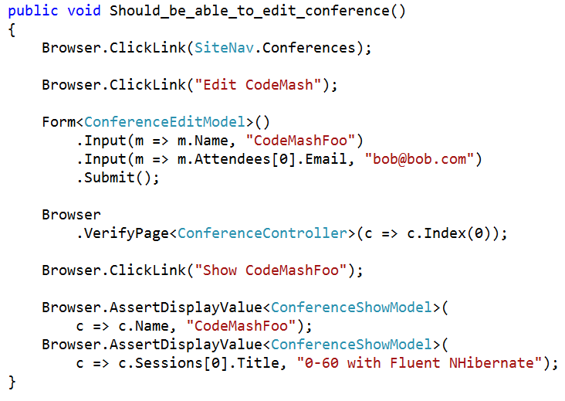
A good UI test

Slide 40
Parting thoughts
Ship, ship, ship
Test until you’re bored
Listen to your tests
Allow your approach to change with the context
Ship!

