Slide 1




Integration Patterns with NServiceBus
Jimmy Bogard
@jbogard
github.com/jbogard
jimmybogard.lostechies.com

Slide 2
Ideal World vs Reality

Slide 3


Slide 4
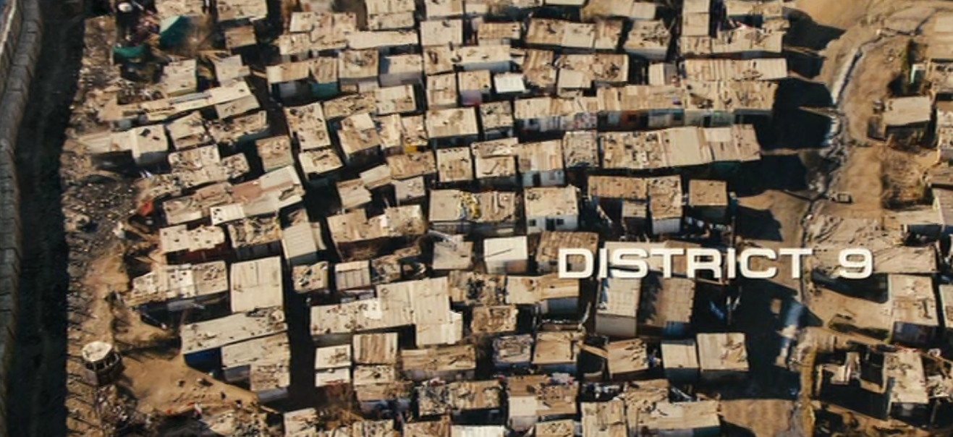

Slide 5
The Daily AS/400 Dump
Processing bulk data

Slide 6
Characteristics
1/day dump of entire SKU catalog
Flat file
1.4M rows daily and growing
Fill in details for support website

Slide 7


Consuming Files
Data
Importer
Deadlock
DB
Rollback
What made it through?

Slide 8

Consuming Files
Data
Parser
Process File
Process Line
Commit
Commit
Processor
DB

Slide 9
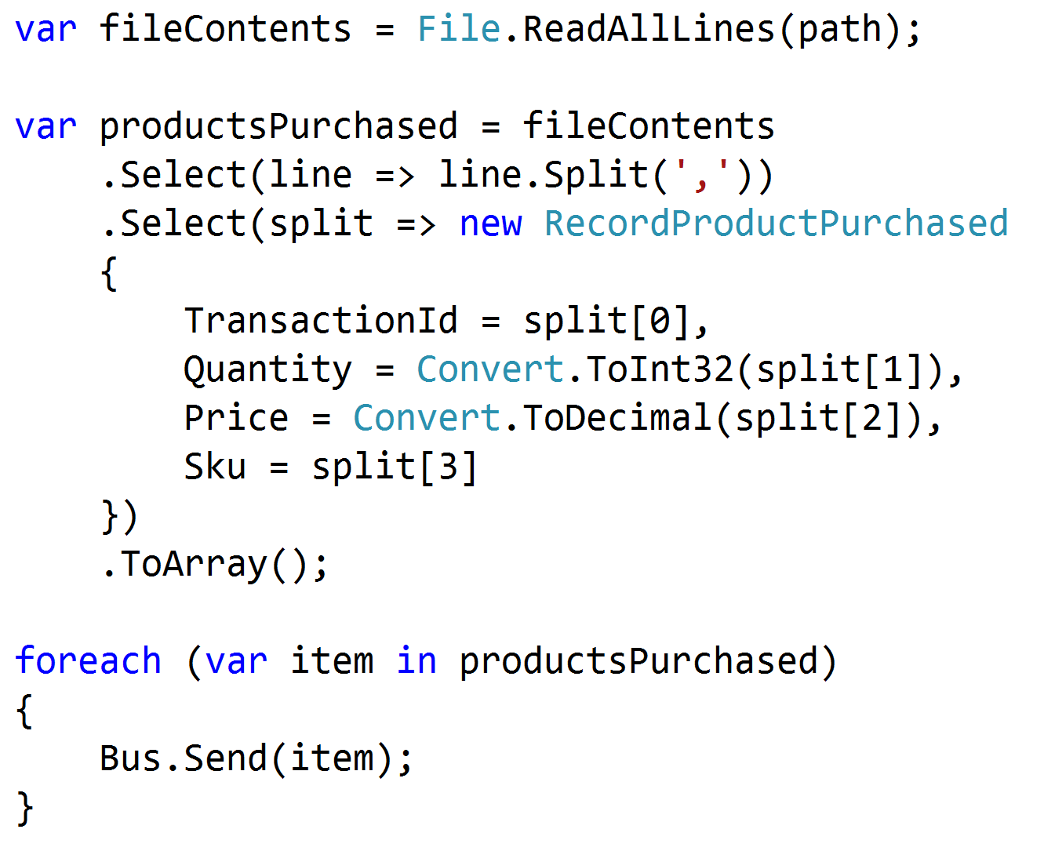

Slide 10
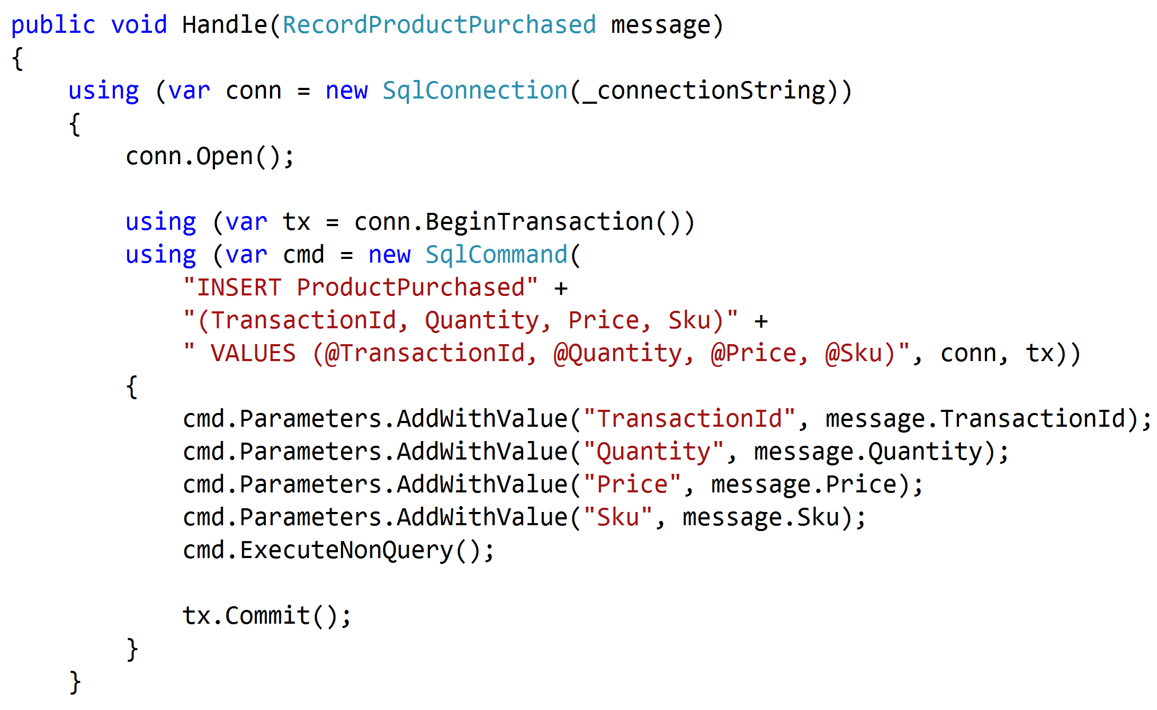

Slide 11
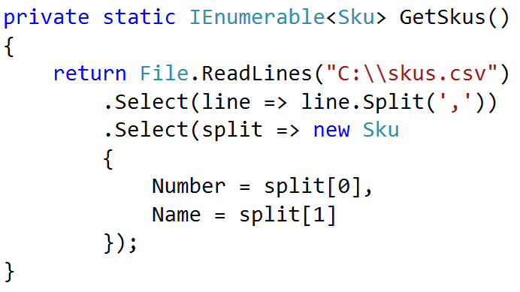
Streaming Bulk Copy

Slide 12
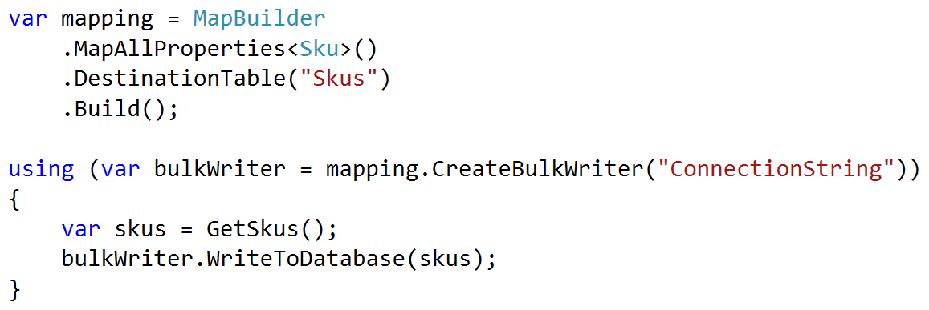
Streaming Bulk Copy

Slide 13
Data Warehouse Exports
Exporting Bulk Data

Slide 14
Producing Files
Id | Name | Changed
1 | Walter | Y
2 | Cora | N
3 | Alejandro | N
4 | Carlton | Y
5 | Janice | N
Id | Name | Changed
1 | Walter | Y
2 | Cora | N
3 | Alejandro | N
4 | Carlton | Y
5 | Janice | N
Id | Name | Changed
1 | Walter | Y
2 | Kiera | Y
3 | Alejandro | N
4 | Carlton | Y
5 | Janice | N
Exporter
File
SELECT Name
WHERE Changed = ‘Y’
UPDATE People
SET Changed = ‘N’
We’re missing a change

Slide 15
Producing Files
Id | Name | BatchId
1 | Walter | NULL
2 | Cora | 1
3 | Alejandro | 1
4 | Carlton | NULL
5 | Janice | 2
Id | Name | BatchId
1 | Walter | 3
2 | Cora | 1
3 | Alejandro | 1
4 | Carlton | 3
5 | Janice | 2
Id | Name | BatchId
1 | Walter | 3
2 | Kiera | NULL
3 | Alejandro | 1
4 | Carlton | 3
5 | Janice | 2
Exporter
File
UPDATE People
SET BatchId = 3
WHERE BatchId IS NULL
SELECT Id, Name
FROM People
WHERE BatchId = 3
Mark records to export
Export marked records

Slide 16
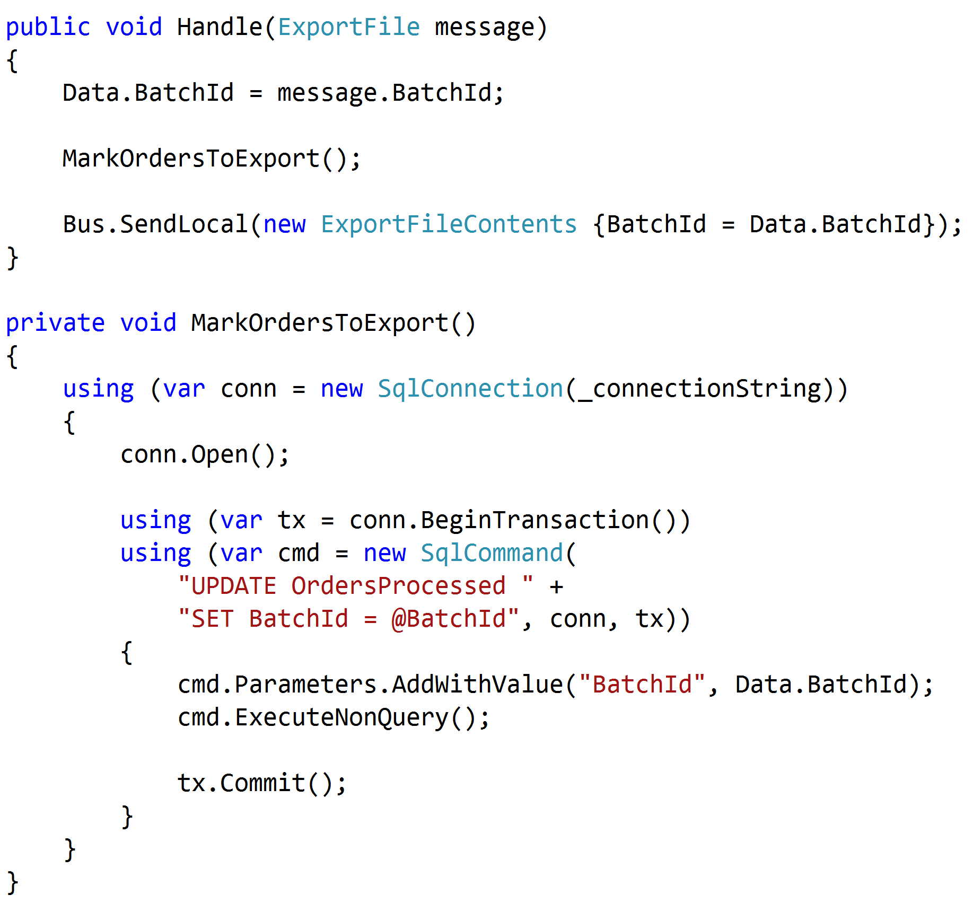

Slide 17
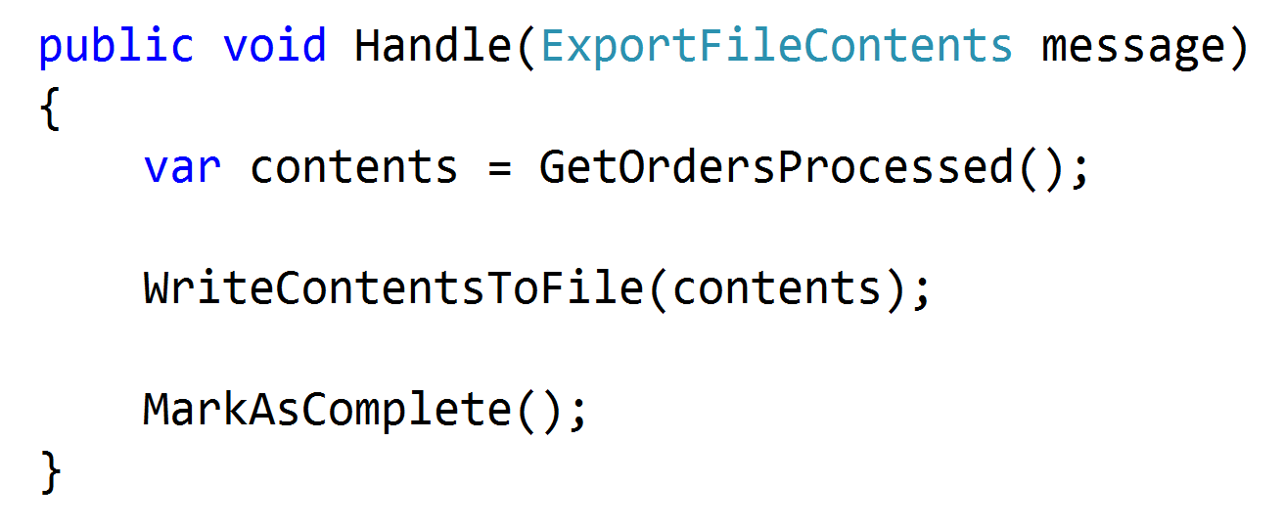

Slide 18
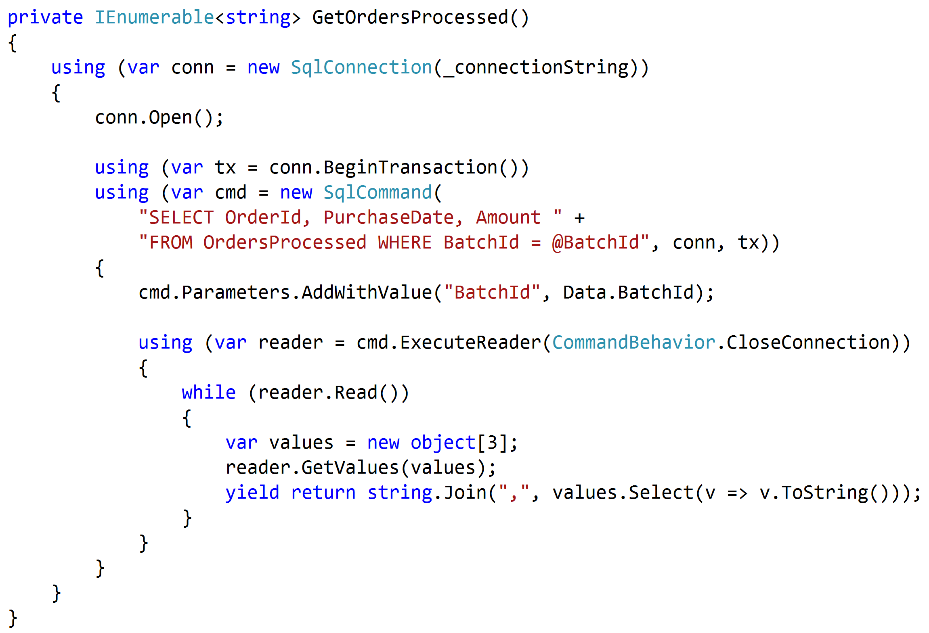

Slide 19
Search Database Enrichment
Routing slips

Slide 20
Characteristics
Enriching search data from various sources
Some sources are required, some not
Some dependent on previous steps
Initiated with large batch of initial messages

Slide 21
Option #1: Observer
Publisher
Price
Catalog
Content
Saga
Options
Saga Creation (fixed in V4.x)
Notes:
Saga not created yet
Tons of exceptions trying to create saga
Tons of concurrency exceptions trying to modify saga
Huge load on saga O(N * M)

Slide 22
Option #1: Observer
Publisher
Price
Catalog
Content
Saga
Options
Queue Contention
Notes:
Saga not created yet
Tons of exceptions trying to create saga
Tons of concurrency exceptions trying to modify saga
Huge load on saga O(N * M)

Slide 23
Option #1: Observer
Publisher
Price
Catalog
Saga
Price
Content
Catalog
Content
Options
Options
Complicated and Slow
Notes:
Saga not created yet
Tons of exceptions trying to create saga
Tons of concurrency exceptions trying to modify saga
Huge load on saga O(N * M)

Slide 24
Option #2: Controller
Publisher
Price
Catalog
Content
Saga
Options
Slooooooow
Notes:
No one item would finish until all finished their steps

Slide 25
Option #2: Controller
Publisher
Price
Catalog
Saga
Price
Content
Catalog
Content
Options
Options
Complicated and slow
Notes:
Difficult to maintain routes
Adding a new step meant re-deploying steps
Now 2N endpoints

Slide 26
McDonald’s Sagas
Sandwich
Drinks
Coffee
Shakes
2) Order Accepted
Fries
3) Item Completed
Order #1
Register
4) Order Completed
1) Place Order
Tray Contention
Customer

Slide 27
Subway’s Sagas
2) Prep Meal
3) Pack Meal
Register
Prep
Pack
1) Place Order
Customer
4) Order Completed

Slide 28
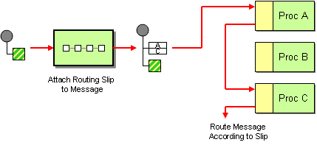
Routing Slip
How do we route a message consecutively through a series of processing steps when the sequence of steps is not known at design-time and may vary for each message?
Attach a Routing Slip to each message, specifying the sequence of processing steps. Wrap each component with a special message router that reads the Routing Slip and routes the message to the next component in the list.

Slide 29
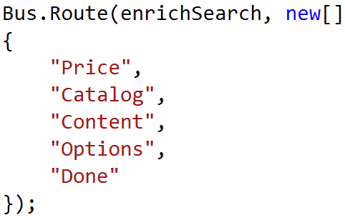
Option #3: Routing Slip
Initiator
Price
Catalog
Content
Options
Notes:
1st one goes through quickly
Additional data stored on routing slip
Adding a new step doesn’t significantly affect process
No step knows about the other

Slide 30
More Mainframe Madness
Stored Procedure Explosions

Slide 31
App Modernization Transition
Cobol Magic
SQL Server
Green Screen
???
.NET App

Slide 32
Trigger Happy
Cobol Magic
SQL Server
Green Screen
1
100
NSB Handler
100
.NET App
Slooooooow

Slide 33
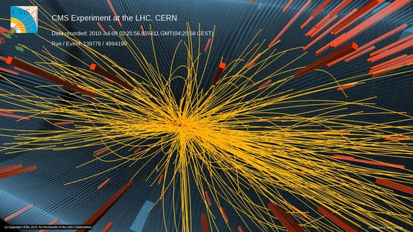
Particle Explosions

Slide 34
Slow Your Roll
Cobol Magic
SQL Server
Green Screen
1
100
NSB Saga
1
.NET App

Slide 35
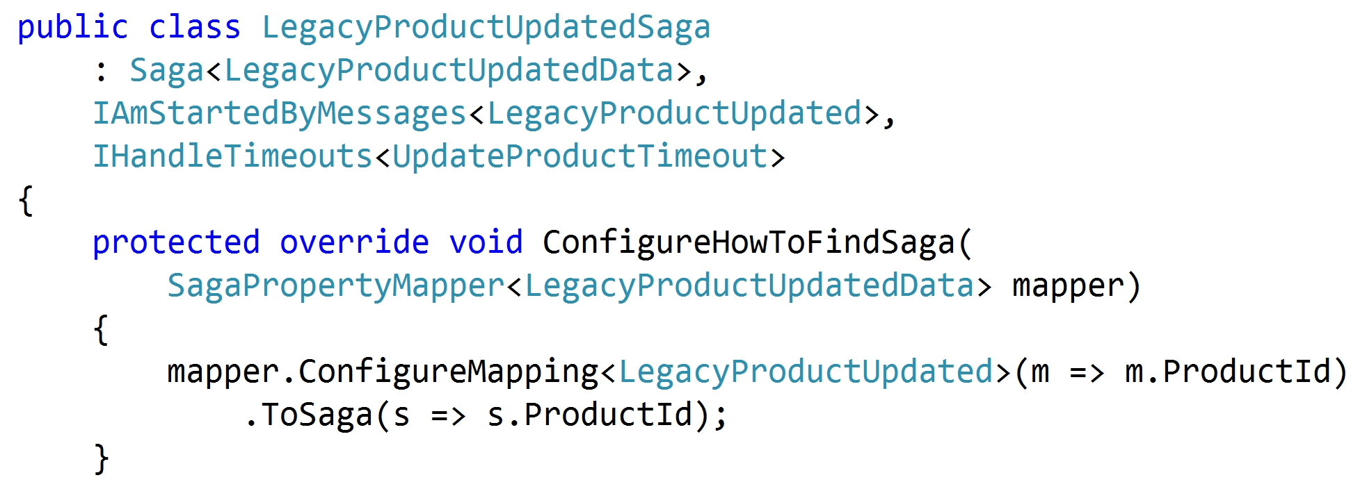

Slide 36
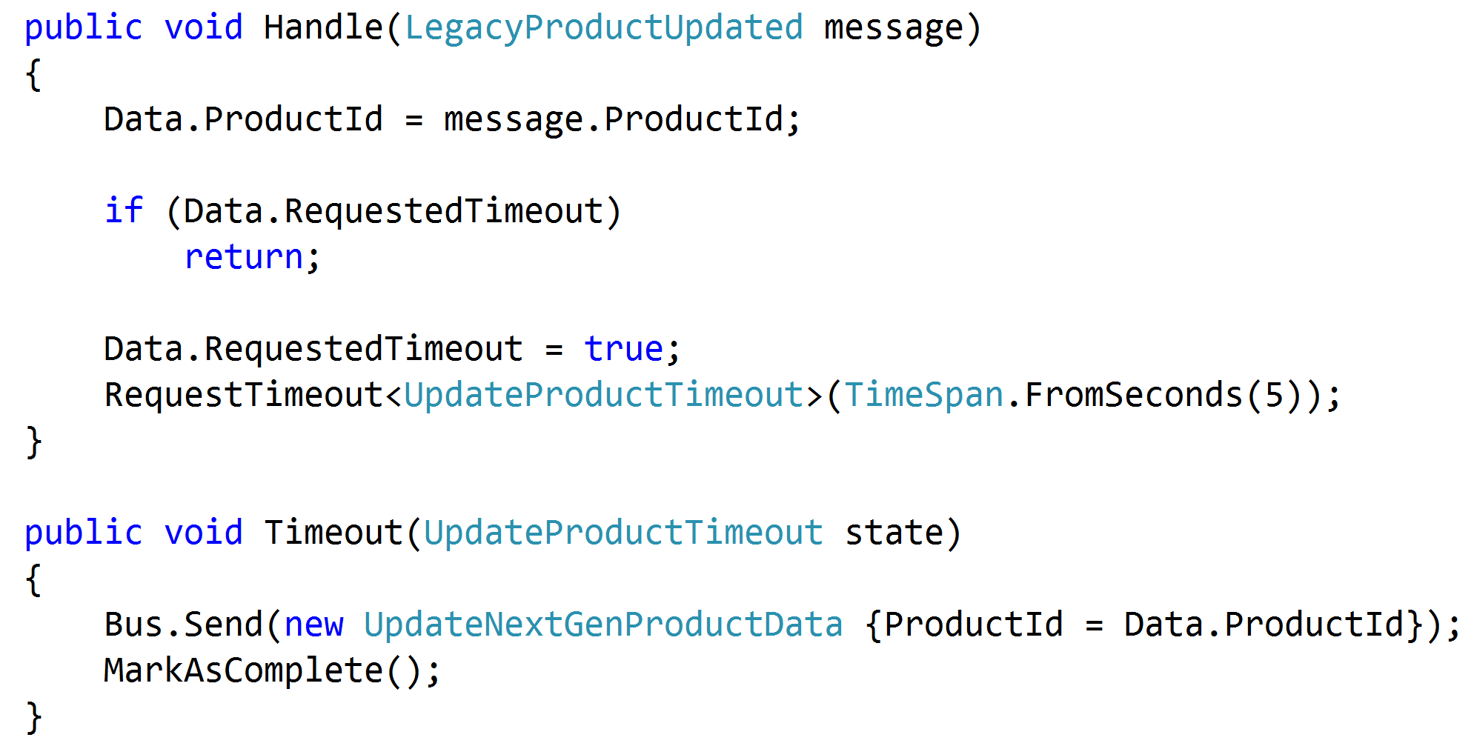

Slide 37
Integration Patterns with NServiceBus
Jimmy Bogard
@jbogard
github.com/jbogard
jimmybogard.lostechies.com

