Slide 1




From SQL to Azure Cosmos DB
Jimmy Bogard
@jbogard
github.com/jbogard
jimmybogard.com

Slide 2
What is Azure Cosmos DB?

Slide 3
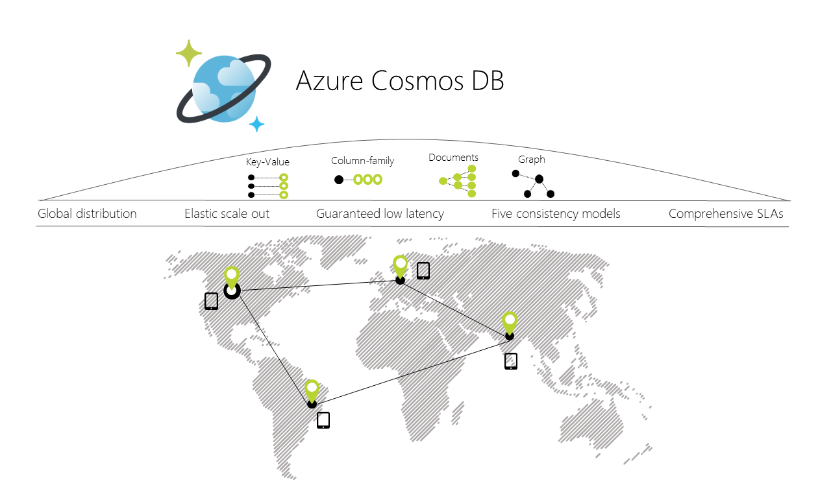
Notes:
globally distributed, multi-model database service

Slide 4
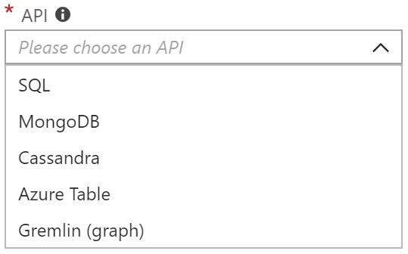
Multi-Model
SQL-over-JSON
Document
Column
Table (Azure Table Storage)
Graph
More to come

Slide 5
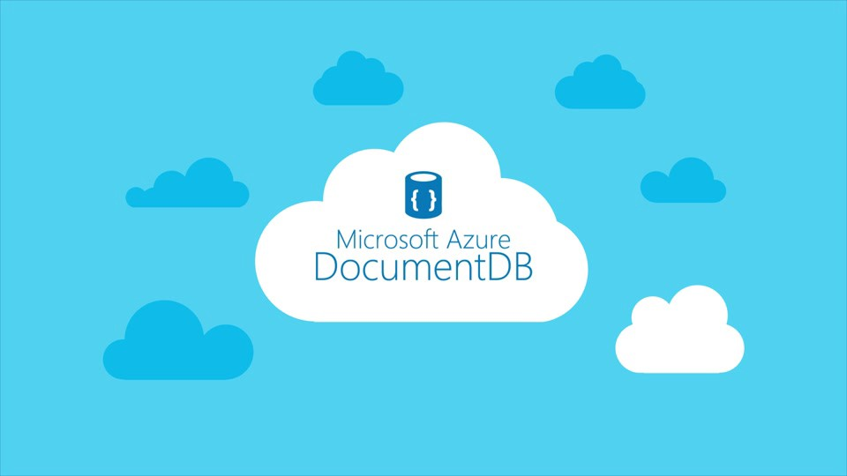

Slide 6
Why should I use it?

Slide 8
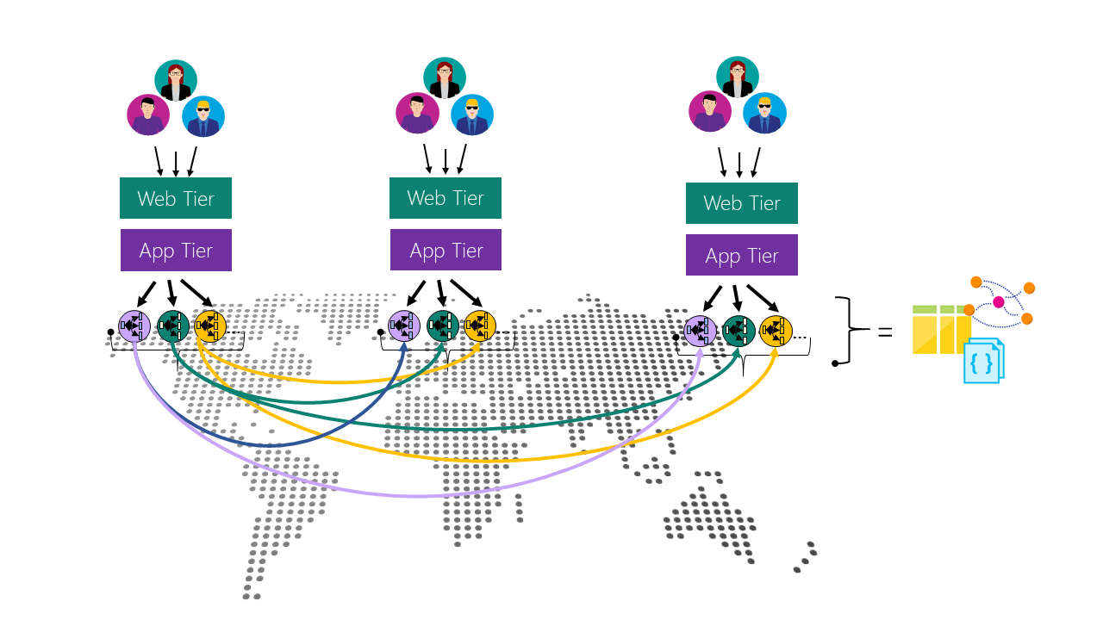

Slide 9





Slide 10
Schema-less in SQL

Slide 11
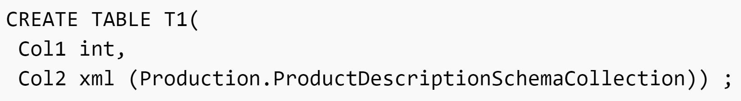

Slide 12
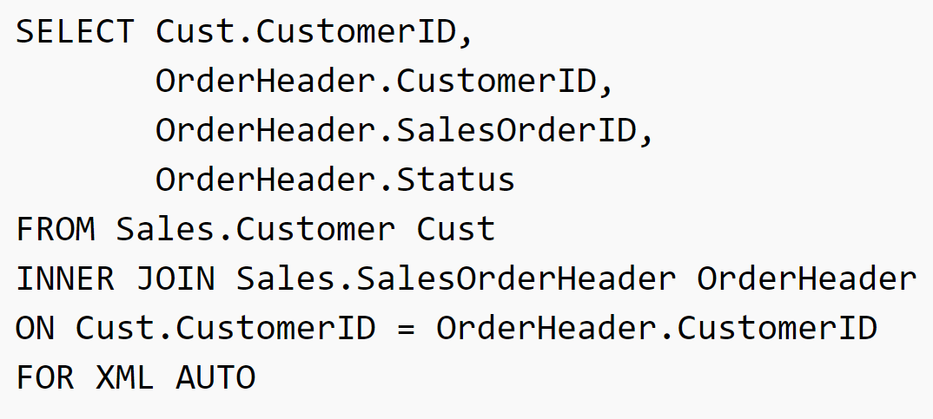

Slide 13
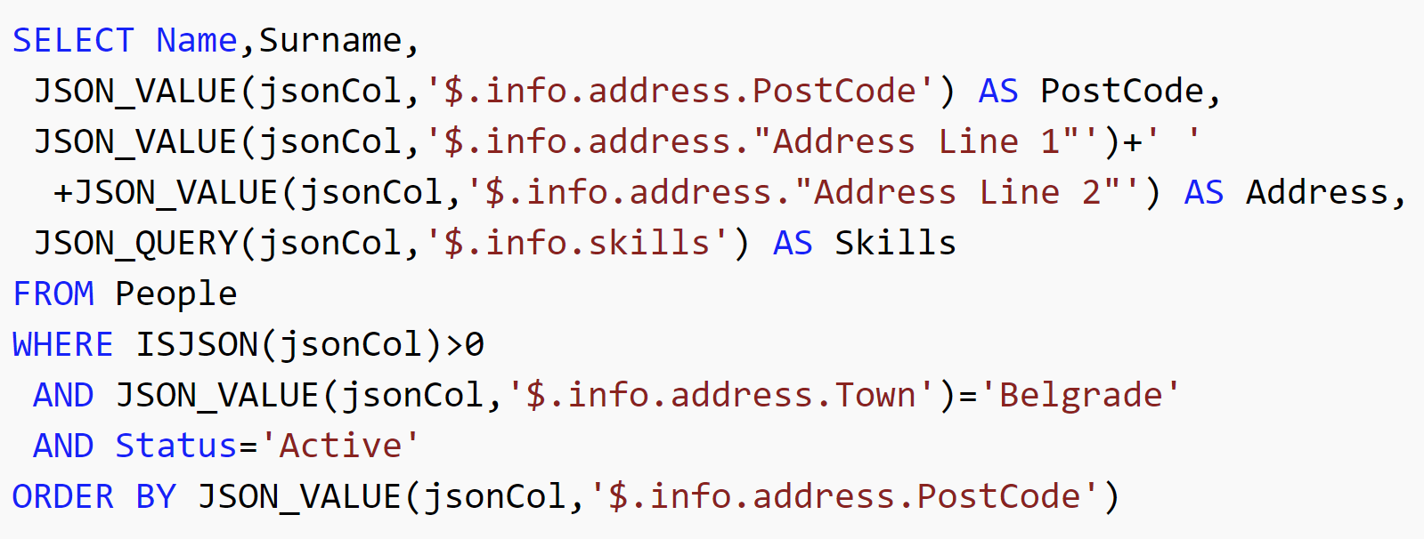

Slide 14
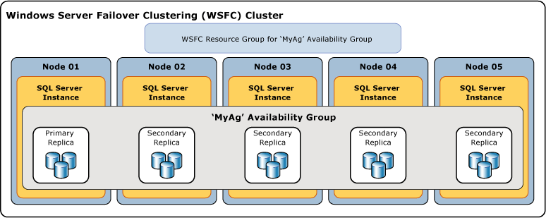

Slide 15
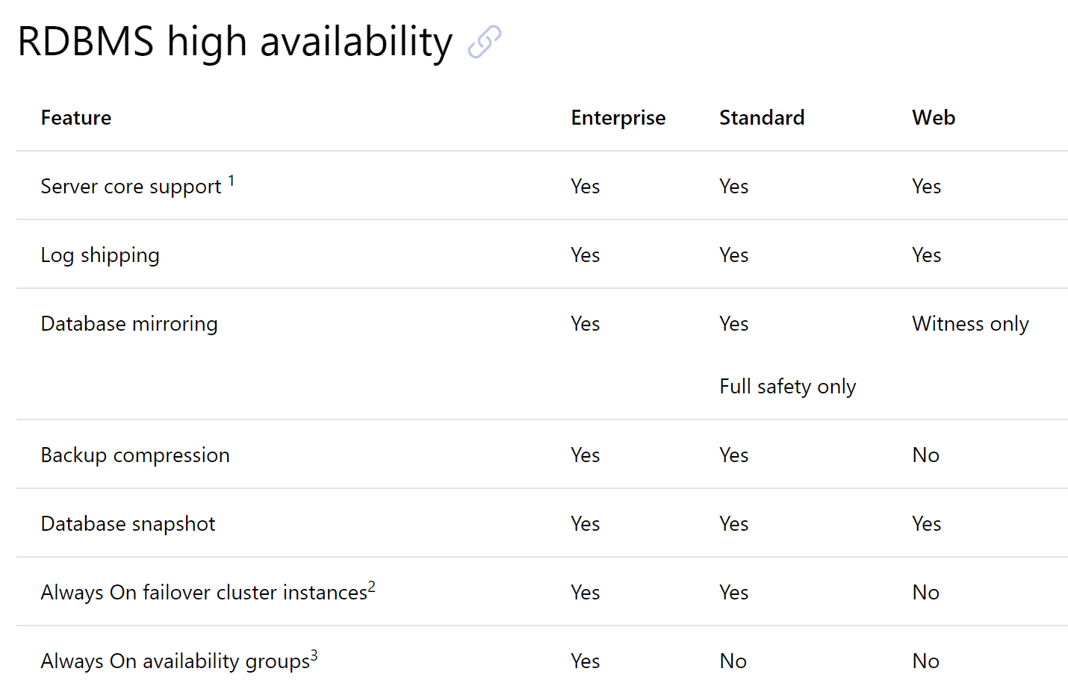

Slide 16
Transitioning from SQL

Slide 18
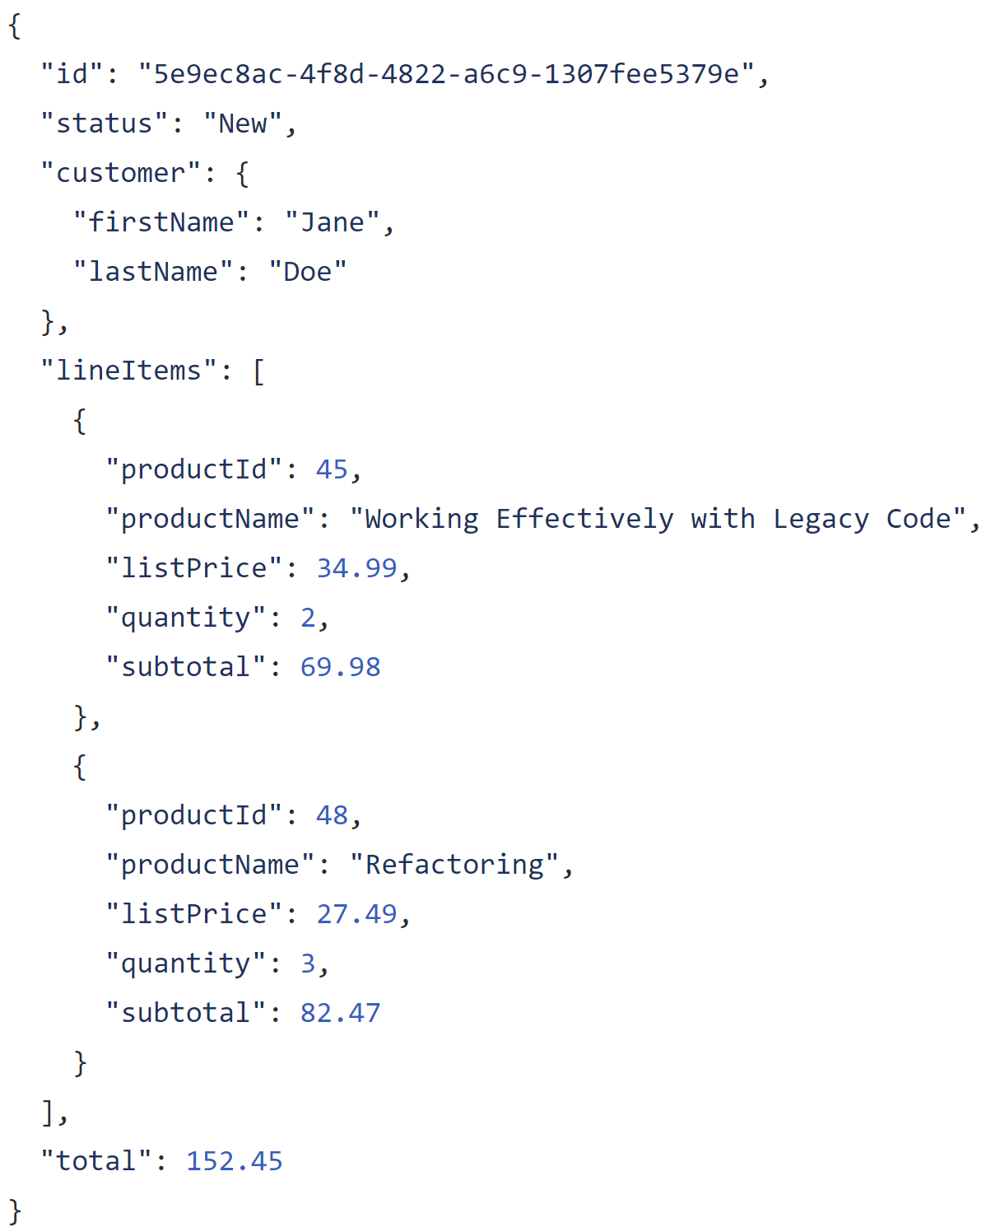

Slide 19
Entire model in one record

Slide 20
Complex structures

Slide 21
Arrays for one-to-many

Slide 22
Store keys for other/external entities

Slide 23
Duplicate data as needed

Slide 24
Not all duplicate data is evil!

Slide 25
Catalog
Cart
Order
Fulfillment
Customer Journey and Value Stream

Slide 26
$24.99
Catalog
Cart
Order
Fulfillment
Customer Journey and Value Stream

Slide 27
$24.99
$24.99
Catalog
Cart
Order
Fulfillment
Customer Journey and Value Stream

Slide 28
$24.99
$24.99
$24.99
Catalog
Cart
Order
Fulfillment
Customer Journey and Value Stream

Slide 29
$24.99
$24.99
$24.99
$24.99
Catalog
Cart
Order
Fulfillment
Customer Journey and Value Stream

Slide 30
$24.99
$25.49
$24.99
$24.99
$24.99
Catalog
Cart
Order
Fulfillment
Customer Journey and Value Stream

Slide 31
?
?
?
$24.99
$25.49
$24.99
$24.99
$24.99
Catalog
Cart
Order
Fulfillment
Customer Journey and Value Stream

Slide 32
$24.99
$25.49
$24.99
$24.99
$24.99
Catalog
Cart
Order
Fulfillment
Customer Journey and Value Stream
Data may move around and when it crosses service boundaries, its meaning can change

Slide 35
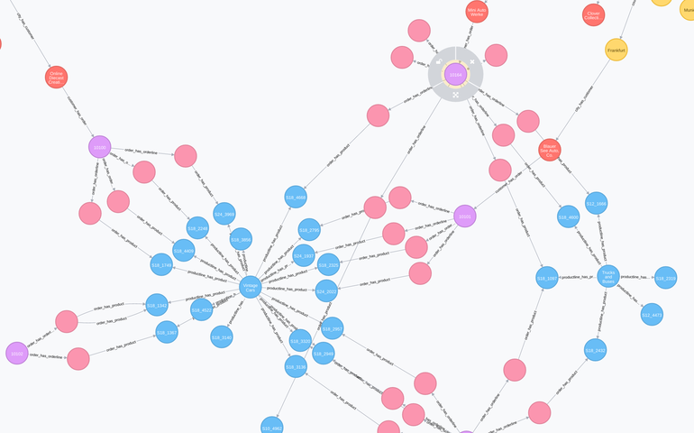

Slide 36
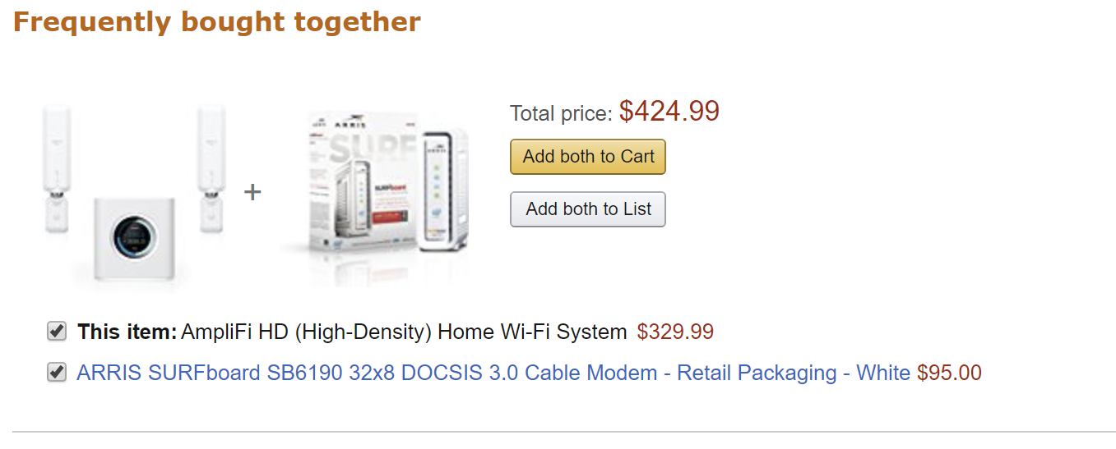

Slide 37
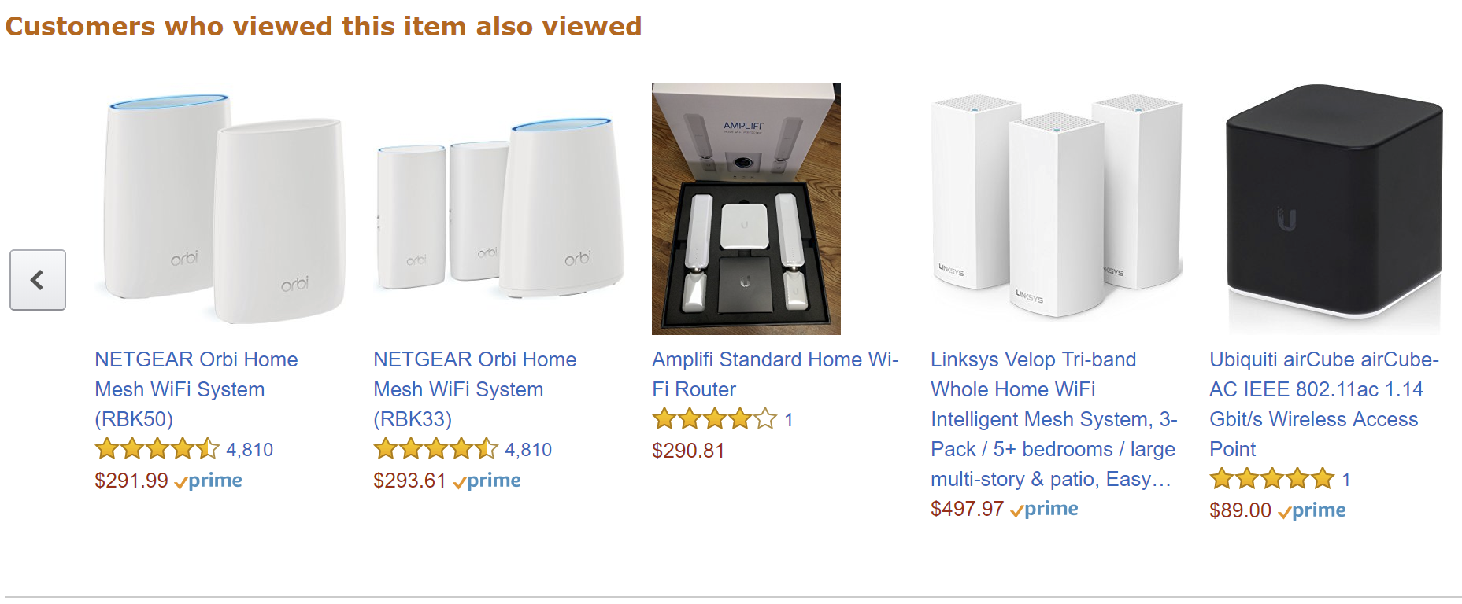

Slide 38
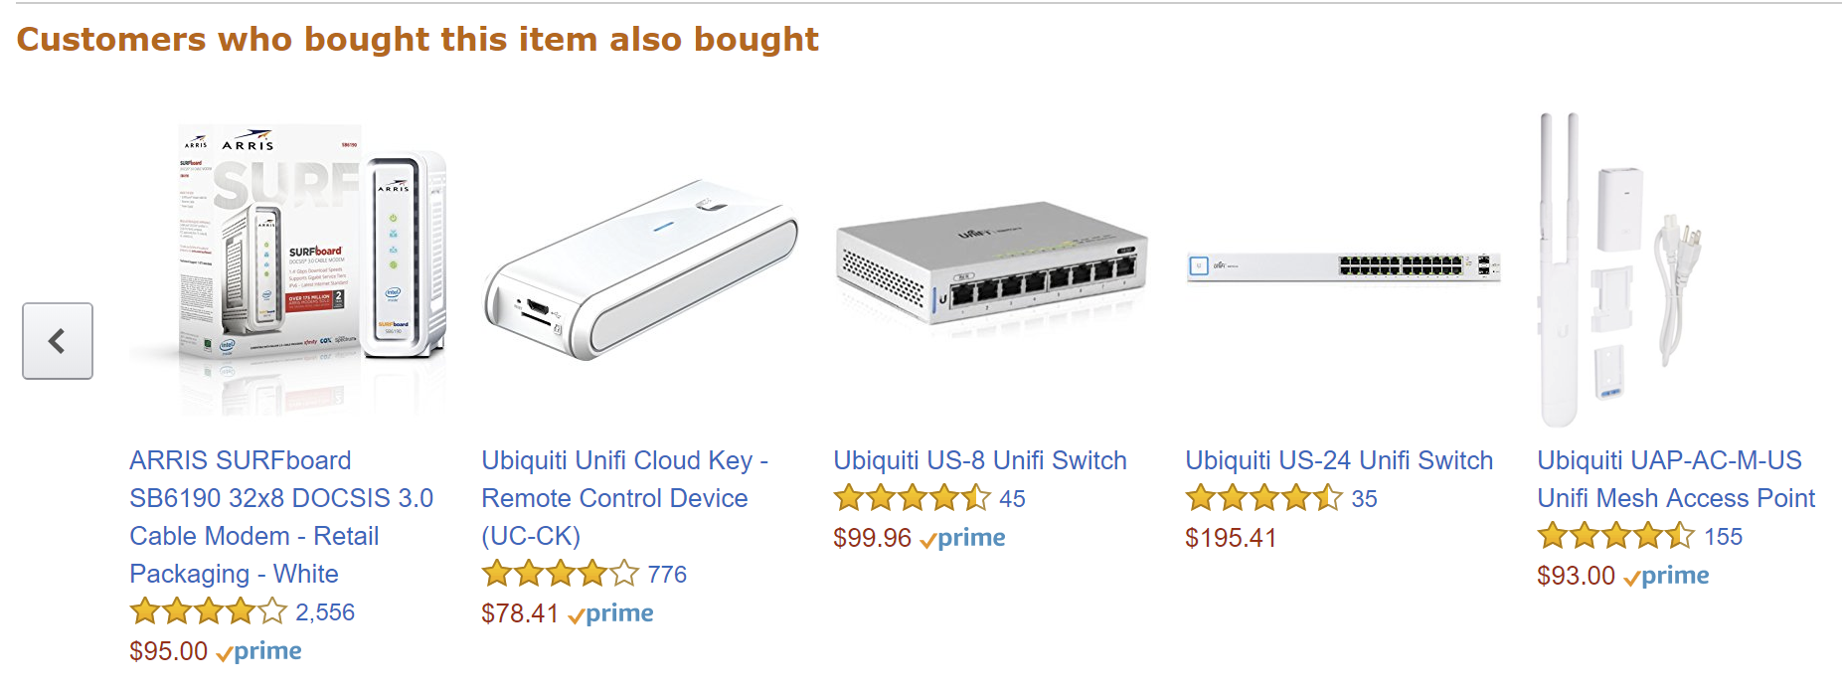

Slide 40
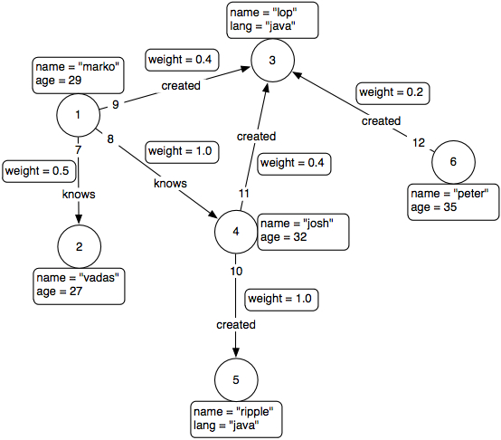


Slide 41
Transitioning from Transactioning in SQL

Slide 42


Slide 43
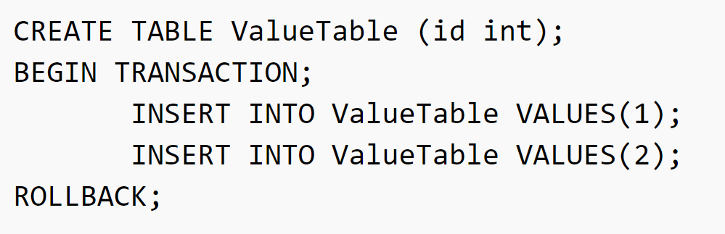

Slide 44
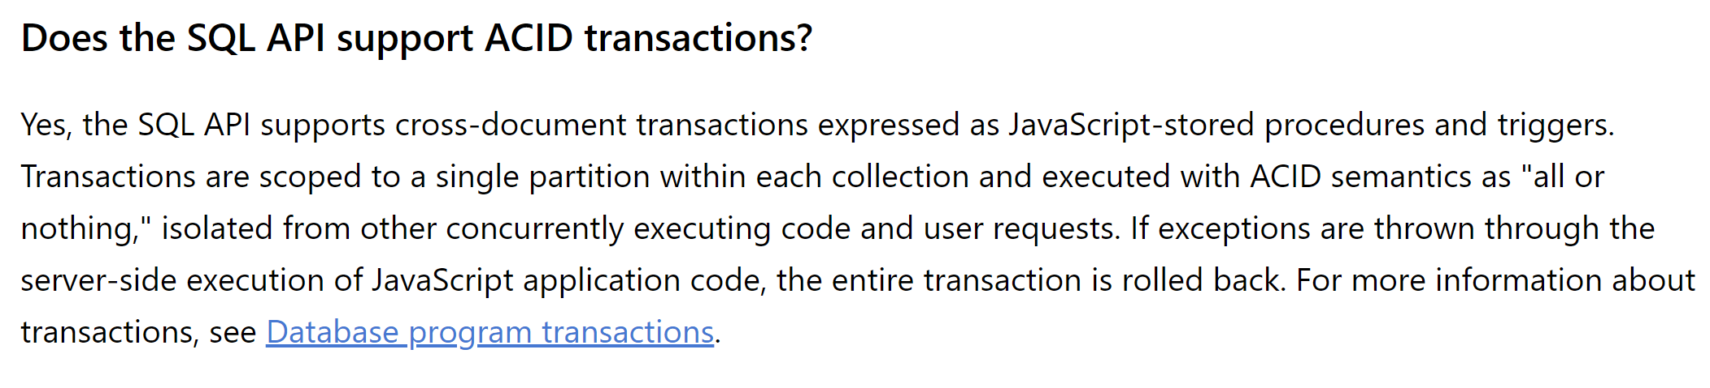

Slide 46
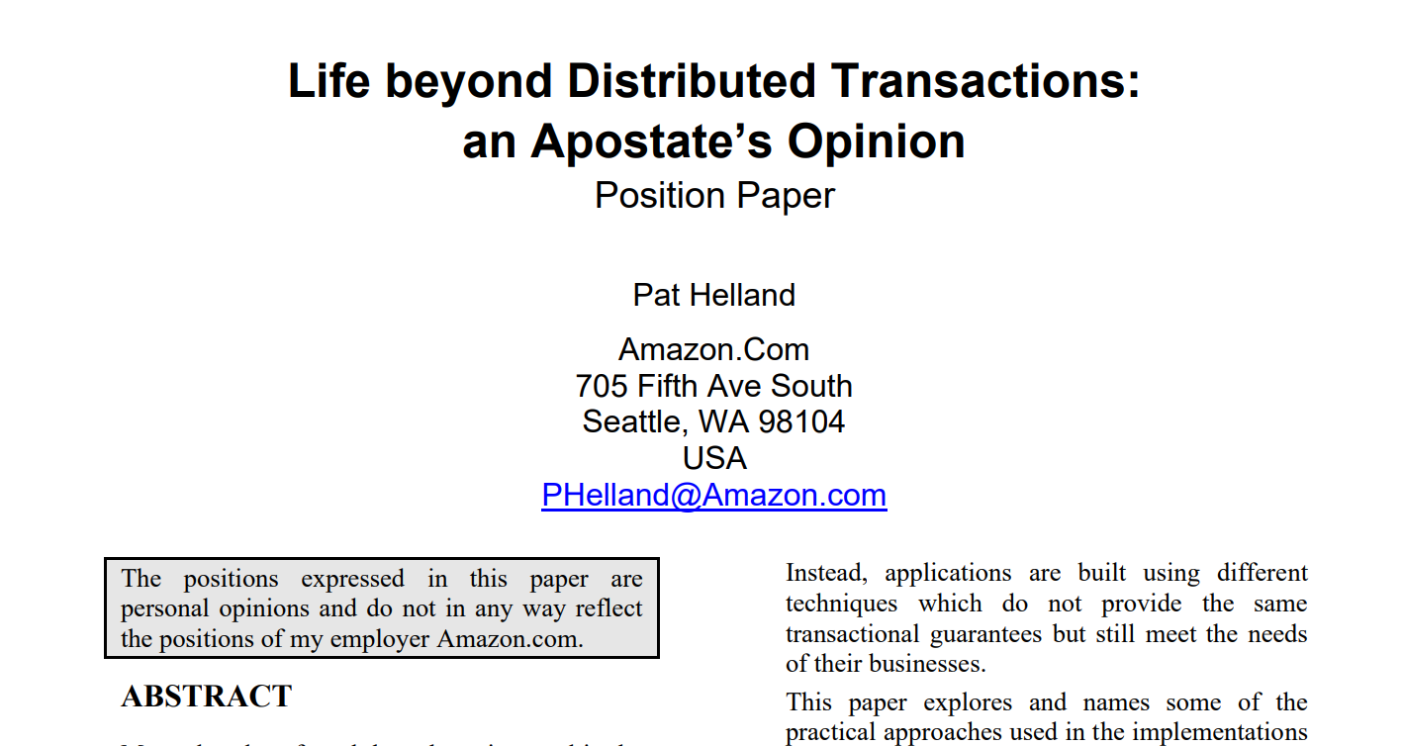

Slide 47
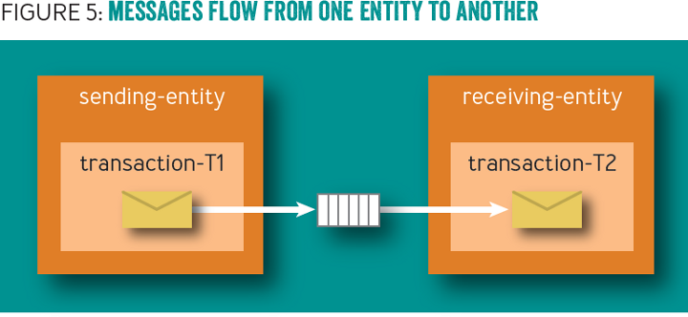

Slide 48
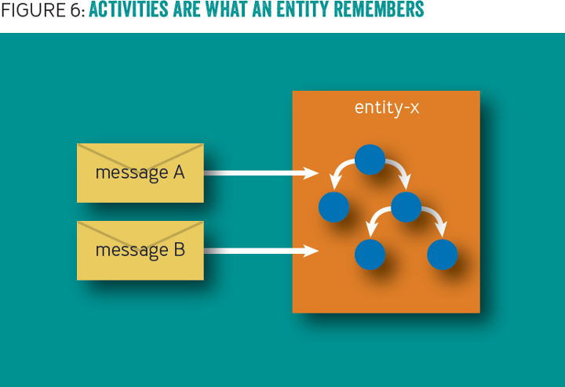

Slide 49
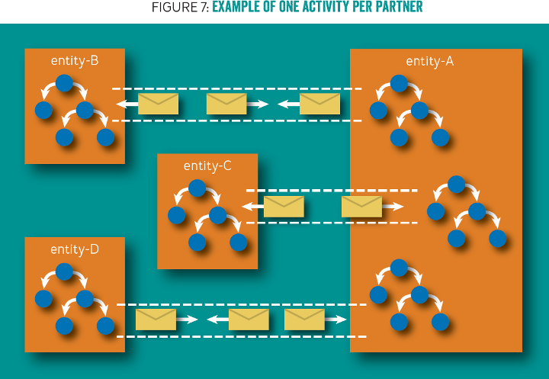

Slide 50
/orders/123
Solution: Domain events!
Check inbox for already received events
Use outbox to "communicate" to other aggregates
Remove events from outbox as they are processed
Inbox
Outbox

Slide 51
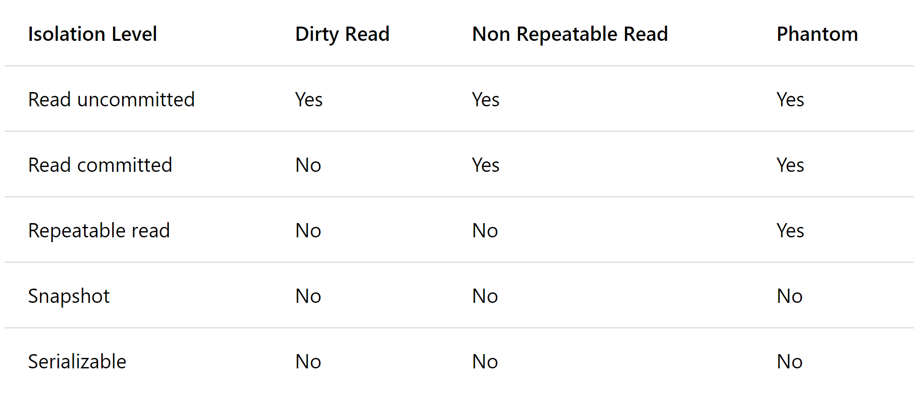

Slide 52
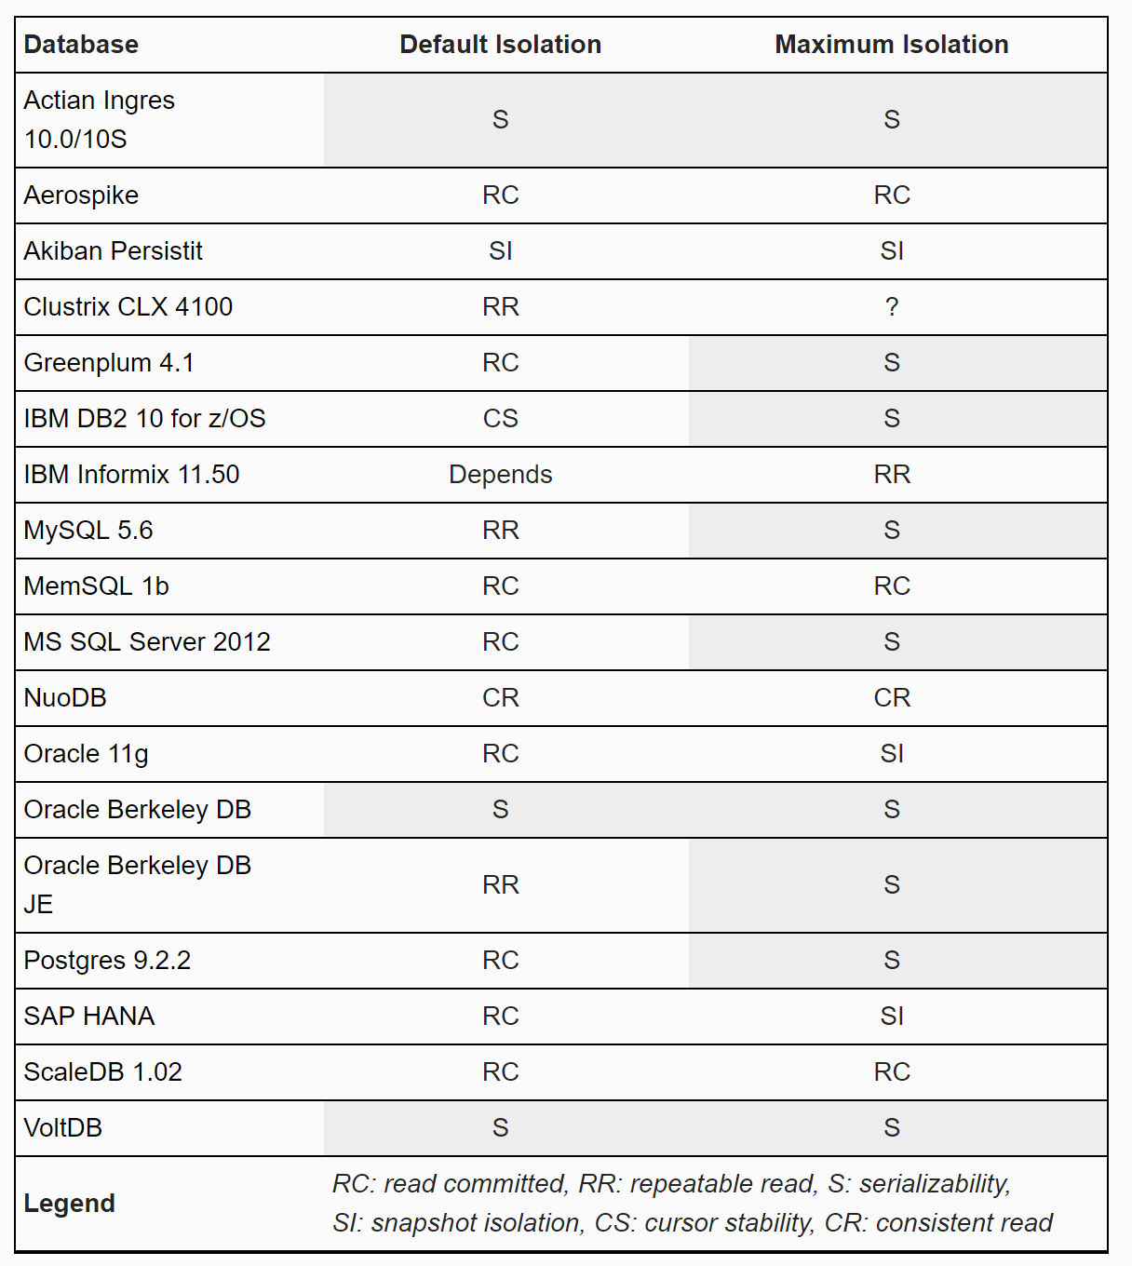

Slide 53
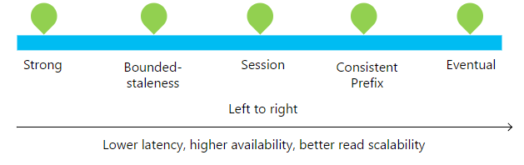
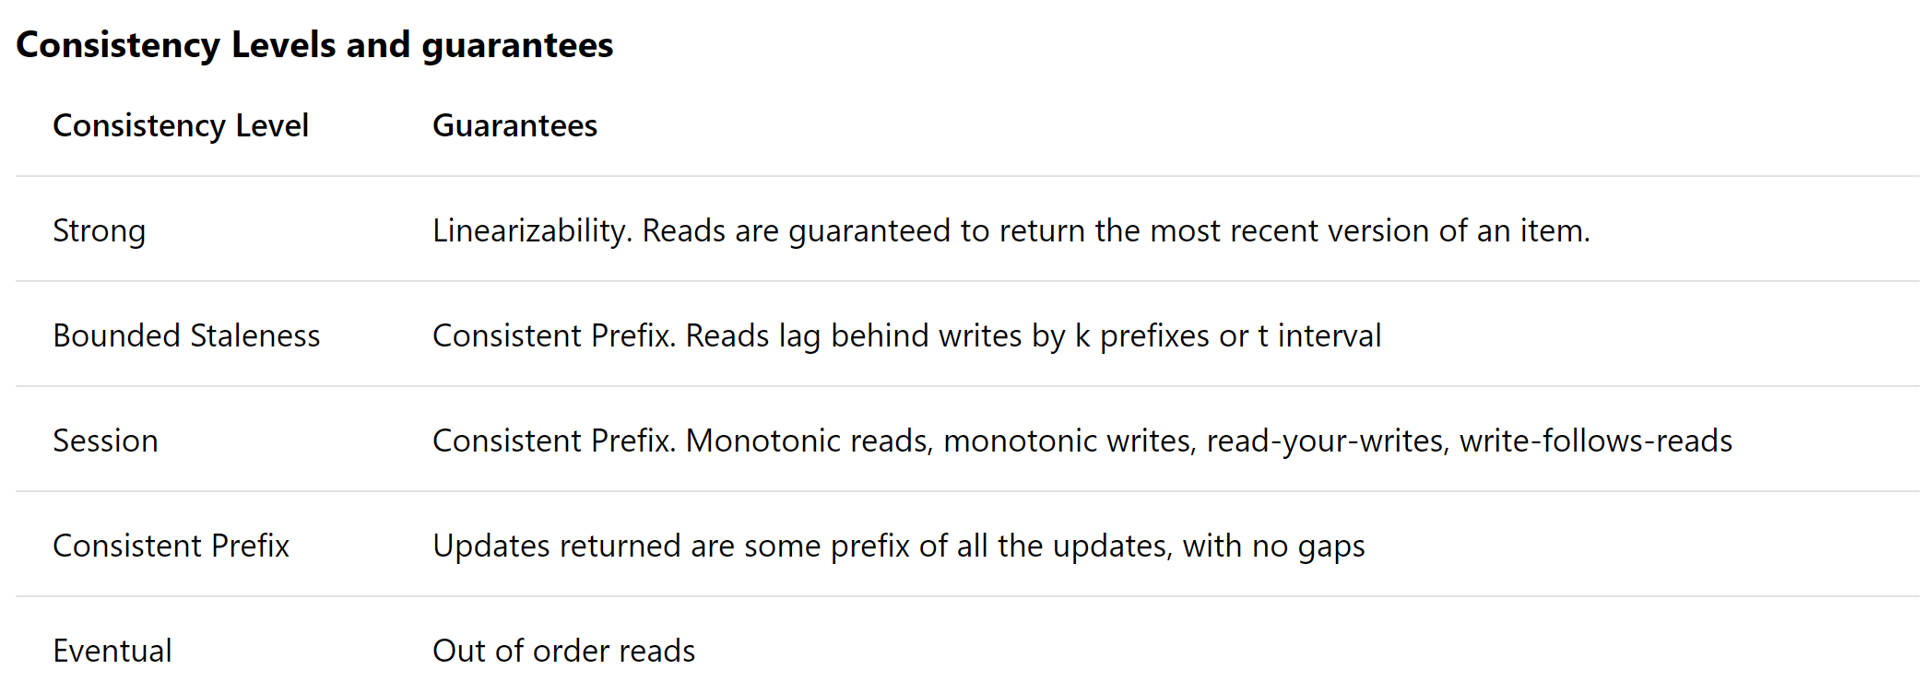

Slide 54
Demo

Slide 55
From SQL to Azure Cosmos DB
Jimmy Bogard
@jbogard
github.com/jbogard
jimmybogard.com

