Slide 1
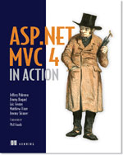



Beyond Containers
Jimmy Bogard
@jbogard
github.com/jbogard
jimmybogard.lostechies.com

Slide 2


































Titanium Sponsors
Platinum Sponsors
Gold Sponsors

Slide 3
Quick IoC/DI Review

Slide 4
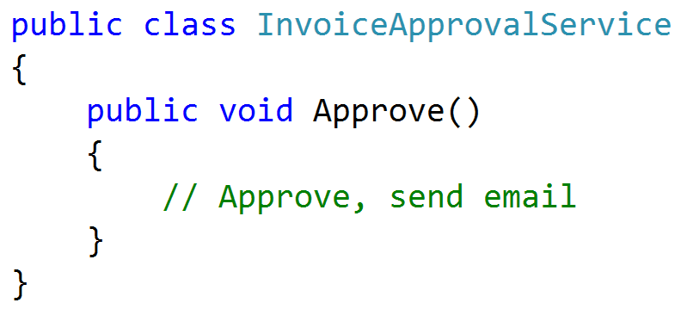

Slide 5
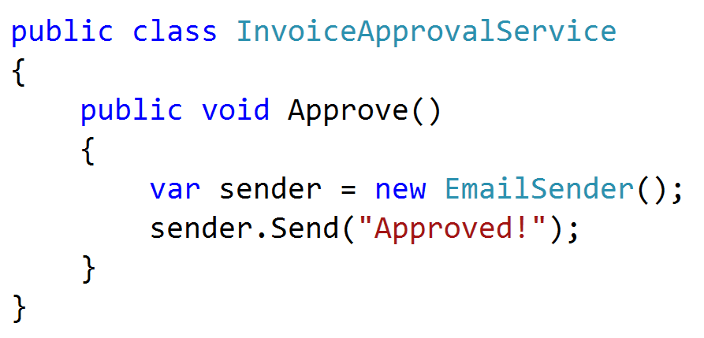
Notes:
New is coupling, new is opaque, new can’t be configured

Slide 6
Inversion of Control
A concept
Relinquishing responsibility of managing dependencies
Dependency Injection
A pattern
Constructor injection
Property injection
Method injection
Ambient context

Slide 7
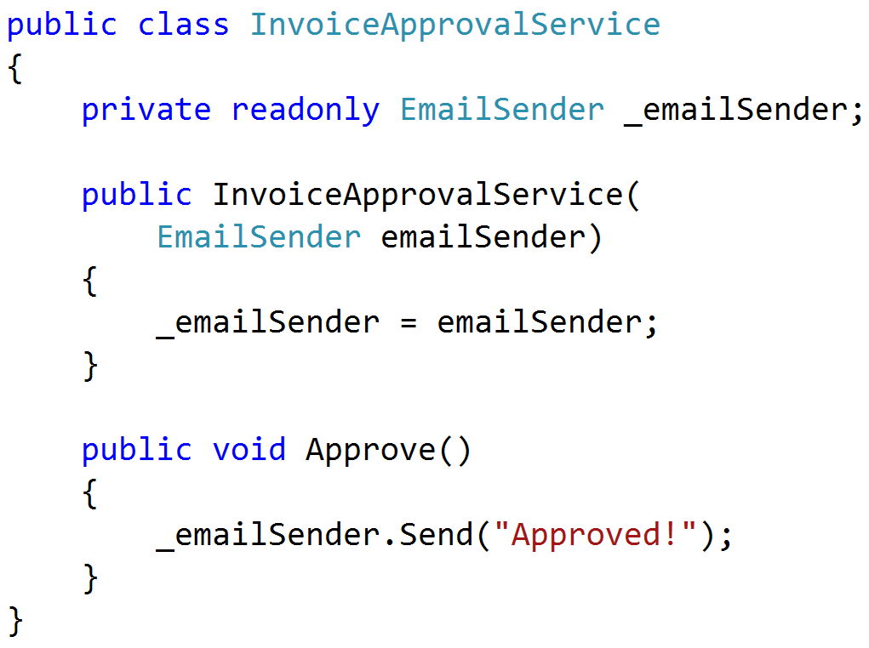

Slide 8
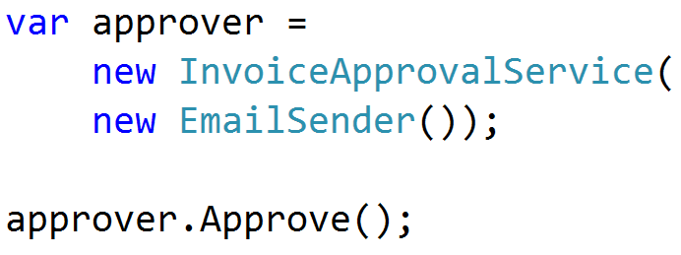

Slide 9
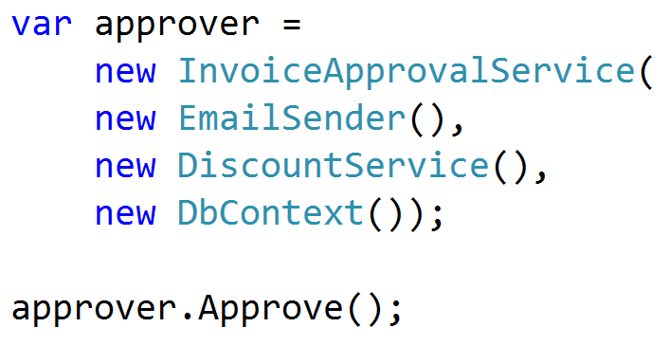

Slide 10
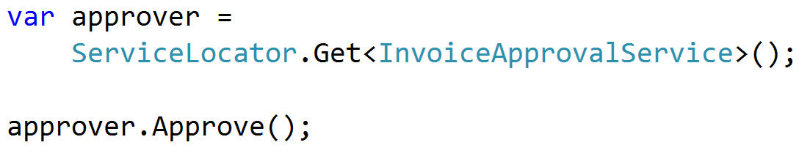

Slide 11
Demo

