Slide 1




Cross Platform Development with Portable Class Libraries
Jimmy Bogard
@jbogard
github.com/jbogard
jimmybogard.lostechies.com

Slide 2
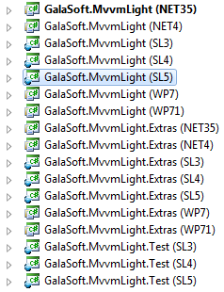
What are Portable Class Libraries?
“The Happy Little Feature that Could”
Enable targeting multiple platforms without recompiling or multiple projects
Save us from #if hell
Abstract away the differences between APIs and available features

Slide 3
Who should care?
2012 – earlier
OSS library developers
Thick client app developers
2013 – today
Mobile app developers (plus all of the above)
People who like testing

Slide 4
What is supported?
VS 2012
.NET 4+
Silverlight 4+
Windows Phone 7+
Windows Store apps
Xbox 360
VS 2013
.NET 4+
Silverlight 5
Windows Phone 8
Windows Store apps

Slide 5

What is supported?
VS 2012
.NET 4+
Silverlight 4+
Windows Phone 7+
Windows Store apps
Xbox 360
VS 2013
.NET 4+
Silverlight 5
Windows Phone 8
Windows Store apps
Xamarin.Android
Xamarin.iOS

Slide 6
What is supported? //build edition
VS 2012
.NET 4+
Silverlight 4+
Windows Phone 7+
Windows Store apps
Xbox 360
VS 2013 Update 2 RC
.NET 4+
Silverlight 5
Windows Phone 8 Silverlight
Windows Phone 8.1
Windows 8
Xamarin.Android
Xamarin.iOS

Slide 7
Licensing
Pre November 2013 – Windows only
After November 2013 - available on all platforms

Slide 8
MVVM (Model-View-ViewModel)
Views
How to display information
Native
View Models
What information to display
Flow of interaction
Models
Data objects
Business objects
Domain models etc
Views
Platform-specific
Databinds
View Model
References
Portable
Model

Slide 9
Windows Universal Apps
Announced at //build
Windows 8.1
Windows Phone 8.1
Xbox One
Views
Databinds
View Model
Portable
References
Model

Slide 10
Cross-Platform App Architecture
Windows Store App
Windows Phone App
Startup
Startup
Views
Views
Platform-specific functionality
Platform-specific functionality
Reference
Reference
Portable Class Library
View Models
Models
Platform abstractions

Slide 11
Xamarin.Forms Apps
Native UIs from single, shared codebase
iOS, Android, Windows Phone
XAML Views
Shims for devices
XAML
Databinds
View Model
Xamarin
References
Model

Slide 12
Demo

