Slide 1




ORMs: You’re Doing it wrong
Jimmy Bogard
@jbogard
github.com/jbogard
jimmybogard.lostechies.com

Slide 2











Notes:
Please take a moment and thank our Principal, Platinum and Gold Sponsors.

Slide 3

What is an ORM?
“A programming technique for converting data between incompatible type systems in object-oriented programming languages”

Slide 4
DB
App

Slide 5
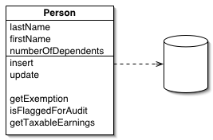
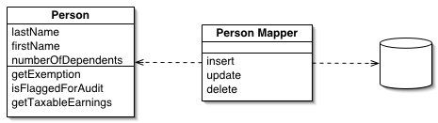
Data Source Patterns
Active Record
Data Mapper

Slide 6
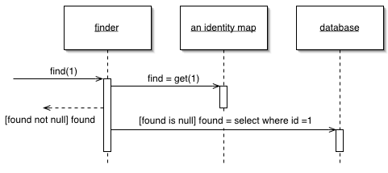
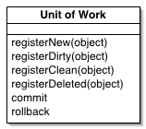
Behavioral Patterns
Unit of Work
Identity Map

Slide 7
What an ORM is not

Slide 8

Evil

Slide 9
Magic

Slide 10
Mapping Problems

Slide 11
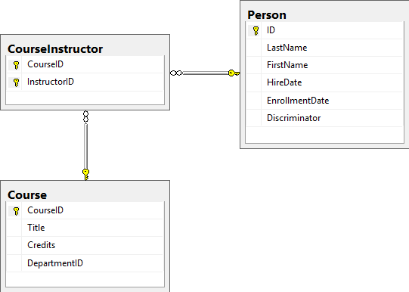
Bad Idea: Many-to-many mapping

Slide 12
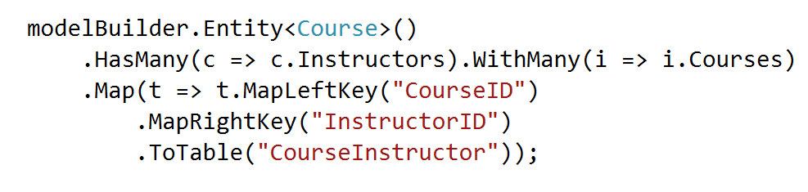
Bad Idea: Many-to-many mapping

Slide 13
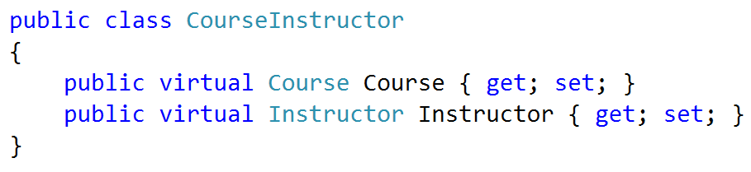
Good idea: Map join table

Slide 14
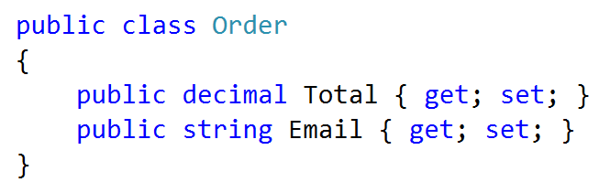
Bad Idea: Primitive Obsession

Slide 15
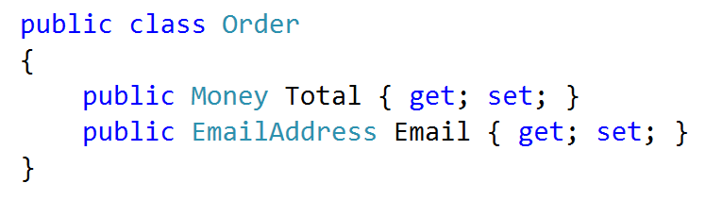
Good Idea: Custom User Types

Slide 16
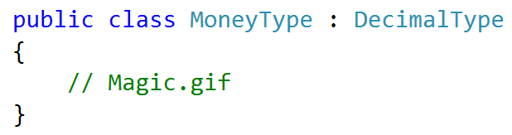
Good Idea: Custom User Types

Slide 17
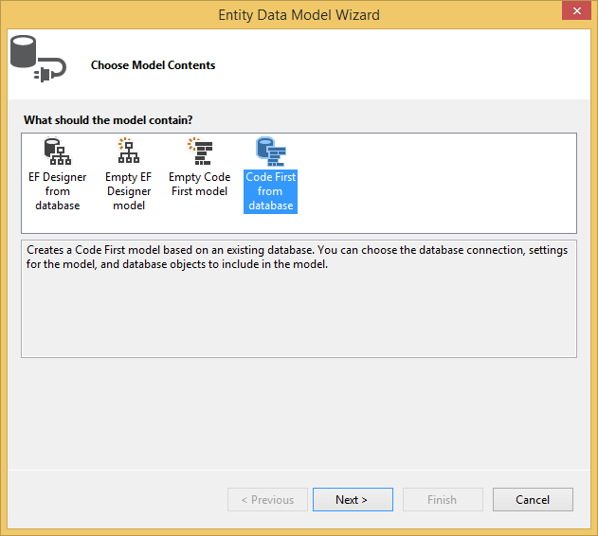
Bad Idea: DB-Generated

Slide 18
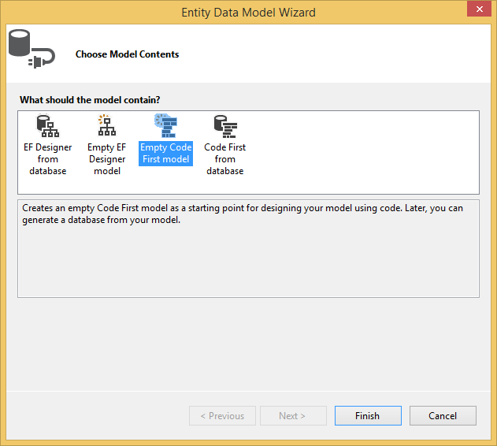
Good Idea: Code-First

Slide 19
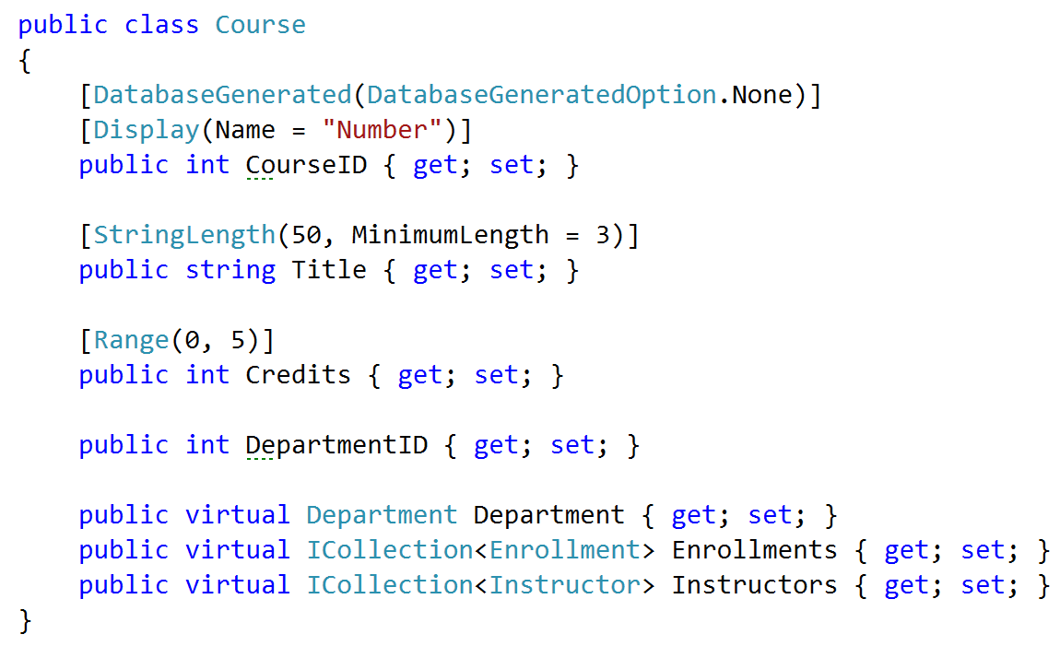
Bad Idea: Extraneous navigations

Slide 20
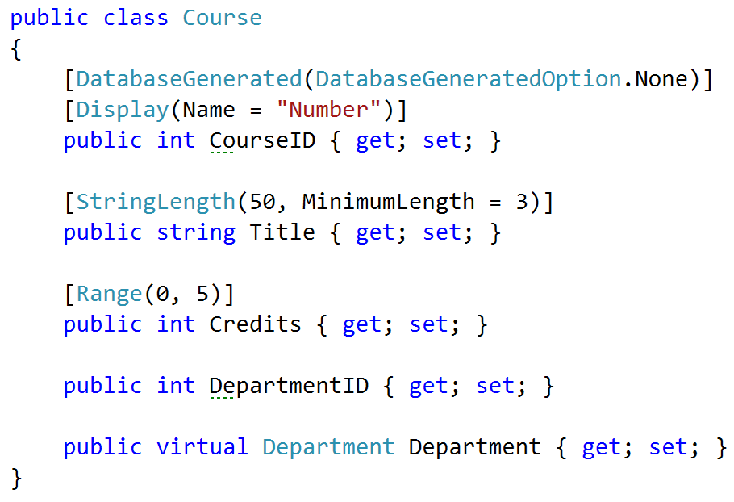
Good Idea: YAGNI Associations

Slide 21
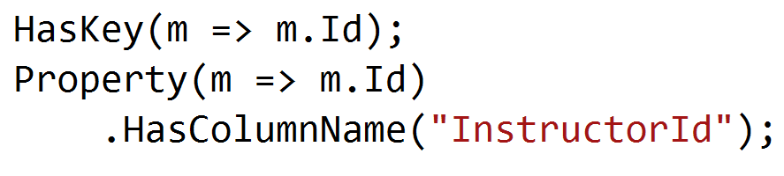
Bad Idea: Mapping Duplication

Slide 22
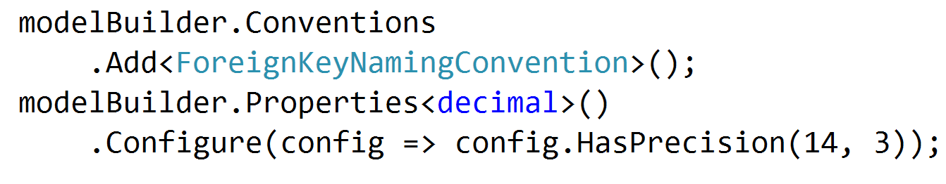
Good Idea: Mapping Conventions

Slide 23
Querying Problems

Slide 24
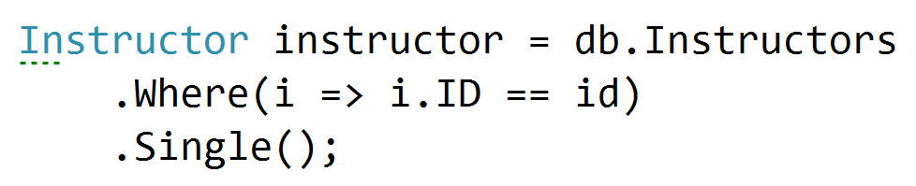
Bad Idea: Excessive Lazy Loading / SELECT N+1

Slide 25
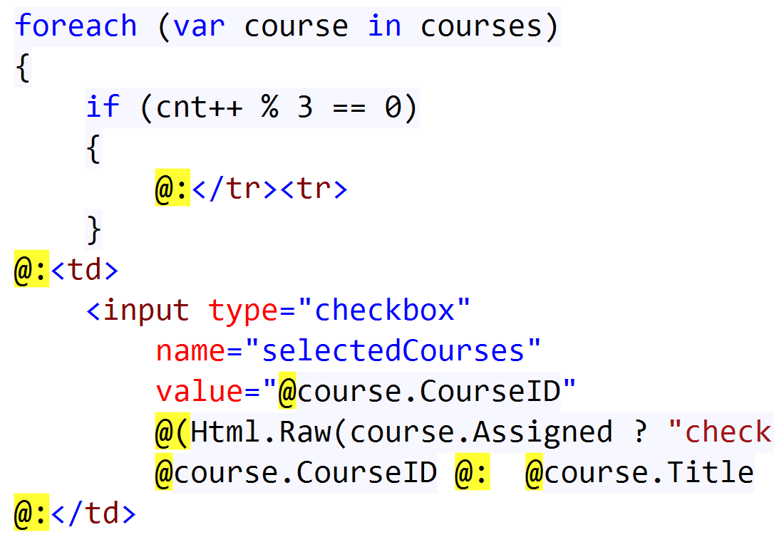
Bad Idea: Excessive Lazy Loading / SELECT N+1

Slide 26
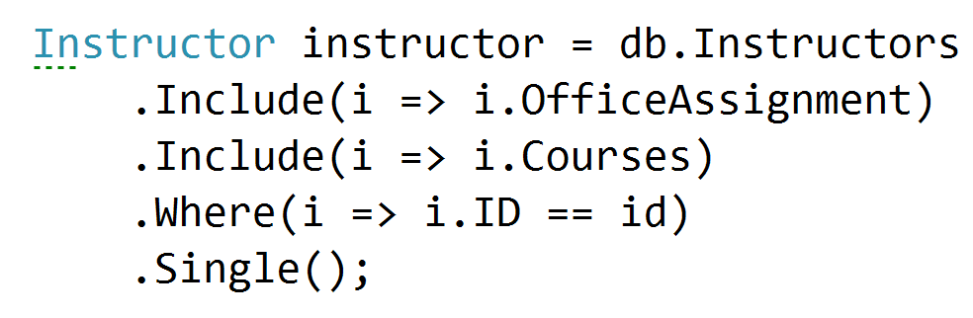
Good Idea: Eager Fetch

Slide 27
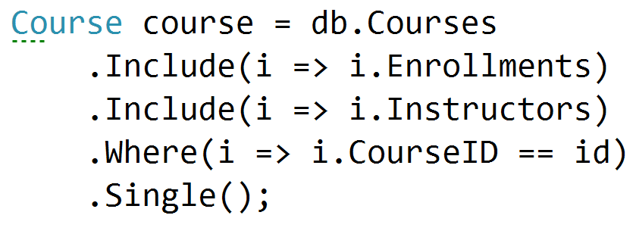
Bad Idea: Cartesian Products

Slide 28
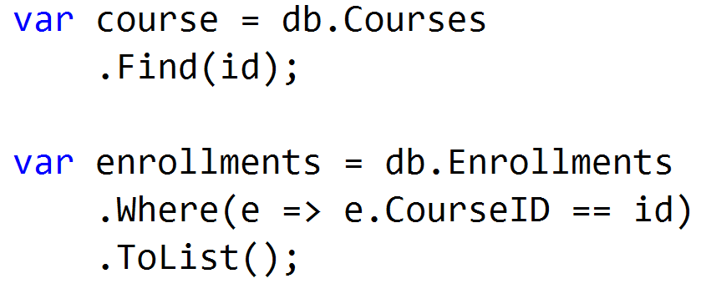
Good Idea: Multiple Queries

Slide 29
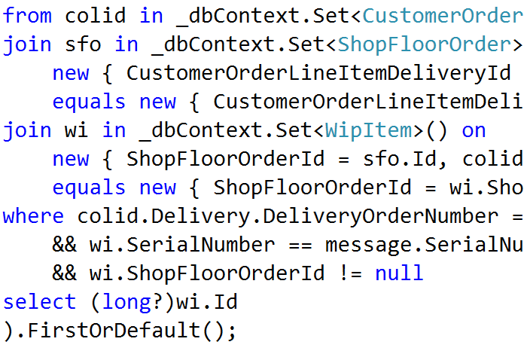
Bad Idea: Indecipherable LINQ

Slide 30
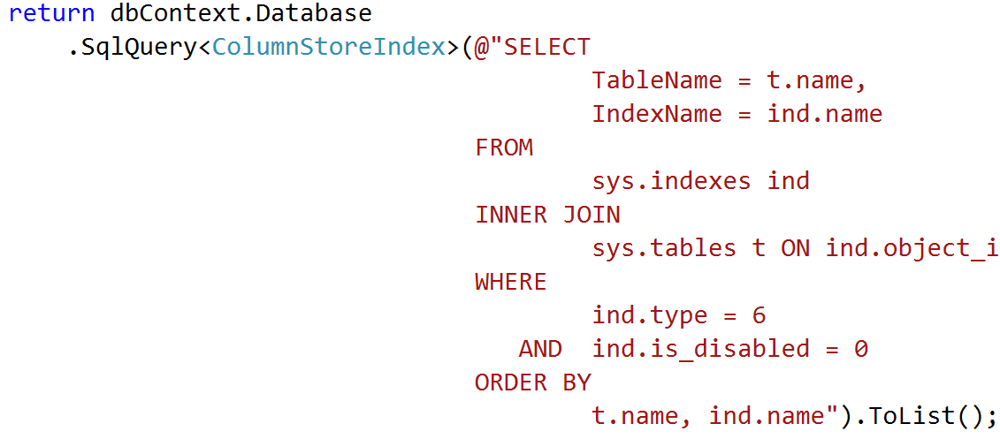
Good Idea: Just use SQL

Slide 31
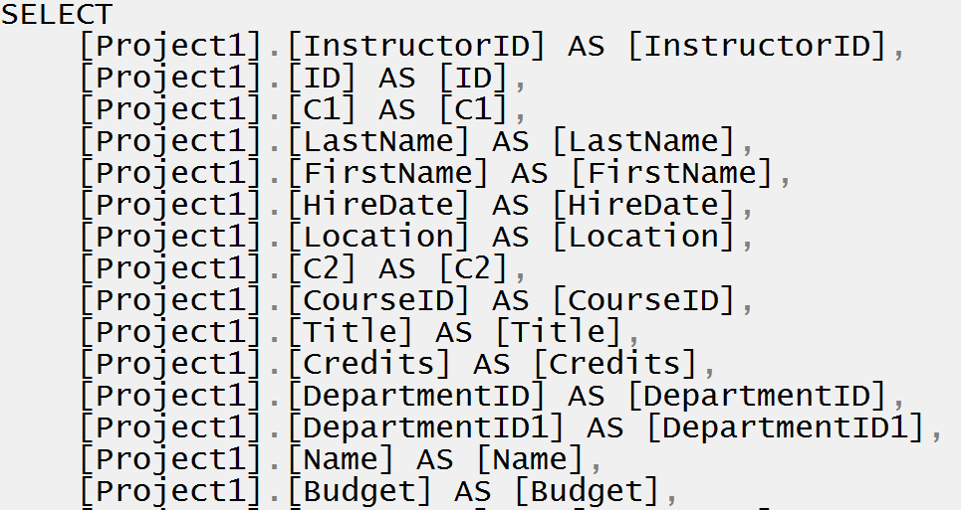
Bad Idea: Too much data

Slide 32
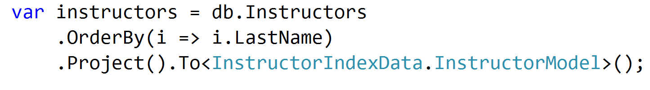
Good Idea: Projection

Slide 33
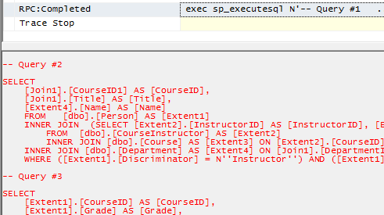
Good Idea: Projection

Slide 34
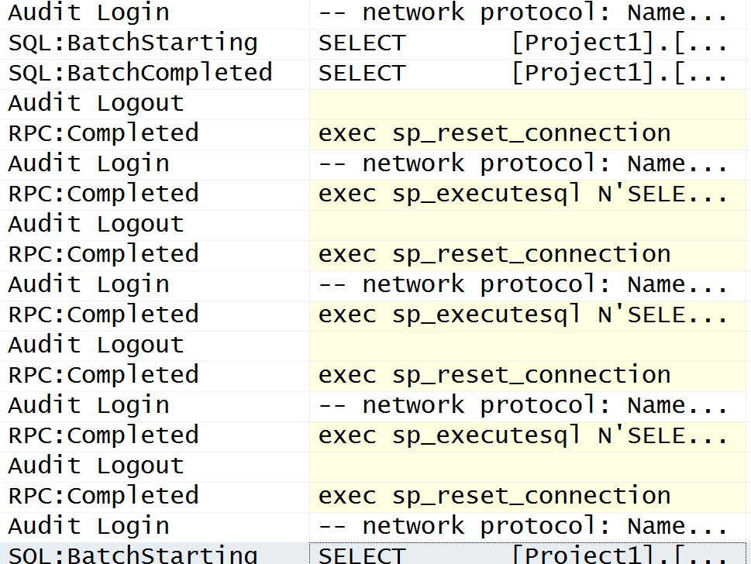
Bad Idea: Excessive Round trips

Slide 35
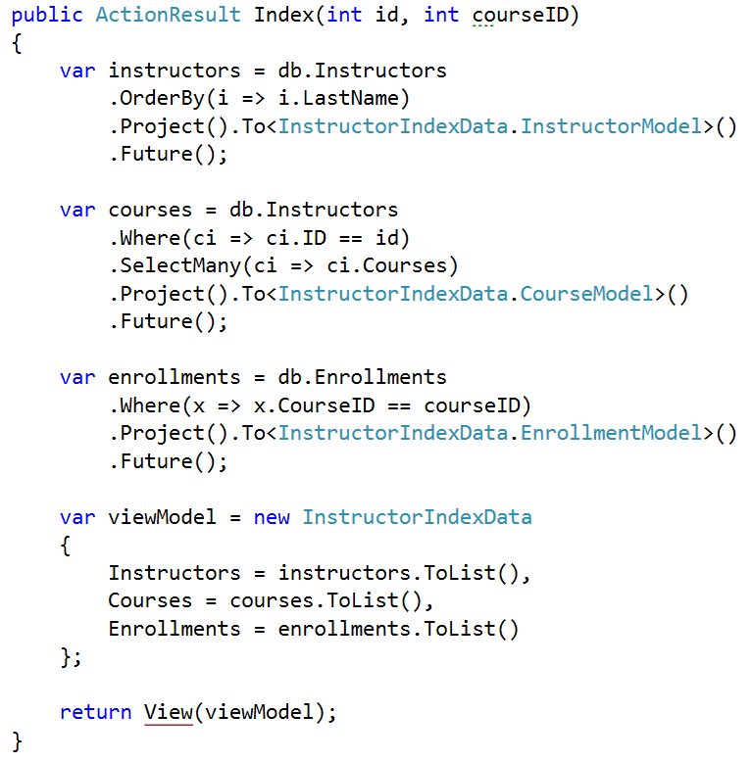
Good Idea: Batched/Future Queries

Slide 36
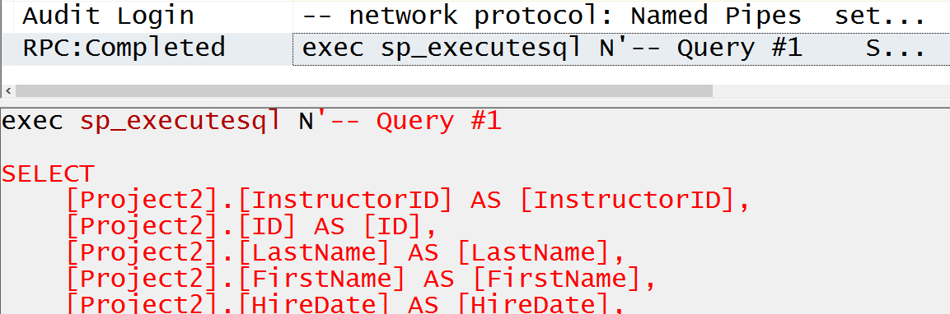
Good Idea: Batched/Future Queries

Slide 37
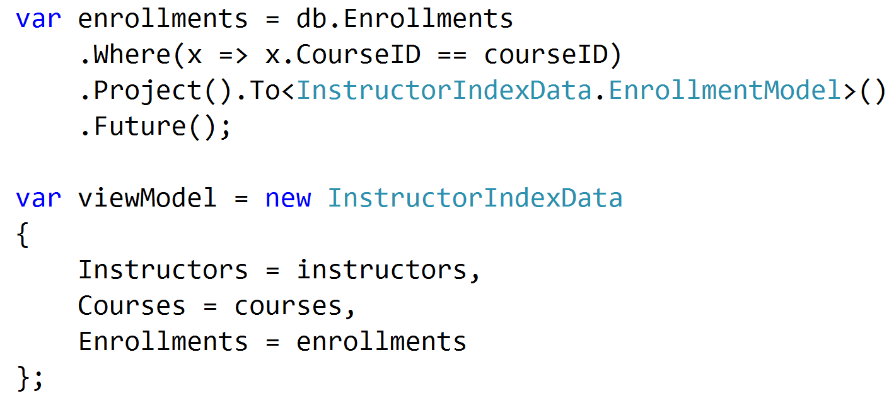
Bad Idea: Deferred Execution

Slide 38
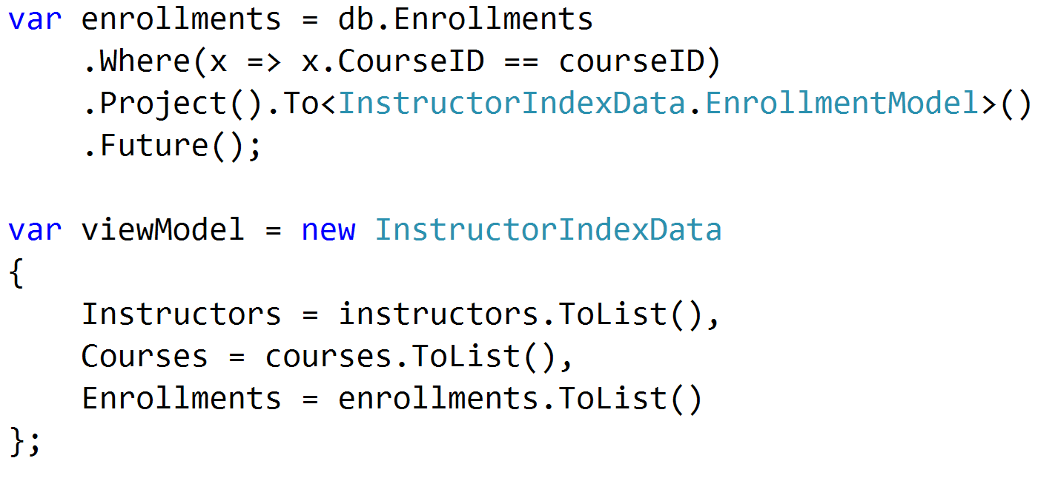
Good Idea: Immediate Execution

Slide 39
Usage Problems

Slide 40
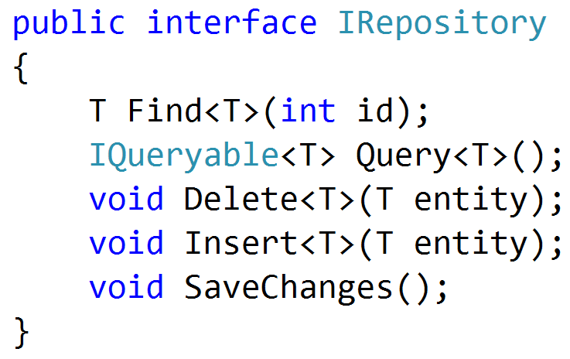
Bad Idea: Repositories

Slide 41
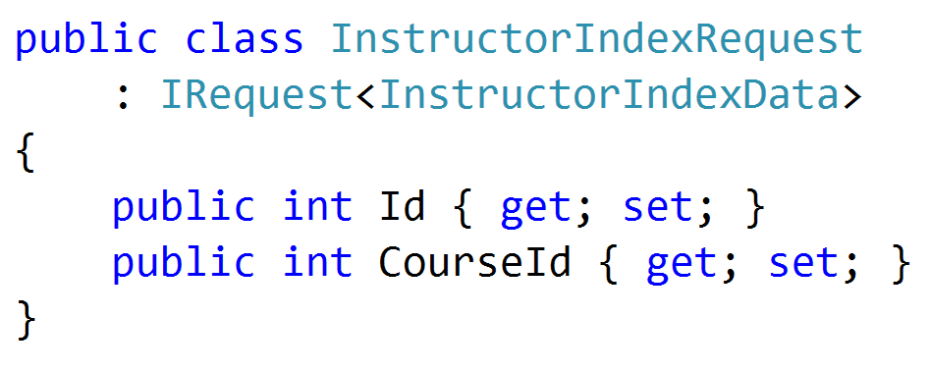
Good Idea: Commands and Queries

Slide 42
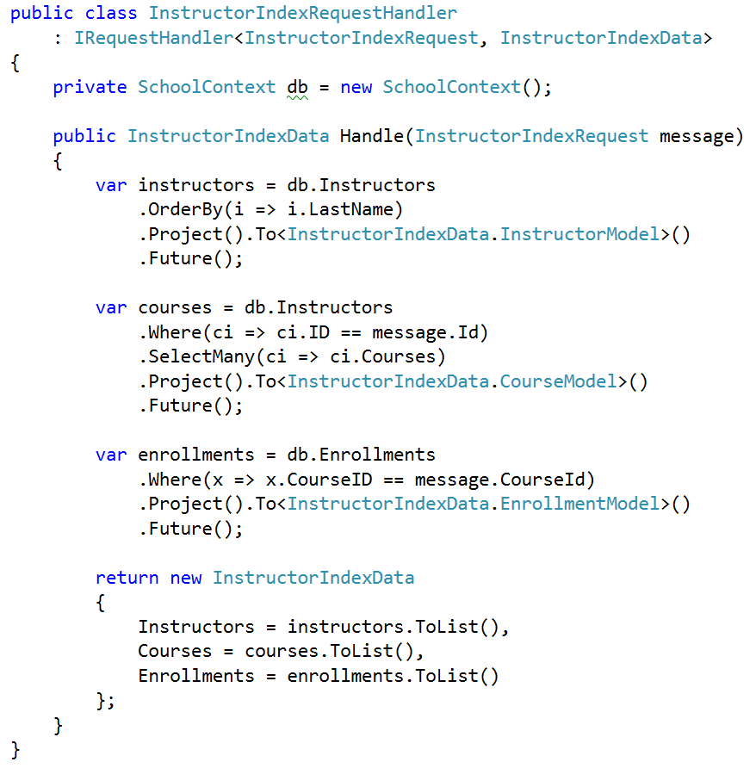
Good Idea: Commands and Queries

Slide 43
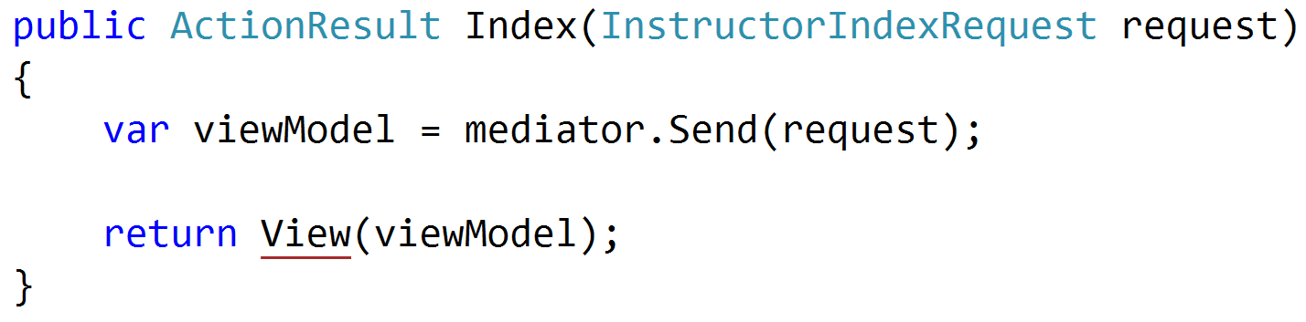
Good Idea: Commands and Queries

Slide 44
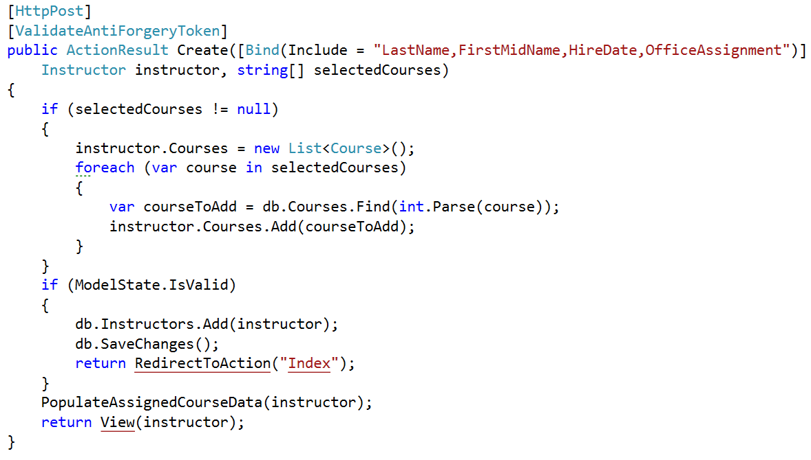
Bad Idea: Binding to Entities

Slide 45
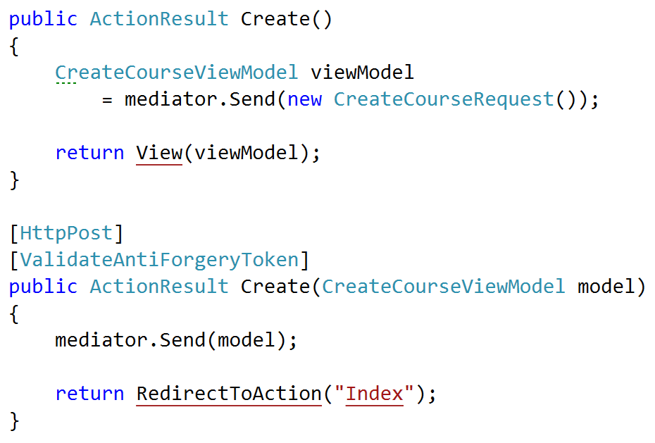
Good Idea: Bind to DTOs

Slide 46
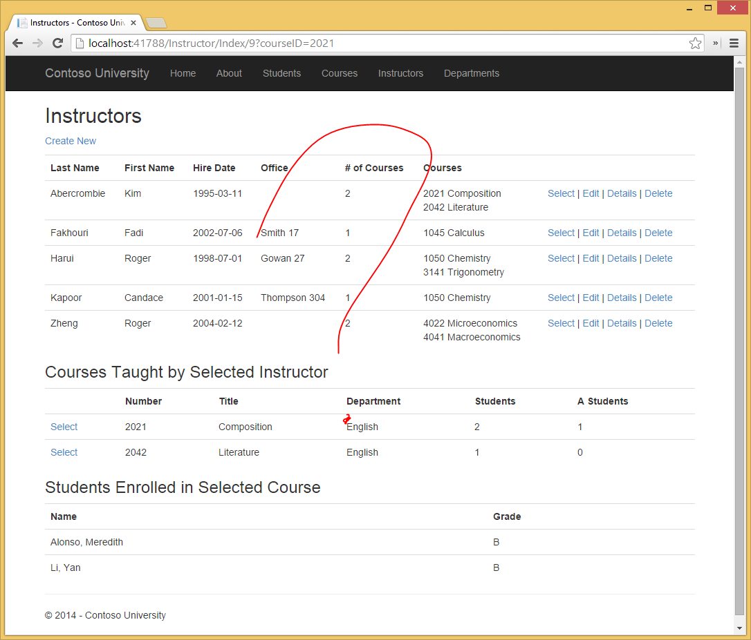
Bad Idea: SQL Ignorance

Slide 47
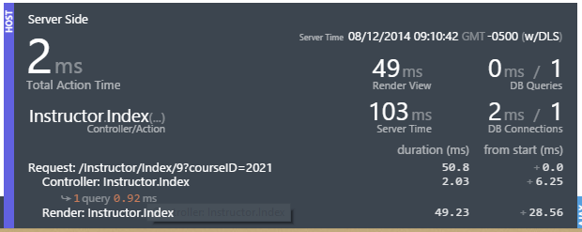
Good Idea: SQL Enlightenment

Slide 48
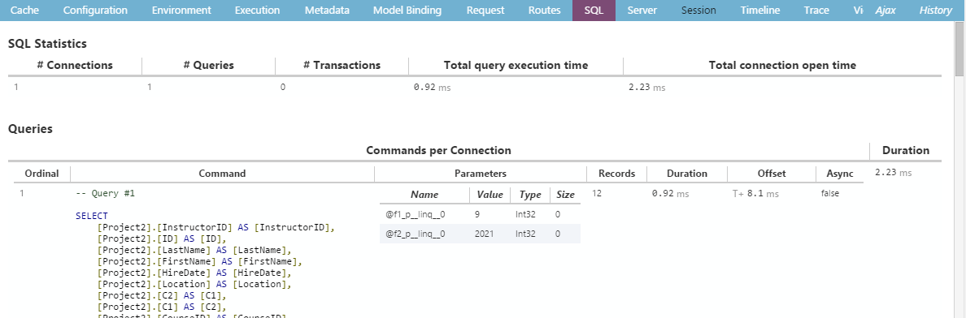
Good Idea: SQL Enlightenment

Slide 49
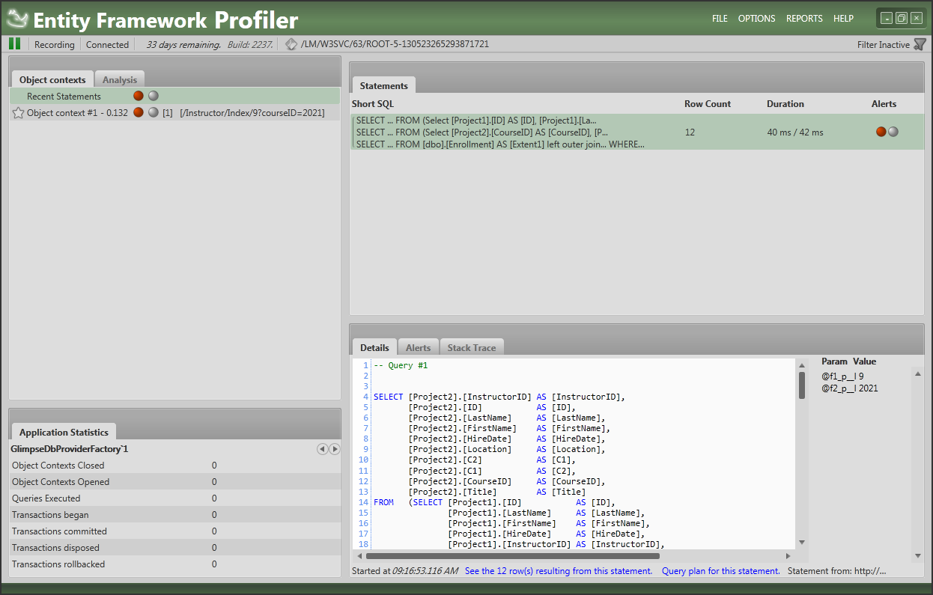
Good Idea: SQL Enlightenment

Slide 50
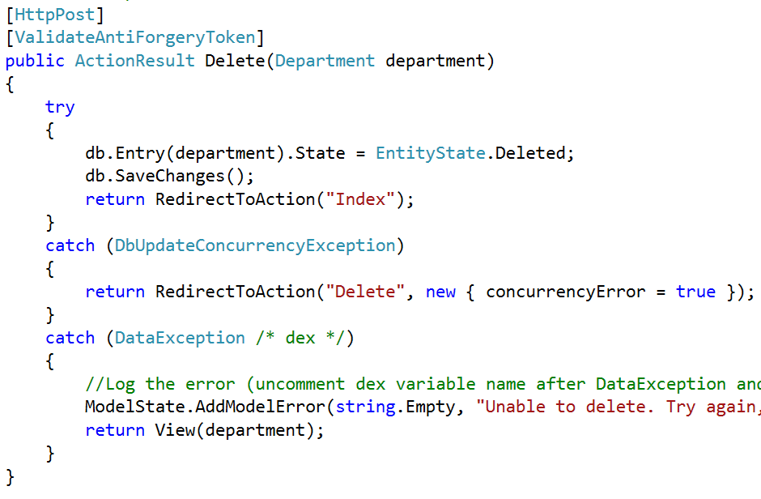
Bad Idea: Implicit Transactions

Slide 51
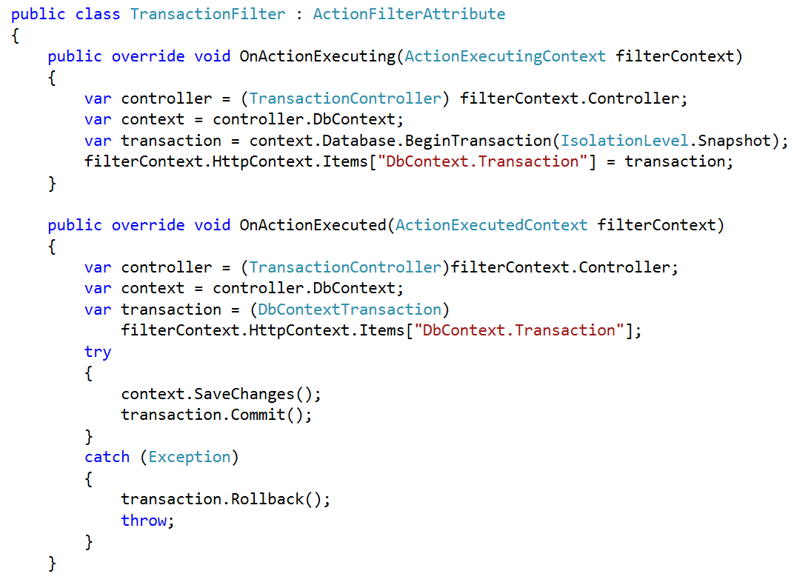
Good Idea: Explicit Transactions

Slide 52
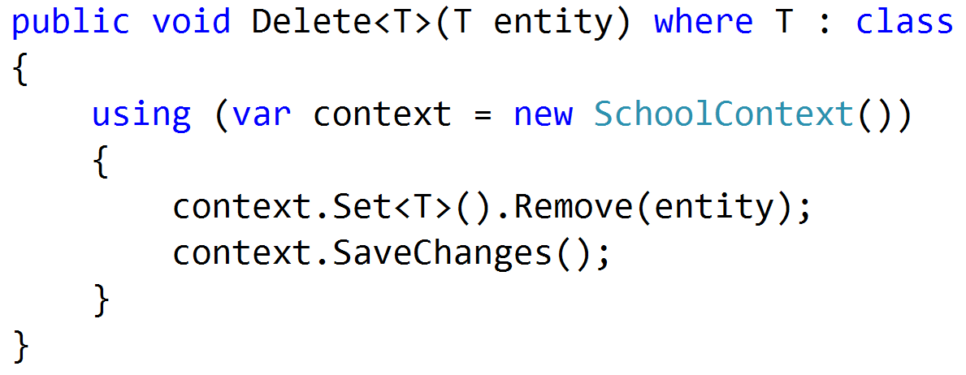
Bad Idea: Too Many Contexts

Slide 53
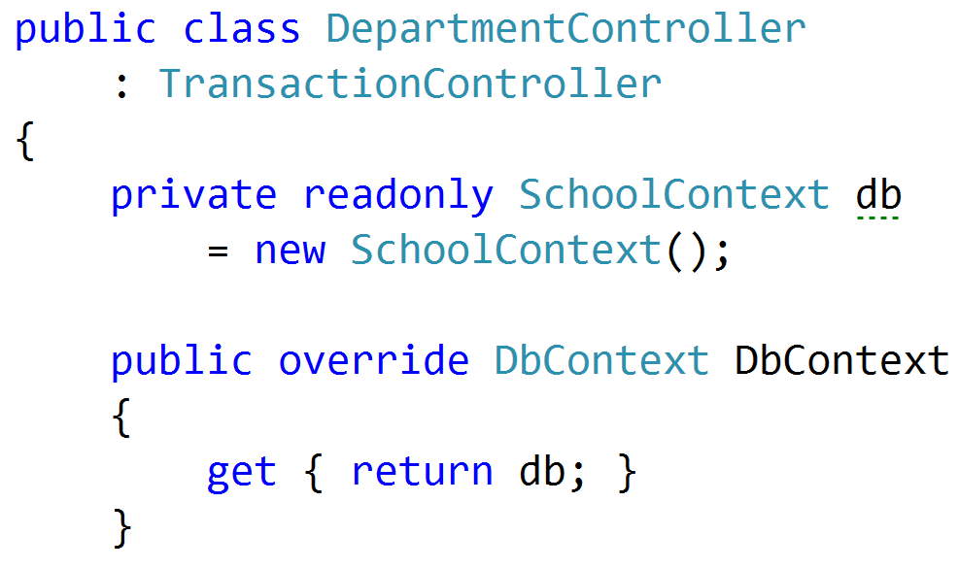
Good Idea: Context Per Request

Slide 54
Summary
ORMs – not evil
SQL – not evil
Developers – sometimes misguided

