Slide 1




Full Stack REST
Jimmy Bogard
@jbogard
github.com/jbogard
jimmybogard.com

Slide 2
REST: the good parts Hypermedia

Slide 3
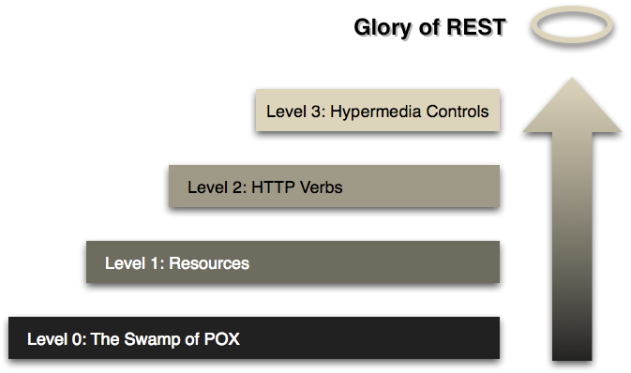

Slide 4
What’s wrong with plain ol’ JSON objects? (POJSONO)

Slide 5
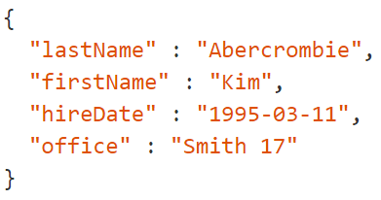
Mo’ POJSONO problems
Labels/names hardcoded
Types inferred
What can I do with this?
What is related to this?

Slide 6
Hypermedia = JSON + Links + URLs + Forms/Queries

Slide 7
Typical Hypermedia experience

Slide 8


Slide 9


Deployed together
Browser
Server
HTML
JavaScript
AJAX
Hypermedia

Slide 10
Where is hypermedia applicable?

Slide 11
Normal app – probably not
Browser
Server
HTML
JavaScript
AJAX

Slide 12
Disparate clients - yes
App V1
Server
App V2

Slide 13
Disparate servers - yes
App
Server V1
Server V2

Slide 14
Mobile apps - perhaps
Mobile Device
App Store
App.ipa
Server
AJAX

Slide 15
Common theme: Client/server developed/deployed independently

Slide 16
Choosing a hypermedia format
Build your own
Pick a standard
Hybrid – pick a standard and extend

Slide 17
collection+json

Slide 18
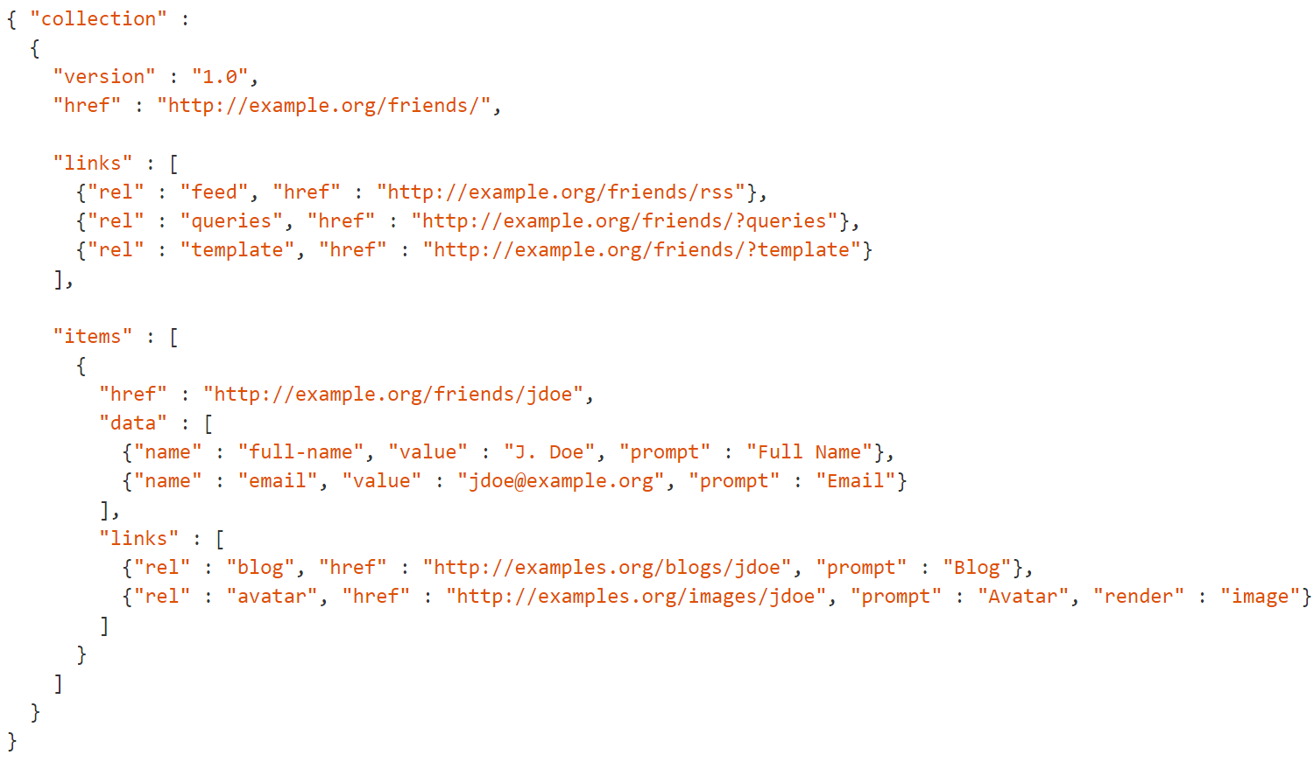

Slide 19
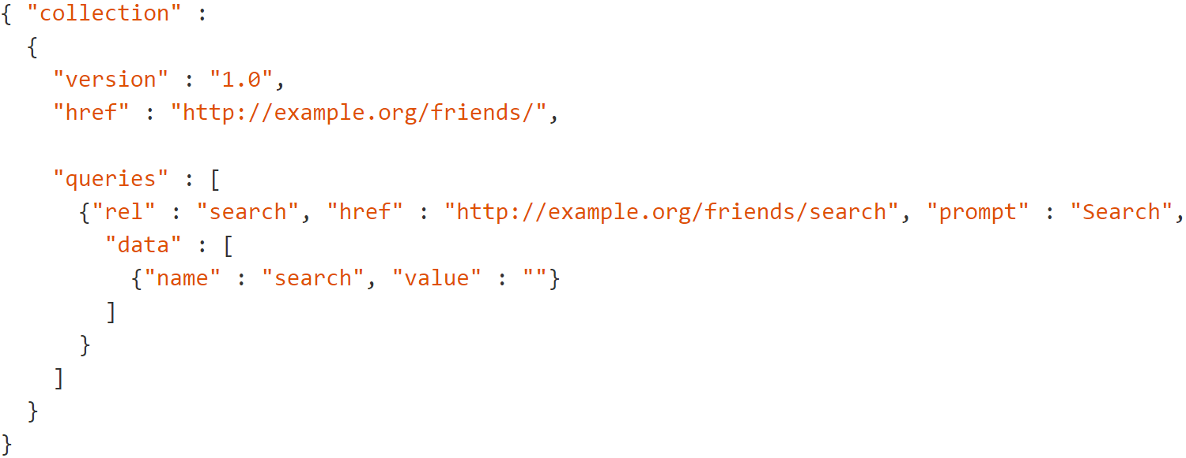

Slide 20
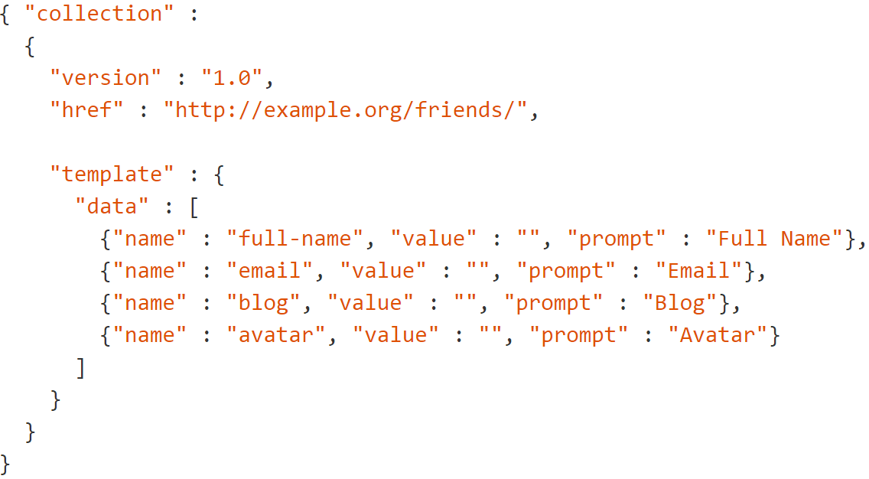

Slide 21
Why React?

Slide 22

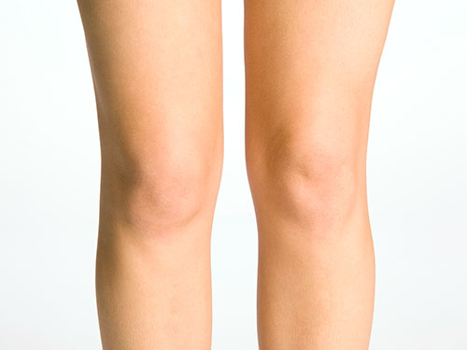

Slide 23



Slide 24



Slide 25
POST-Redirect-GET
Browser
POST
/student
MVC
302 Found
/student/index
Clear screen
GET
/student/index
200 OK
text/html

Slide 26
React Flow
Browser
POST
/student
API
302 Found
/student
Refresh state
GET
/student
Re-render
200 OK
collection+json

Slide 27
Demo: collection+json

Slide 28
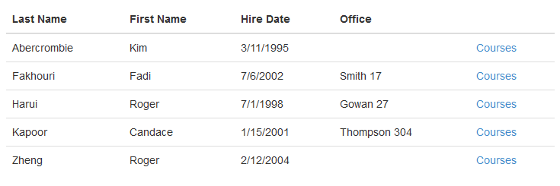
Table
Header
Row
Cell
Link

Slide 29
Full Stack REST
Jimmy Bogard
@jbogard
github.com/jbogard
jimmybogard.com

