Slide 1




Life Beyond Distributed Transactions: An Apostate's Implementation
Jimmy Bogard
@jbogard
github.com/jbogard
jimmybogard.com

Slide 2
A Simpler Time…

Slide 3
The Database
The App

Slide 4
The Database
The App
UPDATE Orders
SET Status = 3
WHERE Id = 123

Slide 5
The Database
The App

Slide 6
The Database
The App
SELECT Status
FROM Orders
WHERE Id = 123

Slide 7
The Database
The App
SELECT Status
FROM Orders
WHERE Id = 123
And all was good.jpg

Slide 8
The Database
The App

Slide 9
The Database
The App
UPDATE Orders
SET Status = 4
WHERE Id = 123
UPDATE Inventory
SET Quantity = Quantity – 3
WHERE ProductId = 456

Slide 10
The Database
The App

Slide 11
The Database
The App
SELECT Status
FROM Orders
WHERE Id = 123
SELECT Quantity
FROM Inventory
WHERE ProductId = 456

Slide 12
The Database
The App

Slide 13
The Database
The App
UPDATE Orders
SET Status = 4
WHERE Id = 123
UPDATE Inventory
SET Quantity = Quantity – 3
WHERE ProductId = 456

Slide 14
The Database
The App
UPDATE Orders
SET Status = 4
WHERE Id = 123
UPDATE Inventory
SET Quantity = Quantity – 3
WHERE ProductId = 456

Slide 15
The Database
The App
UPDATE Orders
SET Status = 4
WHERE Id = 123
UPDATE Inventory
SET Quantity = Quantity – 3
WHERE ProductId = 456

Slide 16
The Database
The App
UPDATE Orders
SET Status = 4
WHERE Id = 123
UPDATE Inventory
SET Quantity = Quantity – 3
WHERE ProductId = 456

Slide 17
✓
The Database
The App
UPDATE Orders
SET Status = 4
WHERE Id = 123
UPDATE Inventory
SET Quantity = Quantity – 3
WHERE ProductId = 456

Slide 18
A Slight Wrinkle…

Slide 19
The Database
The App

Slide 20
Sales Database
UPDATE Orders
SET Status = 4
WHERE Id = 123
The App
Shipping Database

Slide 21
Sales Database
UPDATE Orders
SET Status = 4
WHERE Id = 123
The App
Shipping Database
UPDATE Inventory
SET Quantity = Quantity – 3
WHERE ProductId = 456

Slide 22
✓
Sales Database
UPDATE Orders
SET Status = 4
WHERE Id = 123
The App
Shipping Database
UPDATE Inventory
SET Quantity = Quantity – 3
WHERE ProductId = 456

Slide 23
Sales Database
UPDATE Orders
SET Status = 4
WHERE Id = 123
The App
Shipping Database
UPDATE Inventory
SET Quantity = Quantity – 3
WHERE ProductId = 456

Slide 24
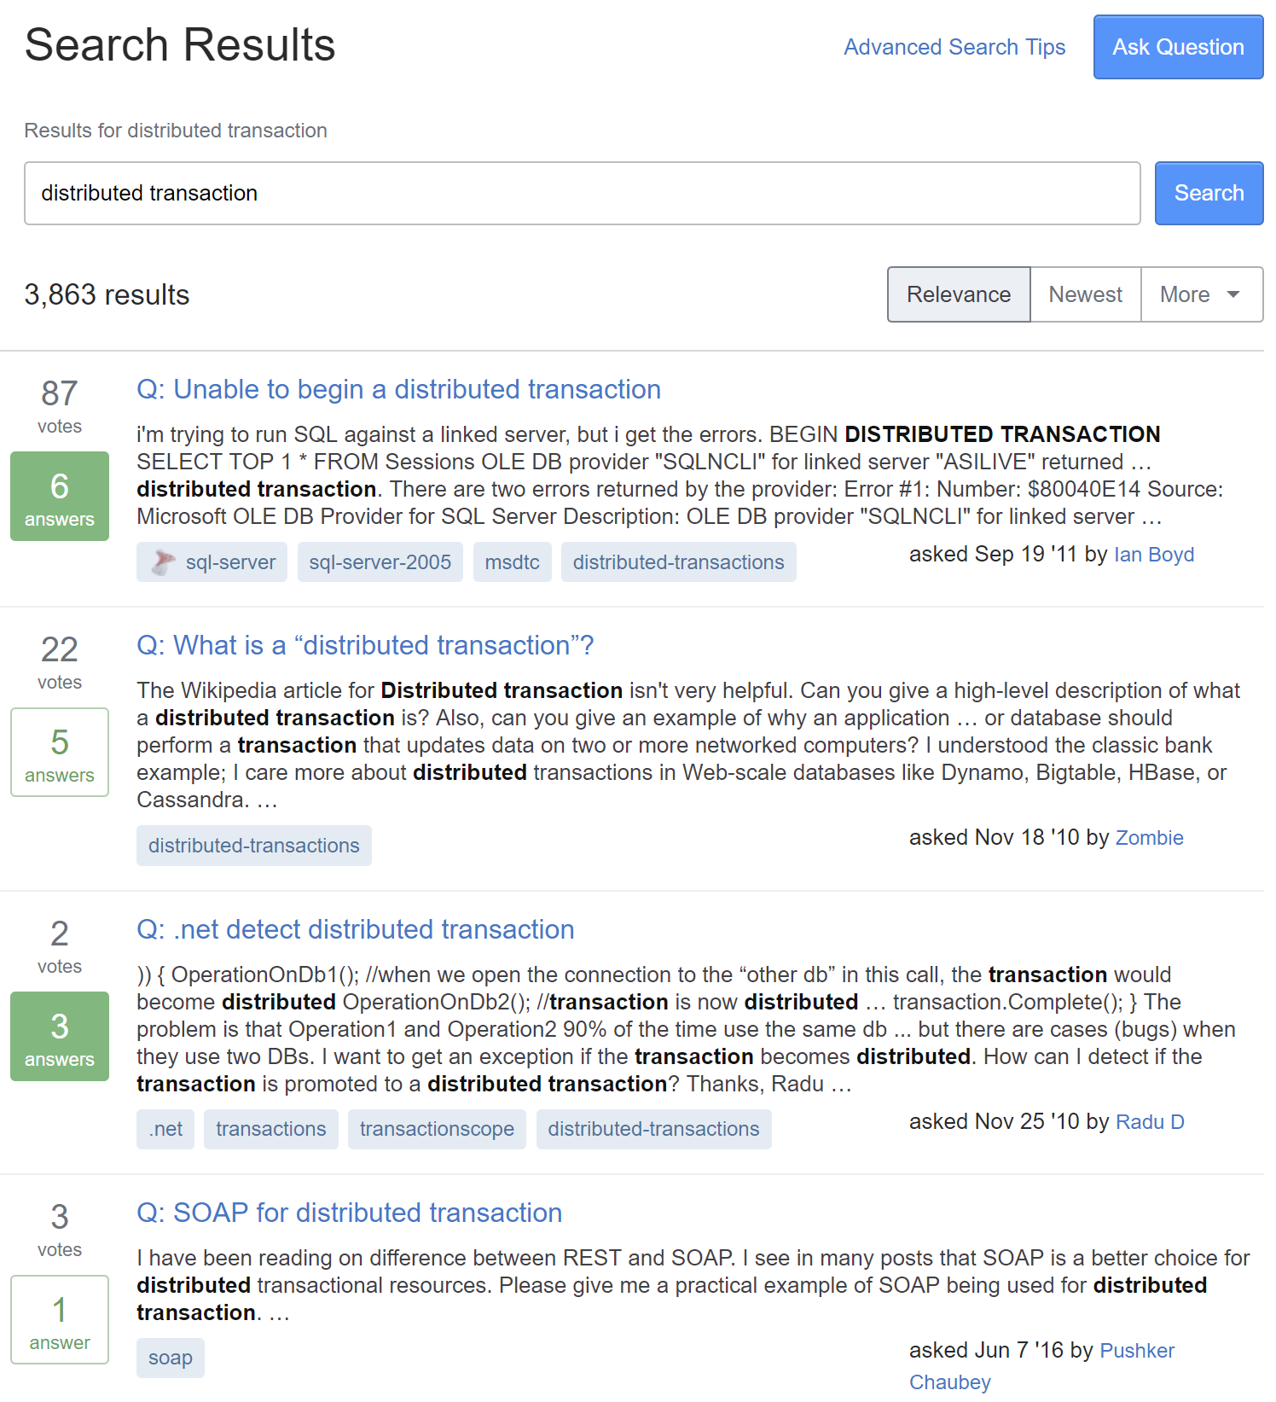

Slide 25
Distributed Transaction?

Slide 26
A database transaction in which two or more network hosts are involved

Slide 27
Most common protocol: Two-Phase Commit (aka 2PC)

Slide 28
Prepare
Resource A
Coordinator
Feedback
Resource B
Commit

Slide 29
Prepare
Resource A
Coordinator
Feedback
Resource B
Commit

Slide 30
✓
SQL Server
MS DTC
SQL Server

Slide 31
Always On
SQL Server
SQL Server
MS DTC
SQL Server

Slide 32
Azure
SQL Server
MS DTC
SQL Server

Slide 33
✓
SQL Server
MS DTC
MSMQ

Slide 34
SQL Server
MS DTC
RabbitMQ

Slide 35
MongoDB
MS DTC

Slide 36
2PC Summary
Transactions in a single resource – yes
Transactions across identical resources – no
Transactions across disparate resources – no
Transactions across multiple items – YesSQL and NoSQL

Slide 37
MongoDB
MS DTC
RabbitMQ

Slide 38
Order Fulfillment Example
Consuming messages from RabbitMQ
Multiple writes to MongoDB
Producing messages to RabbitMQ
All in a single "transactional" activity

Slide 39
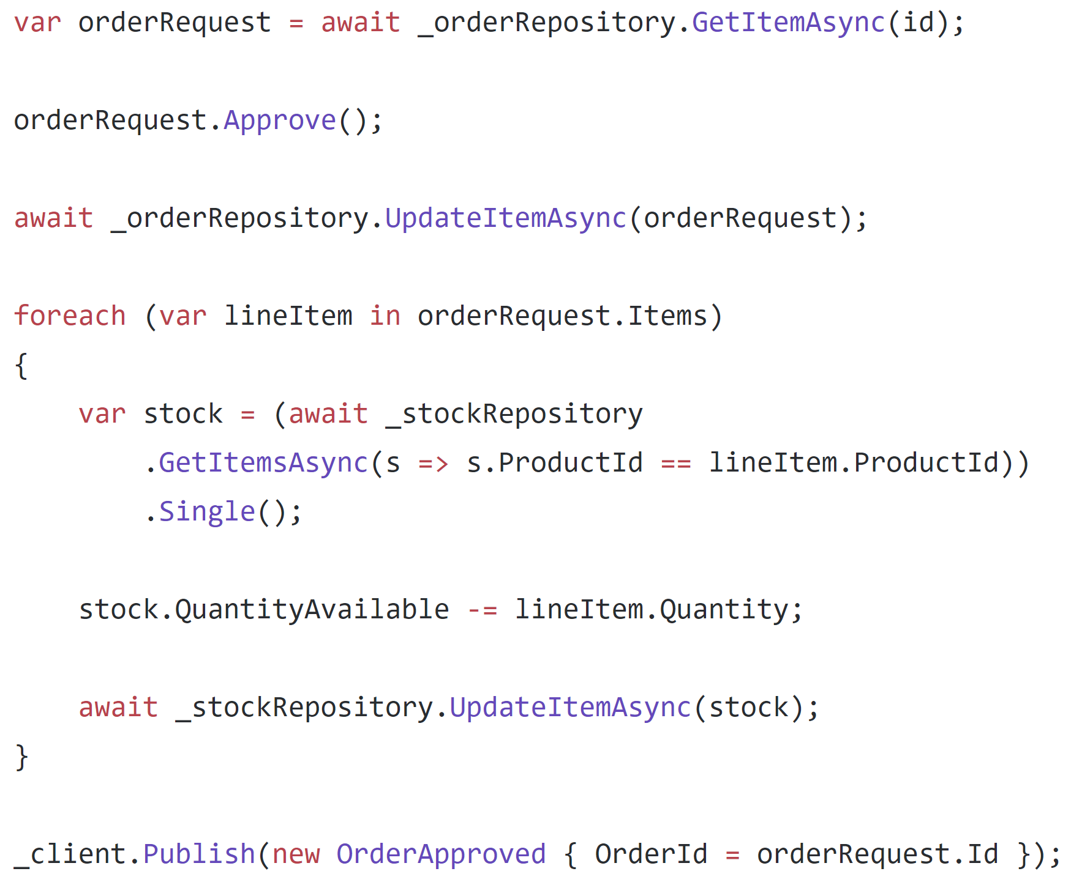

Slide 40
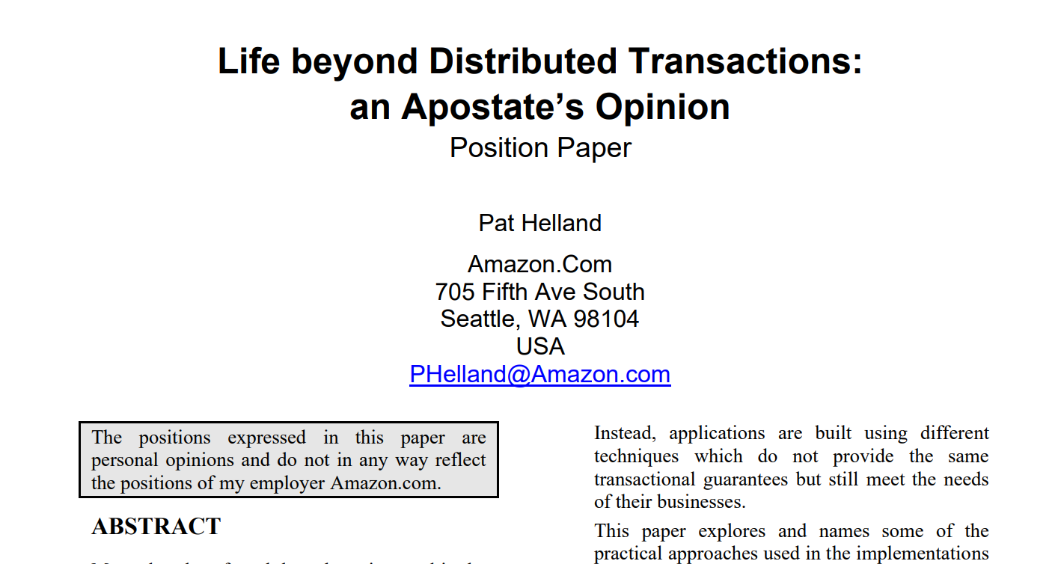

Slide 41
Epiphany: Assume a transactional boundary of a single item

Slide 42
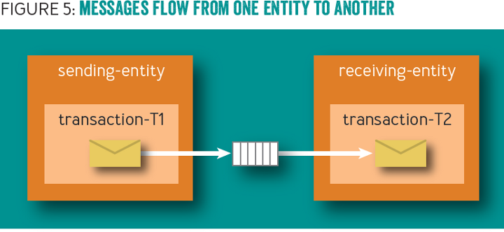

Slide 43
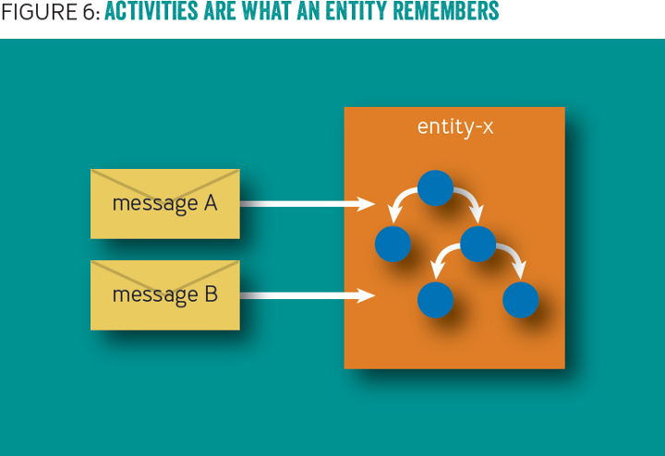

Slide 44
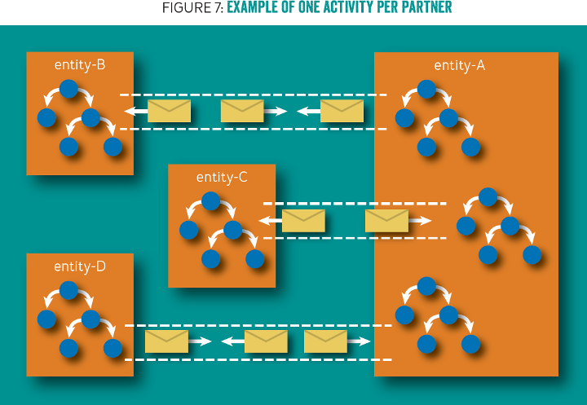

Slide 45
Problem: No code, only pictures

Slide 46
Document
Document
Business Data
Business Data
Outbox
Outbox
Inbox
Inbox

Slide 47
Example
Notes:
IDocumentMessage
DocumentBase
OrderRequest.ctor
OrderRequest.Approve
OrderRequest.Reject

Slide 48
Facilitating communication with a dispatcher

Slide 49
Document
Document
Data
Data
In
In
Out
Out
Document
Data
In
Out
Notes:
3 documents participating in a single request, but no way to coordinate a transaction between the 3

Slide 50
Document
Document
Data
Data
…
…
In
In
Out
Out
Document
Data
In
Out
Notes:
Initial request initiates changes in the first document. It needs to communicate to the others so it creates a couple of domain events.

Slide 51
✓
Document
Document
Data
Data
…
…
In
In
Out
Out
Document
Data
In
Out
Notes:
The transaction for the first document document commits, including the domain events

Slide 52
✓
Document
Document
Data
Data
…
…
In
In
Out
Out
Document
Data
Dispatcher
In
Out
Notes:
The domain event dispatcher is responsible for taking domain events and dispatching them to event handlers (and eventually other documents)

Slide 53
✓
Document
Document
Data
Data
…
…
In
In
Out
Out
Document
Data
Dispatcher
In
Out
Notes:
The dispatcher reads the first event from the document

Slide 54
✓
Document
Document
Data
Data
…
…
In
In
Out
Out
Document
Data
Dispatcher
In
Out
Notes:
And will dispatch it to handlers, who know how to match domain events to documents

Slide 55
✓
Document
Document
Data
Data
…
…
…
…
In
In
Out
Out
Document
Data
Dispatcher
In
Out
Notes:
The first domain event is matched to an document, and the document handles it by mutating its data and storing this handled domain event in its inbox

Slide 56
✓
✓
Document
Document
Data
Data
…
…
…
…
In
In
Out
Out
Document
Data
Dispatcher
In
Out
Notes:
This document document transaction succeeds

Slide 57
Example
Notes:
Dispatcher
IDocumentMessageHandler
OrderCreatedHandler

Slide 58
When things go wrong

Slide 59
✓
✓
Document
Document
Data
Data
…
…
…
…
In
In
Out
Out
Document
Data
Dispatcher
In
Out
Notes:
This document document transaction succeeds

Slide 60
✓
✓
Document
Document
Data
Data
…
…
…
…
In
In
Out
Out
Document
Data
Dispatcher
In
Out
Notes:
Upon dispatch to the second document however, this one fails, so no data is written and no event stored in the outbox

Slide 61
✓
✓
Document
Document
Data
Data
…
…
…
…
In
In
Out
Out
Document
Data
Dispatcher
In
Out
Retry
Notes:
Detecting a failure, the dispatcher sends a durable message to an document retry queue, noting the document type and ID to retry domain events.

Slide 62
Retries

Slide 63
Document
Document
Data
Data
…
…
…
…
In
In
Out
Out
Document
Data
Dispatcher
In
Out
Retry
Notes:
For retries, the dispatcher reads messages from the document retry queue.

Slide 64
Document
Document
Data
Data
…
…
…
…
In
In
Out
Out
Document
Data
Dispatcher
In
Out
Retry
Notes:
The dispatcher then pulls the document and attempts to re-dispatch its domain events to the relevant handlers

Slide 65
Document
Document
Data
Data
…
…
…
…
In
In
Out
Out
Document
Data
Dispatcher
In
Out
Retry
Notes:
For the first document, it sends the domain event to the handler

Slide 66
Document
Document
Data
Data
…
…
…
…
In
In
Out
Out
Document
Data
Dispatcher
In
Out
Retry
Notes:
The document checks its inbox and compares the ID of the incoming domain event to its inbox of processed events

Slide 67
¯\_(ツ)_/¯
Document
Document
Data
Data
…
…
…
…
In
In
Out
Out
Document
Data
Dispatcher
In
Out
Retry
Notes:
It sees that the message has already been processed, so ignores the event. Handling the domain event maintains idempotency, so that receiving a domain event at-least-once results in the actual processing of the event to only happen once

Slide 68
¯\_(ツ)_/¯
Document
Document
Data
Data
…
…
…
…
In
In
Out
Out
Document
Data
…
…
Dispatcher
In
Out
Retry
Notes:
The dispatcher notifies the next handler of a domain event

Slide 69
¯\_(ツ)_/¯
Document
Document
Data
Data
…
…
…
…
In
In
Out
Out
✓
Document
Data
…
…
Dispatcher
In
Out
Retry
Notes:
However, this document has not processed this domain event before, so it processes the domain event and stores it in its inbox.

Slide 70
¯\_(ツ)_/¯
Document
Document
Data
Data
…
…
…
…
In
In
Out
Out
✓
Document
Data
…
…
Dispatcher
In
Out
Retry
Notes:
Now that all handlers have successfully processed the domain event, the dispatcher tells the originating document that the domain event can safely be deleted (or marked as processed)

Slide 71
✓
¯\_(ツ)_/¯
Document
Document
Data
Data
…
…
…
…
In
In
Out
Out
✓
Document
Data
…
…
Dispatcher
In
Out
Retry
Notes:
The originating document is now saved, and we repeat for all domain events.

Slide 72
Example
Notes:
OrderCreatedHandler
OrderFulfillment.Handle
DocumentBase.Process

Slide 73
How do we dispatch?

Slide 74
Document
Document
Document
Document
Document
Document
Document
Document
Notes:
A single activity results in a cascade of interactions with other Documents

Slide 75
Document
Document
Document
Document
Document
Document
Unit of Work
Document
Document
…
…
…
…
Notes:
As Documents are loaded, they get registered in the unit of work

Slide 76
Document
Document
Document
✓
Document
Document
Document
Unit of Work
Document
Document
…
…
…
…
Notes:
The first Document completes with domain events, and registers with the unit of work

Slide 77
✓
Document
Document
Document
✓
Document
Document
✓
Document
Unit of Work
Document
Document
…
…
…
…
Notes:
The unit of work, through the dispatcher, dispatches domain events to other Documents, which also register in the unit of work

Slide 78
✓
✓
Document
Document
Document
✓
Document
✓
Document
✓
Document
Unit of Work
✓
Document
Document
…
…
…
…
Notes:
And continues to the next level, each Document committing independently

Slide 79
✓
✓
✓
Document
Document
Document
✓
Document
✓
Document
✓
Document
Unit of Work
✓
Document
Document
…
…
…
…
Notes:
But at some point we encounter a failure

Slide 80
✓
✓
✓
Document
Document
Document
✓
Document
✓
Document
✓
Document
Unit of Work
✓
Document
Document
…
…
…
…
Retry
Notes:
We can retry the Document directly above the failure. This will put the failed Documents out of the unit of work processing

Slide 81
✓
✓
✓
Document
Document
Document
✓
Document
✓
Document
✓
Document
Unit of Work
✓
Document
Document
…
…
…
…
Retry
Notes:
Or we can retry at the root of the failure. Most of the operations will be no-op, but we would only have marked the domain events as deleted if the entire operation below it succeeds.

Slide 82
Example
Notes:
UnitOfWork
Repository

Slide 83
What if something goes REALLY wrong?

Slide 84
Document
Document
Document
Document
Document
Document
Document
Document
Notes:
A single activity results in a cascade of interactions with other Documents

Slide 85
✓
✓
Document
Document
Document
✓
Document
✓
Document
✓
Document
Unit of Work
✓
Document
Document
…
…
…
…
Notes:
And continues to the next level, each Document committing independently

Slide 86
✓
✓
✓
Document
Document
Document
✓
Document
✓
Document
✓
Document
Unit of Work
✓
Document
Document
…
…
…
…
Notes:
But at some point we encounter a failure

Slide 87
✓
✓
✓
Document
Document
Document
✓
Document
✓
Document
✓
Document
Unit of Work
✓
Document
Document
…
…
…
…
Notes:
But at some point we encounter a failure

Slide 88
✓
✓
✓
Document
Document
Document
✓
Document
✓
Trigger
Document
…
…
…
…
✓
Document
Unit of Work
✓
Document
Document
…
…
…
…
Notes:
But at some point we encounter a failure

Slide 89
✓
✓
✓
Document
Document
Document
✓
Document
✓
Trigger
Document
…
…
…
…
✓
Document
Unit of Work
✓
Document
Document
…
…
…
…
Notes:
But at some point we encounter a failure

Slide 90
✓
✓
✓
Document
Document
Document
✓
Document
✓
Trigger
Document
…
…
…
…
✓
Document
Unit of Work
✓
Document
Document
…
…
…
…
Retry
Notes:
But at some point we encounter a failure

Slide 91
Example
Notes:
DocumentFeedObserver

Slide 92
Complex Coordination with Sagas

Slide 93
Order Request
Order Fulfillment Saga
Stock

Slide 94
Order Request
OrderCreated
Order Fulfillment Saga
StockRequest
OrderFulfillmentSuccessful
Stock
StockConfirmed

Slide 95
Order Request
OrderRejected
Order Fulfillment Saga
CancelOrderRequest
StockReturnRequest
Stock
StockRequestDenied

Slide 96
Example
Notes:
DocumentFeedObserver

Slide 97
Other situations

Slide 98
SQL Server
MS DTC
RabbitMQ

Slide 99
Find the transactional boundaries

Slide 100
MongoDB
doc1
doc2
doc3
MS DTC
RabbitMQ

Slide 101
MongoDB
doc1
Tx
doc2
Tx
doc3
Tx
MS DTC
RabbitMQ

Slide 102
SQL Server
row1
row2
row3
Tx
MS DTC
RabbitMQ

Slide 103
SQL Server
row1
row2
row3
Outbox
Id
Type
Body
Dispatcher
Tx
RabbitMQ

Slide 104
Broker
Microservice A
Microservice B
Dispatcher
Translator
Receiver
Dispatcher
SQL
SQL
Outbox
Inbox

Slide 105
Our lessons
Distributed transactions are "Easy" locally
Distributed transactions are hard/impossible when…distributed
Find the transactional boundary
Outbox to coordinate communication

Slide 106
Life Beyond Distributed Transactions: An Apostate's Implementation
Jimmy Bogard
@jbogard
github.com/jbogard
jimmybogard.com

