Slide 1


Git & Github Introduction (1)
AbdulHakeem Mohammad

Slide 2

Objectives
Version Control
Git , Git repository
Git vs Github
Setup git environment
Create a git repository ( adding file, adding folder)
Checkout different version/ignore files…
Git tools

Slide 3
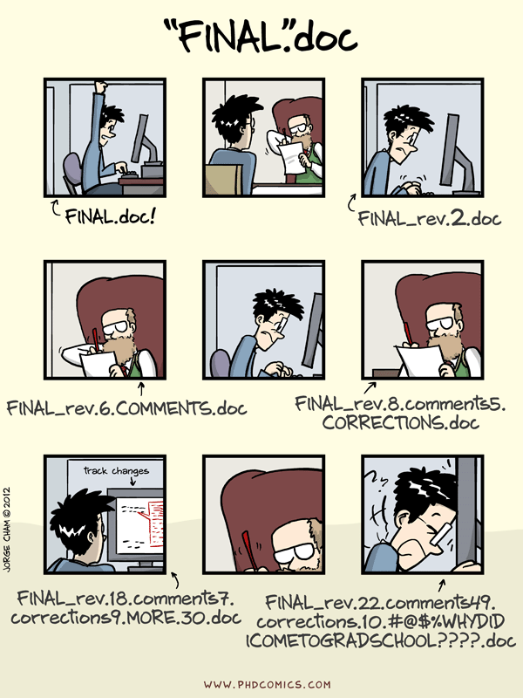

Slide 4
Why Use Git?
Version Control: Git helps in tracking changes, allowing you to revert to previous states if something goes wrong.
Collaboration: It enables multiple developers to work on a project simultaneously without interfering with each other’s work.
Backup: Your entire project history is saved in a Git repository, providing a backup of all versions.
Branching and Merging: Git’s branching model allows you to experiment with new features or bug fixes independently from the main project.
Open Source Projects: Most open source projects use Git for version control. Learning Git allows you to contribute to these projects.
Industry Standard: Git is widely used in the software industry, making it an essential skill for developers.

Slide 5
Why Version Control?
Collaboration Versioning Rolling Back Understanding
Scenario : Multiple devoplers are doing a project together
Question: Why not Google drive & One drive ????
source code management vs file storage management

Slide 6
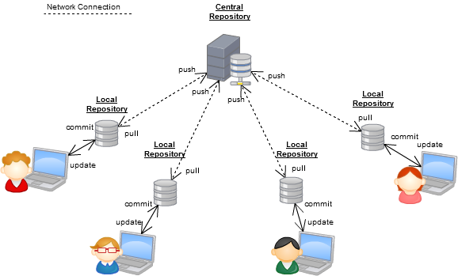
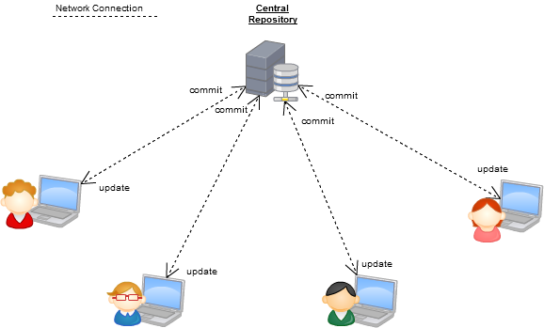
Version Control Systems
Some well-known version control systems are CVS, Subversion, and Git

Slide 7

What is Github?
GitHub was developed by Chris Wanstrath, P. J. Hyett, Tom Preston-Werner and Scott Chacon using Ruby on Rails, and started in February 2008
It is a subsidiary of Microsoft, which acquired the company in 2018 for $7.5 billion
GitHub.com is a site for online storage of Git repositories.
You can get free space for open source projects or you can pay for private projects.
Question: Do I have to use Github in order to use Git?
Answer: No!
you can use Git completely locally for your own purposes, or you or someone else could set up a server to share files, or you could share a repo with users on the same file system.

Slide 8
Download and install Git
Here’s the standard one:
http://git-scm.com/downloads
Git Repository is a place where Git can store versions of our files
  $ cd ~/gitclass
  $ mkdir demo
  $ cd demo
  $ git init
  $ dir /ah or $ ls -a (* .git directory to store all the tracing info)

Slide 9
Introduce yourself to Git
Enter these lines (with appropriate changes):
  git config user.name "John Smith"
  git config user.email jsmith@gmu.edu
--global param

Slide 10
Git clone Vs Git PUll
git clone is how you get a local copy of an existing repository to work on. It's usually only used once for a given repository, unless you want to have multiple working copies of it around. (Or want to get a clean copy after messing up your local one...)
git pull (or git fetch + git merge) fetch from a remote repo and try to merge into the current branch

Slide 11
Git Command
command | description
git clone url [dir] | copy a git repository so you can add to it
git add files | adds file contents to the staging area
git commit | records a snapshot of the staging area
git status | view the status of your files in the working directory and staging area
git diff | shows diff of what is staged and what is modified but unstaged
git help [command] | get help info about a particular command
git pull | fetch from a remote repo and try to merge into the current branch
git push | push your new branches and data to a remote repository
others: init, reset, branch, checkout, merge, log, tag

Slide 12
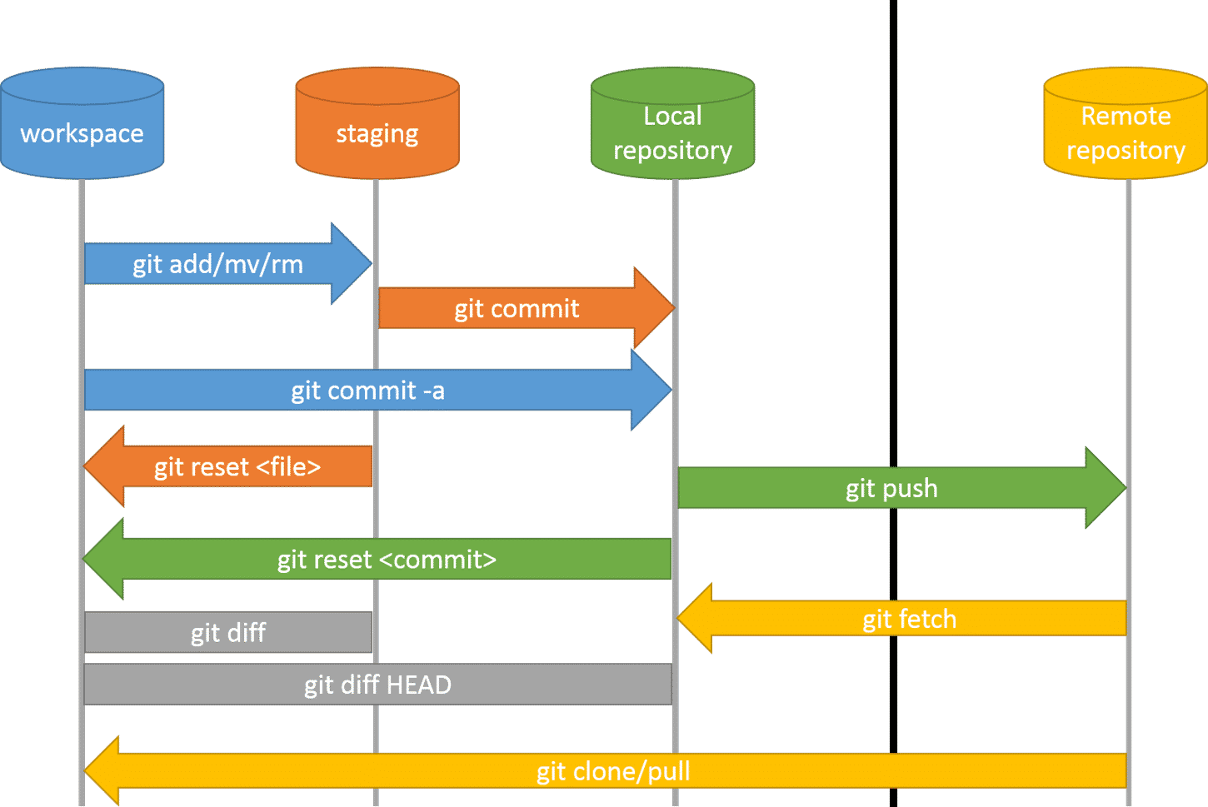
Adding a file to git repository

Slide 13
Adding a file to git repository
Create a rose.txt file ,copy rose.txt to demo folder
$git checkout -b main
Git status $git status
$ git add rose.txt
$ git status
$ git commit -m “my first file checked in “
$ git log

Slide 14
Continue…
Change rose.txt file
$git status
$git diff
$git commit -a –m “new message….”

Slide 15
Adding new folder
git diff HEAD~1 mars.txt
$mkdir poem
copy two text files to that poem folder
$git add poem

Slide 16
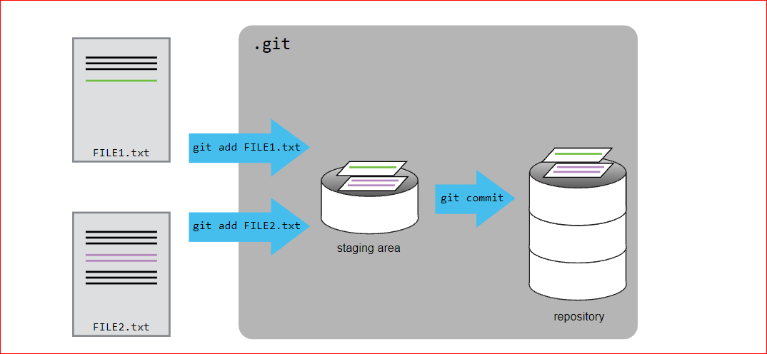
Adding Multimpule files…

Slide 17
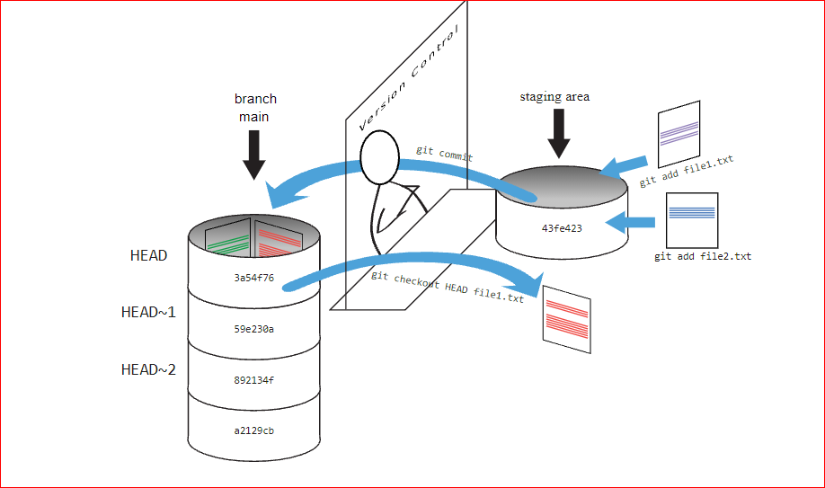

Slide 18
Checking previous version
$ git diff HEAD~1 rose.txt
$git checkout HEAD~1 rose.txt
$git checkout HEAD rose.txt

Slide 19


Git Tools
Windows Git Clients:
Sourcetree
GitHub for Windows .
Tortoise Git
Mac Git Clients:
GitUp
GitBox
Git-Xdev

Slide 20
1. git push
The git push command is used to upload local repository content to a remote repository. Pushing is how you transfer commits from your local repository to a remote repo.
2. git pull/clone
3. git fetch

Slide 21
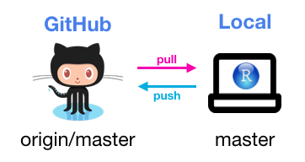
Thank You

