Slide 1



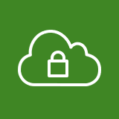




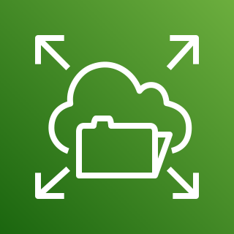
AWS Cloud
Region
Availability Zone
VPC
DMZ SG
NFS SG
1
Public subnet
Private subnet
3
2
Port 2049
WebServer
(Amazon EFS)
Inbound: Port 80/443
Outbound: All Traffic
Inbound: Port 2049
Outbound: All Traffic

Slide 2


MGMT
VPC
Availability Zone 1
(us-east-1a)
DMZ
Web SG
Backend SG
Public subnet
(10.0.1.0/24)
WebServer 1
Bastion 1
NAT gateway
Internet gateway
Availability Zone 2
(us-east-1b)
Private subnet
(10.0.2.0/24)
BEServer 1
Inbound: Port 22 from 0/0
Outbound: All Traffic
Inbound: Port 80/443 from 0::/0
Outbound: All Traffic
Inbound: Port: 3306 from Web SG
Outbound: All Traffic
Inbound: Port 22 from DMZ
Outbound: All Traffic
Notes:
Create a VPC
Name - myVPC
IPv4 CIDR – 10.0.0.0/16
IPv6 CIDR – Amazon Provided
Tenancy – Default (Multi-tenant)
Create a Subnet
Name – myPublicSN
VPC – Select myVPC
AZ – us-east-1a
IPv4 CIDR – 10.0.1.0/24
Create second subnet
Name – myPrivate SN
VPC – Select myVPC
AZ – us-east-1b
IPv4 CIDR – 10.0.2.0/24
Create an Internet Gateway
Attach to myVPC
Route Table
Main route table allows by default public access
Create a Route Table
myPublicRoute
Attach to myVPC
Add a route from internet to Internet Gateway
Edit Subnet Associations
Add myPublicSN to attached SNs

Slide 3

AWS Cloud
Region
Availability Zone
VPC
DMZ SG
FSX SG
1
Public subnet
Private subnet
3
2
Port 2049
WebServer
(Amazon FSx)
Inbound: Port 80/443
Outbound: All Traffic
Inbound: Port 998, 1018-1023
Outbound: All Traffic

