Slide 1
Get Started Quick NYL Cloud training 4/4/2022
For latest version, please click here. Read only latest version: https://newyorklife.sharepoint.com/:p:/s/LifePASTeam/EVYuas4nUZpHsKRaAnrqBtEBKO9zMRvolD0qef3Fue9FCg?e=ct7bbq
Notes:
Instructions:
Instructions for each slide will show up here.

Slide 2
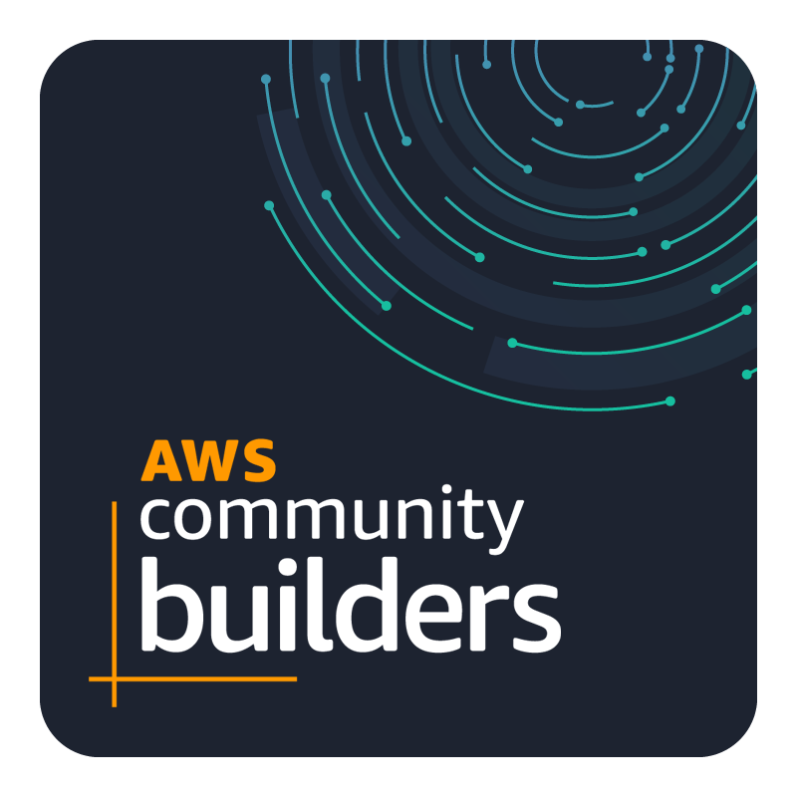


Cloud Training Guide – Community Edition
This guide is NOT maintained or supported by NYL Cloud resources. This is a community supported guide. Anyone may edit this guide or improve upon the artifacts referenced in this documentation.
To edit this guide, simply click this link. All changes you make is immediately committed to SharePoint.
To make changes to artifacts, contact Michael_J_Murphy@newyorklife.com.
I am looking to create a Community Cloud user group to create and share artifacts.

Slide 3
Outline
NYL Training courses
Create accounts
Creating an AWS
Creating a GitHub
Workspace options
Create AWS Keypair
Turn-key training server
Manually configure server
Connecting to your server
Resource Links

Slide 4
NYL Cloud Training Courses
The latest recommended curriculum for NYL cloud training is available in the link below. If you cannot access this link or items located on the page, please email cloud_services@newyorklife.com for help. https://degreed.com/pathway/e9k6qvrw9o?orgsso=newyorklife
The training includes using AWS, GitHub and Terraform. To take these courses it is strongly recommended you first setup accounts to use during your training sessions. These accounts are for personal use and cannot be used for any NYL assets. The accounts can be used to support the training courses. The training courses should remain in the free tier. In the event there is a charge, please see your manager about charging to your annual educational stipend.

Slide 5
Outline
NYL Training courses
Create accounts
Creating an AWS
Creating a GitHub
Workspace options
Create AWS Keypair
Turn-key training server
Manually configure server
Connecting to your server
Resource Links

Slide 6
Creating an AWS – 1 of 2
It is strictly forbidden to place NYL assets to your personal AWS account. The personal AWS account is only to be used to support training courses. You must use a personal email address for the account. Setup AWS Account
Video to guide you on setting up your AWS account.
https://youtu.be/bgPuPSPZe2U?t=180
AWS login When using a NYL computer for AWS training, you may run into issues logging into your personal AWS account. The NYL devices can get confused between your personal account and a NYL account. Normal console login is here: https://aws.amazon.com/console/ If you have issues logging into your personal AWS account, try this link: https://signin.aws.amazon.com/signin?client_id=arn%3Aaws%3Asignin%3A%3A%3Aconsole%2Fcanvas&redirect_uri=https%3A%2F%2Fus-east-1.console.aws.amazon.com%2Fconsole%2Fhome%3Ffromtb%3Dtrue%26hashArgs%3D%2523%26isauthcode%3Dtrue%26region%3Dus-east-1%26skipRegion%3Dtrue%26state%3DhashArgsFromTB_us-east-1_38ce933c8e82e221&page=resolve
AWS courses To learn more, AWS has courses, as well as NYL https://explore.skillbuilder.aws/learn/catalog

Slide 7
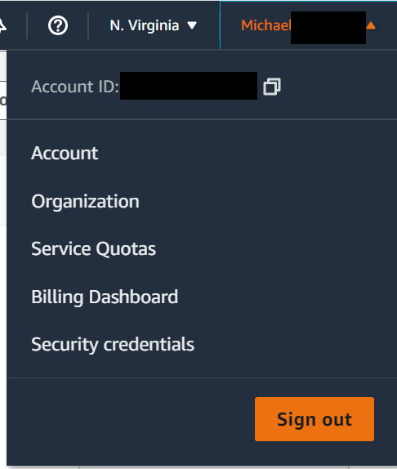
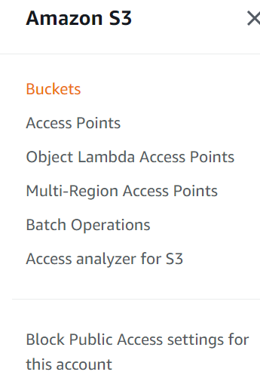
Creating an AWS – 2 of 2
1
TIPS
Recommend using us-east-1, it has all AWS services
. Under account make sure your information is up to date and accurate. Amazon will ONLY use these credentials to assist you.
Recommend enabling MFA to secure your account. One option is to install Google Authenticator on your device and scan the QR code.
Recommend clicking under services, then S3. In menu select “block public access settings for this account”. Enable blocking public storage access of your data, this will prevent exposing S3 stored files to the public. Click here for help.
2
3
4

Slide 8
Creating a GitHub – 1 of 2
GitHub is a web hosted service that allows you manage source code. This will be used in conjunction with Terraform, learning infrastructure as code. Please note, it is strictly forbidden to place any NYL assets to your personal GitHub account. This is to be used only for training material. You must use a personal email address for the account.
Setup GitHub Account
Video to guide you on setting up your GitHub account.
https://www.youtube.com/watch?v=iv8rSLsi1xo
GitHub login https://github.com/

Slide 9
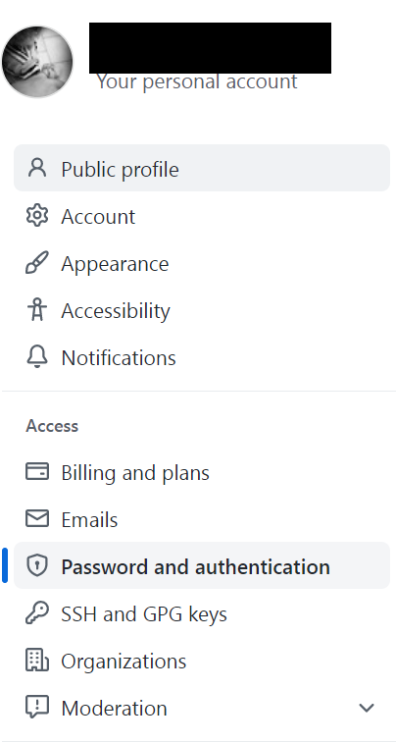
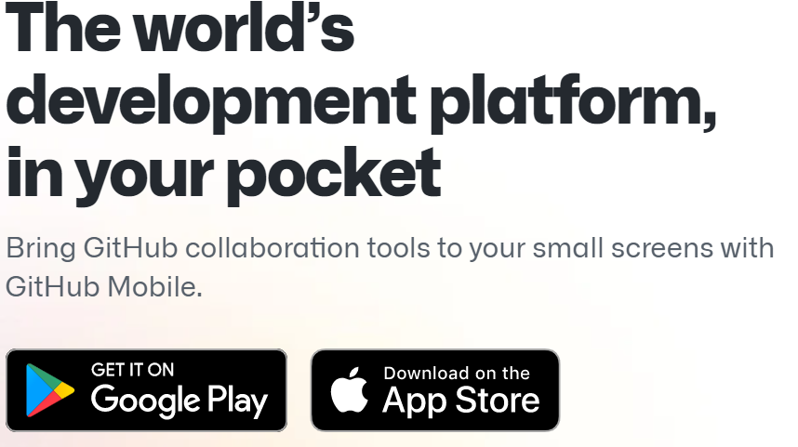
Creating a GitHub – 2 of 2
TIPS
Under settings add additional information. For your personal account do NOT reference New York Life as part of your personal account.
Recommend enabling MFA to secure your account. One option is to install Google Authenticator on your device and scan the QR code.
GitHub has an app for your phone, making some of the work easier.
1
3
2

Slide 10
Outline
NYL Training courses
Create accounts
Creating an AWS
Creating a GitHub
Workspace options
Create AWS Keypair
Turn-key training server
Manually configure server
Connecting to your server
Resource Links

Slide 11
Workspace options
To get the most out of your time taking training courses, it is recommended you can use the tools. A training workspace requires a personal GITHub account, Terraform account, AWS account, and AWS V2 CLI installed on a desktop. Please note: AWS V2 CLI does not support windows 7, as it uses a Python 3.9 DLL.
This guide covers two options to create your workspace.
Load a turn-key training server on your AWS account.
Deploy server image on a personal AWS account. It is Not certified by NYL, and is NYL AWS community supported. This image is not permitted on NYL assets, and is a personally maintained by Michael_J_Murphy@newyorklife.com
Guide will cover how to remotely connect to the server
Install tools on a desktop (can install on an AWS server)

Slide 12
Outline
NYL Training courses
Create accounts
Creating an AWS
Creating a GitHub
Workspace options
Create AWS Keypair
Turn-key training server
Manually configure server
Connecting to your server
Resource Links

Slide 13
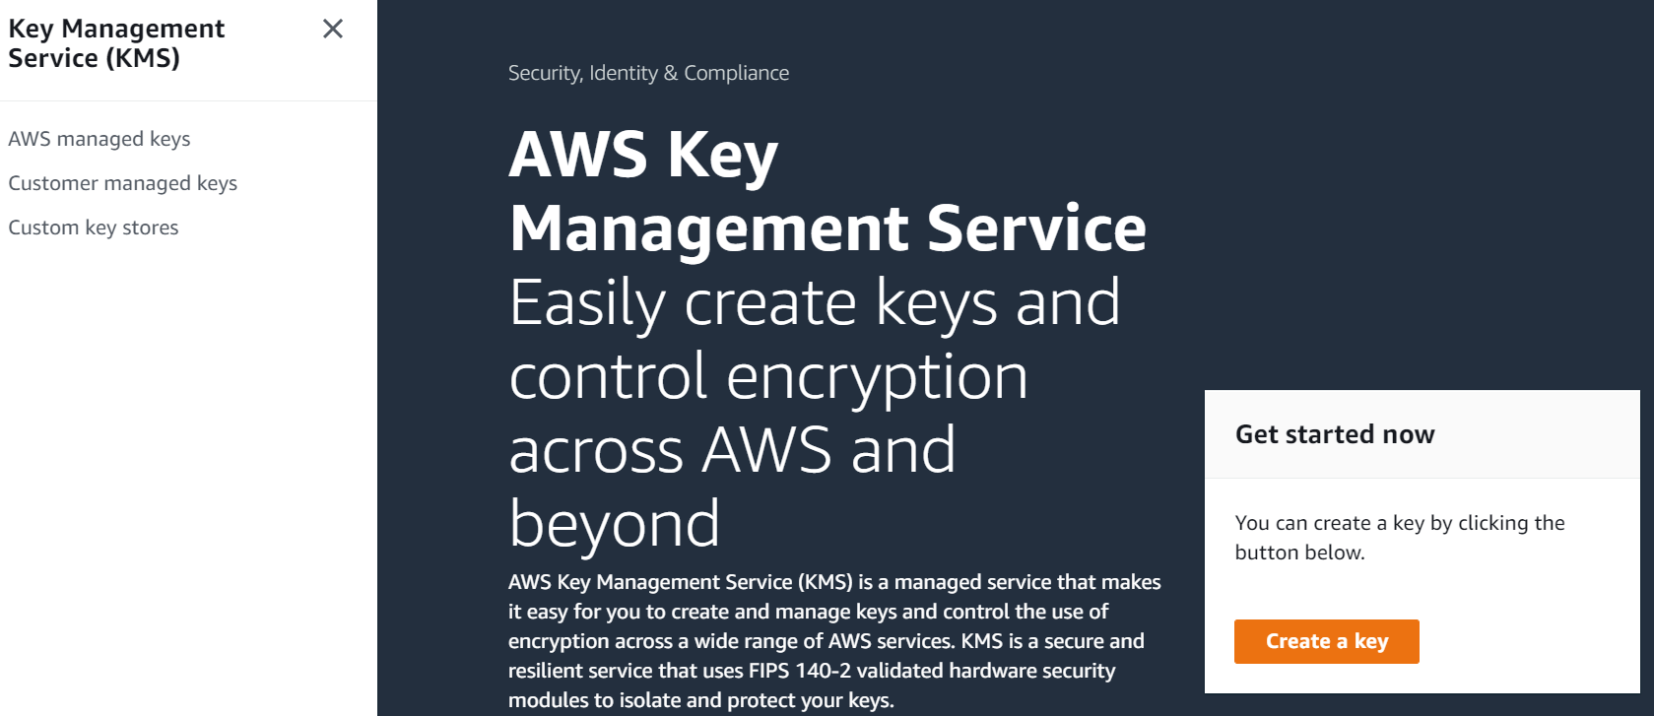
Create AWS Keypair 1 of 2
To connect to your server, you will need to create a keypair. This creates a file you can import into PUTTY or other tools to remotely connect to the server via command line.
Youtube video on the process:
https://www.youtube.com/watch?v=TkSuLg-8TD8
In the search bar type “key Management Service”, and click “create a key”. NOTE: There is a $1 charge per month per keypair, first 20,000 uses are free per month.

Slide 14
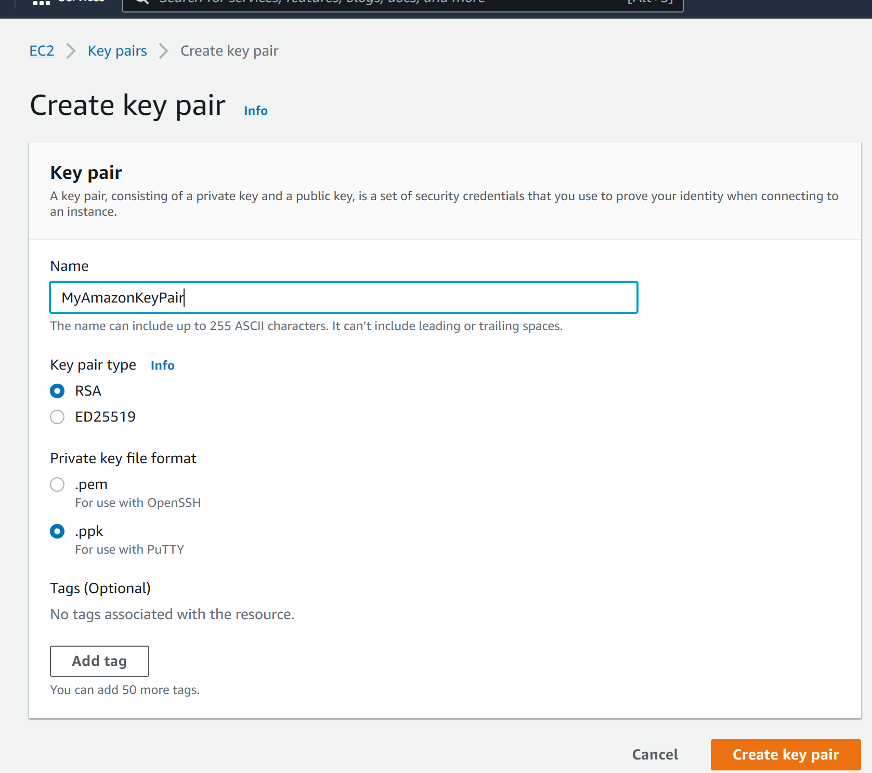
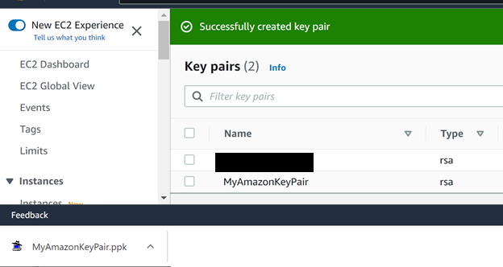
Create AWS Keypair 2 of 2
Type in your keypair name, like “MyAmazonKeyPair”, select RSA and .ppk if you plan to use Putty. If you plan to use OpenSSH choose .pem. This guide assumes Putty, please watch the video to learn more about other options.
Once created download the ppk and store in a safe place. You cannot redownload this file so do not lose!

Slide 15
Outline
NYL Training courses
Create accounts
Creating an AWS
Creating a GitHub
Workspace options
Create AWS Keypair
Turn-key training server
Manually configure server
Connecting to your server
Resource Links

Slide 16
Outline
NYL Training courses
Create accounts
Creating an AWS
Creating a GitHub
Workspace options
Create AWS Keypair
Turn-key training server
Manually configure server
Connecting to your server
Resource Links

Slide 17
Manual Configure servers
Please see complete guide at the link below. https://newyorklife.sharepoint.com/:w:/s/LifePASTeam/EccKUWrg6L5CjZujGAg6nZIBbdHsx0AaS129e5mzZabf7Q?e=bkLi0d

Slide 18
Outline
NYL Training courses
Create accounts
Creating an AWS
Creating a GitHub
Workspace options
Create AWS Keypair
Turn-key training server
Manually configure server
Connecting to your server
Resource Links

Slide 19
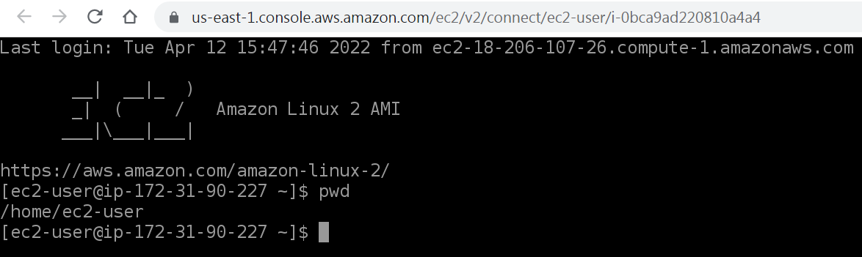
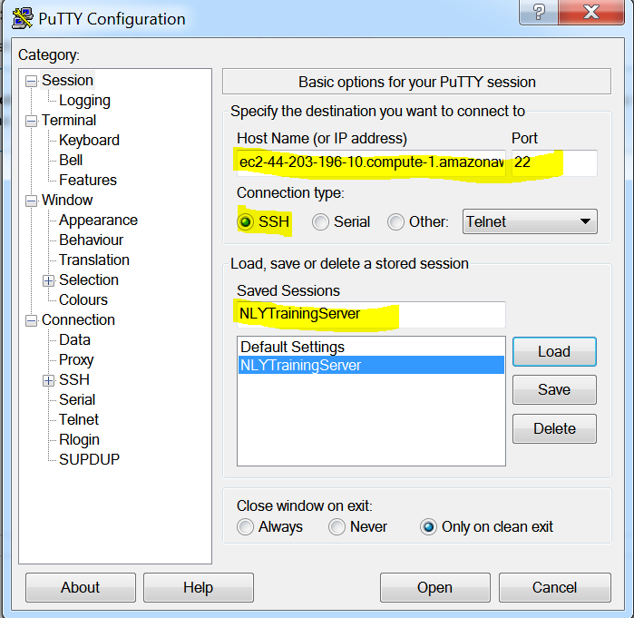
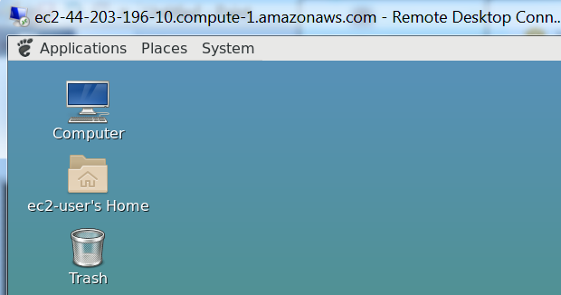
Connecting to your server
You can connect to your EC2 instance by using the AWS console, PUTTY, or even a graphical interface! Click the guide below, under section “Connecting to EC2 Instance” https://newyorklife.sharepoint.com/:w:/s/LifePASTeam/EccKUWrg6L5CjZujGAg6nZIBbdHsx0AaS129e5mzZabf7Q?e=bkLi0d

Slide 20
Outline
NYL Training courses
Create accounts
Creating an AWS
Creating a GitHub
Workspace options
Create AWS Keypair
Turn-key training server
Manually configure server
Connecting to your server
Resource Links

Slide 21
Quick Links
Description | Link
NY Life Cloud Training guide | https://degreed.com/pathway/e9k6qvrw9o?orgsso=newyorklife
AWS console NOTE: Use incognito on NYL PC | https://aws.amazon.com/console/
GitHub | https://github.com/
Terraform | https://www.terraform.io/
AWS CLI (Command Line Interface) | https://awscli.amazonaws.com/ https://awscli.amazonaws.com/AWSCLIV2.msi

Slide 22
Install AWS CLI – 1 of 2
AWS CLI is the command line interface that allows you to connect to your AWS infrastructure. Python is a prerequisite. Recommend using windows 10 or greater. Install Python https://www.python.org/downloads/ NOTE: for windows 7, you can only use 3.8.10, there are no binary fixes after may 3rd, 2021. https://www.python.org/downloads/release/python-3810/ Install AWS CLI Video to guide install AWS cli. https://www.youtube.com/watch?v=11aYe_VWMg0 Connecting to your AWS account https://docs.aws.amazon.com/cli/latest/userguide/getting-started-prereqs.html
Troubleshooting: https://docs.aws.amazon.com/cli/latest/userguide/getting-started-install.html AWS CLI Download
https://awscli.amazonaws.com/AWSCLIV2.msi
https://awscli.amazonaws.com/ If you have error regarding api-ms-win-core-path-l1-1-0.dll Latest C++ distributable package. https://docs.microsoft.com/en-us/cpp/windows/latest-supported-vc-redist?view=msvc-170 Alternately, you may be able to install visual studio to eliminate the error https://visualstudio.microsoft.com/vs/community/

Slide 23
Creating a Terraform – 1 of 1
Terraform is a web hosted service that allows you to create infrastructure as code, deployable across Aws, Azure, GCP, and other cloud providers. Please note, it is strictly forbidden to place any NYL assets to your personal Terraform account. This is to be used only for training material. You must use a personal email address for the account.
Setup Terraform Account
Video to guide install Terraform cli. https://www.youtube.com/watch?v=oURFbTZLMl0
Terraform Download
https://www.terraform.io/downloads https://www.terraform.io/

Slide 24
Install AWS CLI - 2 of 2
TIPS
x
1
3
2

Slide 25
Appendix

Slide 26
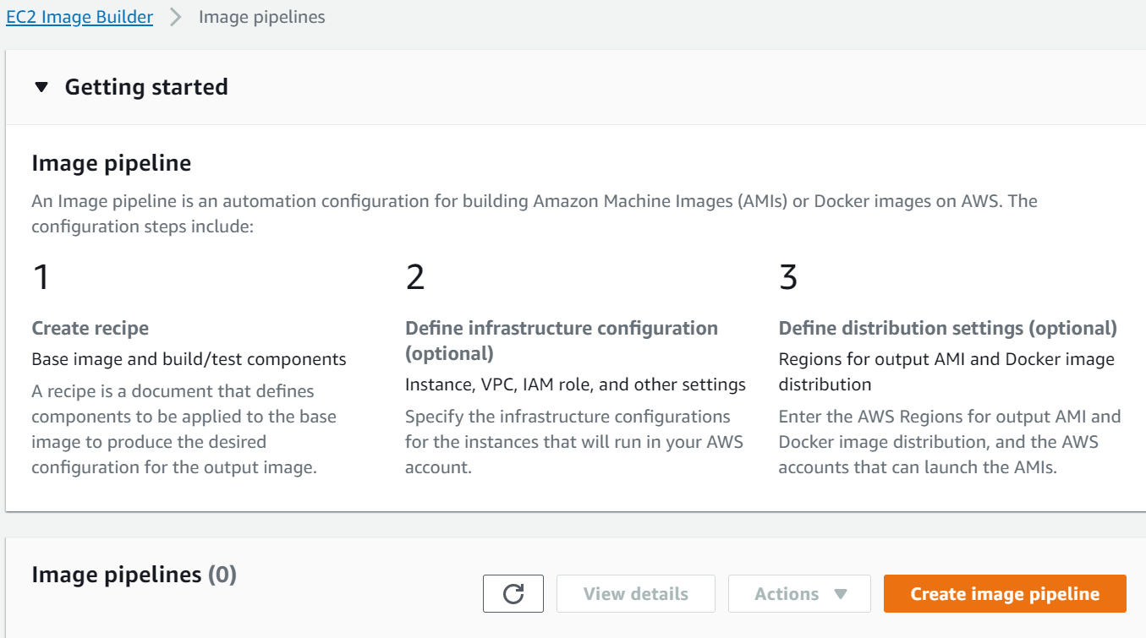
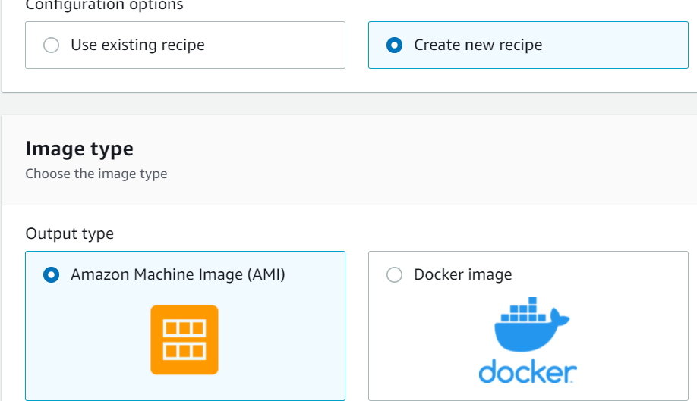
(optional) Create AWS server 1 of 5
Log into your AWS account, in the top search bar type “EC2”, and select EC2 Image Builder. This is a workflow to assist in creating your EC2 instance.
Select “Create Image Pipeline” on far right. Name pipeline something like CloudTrainingServer. Choose schedule to be manual.
Select “create new recipe” and choose “AMI”. Name the configuration, for example “LinuxWorkspace”. (This guide covers linux deploy) Select “Quickstart” and select “Amazon Linux 2 Kernal 5 x86” (or a different of your choosing).

Slide 27
(optional) Create AWS server 2 of 5
Install components onto your image to ‘play’ and learn more about AWS services!
The following are recommended but NOT required for training server. Services can be installed later. Recommend the first item in the “order of install” be the Linux Kernel mainline.
Required | Amazon-Cloudwatch-Agent-Linux | Allows for greater detailed AWS console monitoring
N | Amazon-Cloudwatch-Agent-Linux | Allows for greater detailed AWS console monitoring
N | amazon-corretto-11 | Pure opensource Java by AWS
Y | aws-cli-version-2-linux | AWS CLI (required for training)
N | aws-codedeploy-agent-linux | Able to use AWS code deploy for CICD pipeline
N | dotnet-sdk-linux | .NET core 6 – free / open source
N | nodejs-12-lts-linux | To run NodeJS code
N | mate-de-linux | Allow for xrdp service, TigerVNC, MATE
N | python-3-linux | Python

Slide 28
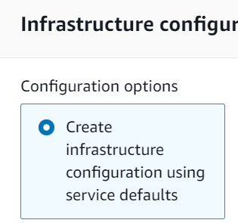
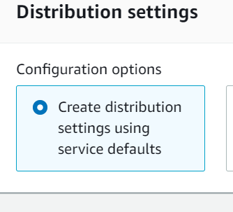
(optional) Create AWS server 3 of 5
Install components onto your image to ‘play’ and learn more about AWS services!
The following are recommended but NOT required for training server. Services can be installed later. Recommend the first item in the “order of install” be the Linux Kernel mainline.
Required | Test Component | Allows for greater detailed AWS console monitoring
N | chrony-time-configuration-test | Verifies Server time synchronization is correctly configured.
Recommend giving 8GB of disk space. Free Tier is up to 30GB per account: Note there is a charge for disk storage! Click next, and choose “create infrastructure configuration using service defaults”. And “Create Distribution settings using service defaults”. Review and click “Create Pipeline!”

Slide 29
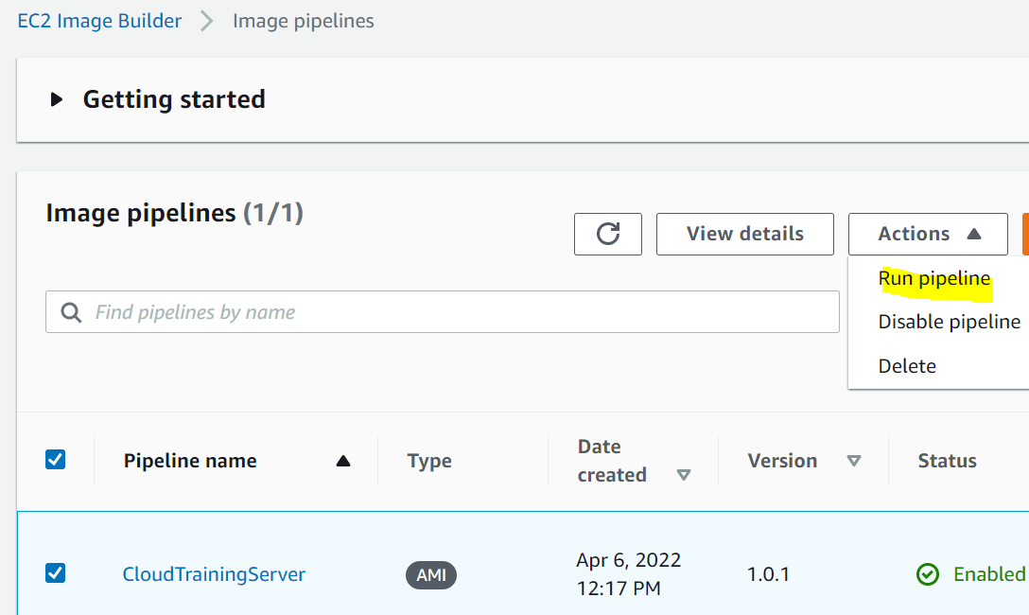
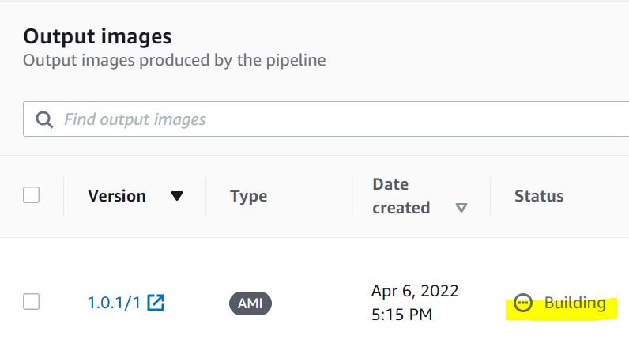
(optional) Create AWS server 4 of 5
The Pipeline is a “Recipe” that can be run to recreate a server” To create your first server select the pipeline “CloutTrainingServer” and under actions select “Run pipeline”. To view status, click on your pipeline name, in screenshot below “CloudTrainingServer”. You can view the output image status. Building may take upwards of an hour to complete. (5:15pm start)

Slide 30
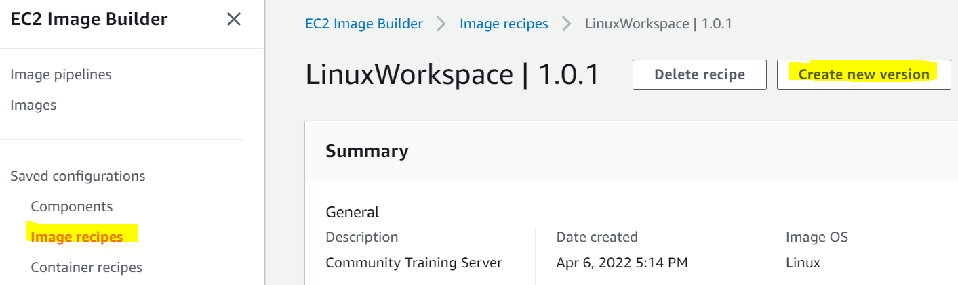
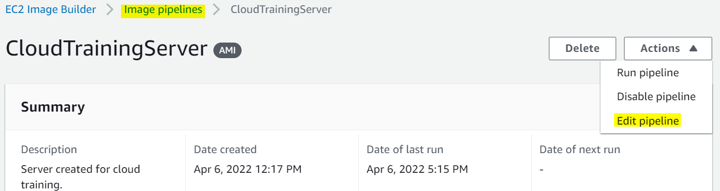
(optional) Create AWS server 5 of 5
If you have an error during creation process, you can edit the Image recipe by creating a new version and edit. Then edit the pipeline and change to your new image recipe, and save. Repeat until errors are corrected.

Slide 31
(optional) Create AWS server 6 of 6
With the EC2 Image builder available, the next steps are listed below. Full word documentation is available at this link:

