Slide 1
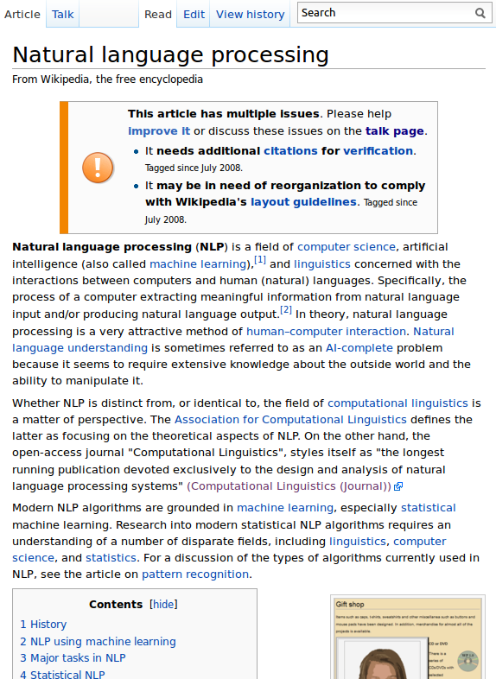
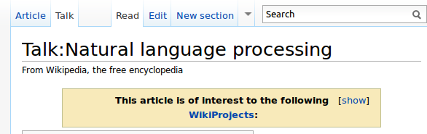
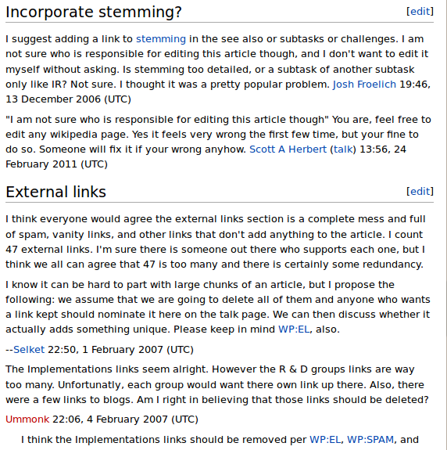
4a
1
4b
2
3a
4b
3c
3b
4b
3c
2
3a
4b
3c
3b
3c

Slide 2
All Relations
4a
1
4b
2
3a
4b
3c
3b
4b
3c
2
3a
4b
3c
3b
3c

Slide 3
Relations with DiscourseParts and between Contributions
4a
1
4b
2
3a
4b
3c
3b
4b
3c
2
3a
4b
3c
3b
3c

Slide 4
Relations with Context
4a
1
4b
2
3a
4b
3c
3b
4b
3c
2
3a
4b
3c
3b
3c

Slide 5
Relations with Content
4a
1
4b
2
3a
4b
3c
3b
4b
3c
2
3a
4b
3c
3b
3c

