Slide 1
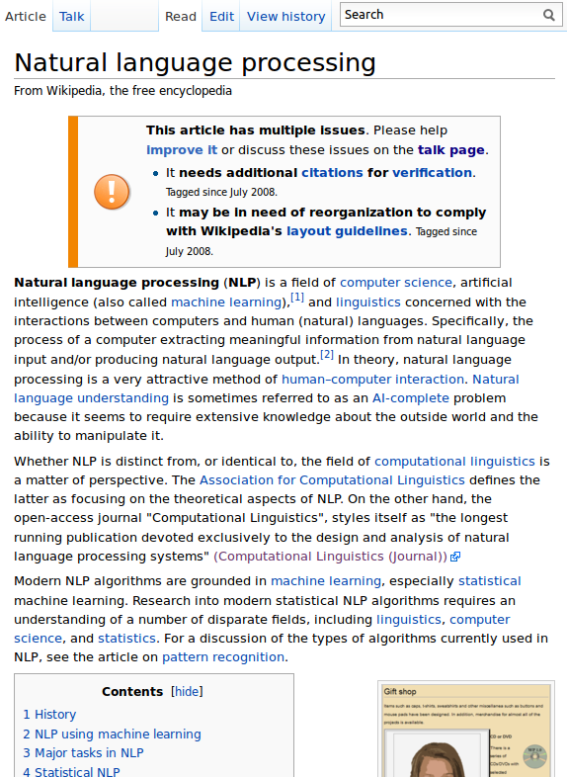
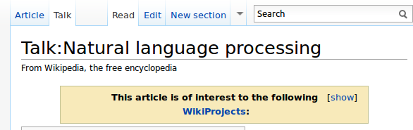
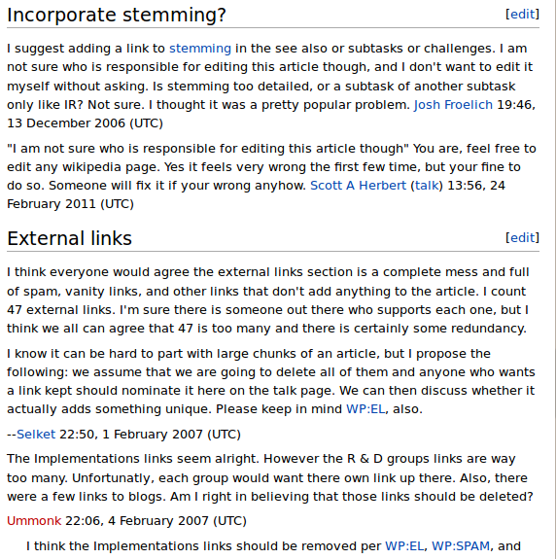
4a
1
4b
2
3a
4b
3c
3b
4b
3c
2
3a
4b
3c
3b
3c
Notes:
So far, we have looked at a method to identify problems in article.
We will now turn to an approach to analyze what the community is doing about these problems.
The quality assurance process in Wikipedia mainly happens on the article Talk pages. Talk page = generic Wiki page like an article = is implicitly associated with an article and reachable via the Talk link on the article page.
On these Talk pages, the authors discuss the
current state of the article
its future development
decide which content should be included or excluded

