Slide 1
Building high performance software with Microsoft Application Insights
Ken Cenerelli
Microsoft MVP - .NET Platform

Slide 2





About Me
Ken Cenerelli
CTTDNUG
Bio:
Programmer Writer
Microsoft MVP - .NET Platform
Microsoft TechNet Wiki Guru
Co-Organizer of CTTDNUG
Technical reviewer for multiple books
Twitter: | @KenCenerelli
Email: | Ken_Cenerelli@Outlook.com
Blog: | kencenerelli.wordpress.com
LinkedIn: | linkedin.com/in/kencenerelli

Slide 3
Agenda
1. Overview
2. How to get data in
3. How to work with data
4. How to get data out

Slide 4
What is it?
Application Insights offers availability monitoring for your deployed live applications
What it allows you to do:
Understand what your users are doing with your apps
Detect issues faster (dashboards, alerts)
Solve the right problems
Continuously improve your applications
Make telemetry data an integral part of your development cycle
Notes:
Notes:
How are we notified now?
Designed to help development teams get 360° views of their applications across Availability, Performance and Usage with fast & powerful troubleshooting, diagnostics and usage insights
Can generate metrics locally or when it is deployed
Currently Microsoft is using Application Insights in OneDrive, Xbox, Dynamics, Visual Studio Online and other services
“AI is an end-to-end solution where telemetry data is collected at every tier, sent to the cloud for processing and storage, and made available for an interactive experience in the Azure Portal”
Source:
http://msdn.microsoft.com/en-us/library/dn481095.aspx
http://azure.microsoft.com/en-gb/documentation/articles/app-insights-get-started/

Slide 5
Where can you use it?
Languages
Platforms
Logging frameworks
C#|VB (.NET & ASP.NET)
C#|VB|C++ (Windows Store)
Java
JavaScript web pages
Objective-C
PHP
Python
Ruby
Angular
Android, iOS
Azure web apps and VMs
Azure Cloud Services – for both web & worker roles
Drupal, Joomla
J2EE
Node.JS
OSX
SharePoint
Windows desktop applications & services
WordPress
Log4Net, NLog, or System.Diagnostics.Trace
Java, Log4J, or Logback
Semantic Logging – integrates with Semantic Logging Application Block
Cloud-based load testing
Notes:
- Drupal, Joomla are CMS systems

Slide 6
Background
Launched in November 2013 as part of Visual Studio Online
Derived from Microsoft's System Center Operations Manager (SCOM) 2012
Managed from the cloud
No desktop client or local storage needed
Notes:
Source: http://kevingreeneitblog.blogspot.ie/2014/02/application-insights-ai-future-is-now.html

Slide 7
Two Versions
Application Insights for Visual Studio Online (Old)
No new development
Closed to new users mid-February and shuttered mid-2015
Uses the 1.x version of Application Insights SDK
Visual Studio Application Insights (New)
New features added continuously
Need an Azure subscription
Visual Studio 2013 Update 3 or greater with 2.x version of Application Insights SDK
Visual Studio 2015 has it baked in
Notes:
- Pre-installed into Visual Studio 2013 Update 3

Slide 8
Visual Studio Application Insights
Launched in Fall 2014
Still in Preview
Available through Azure Preview Portal
Need an Azure account
Works with the free trial
Performance overhead?
Very small
Calls are non-blocking, batched, and sent in a separate thread
Notes:
The new portal radically simplifies building, deploying, and managing your applications
In your firewall, you might have to open TCP ports 80 and 443 for outgoing traffic to dc.services.visualstudio.com and f5.services.visualstudio.com.
What's the overhead? The impact on your performance is very small. Tracking calls non-blocking, and are batched and sent in a separate thread.

Slide 9
360° view of any app or service
ASP.NET
SDK
win apps
SDK
web
<script/>
IIS
Status Monitor
ping
WebTest
Application Insights
Notes:
- How to get data in

Slide 10
Demo
Microsoft Azure Preview Portal overview
Create a new Application Insights resource

Slide 11
ASP.NET apps
ASP.NET
SDK
win apps
SDK
web
<script/>
IIS
Status Monitor
ping
WebTest
Application Insights

Slide 12
Demo
Add Application Insights to:
A new MVC project
An existing project
Notes:
NEW:
Select ASP.Net Web Application
Notice Add Application Insights to Project is selected by default when Visual Studio is connected to Azure
Notice my Azure subscription name is shown
If this is your first time, you'll be asked login or sign up to Microsoft Azure
The project will add the Application Insights SDK to the project
Right click References and click Manage NuGet Packages
Show that the ApplicationInsights.config has been added to the project
Show the Instrumentation Key matches the one in Azure
Show the link to Azure under ApplicationInsights.config
Existing:
Use NuGet on older VS 2013 projects to add AI
Right click the project and select Add Application Insights Telemetry to project
Talk about the dialog box
Show that we can change accounts
Show that a component is created with the same name as the project
Click Send telemetry to: to change the resource
Click Configure Settings to change resource groups

Slide 13
Win Apps
ASP.NET
SDK
win apps
SDK
web
<script/>
IIS
Status Monitor
ping
WebTest
Application Insights

Slide 14
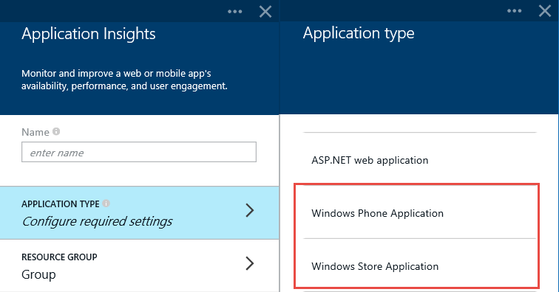
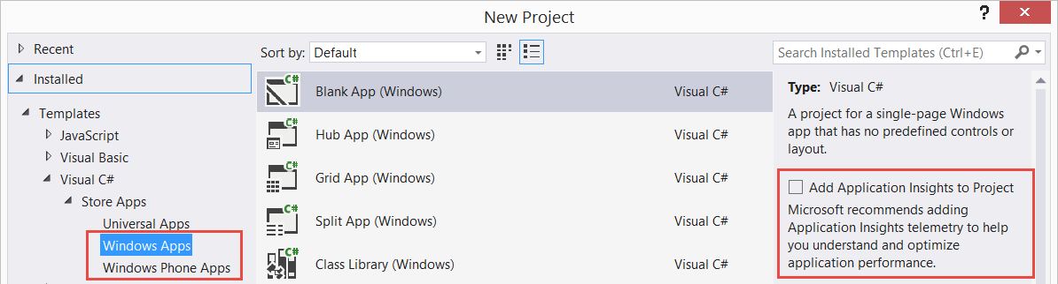
Windows Apps
Add the appropriate resource
Can be used in the new Universal Windows Apps as well as Windows 8 Store and Windows Phone 8 apps
Add Application Insights to your existing or new projects

Slide 15
Web Apps
ASP.NET
SDK
win apps
SDK
web
<script/>
IIS
Status Monitor
ping
WebTest
Application Insights

Slide 16
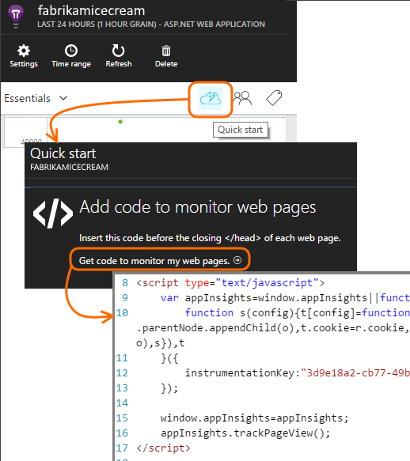
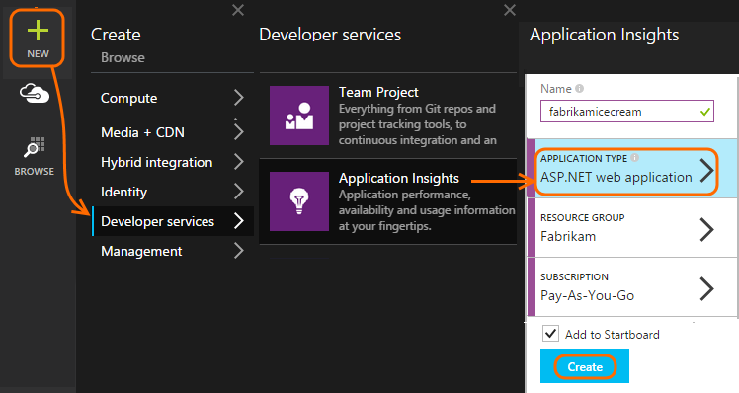
Web Applications
Add a resource
Get the code from the Quick Start blade
Insert the script just before the </head> tag of every page you want to track
Notes:
Open the Quick Start blade and get the code snippet to add to your web pages
Java Web App: Tomcat (5.5, 6, 7) / JBoss Application Server 6
Angular SPA apps
JavaScript apps

Slide 17
IIS
ASP.NET
SDK
win apps
SDK
web
<script/>
IIS
Status Monitor
ping
WebTest
Application Insights

Slide 18
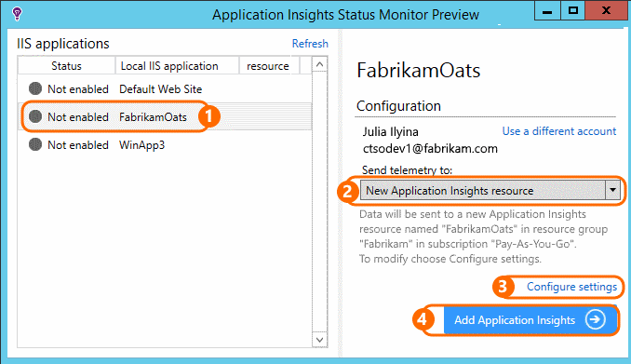
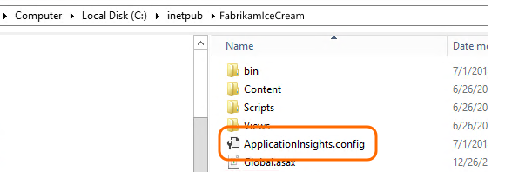
Status Monitor
Diagnose exceptions and performance issues in deployed server or VM apps without rebuilding or redeploying
Can be used either on its own or in conjunction with the Application Insights SDK in your code
Notes:
Monitor web apps that are already running: no need to rebuild or republish them.
Dependency diagnostics—locate faults or poor performance where your app uses other components such as databases, REST APIs, or other services.
Status monitor works on:
Windows Server 2008, 2008 R2, 2012, 2012 R2
On the client side Windows 7, 8 and 8.1, again with .NET Framework 4.0 and 4.5
IIS support is: IIS 7, 7.5, 8, 8.5 (IIS is required)
You need to open some outgoing ports in your server's firewall to allow Status Monitor to work
IIS Status Monitor is out of proc detection and the SDK is InProc; Need both for 100% coverage

Slide 19
Web Tests
ASP.NET
SDK
win apps
SDK
web
<script/>
IIS
Status Monitor
ping
WebTest
Application Insights

Slide 20
Availability Monitoring with Web Tests
Works for any web application on any platform
Check the availability and performance of your app from across the world
Up to 16 locations per test

Slide 21
Demo
Creating and diagnosing a web test
Notes:
Add a URL of a server where your application might be deployed
The URL must be visible from the public internet
It can include a query string
If the URL resolves to a redirect, it will follow up to 10 redirects
Can enable specific success criteria
200 success code
403 Forbidden
404 Not Found
500 Internal Server Error
Content match: Must be a plain string, without wildcards
Open an individual test to edit or disable it

Slide 22
Detect & Diagnose
Now that we have our data, it is time to understand it
We can correlate failed requests with exceptions and other events at both the client and server level
The Portal allows us to diagnose:
Failures
Performance
Usage
Browsers
Notes:
How to work with data
If in DevOps, can click the Servers tab to get info on your servers
In web applications, users are counted by using cookies. A person who uses several browsers, clears cookies, or uses the privacy feature will be counted several times.
A web session is counted after 30 minutes of inactivity. A session on a phone or other device is counted when the app is suspended for more than a few seconds.

Slide 23
Demo
Viewing the telemetry data
Notes:
The Portal allows us to diagnose:
Failures
Performance
Usage
Browsers

Slide 24
Custom Telemetry & Alerts
Use Custom Telemetry to track detailed items you need
TrackEvent
TrackPageView
TrackException
Alerts
Web Test Alerts (seen above)
Metric Alerts (for threshold checking)
Notes:
Custom telemetry is particularly useful to trace user stories:
TrackException is used to report exceptions because it sends a copy of the stack; TrackEvent is used to report other events. You can attach any properties that might be useful in diagnosis.
Exceptions and events show up in the Diagnostic Search blade
Metric Alerts can be combined together with the availability alert

Slide 25
Demo
Viewing Custom Telemetry events
Creating a Metric Alert

Slide 26
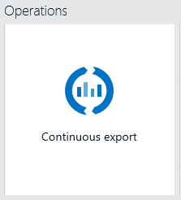
Telemetry Export
Use the Continuous Export button on your resource’s Overview blade
Export your raw Application Insights telemetry data in JSON format to an Azure storage account
Can then download it or write code to process it
Notes:
How to get data out
You are responsible for managing your storage capacity and deleting the old data if necessary.
Can be combined with CRM or other data

Slide 27
Export Options
Export to Power BI
Using Azure Stream Analytics
Export to SQL
Using a worker role
Using Azure Stream Analytics
Notes:
Azure Stream Analytics (ASA) is a fully managed, cost effective real-time event processing engine that helps to unlock deep insights from data. Stream Analytics makes it easy to set up real-time analytic computations on data streaming from devices, sensors, web sites, social media, applications, infrastructure systems, and more.
With a few clicks in the Azure portal, you can author a Stream Analytics job specifying the input source of the streaming data, the output sink for the results of your job, and a data transformation expressed in a SQL-like language.
Both require storage accounts
ASA price by GB or by Streaming Unit hour

Slide 28
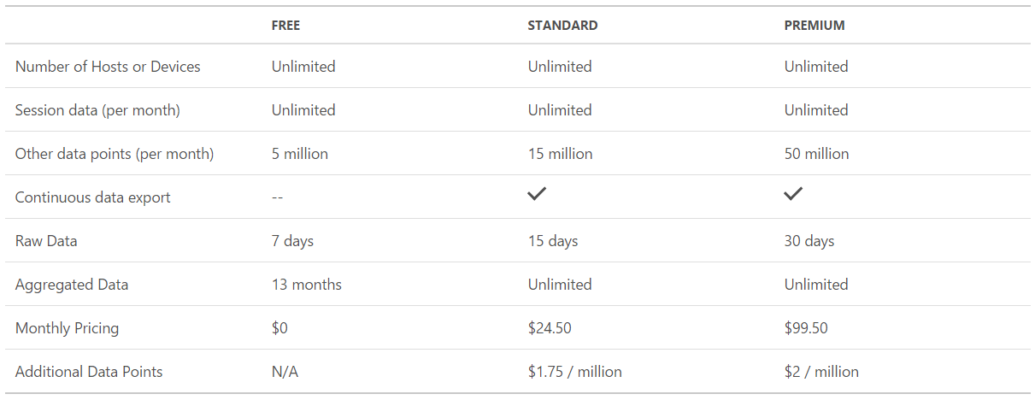
Pricing (USD)
Source: https://azure.microsoft.com/en-us/pricing/details/application-insights/
Notes:
- Application Insights offers a pricing model based on telemetry data volume per app with no limitation on the number of hosts or devices on which your app is running.
Session data - includes count of sessions, users, geography and other environment and device data.
Other data points - includes all types of data (aside from session data) such as: custom events, dependencies, exceptions, custom metrics, page loads, page views, performance counters, requests and trace data.
Continuous data export – sends the complete telemetry data as a continuous stream to your database of choice.
Raw data - includes access to all telemetry data points collected by application insights.
Aggregated data - includes access to telemetry data points aggregated at hourly/daily levels.
Monthly Pricing – Billing is prorated hourly. Price above is based on 744 hours per calendar month.

Slide 29
Resources
Get started with Application Insights for Azure Preview:
http://bit.ly/1D1eUet
http://bit.ly/1y4lZZH
Get a free Microsoft Azure trial account:
azure.microsoft.com
Slides:
slideshare.net/KenCenerelli

Slide 30
Summary
Please fill out your surveys!
Building high performance software with Microsoft Application Insights
Contact Details:
@KenCenerelli
Ken_Cenerelli@Outlook.com

