Slide 1
Getting Managers to Ride the Cloud
October 23rd, 2015

Slide 2
Getting Managers to ride the cloud
David Amaya
Consultant, Cardinal Solutions
https://twitter.com/AmayaHuman
https://www.linkedin.com/in/davidamaya

Slide 3
About the speaker
Consultant with over a decade of full-stack development experience
Diving deep into cloud technologies, especially Microsoft Azure
ABOUT CARDINAL SOLUTIONS
Microsoft Central Region Partner of the Year Building the Intelligent Cloud

Slide 4
Agenda
Cloud orientation and Context Setting
How to Change Things when Change is Hard
Clearing the Path – Overcoming Obstacles
Why the Cloud
Case Studies
The Path - Next Steps

Slide 5
What is the cloud?

Slide 6
Cloud computing is a model for enabling convenient, on-demand network access to a shared pool of configurable computing resources (such as networks, servers, storage, applications, and services) that can be rapidly provisioned and released with minimal management effort or service provider interaction. This cloud model promotes availability and is composed of five essential characteristics, three service models, and four deployment models.
—National Institute of Standards and Technology

Slide 7
Characteristics of Cloud Computing
On-Demand Self Service
Broad Network Access
Resource Pooling
Rapid Elasticity
Measured Service
Source: http://csrc.nist.gov/publications/nistpubs/800-145/SP800-145.pdf

Slide 8
Variety of cloud flavors
Service Delivery Models

Slide 9
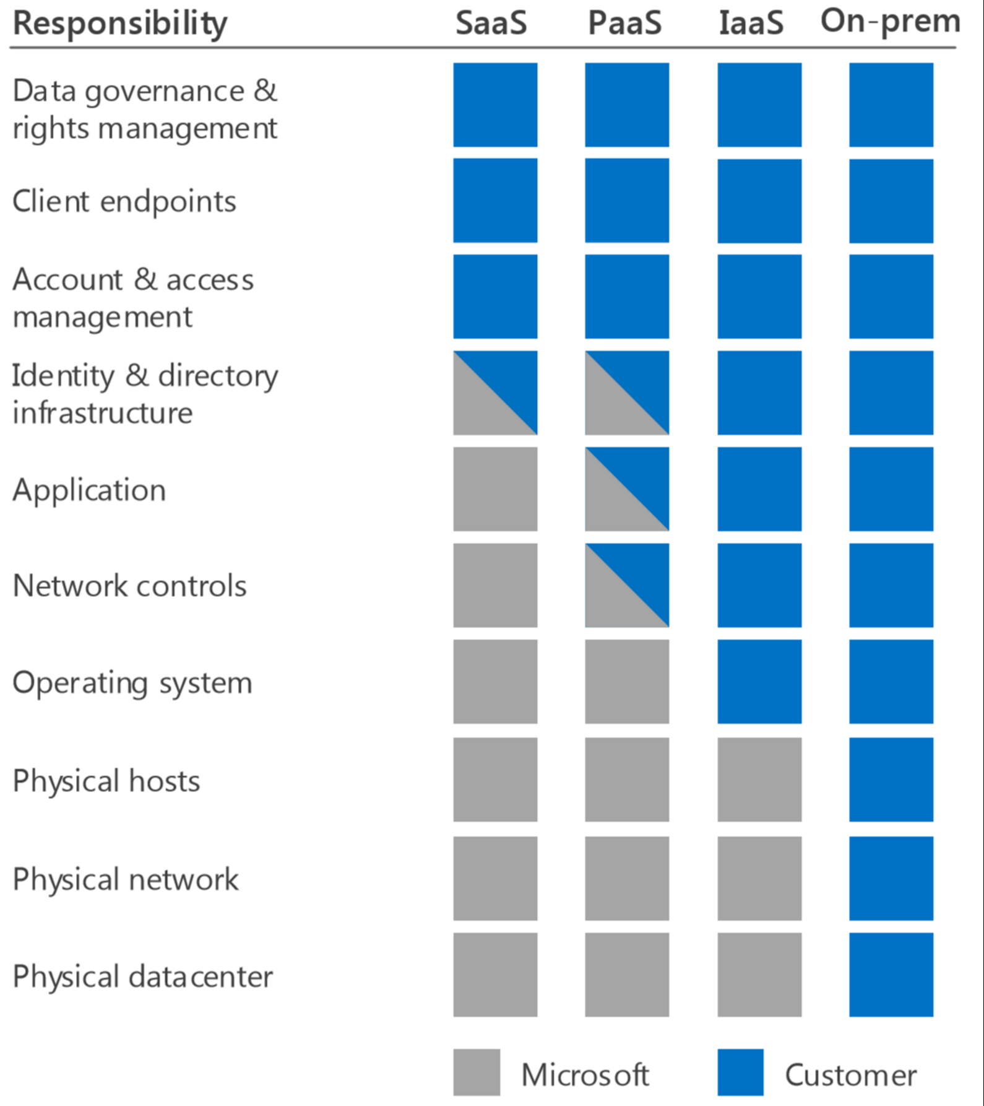
Service Delivery models
On-Prem
Infrastructure as a Service (IaaS)
Platform as a Service (PaaS)
Software as a Service (SaaS)
Cloud Provider
Customer
Source: Microsoft Cloud Security for Enterprise Architects
http://aka.ms/securecustomer

Slide 10
Not One Size fits all
Mix and match delivery models
Use any combination of SaaS, PaaS and IaaS that meets your needs

Slide 11
Audience Poll
Who here is trying to get the decision makers in your organization to ride the cloud?
Who here are the decision makers who can strongly influence the outcome?

Slide 12
How to Change Things when Change is Hard
Switch: How to Change Things when Change is Hard by Chip Heath & Dan Heath
The Rider – The Rational Mind
The Elephant – The Emotional Mind
The Path – The Situation (including the environment)
Change efforts are doomed when the rider and the elephant aren’t united
http://heathbrothers.com/books/switch/

Slide 13
How to Change Things when Change is Hard
Direct the Rider
Motivate the Elephant
Shape the Path

Slide 14
Clearing the path
What obstacles prevent your organization from riding the cloud?

Slide 15
Security
There are many solutions that give you the control you desire over your data and resources.
Private Cloud
Hybrid Cloud
Access Control Lists (ACLs)
Identity tools

Slide 16
Security
It’s a matter of trust.

Slide 17
Security
It’s a partnership.
The security of your cloud service is a partnership between you and your cloud provider.

Slide 18
Security
It’s a partnership.
You own your data and identities and the
responsibility for protecting them.
Your Cloud Provider provides you with security controls and capabilities to help you protect your data and applications
Cloud Provider
Customer
Source: Microsoft Cloud Security for Enterprise Architects
http://aka.ms/securecustomer

Slide 19




















Compliance
Many international, industry, and regional organizations independently certify that cloud services and platforms meet rigorous security standards and are trustworthy.
https://azure.microsoft.com/en-us/support/trust-center/compliance/

Slide 20
Clearing the Path – Overcoming Obstacles
Microsoft Azure Trust Center https://azure.microsoft.com/en-us/support/trust-center/security/
Google Cloud Platform Security https://cloud.google.com/security/
AWS Cloud Security https://aws.amazon.com/security/

Slide 21
Why Use the cloud?

Slide 22
Why the Cloud?
Utility Applications
Low Cost
Reliability
Strategic Applications
Ability to support innovation
Elastic resources
Support for fast development
SAVE MONEY
MAKE MONEY

Slide 23
Lower costs
Understand your TCOs (Total Cost of Ownership
& Total Cost of Operation)

Slide 24
Understand your TCO: Factors often Overlooked
Electricity Costs (to run and to cool servers)
Cycling out on-premise servers every 5 years
Cost of downtime
http://betanews.com/2013/11/04/comparing-cloud-vs-on-premise-six-hidden-costs-people-always-forget-about/

Slide 25
How much does it cost…
to run a server on premises?
http://www.zdnet.com/article/toolkit-calculate-datacenter-server-power-usage/

Slide 26
According to eHow…
A server can use between 500 – 1,200 watts per hour
http://www.ehow.com/info_8763694_much-computer-use-per-hour.html

Slide 27
If average is 850 Watts per hour…
850 watts per hour x 24 hours=
20,400 watts per day
20,400 watts per day x 365 days =
7,446,000 watts per year
7,446 kilowatts per year
http://www.ehow.com/info_8763694_much-computer-use-per-hour.html

Slide 28
According to the us energy information administration…
the average kWh cost for commercial use from August 2014 through July 2015 was 10.68 cents.
7,446 kWh (for a year) x 10.68 cents =
$795.23 per year
http://www.eia.gov/electricity/monthly/

Slide 29
For those who were wondering…
1.21 gigawatts = 1,210,000 kWh
1,210,000 kWh x 10.68 cents =
$129,228.00
Happy belated-Back to the Future Day!

Slide 30
Lower Costs – Maintenance
Hardware
Network
Security Patches
Keeping hardware up-to-date
Allows you to re-allocate resources to focus on data governance & rights management
Cloud Provider
Customer
Source: Microsoft Cloud Security for Enterprise Architects
http://aka.ms/securecustomer

Slide 31
Lower costs - Reliability
Service Level Agreements
Disaster Recovery & Business Continuity

Slide 32
Focus on Innovation
Create Opportunities to Add Revenue

Slide 33
A Superhero Tale
What’s your favorite super power?

Slide 34
Focus on Innovation: Flexible support for new initiatives
Pay for what you use
Scale to meet demand
Empowers you to take calculated risks and mitigate costs
Providing More Opportunities
To Add Revenue

Slide 35
Focus on Innovation: Flexible support for new initiatives
Imagine the possibilities when you have…
Low Cost
and
Low Commitment

Slide 36
Case studies
The Bright Spots

Slide 37
Case #1
Usage-Based Insurance (UBI) Model.
Telematics and mobile-phone technologies are now able to stream real-time data on every move that drivers make: how fast they drive, how hard they brake, even how they adapt driving behavior to changes in the weather.
And having that much information about an individual driver gives an insurance company much better data for pricing a policy than merely knowing what demographic and other categories the driver fits into.

Slide 38
Towers Watson – Big Data Analytics
Benefits
Delivers Competitive Advantage
Projects Saving up to 40 Percent
Broadens Market to New Customers
https://customers.microsoft.com/Pages/CustomerStory.aspx?recid=18222

Slide 39
Case #2
A global customer base relies on your products. You require a flexible, highly scalable platform that could deliver a wide range of solutions and services to help imagine new ways to diagnose and treat cancer, heart disease, neurological diseases and other conditions earlier, more cost-effectively, and more efficiently.

Slide 40
GE Healthcare – compliance
Benefits
Faster Time-to-Market and Lower Operating Costs
Enables Regulatory Compliance
Better Flexibility and faster innovation
Can Focus on Innovation instead of infrastructure
https://customers.microsoft.com/Pages/CustomerStory.aspx?recid=12166

Slide 41
Case #3
You’re creating a tablet-based curriculum for K-12 students. You need to support massive amounts of data – about 40 petabytes in your first year. You also need to incorporate high levels of social collaboration. You also need to support the rapid analyses of student learning to help teachers adopt the most appropriate teaching model for each student.

Slide 42
Pearson – Education
Benefits
Supports highly scalable, cost-effective cloud analytics
Contributes to teaching goals
https://customers.microsoft.com/Pages/CustomerStory.aspx?recid=18484

Slide 43
Other Cases

Slide 44
Ziosk – predictive analytics
Benefits
Gives devices real-time “smarts”
Reveals the hidden value of information
Delivers data-driven competitive advantage
https://customers.microsoft.com/Pages/CustomerStory.aspx?recid=18294

Slide 45
The path
Next steps

Slide 46
Next Steps
Migrating to the Cloud
or
Building in the Cloud

Slide 47

Migrating to the cloud
Replace (SaaS)
High
Rebuild (PaaS)
Rebuild
(PaaS)
Difficulty
Rehost (IaaS)
Replace
(SaaS)
Refactor (Hybrid)
Rehost
(IaaS)
Low
Operational
Degree of Benefit
Strategic
Source: Turning the Infrastructure Inside Out and IT Practices Upside Down: Cloud Adoption In Microsoft IT – David Lef https://channel9.msdn.com/Events/Ignite/2015/BRK3119

Slide 48
Building in the Cloud
Focus on Innovation

Slide 49
New Customer-Facing Applications Where Microsoft Azure is a very good fit
Application Characteristic
Examples
Needs fast access to computing resources with no commitment
Marketing web sites,
high-risk innovative apps
Requires massive or global scale
Consumer web applications
Has very spiky usage
Online ticket sales
Running the application on-premises raises security issues
Backends for enterprise mobile applications
Customers don’t want in-house IT
Start-ups, progressive businesses
Source: Microsoft Azure for Enterprises: What and Why – David Chappell https://channel9.msdn.com/Events/Ignite/2015/BRK1451

Slide 50
Getting Managers to Ride the Cloud
How to change things when change is hard

Slide 51
How would you teach…
A Monkey to Skateboard?

Slide 52
Article: Your Boss is a monkey by dan & Chip heath http://www.fastcompany.com/756459/your-boss-monkey
Rule 1: Ignore Bad Behavior
Rule 2: Any Interaction is Training
Rule 3: Reward the Behavior You Want
See also What Shamu Taught Me About a Happy Marriage
By Amy Sutherland http://www.nytimes.com/2006/06/25/fashion/25love.html

Slide 53
How to Change Things when Change is Hard
Switch: How to Change Things when Change is Hard by Chip Heath & Dan Heath
The Rider – The Rational Mind
The Elephant – The Emotional Mind
The Path – The Situation (including the environment)
How can we effectively reach each one?
http://heathbrothers.com/books/switch/

Slide 54
The Rider – The rational mind
Switch: revisited
What looks like resistance is often a lack of clarity
http://heathbrothers.com/books/switch/

Slide 55
Direct the rider
Follow the Bright Spots Find good examples and duplicate it.
Script the Critical Moves Think in terms of specific behaviors. Be concrete.
Point to the Destination Change is easier when you know where you’re going and why it’s worth it.
http://heathbrothers.com/books/switch/

Slide 56
The Elephant – The emotional mind
Switch: revisited
What looks like laziness is often exhaustion
http://heathbrothers.com/books/switch/

Slide 57
Motivate the Elephant
Find the Feeling Make your people feel something.
Shrink the Change Break down the change until it no longer spooks the elephant.
Grow Your People Cultivate a sense of identity and instill the growth mindset.
http://heathbrothers.com/books/switch/

Slide 58
The Path – The Situation & Environment
Switch: revisited
What looks like a people problem is often a situation problem
http://heathbrothers.com/books/switch/

Slide 59
Shape the path
Tweak the Environment When the situation changes, the behavior changes.
Build Habits Look for ways to encourage habits.
Rally the Herd Behavior is contagious. Help it spread.
http://heathbrothers.com/books/switch/

Slide 60
Key Takeaways
The Low Cost and High Reliability of the cloud can help your enterprise reduce costs.
The flexibility of cloud resources empowers you to focus on innovation, not on infrastructure.
The cloud empowers you to take calculated risks and mitigate costs, providing more opportunities to add revenue.
There is something in the cloud for everyone

Slide 61
A Challenge

Slide 62
thank you
for your time.
https://twitter.com/AmayaHuman
https://www.linkedin.com/in/davidamaya

