Slide 1
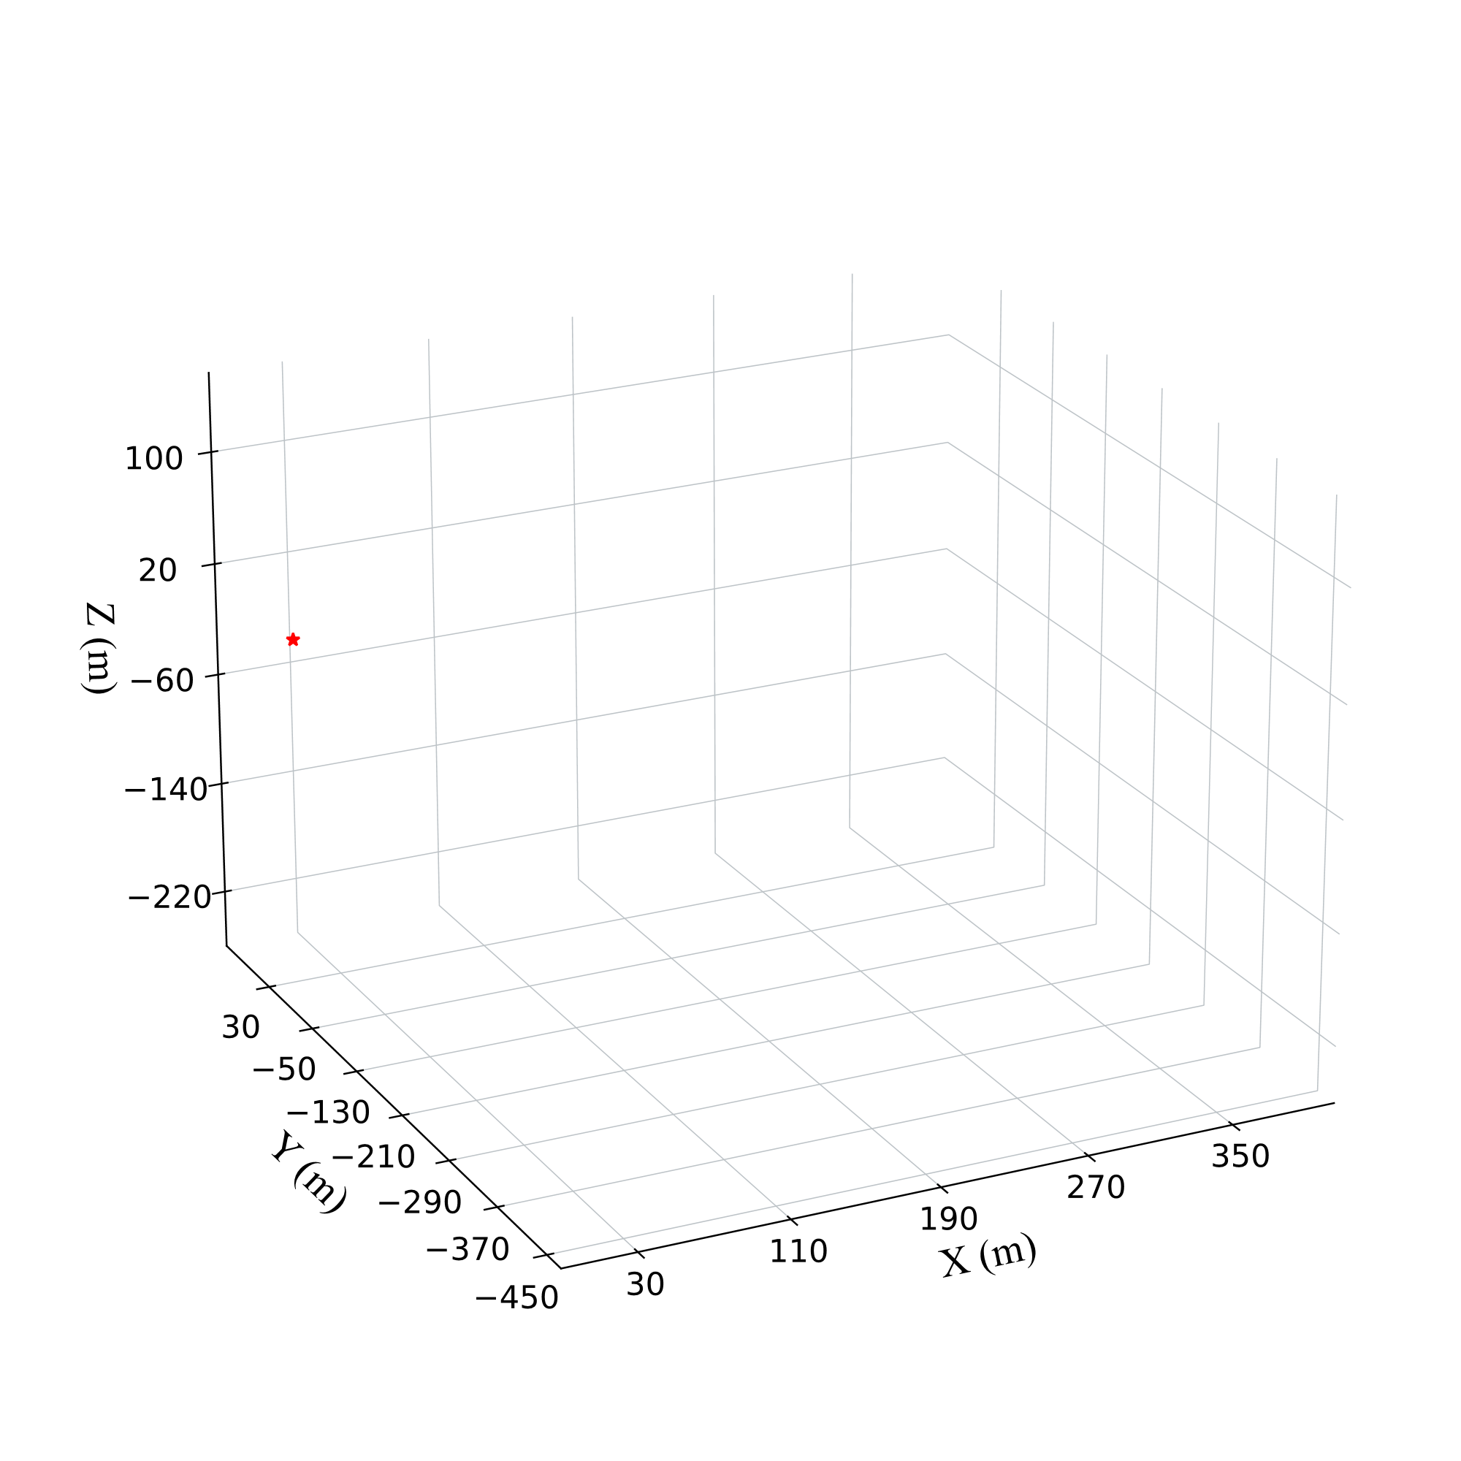
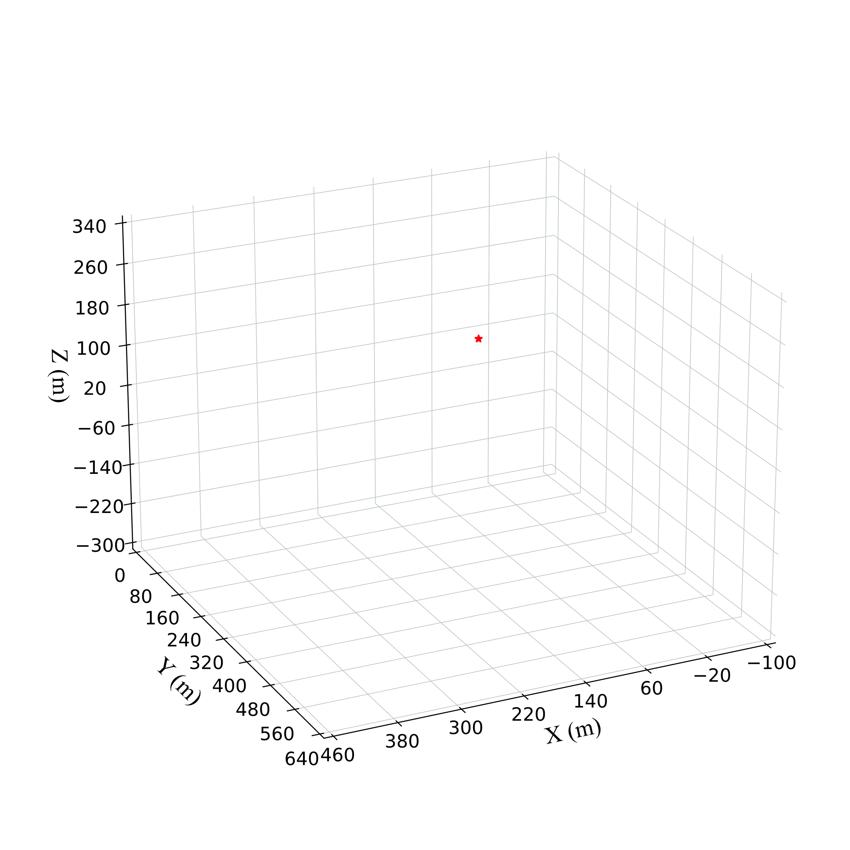
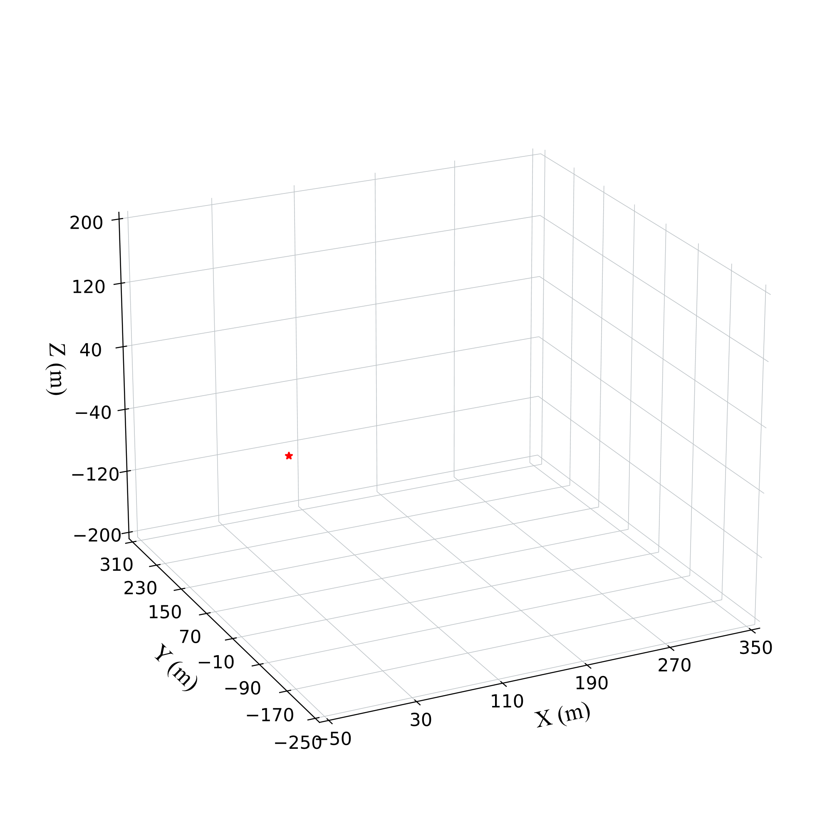



(a) Offroad1
(b) Offroad2
(c) Offroad3

Slide 2
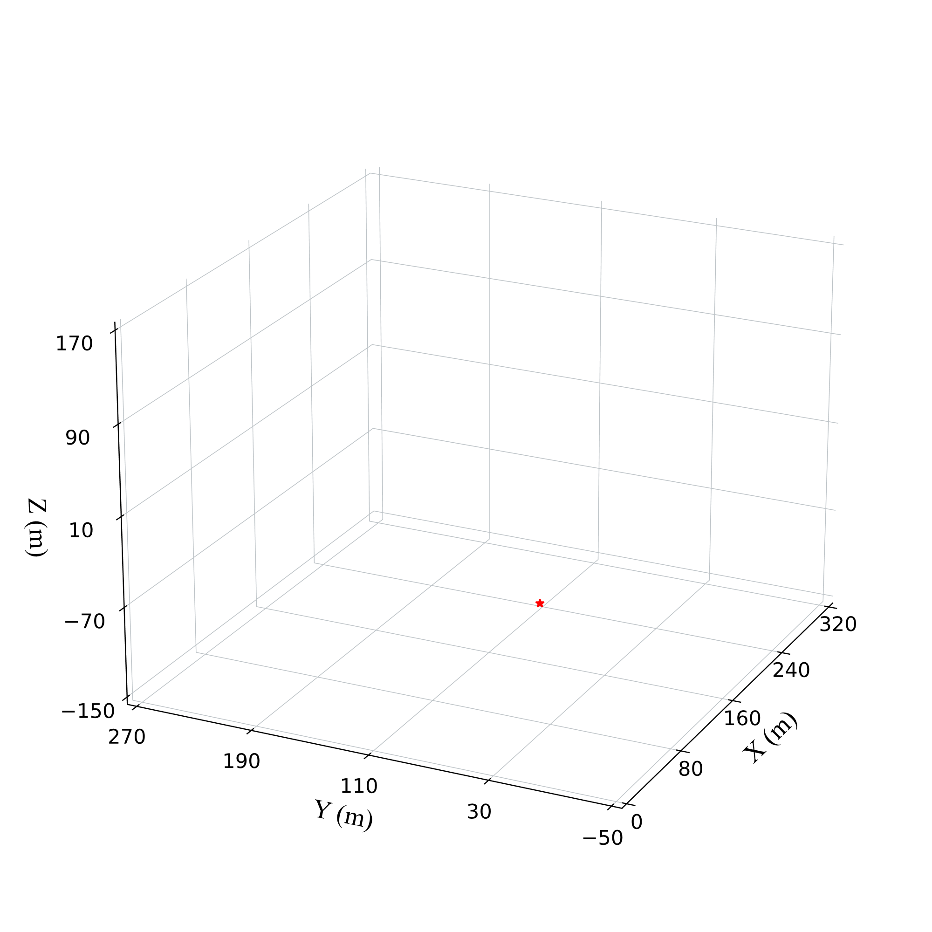
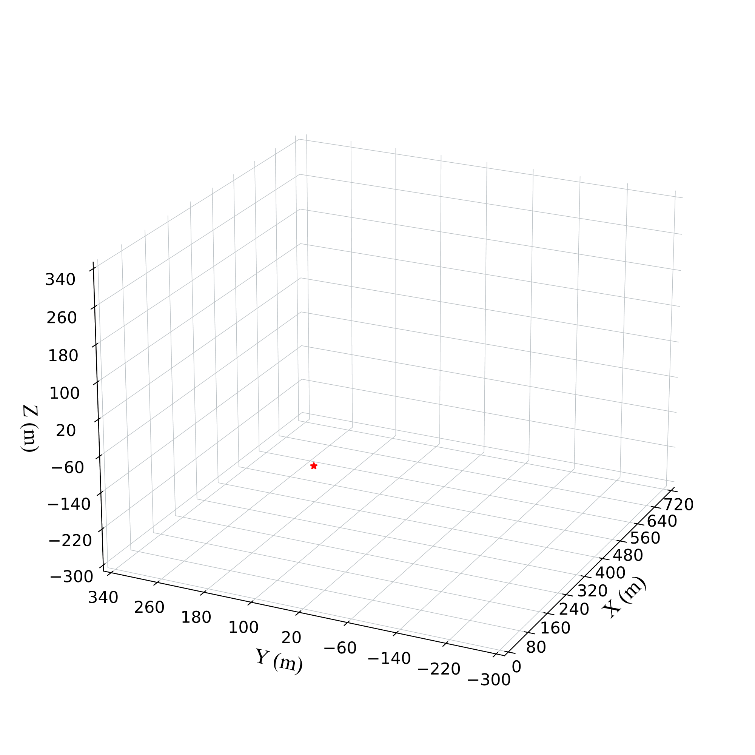


(a) Qianfo
(b) Xinglong

Slide 3




(a) KITTI 00
(c) KITTI 05
(e) KITTI 08
(b) KITTI 00
(d) KITTI 05
(f) KITTI 08

