Slide 1
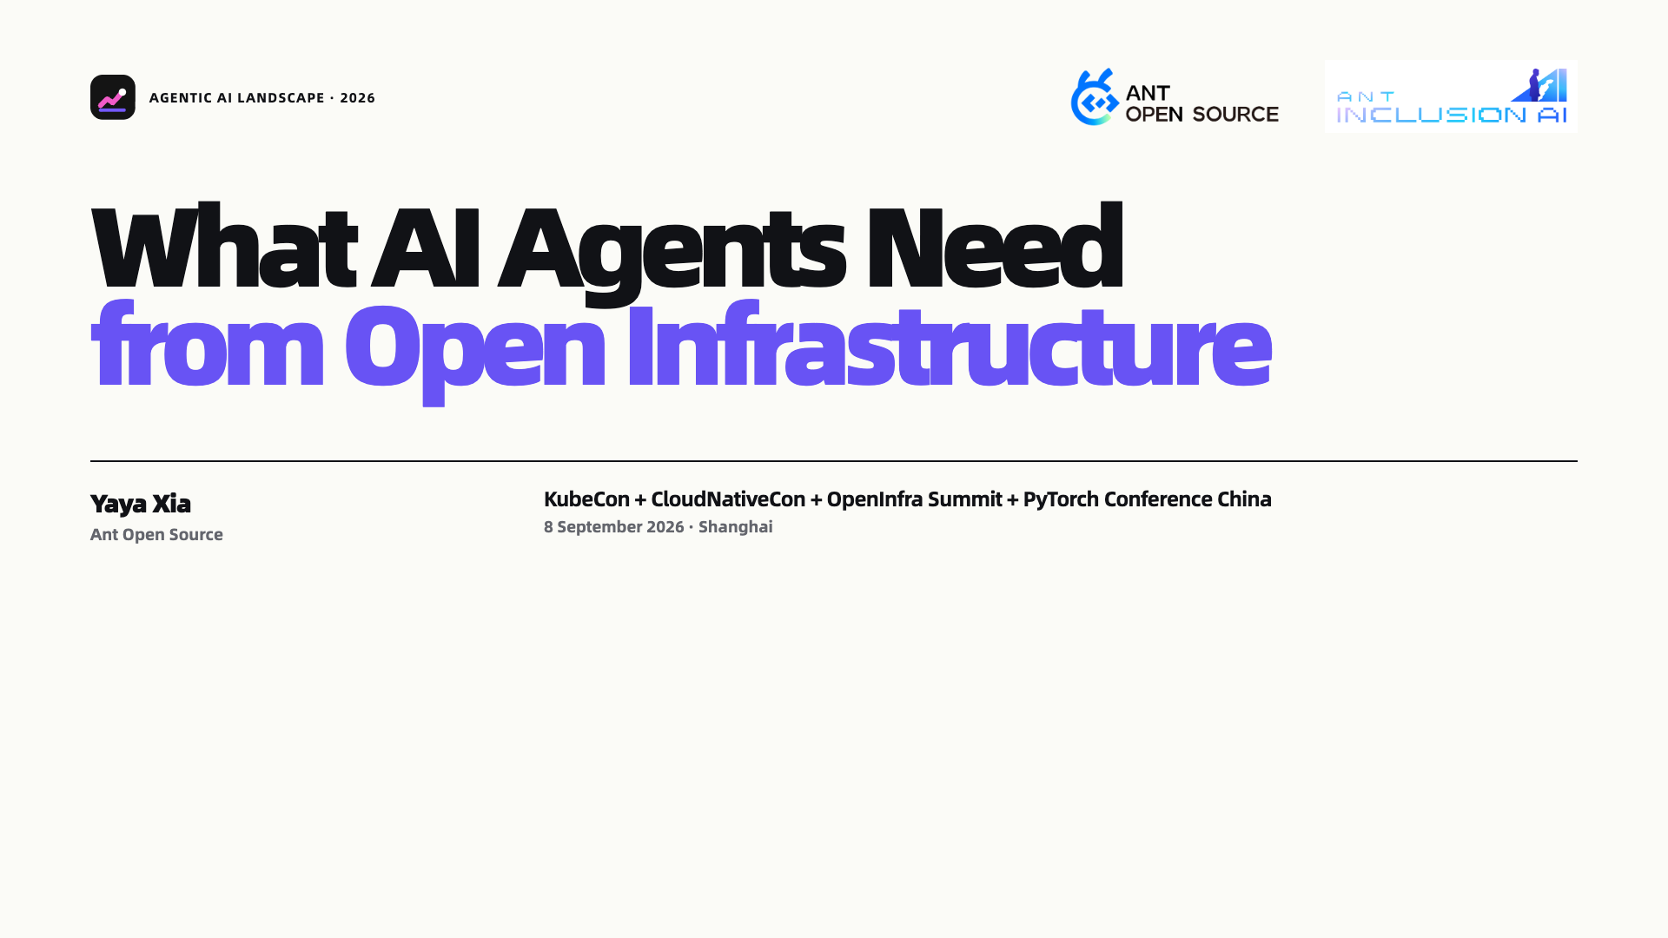
Notes:
Cover

Slide 2
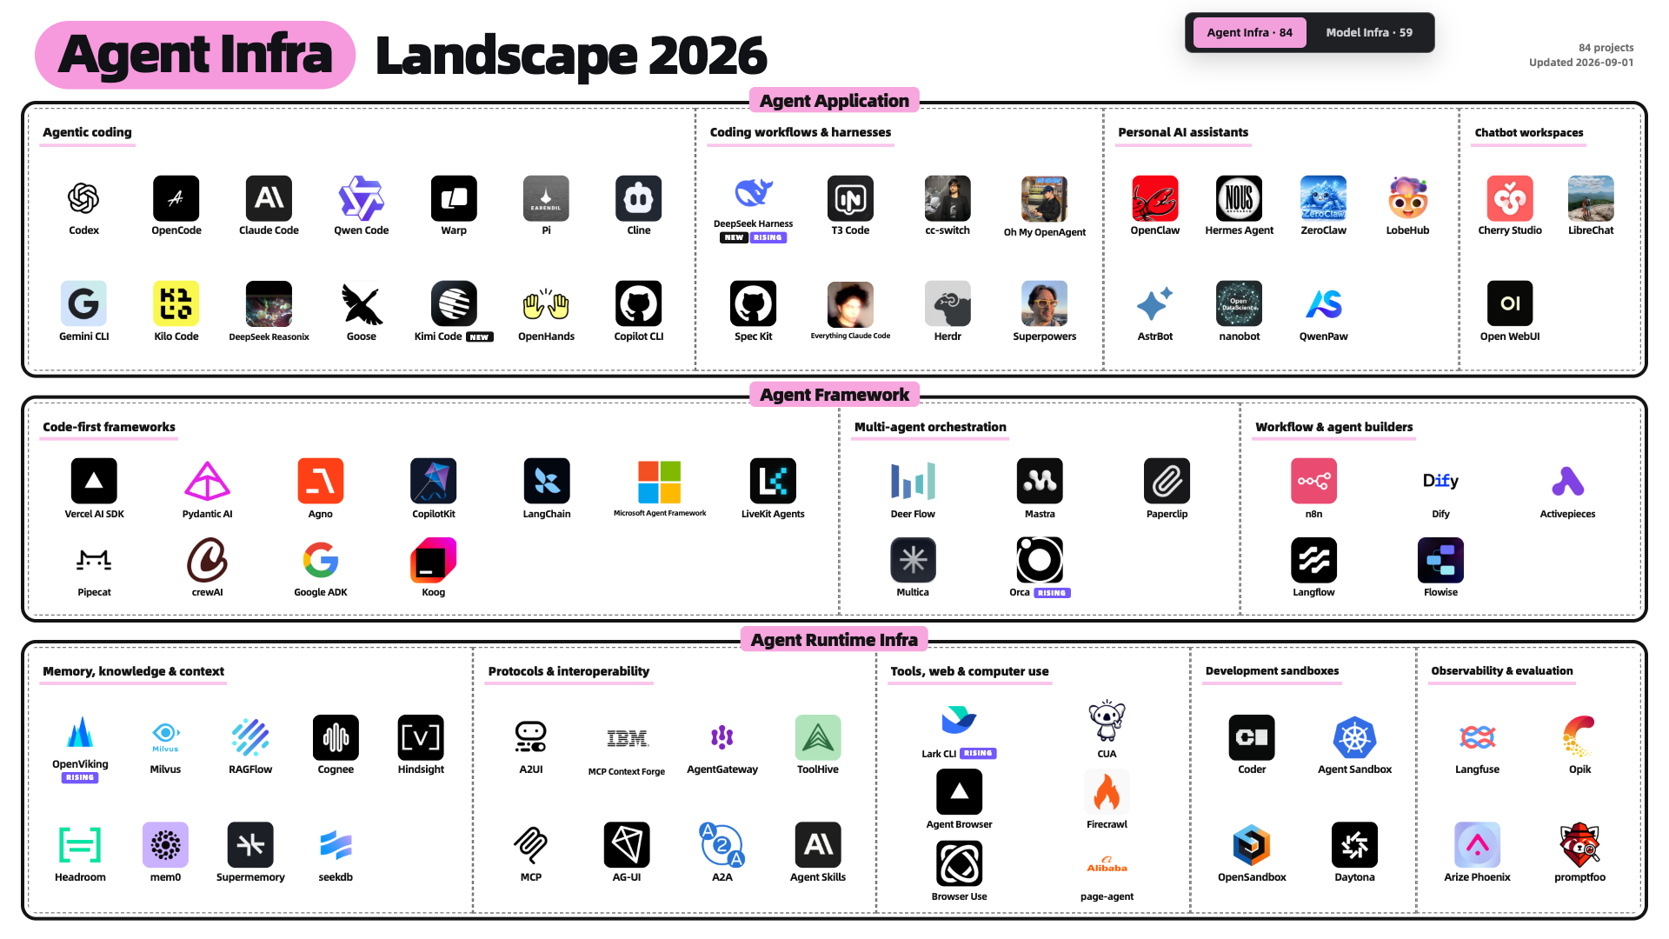
Notes:
Agent Infra — overview

Slide 3
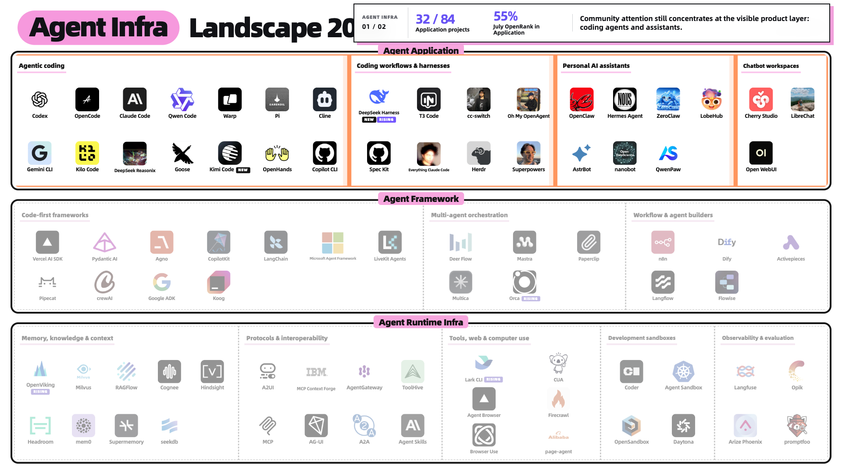
Notes:
Agent Infra — application attention

Slide 4
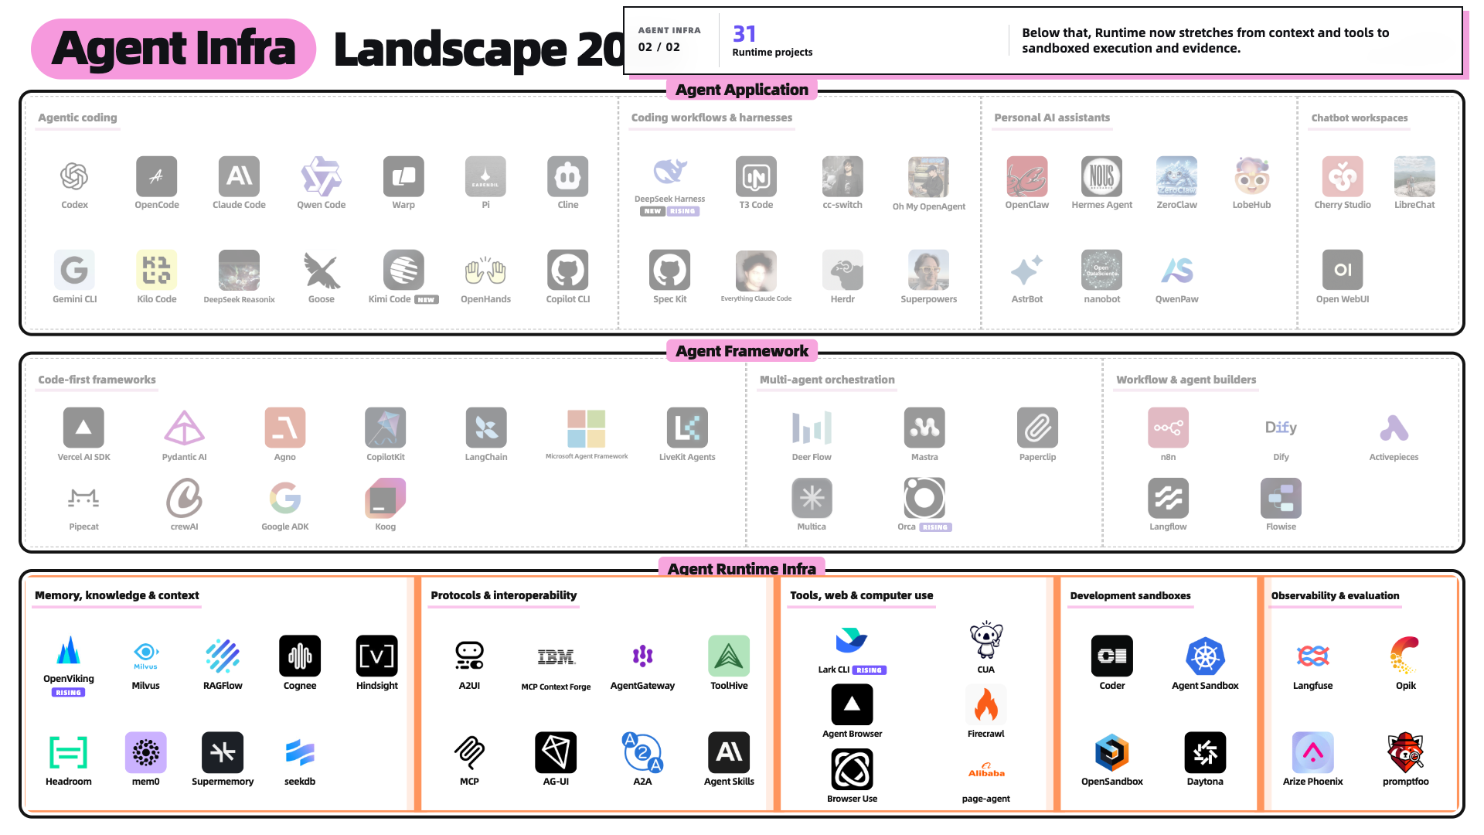
Notes:
Agent Infra — runtime

Slide 5
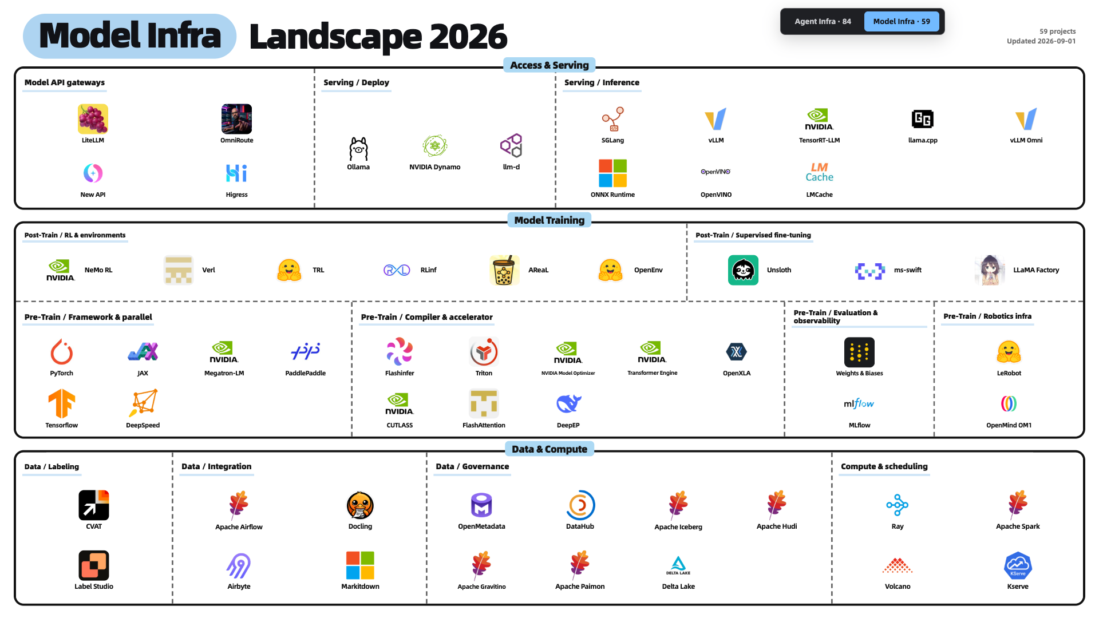
Notes:
Model Infra — overview

Slide 6
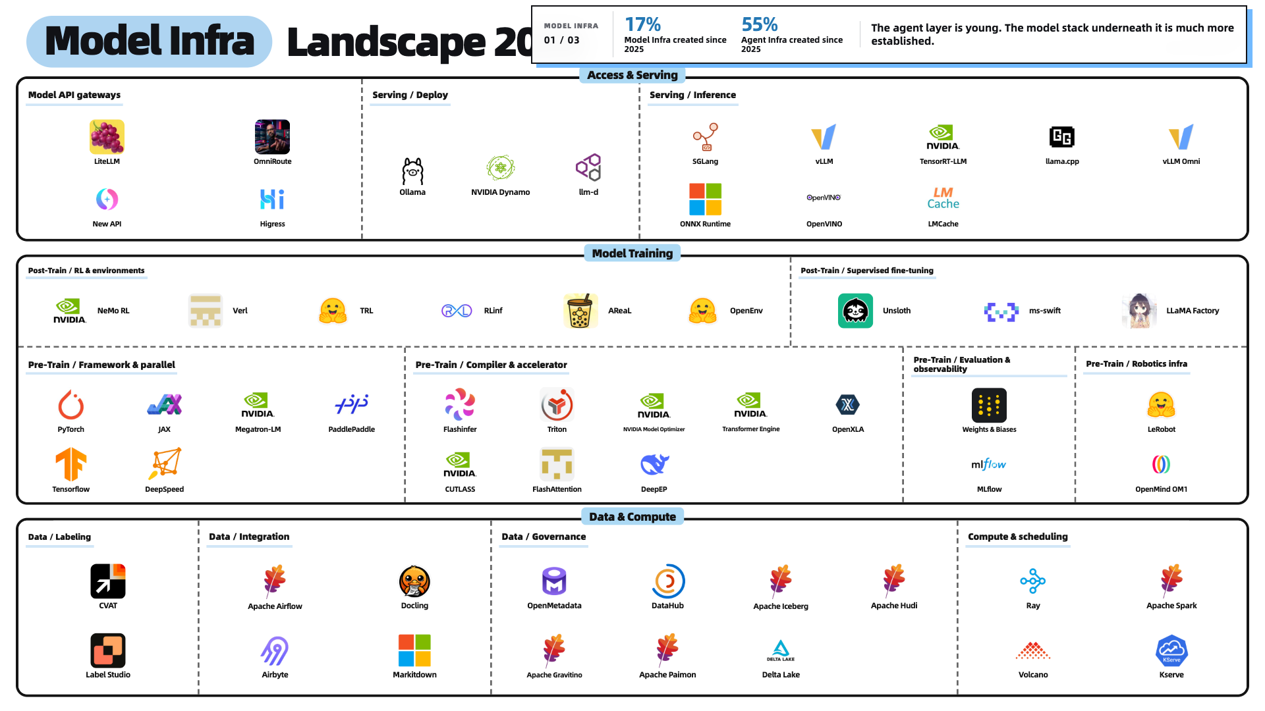
Notes:
Model Infra — age comparison

Slide 7
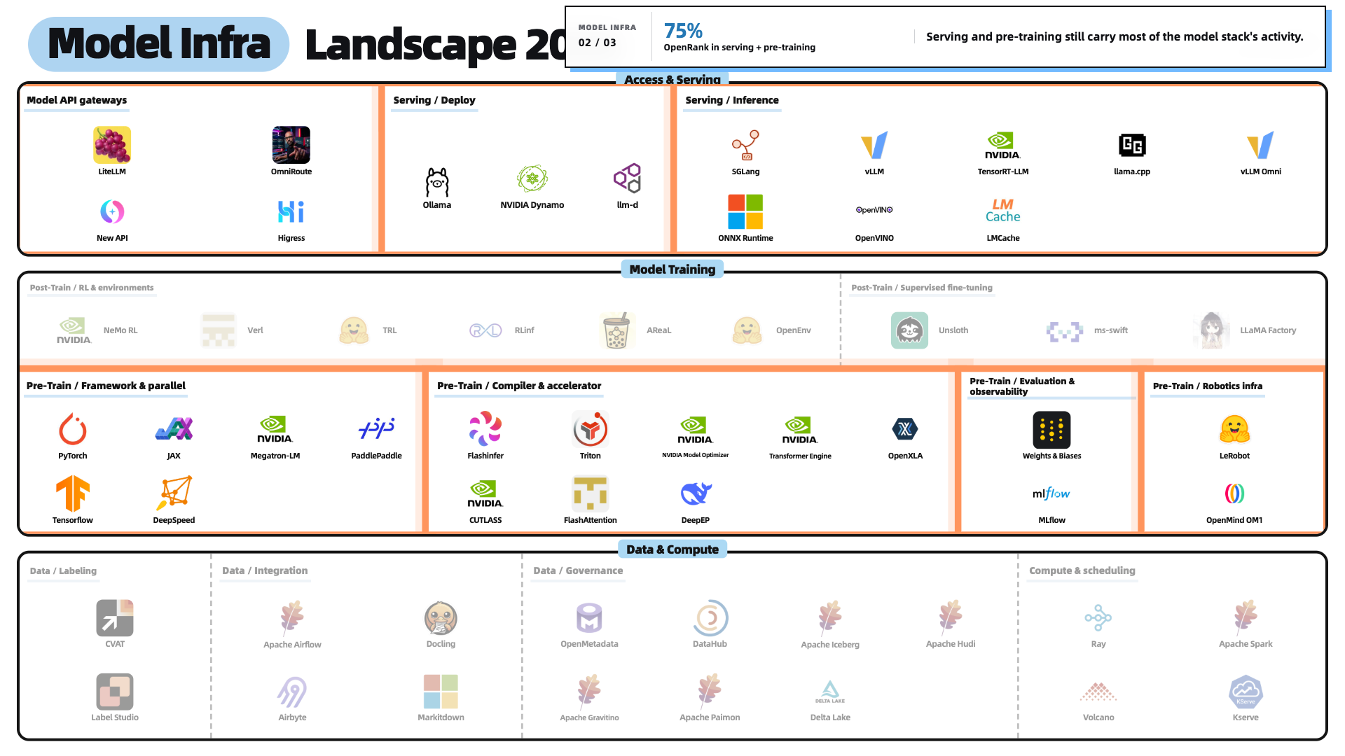
Notes:
Model Infra — serving and pre-training activity

Slide 8
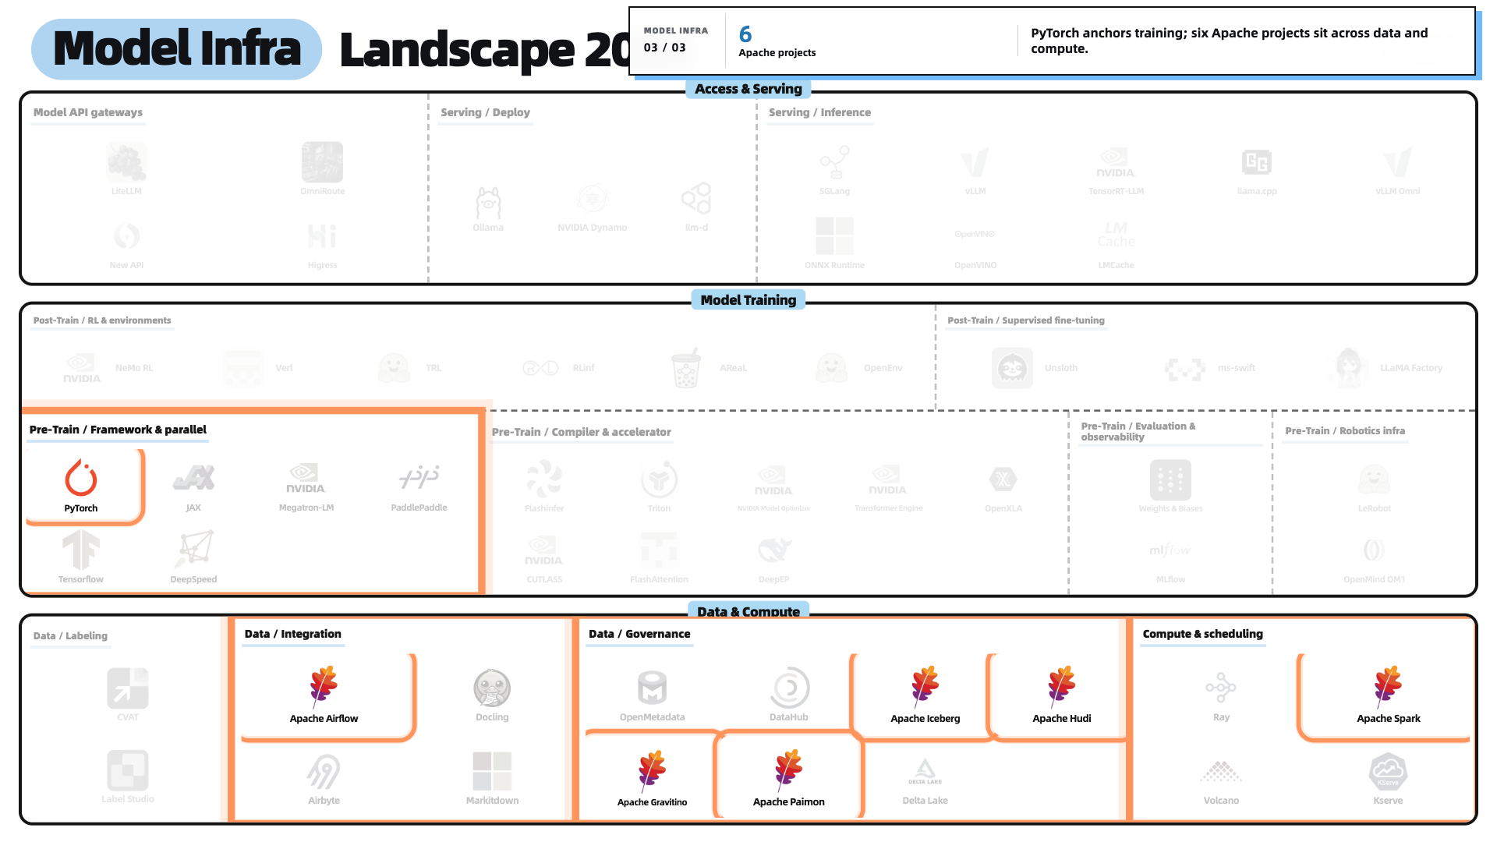
Notes:
Model Infra — PyTorch and Apache foundation

Slide 9
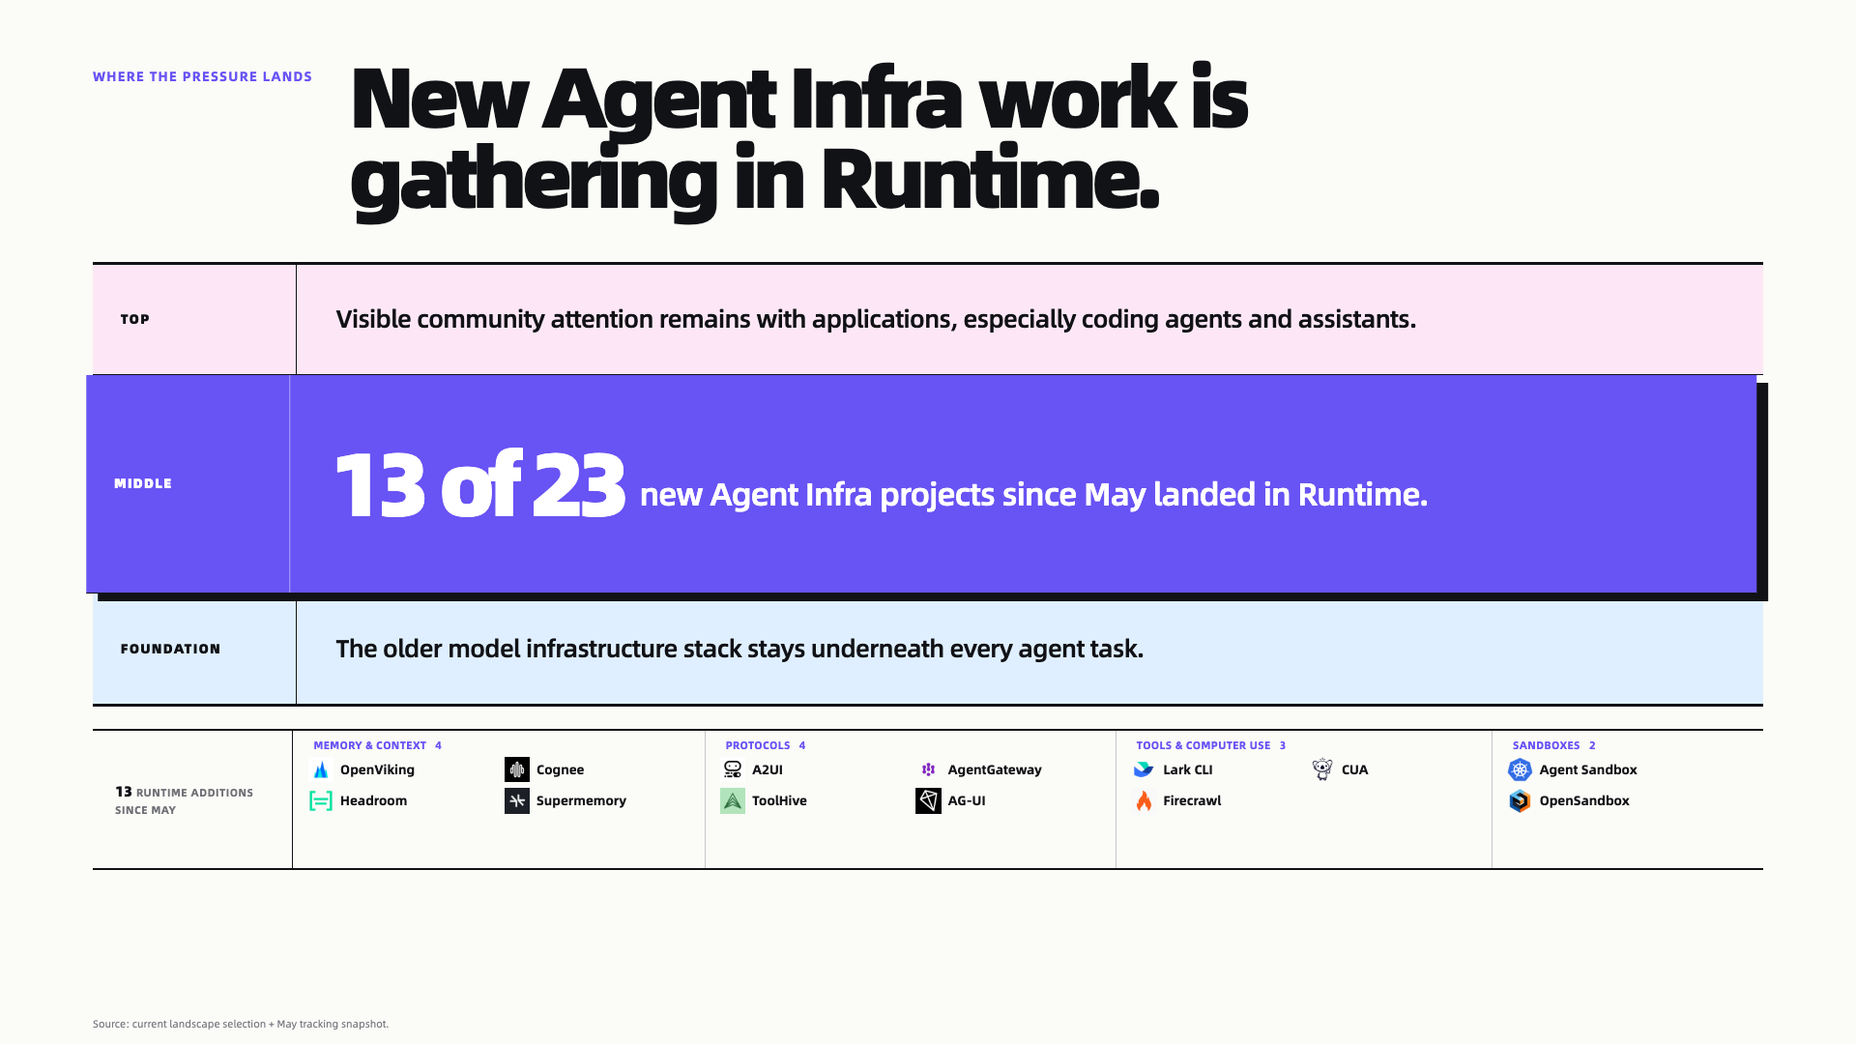
Notes:
Where the pressure lands

Slide 10
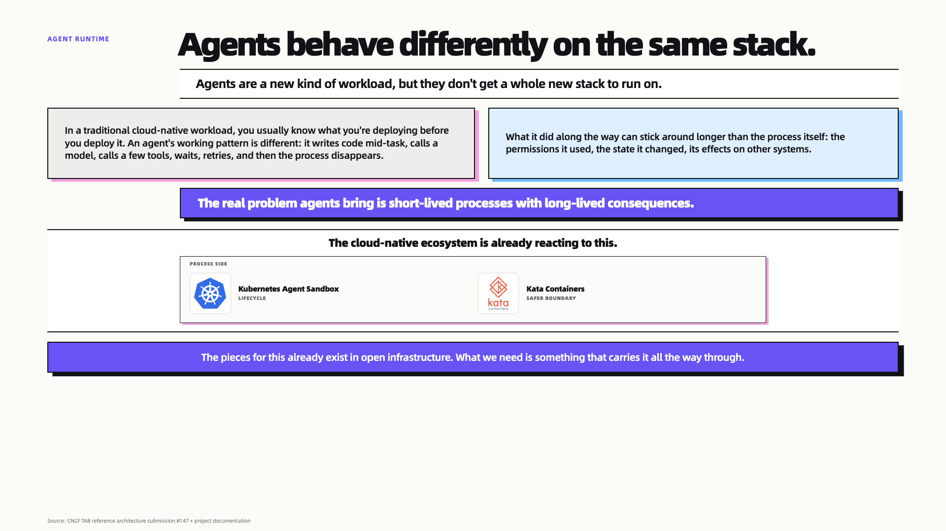
Notes:
Agent runtime

Slide 11
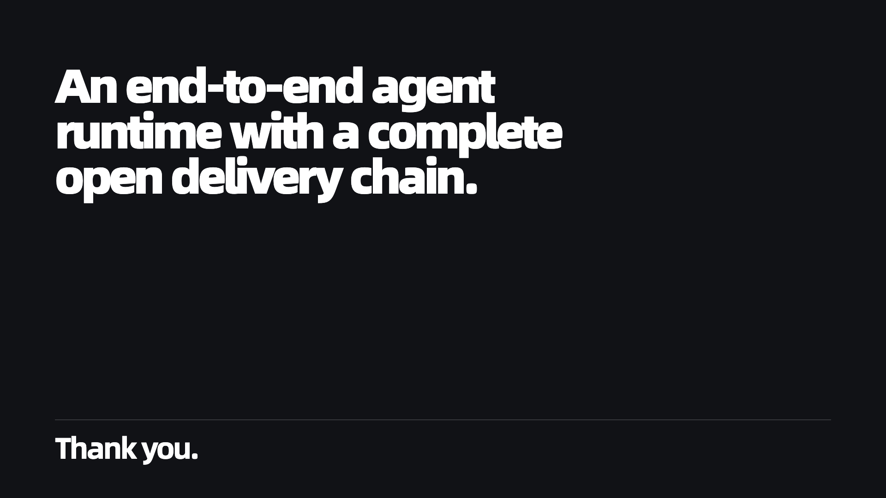
Notes:
Closing

