Slide 1
Start Your Project Right
Jonathan Mills

Slide 2

Who Is This Guy?
Practice Director / AdventureTech
@jonathanfmills
Jonathanfmills.com

Slide 3
Before You Begin
What it is
What it isn’t
What will it take?
Notes:
Who Is the audience?
So many projects fail, because they are set up to fail.
CI Center project, we finished the project and then found out what the ci center was….
Appreciate our customers….
If doing scrum, I would call this sprint 0

Slide 4

I need a project….

Slide 5

Notes:
Understand why you do what you do….

Slide 6
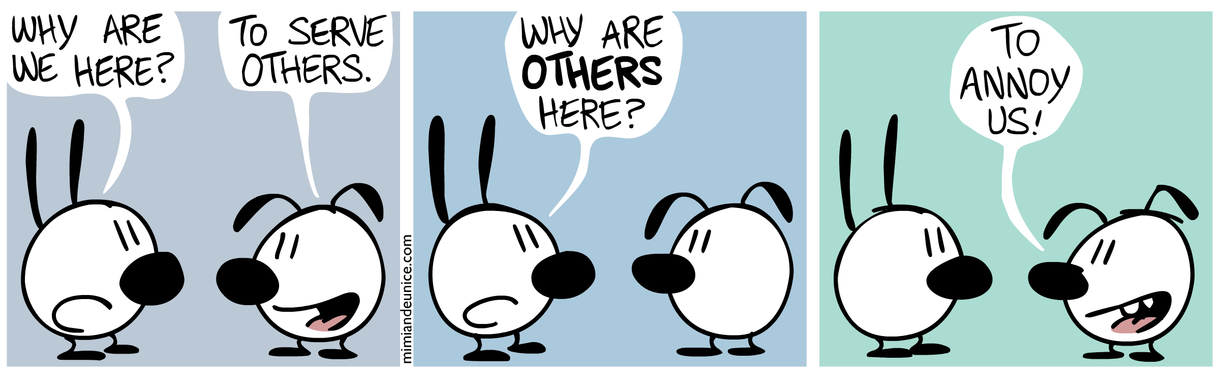
Notes:
This is how we often feel

Slide 7
Notes:
Get up, and go meet people.
Don’t have them come to you….
Go to them
We go figure out who they are and what they do…

Slide 8
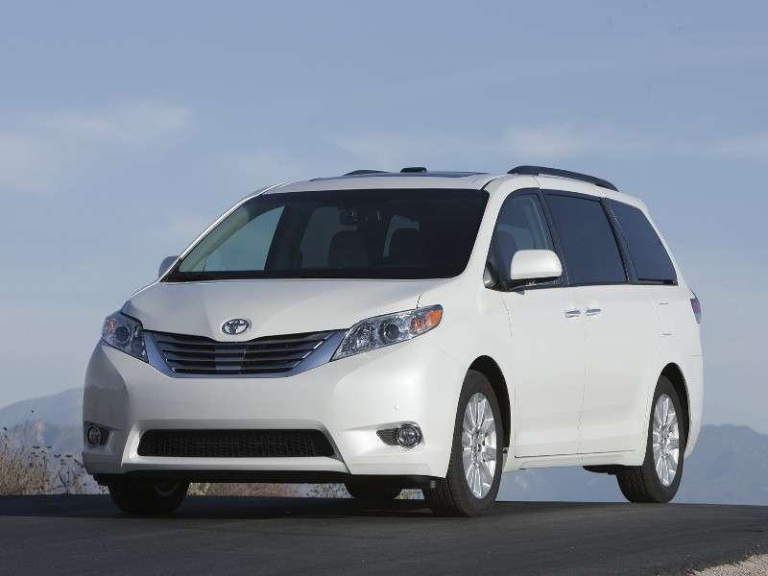
Notes:
The Toyota Way.
The chief Engineer Yuji Yokoya charged with designing the 2004 Toyota Sienna
They lived in Japan, they had no concept of North America
They drove through every state in the US, Mexico and Canada
What they found
Higher crowned roads in snowy Canada led to excellent drift control,
high winds in Mississippi made him engineer for stability,
Santa Fe's narrow streets enforced a tight turning radius.
His observations at Home Depot led to a cargo bay that can take a 4x8' plywood sheet—
Observations of how Americans eat and drink in the car much more than Japanese produced a car with 14 cup holders!

Slide 9
Notes:
Henry project
Figure out why we are doing what we are doing
As a result developer will
Make better more informed decisions
Do a better job of balancing conflicts
Come up with better more innovated solutions because they have been empowered.

Slide 10
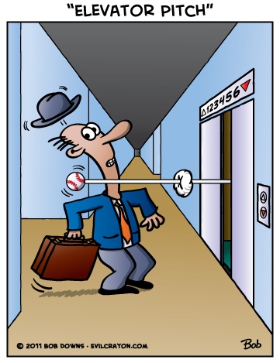
Elevator Pitch
Notes:
Give me a 20 second description of the project?

Slide 11
For [Customer]
Who needs to [Need]
The [Product Name]
Is a [Category]
That will [Key Benefit]
Unlike [Primary Alternative]
The new system will [Differentiator]

Slide 12
Elevator Pitch
Notes:
As a result
Clarity
Think about the customer
It gets to the point

Slide 13

Design a Box
Notes:
Design a box
What are the key product benefits?
Slogan?
Build a box…

Slide 14
Create your Not List
Scope
In | Out
Data Entry | Export Functionality Reporting
Unresolved
How do I see data? How do I know who you are?
Notes:
What’s in, and what’s out…
Let’s all agree on scope limits.
What are the things we are not sure about

Slide 15

Meet Your Neighbors
Notes:
Who is involved in the project?
Who is core?
Who is impacted?
Who impacts us?
Call them together, and get coffee and donughts….
Go over the elevator pitch and the not list.

Slide 16
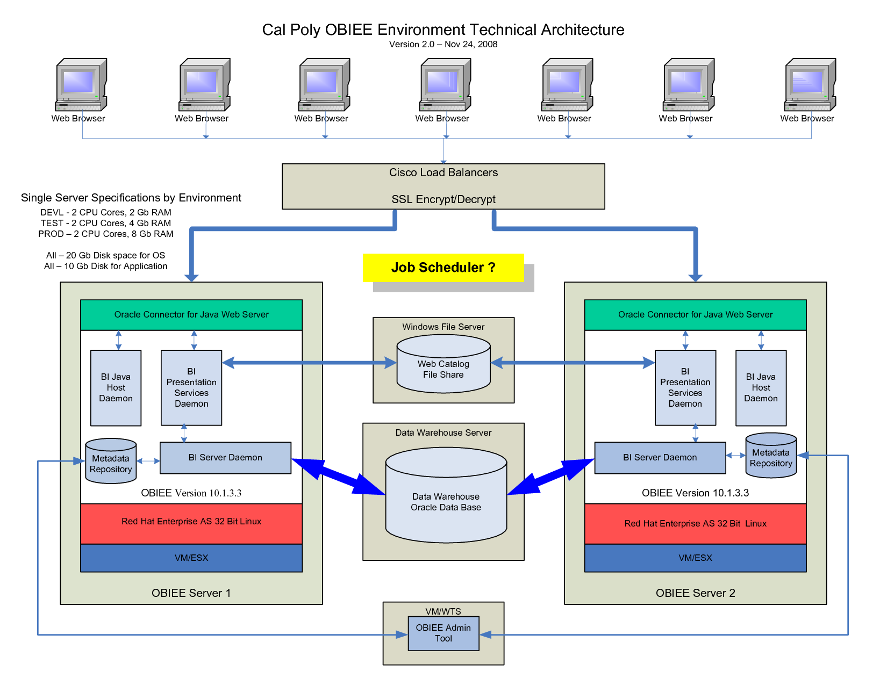
Show the solution
Notes:
Map out what you are thinking
What are you using…
What are the maybes?
Why do it?
Sets expectations around tools and technologies
Visualizes assumptions around boundaries
Communicates risk
show it to the neighbors
Why?
Let them call you on bad decisions or assumptions
You are a hammer… Let the other tools help with solutions
Get their insight

Slide 17

What keeps us up at night?
Notes:
What are we worried about?
What are the risks
Why?
Highlight the challenges
Call out the crazy
It can make you feel better
Now that you have a list, what can you ignore
What is important
What can you do about it?
If you can’t do anything about it, its not important.
Serenity Prayer…

Slide 18


Slide 19

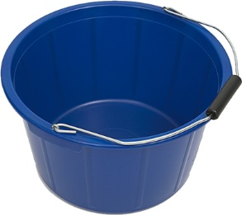
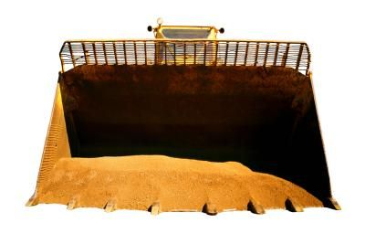
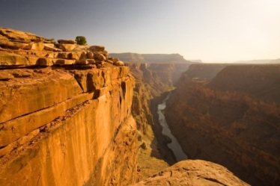
Size it up
Notes:
Initial estimation
The bigger it is, the more risk there is to the timeline.

Slide 20
Be Clear On Priorities
Scope
Budget
Time
Quality
Notes:
Whats important
Scope
Budget
Time
Quality
No ties…
Add in the bullet points… How flexible are they?

Slide 21
Be Clear On Priorities
Scope
Budget
Time
Quality
Notes:
Whats important
Scope
Budget
Time
Quality
No ties…
Add in the bullet points… How flexible are they?

Slide 22
Be Clear On Priorities
Scope
Budget
Time
Quality
Notes:
Whats important
Scope
Budget
Time
Quality
No ties…
Add in the bullet points… How flexible are they?

Slide 23
Be Clear On Priorities
Scope
Budget
Time
Quality
Notes:
Whats important
Scope
Budget
Time
Quality
No ties…
Add in the bullet points… How flexible are they?

Slide 24
Be Clear On Priorities
Scope
Budget
Time
Quality
Notes:
Whats important
Scope
Budget
Time
Quality
No ties…
Add in the bullet points… How flexible are they?

Slide 25
Show What It Will Take
~ 5 Mos
~2 Wks
1 Wk
Build
UAT
Train
Ship!
Notes:
People
Time
Money
Here s how.

Slide 26
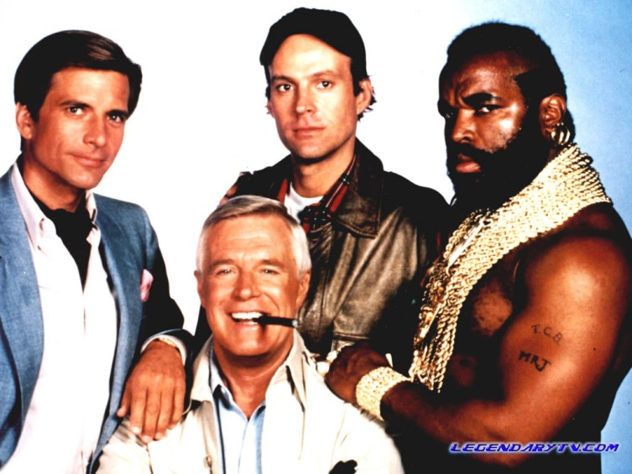
Who Is Your A Team?
Notes:
Who is you’re a team?
UI?
Dev?
PM?
Test?
Customer?

Slide 27

Who Is In Charge?
Notes:
Who calls the shots?
Who is the product owner?

Slide 28
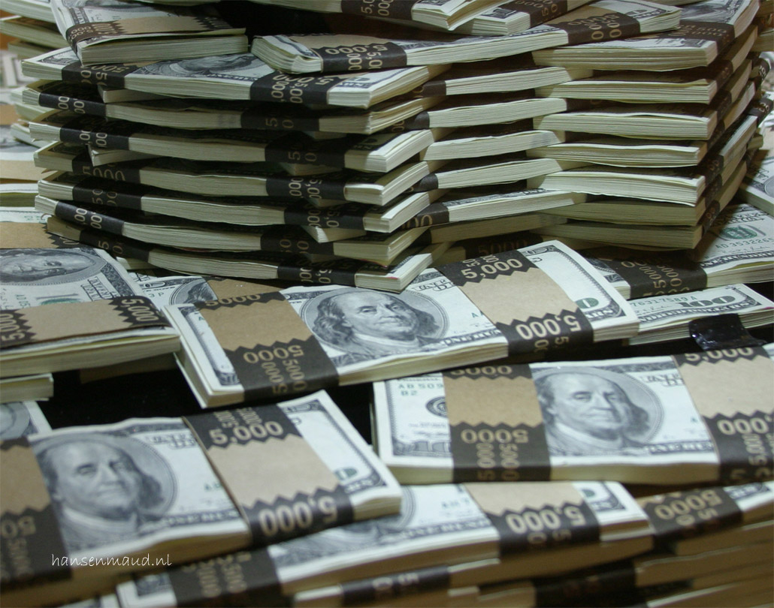
What’s It Cost?

Slide 29
What’s It Cost?
4 People X
5 Months X
$ 100 An Hour
$320 K

Slide 30
Make Sure They Know
Timeframe
Cost
Notes:
Not Commit, But Know

Slide 31

Questions?

