Slide 1
Managing People
Jonathan Mills

Slide 2


































Platinum Sponsors
Gold Sponsors
Silver Sponsors

Slide 3
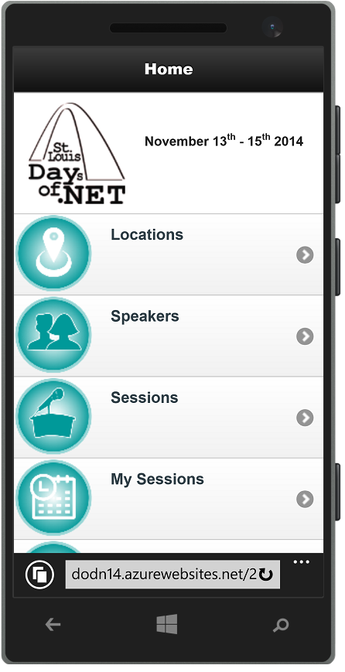
Conference Mobile App
dodn14.azurewebsites.net
Quick access to conference info
Build your custom agenda
Anonymously rate the sessions you attended
Share with the Twitter-verse

Slide 4

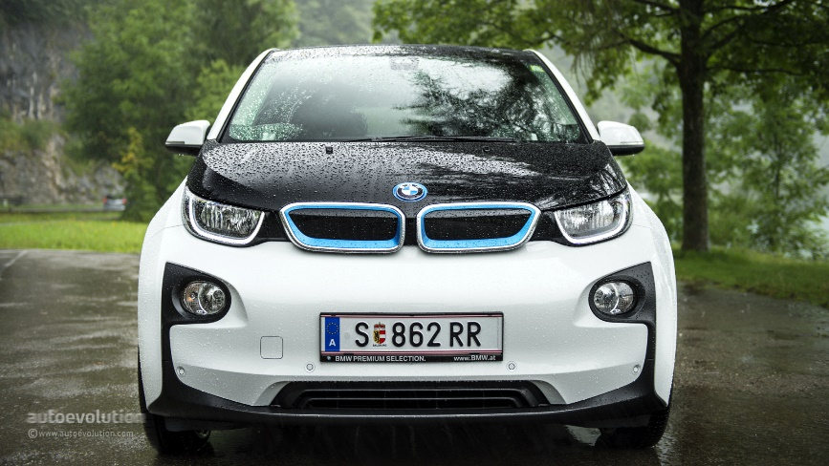
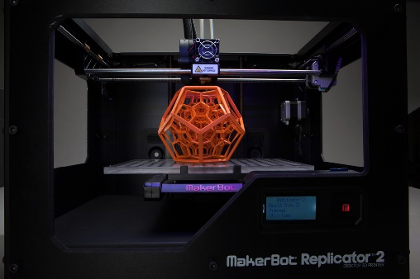
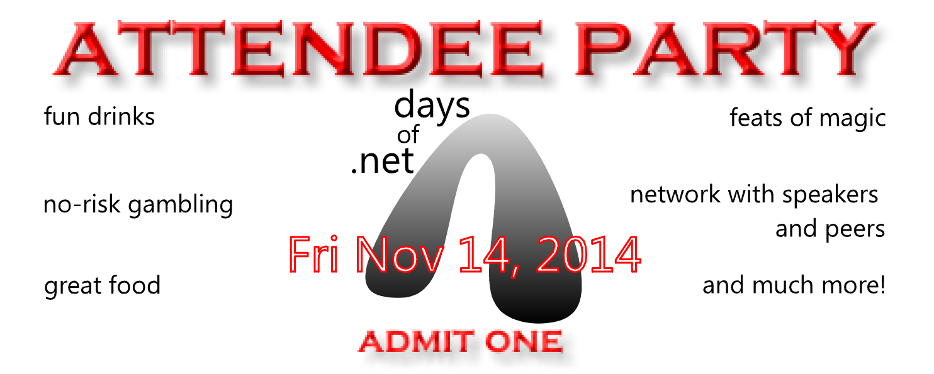
Fun Stuff Downstairs

Slide 5
Managing People
Jonathan Mills

Slide 6
Managing Good People
Jonathan Mills
Notes:
Who is the audience?
It’s the Good people that you want to focus on
So often we spend all of our time on the problem people, we ignore the good ones, and that’s not the way it should be.

Slide 7
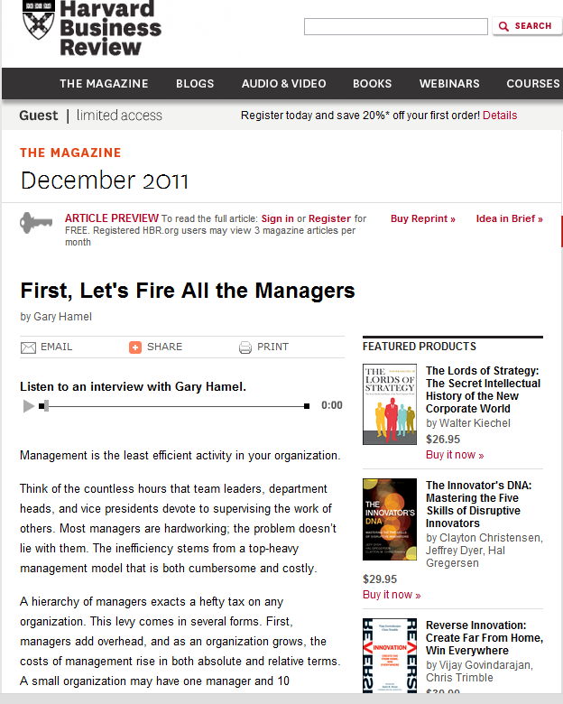
“How a company can make profits with all these
PARASITES chatting and drinking coffee?”
The countless hours that team leads …
devote to supervising the work…
Notes:
What kind of crappy managers have these guys had?
http://hbr.org/2011/12/first-lets-fire-all-the-managers/ar/1

Slide 8
Notes:
These guys view Managers as task directors. That is not the 21st century manager….

Slide 9
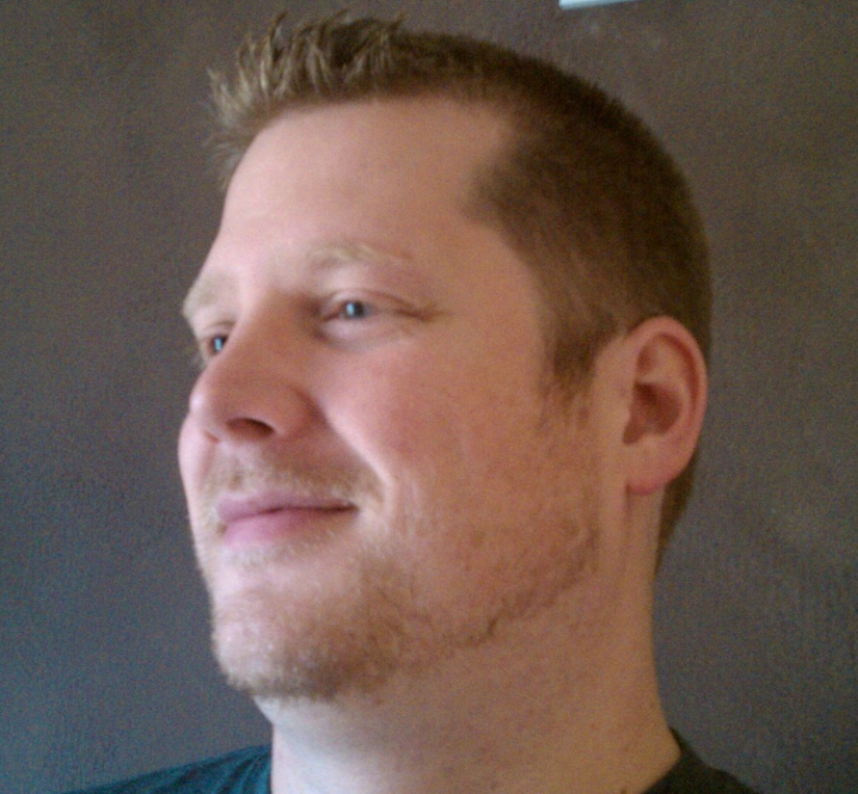
Who Is This Guy?
Director / Paige Technologies
@jonathanfmills
Jonathanfmills.com
Notes:
A little about me
As a manager, I should not have to supervise the work of others……
As a manager, I am responsible for making the team the most efficient team they can be
Over the long term… Sticks don’t work over long term
Make sure they want to come to work every morning
Make sure they feel appreciated.

Slide 10
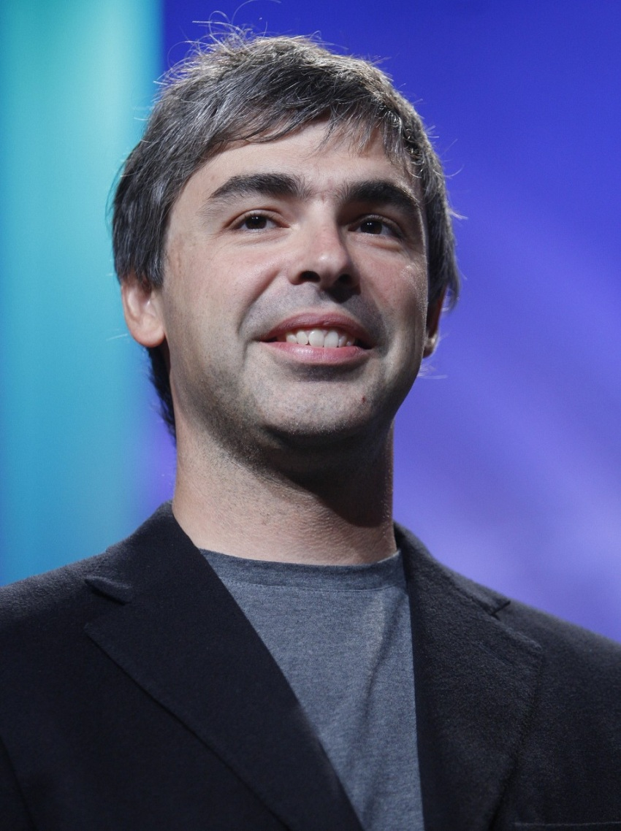
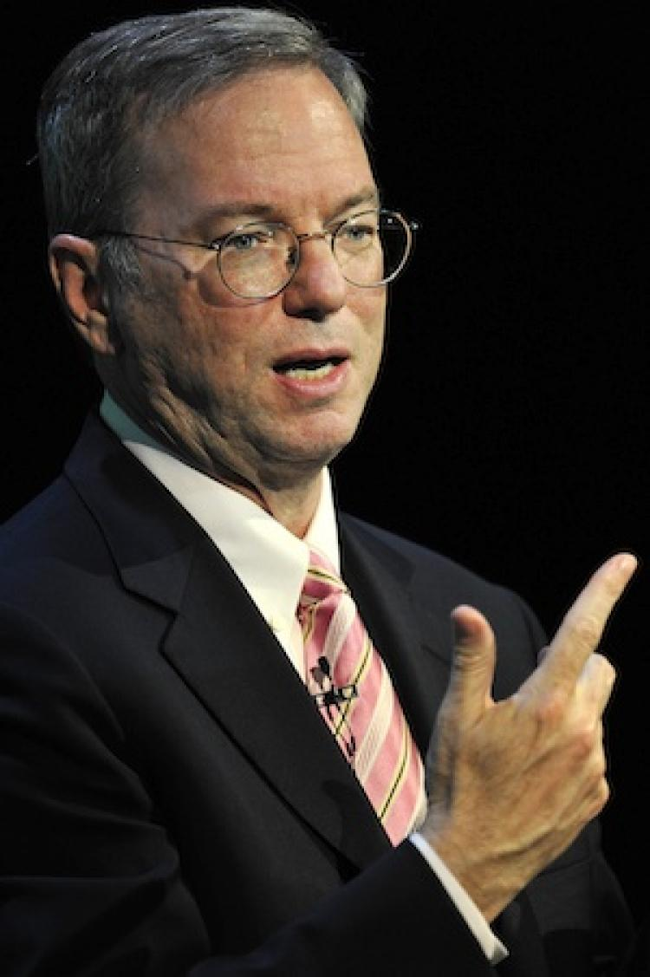

Notes:
One guy, at a small advertising agency, who never had a good manager, once had this idea to get rid of all managers in his company.
Larry Page
Eric Schmidt
The result was Chaos
Google was lucky, because they could absorb the chaos… Most companies could not.

Slide 11

Project Oxygen
Notes:
Years later, they ran a study

Slide 12
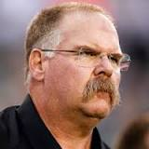
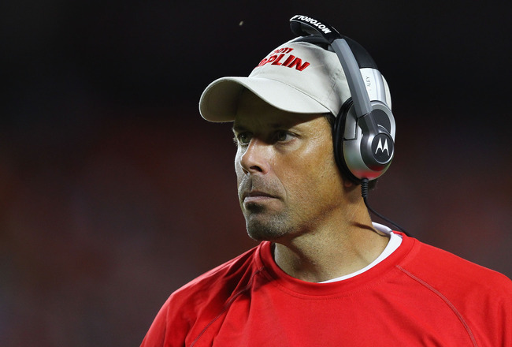
Be a Good Coach

Slide 13

Empower
Provide Specific Feedback
Negative and Positive
One on Ones
Focus on Strengths
Notes:
Let people know how they are doing at all times.
One on Ones are the most important thing you can do as a manager.
Don’t ask a wide receiver to improve their throwing skills.

Slide 14
Be a Good Coach

Slide 15
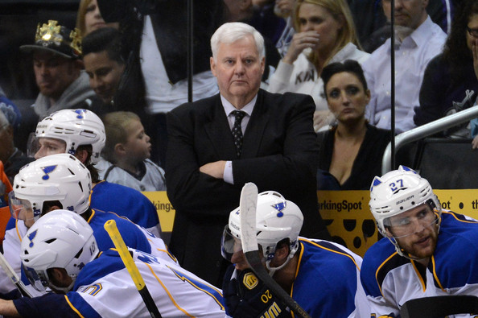
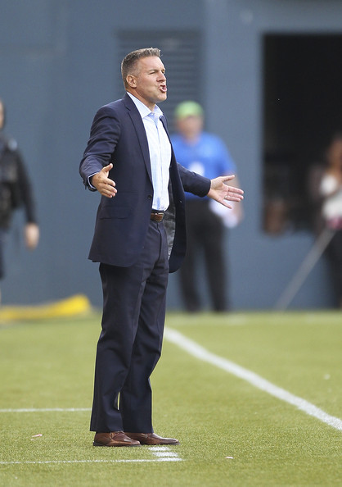
Be a good coach
Be a Good Coach

Slide 16
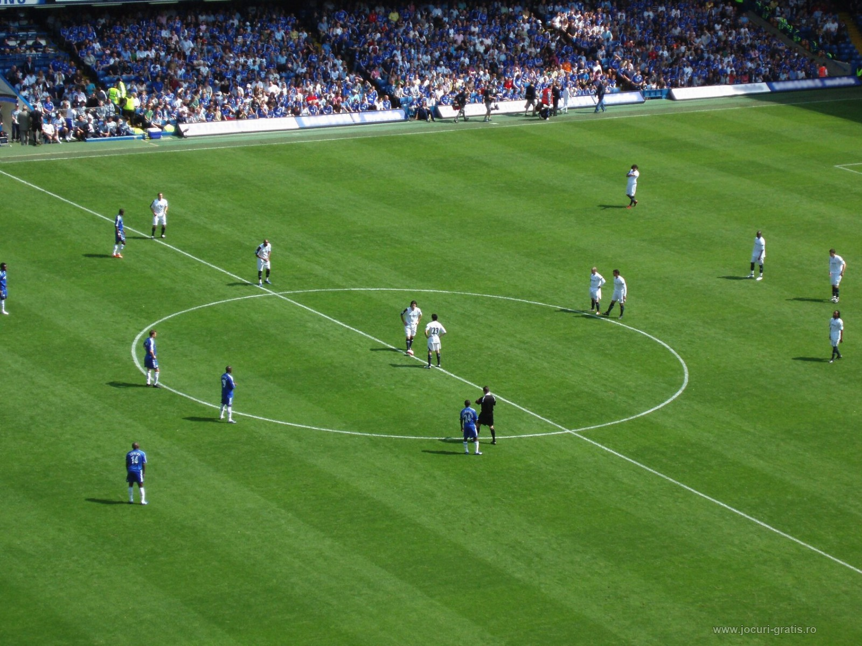
Empower Your Players
Notes:
Empower your team and don’t micromanage.
Self Directing teams
Coach them well, then let them play the game

Slide 17
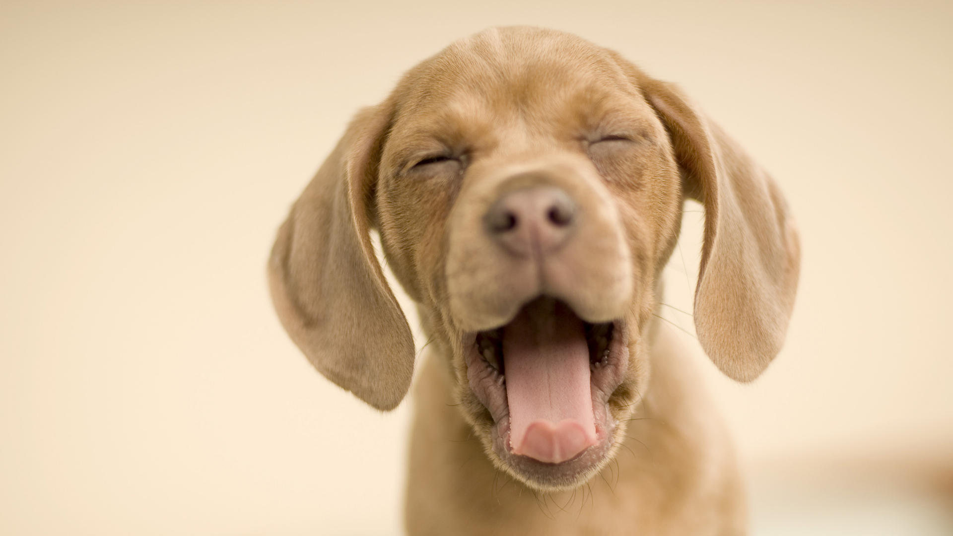
Ask About Their Dog…
Notes:
Express interest in team-members success and personal well-being.
Get to know their personal lives, and make sure they feel welcome onto the team when new.
High quality people are not looking for a place to work. They are looking for a place to live.
Help them understand that they are not just cogs in the machine. They matter to you as people.

Slide 18
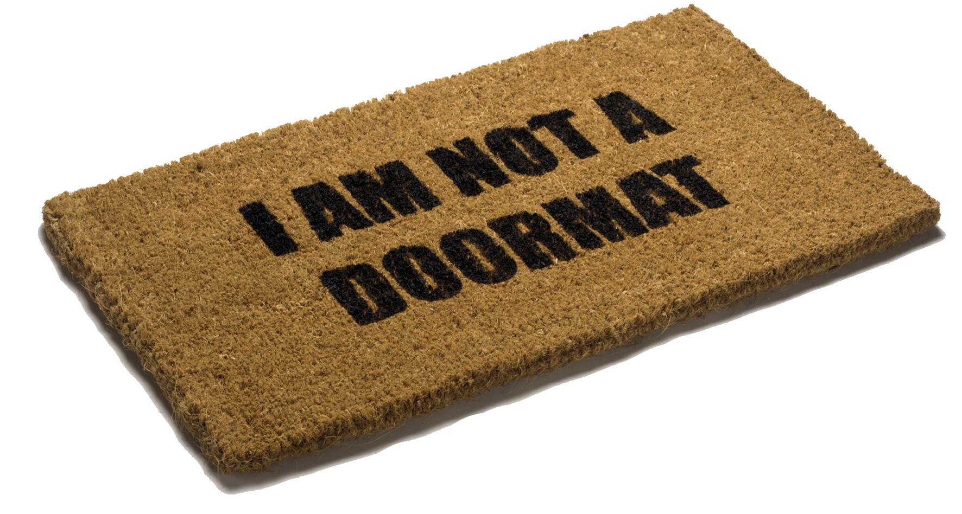
Don’t Be a Doormat
Notes:
Be Productive and Results Oriented Focus on what you want to achieve, and help achieve it; help employees prioritize.
Don’t be afraid to make a decision.
Nothing frustrates your team more than a manager that cant fight battles for them.

Slide 19
Communicate
Listen
Notes:
Be open and transparent.
Communication is two way.
Active listen.
Put your phone away and listen to what they are saying
Sometimes they don’t want the answer, they just want to know you heard.
Ask them what they need from you.

Slide 20
Develop Their Career
What Do You Want To Be
When You Grow Up?
Notes:
Marco, Boon

Slide 21
Develop Their Career
What Do You Want To Do
When You Grow Up?
Notes:
Marco, Boon

Slide 22


Clear Vision
and Strategy
Notes:
A vision you create is not the teams vision!

Slide 23
Know what you are talking about….

Slide 24

Questions?

Slide 25
Who Is This Guy?
Director / Paige Technologies
@jonathanfmills
Jonathanfmills.com
Notes:
A little about me
As a manager, I should not have to supervise the work of others……
As a manager, I am responsible for making the team the most efficient team they can be
Over the long term… Sticks don’t work over long term
Make sure they want to come to work every morning
Make sure they feel appreciated.

