Slide 1



GraphQL with Hot Chocolate
Part I
Thomas Freudenberg
@thoemmi
Robert Meyer
@roeb
Alex Dörfler
@AlexDoerfler

Slide 2
Whats the plan?
We want to answer the following questions:
What is GraphQL and how do I use it?
What are the advantages of GraphQL to REST and where does it differ?
What are Queries, Mutation & Subscriptions?
How do I create and structure a GraphQL server with Hot Chocolate?
Security, Error Handling & Testing

Slide 3
How do we do it?
This workshop includes 7 exercises that you can solve alone or in groups
Before each new theme we give you an introduction and demos
If you have any questions, there are 3 contact persons at your disposal
If you cannot complete an exercise, you will always find a working project from the last exercise to start with in the next exercise.

Slide 4
Time Schedule
09:00 - Start of the workshop
12:00 – Lunch break (45 min)
15:00 – Coffee break (15 min)
17:00 – End of the workshop

Slide 5
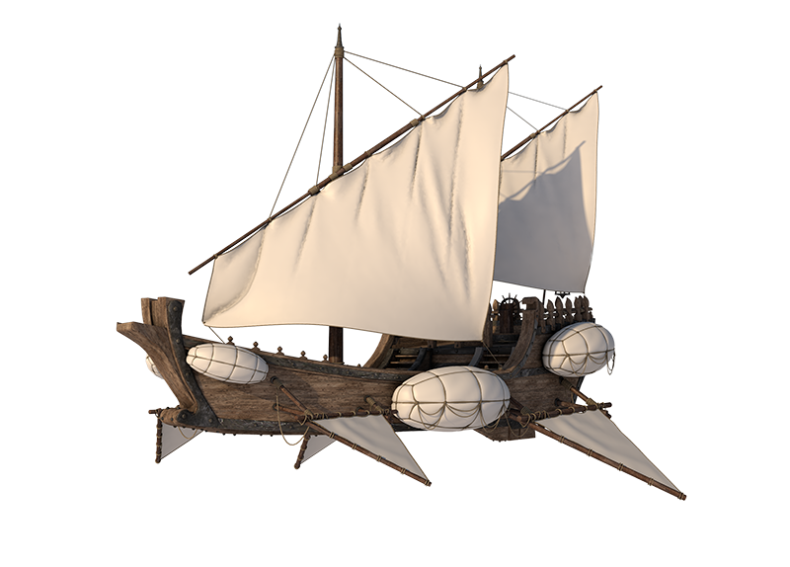








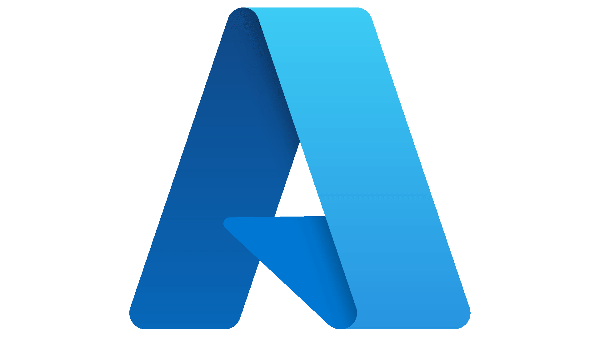

Who are we?
We work for the Cloud Klabauter in Munich. We are a 100% remote company founded in 2019. Our goal is to create solutions for automation and connectivity in the real estate industry.
We have already implemented several projects with GraphQL. We have used Apollo as well as Hot Chocolate.
This is our tech stack:

Slide 6
Your goals & wishes
Now it's your turn!
Who are you and what is your technical focus?
What do you expect from this training?
What is your level at .NET (6) and GraphQL (Hot Chocolate)

Slide 7
What is GraphQL?
GraphQL is a query language
Designed & Developed by Facebook
It's not a framework, it's a set of rules how to interact with a API.
Multiple Data Sources like API, Microservices or databases

Slide 8
GraphQL vs REST
Main Advantage: Query Language
Over Fetching & Under Fetching with REST APIs
REST is the more common standard
REST implementation is faster
GraphQL comes with two-way communication (Subscriptions)
Significantly better performance with GraphQL, when implemented carefully

Slide 9
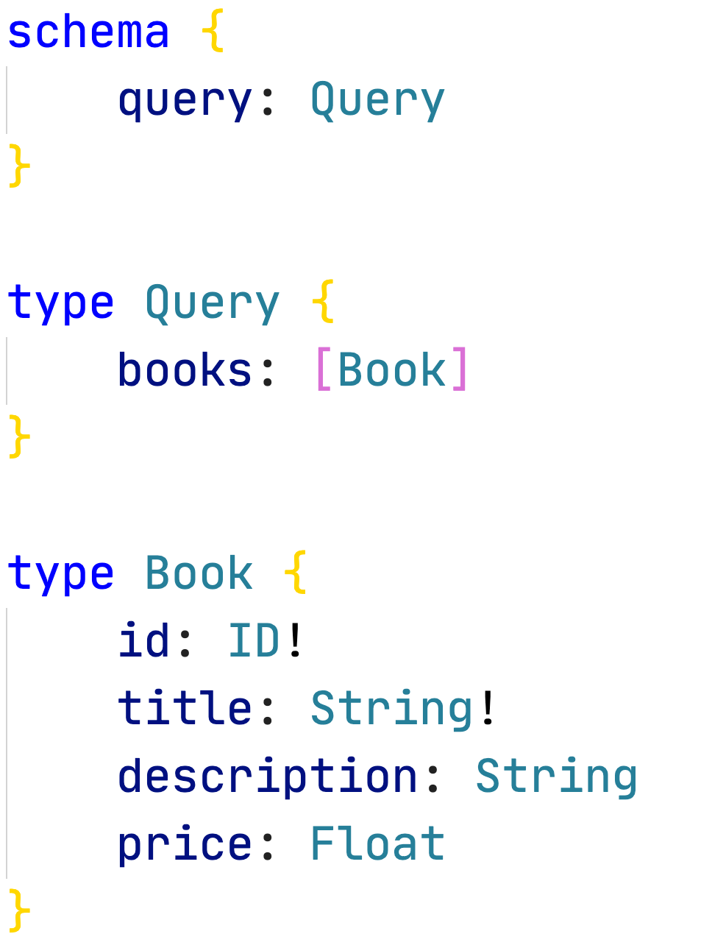
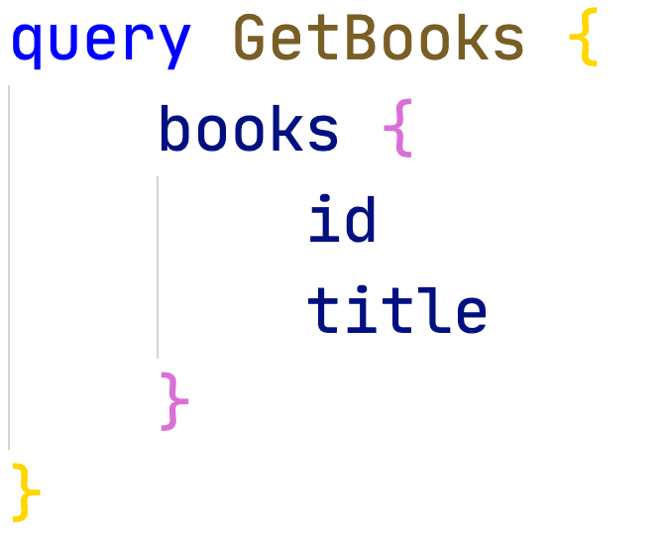
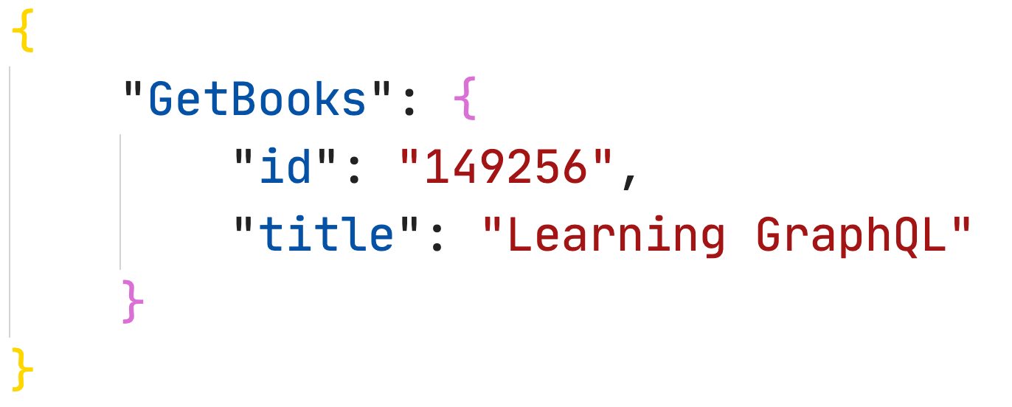
The 3 essential parts of GraphQL
Schema Definition
Query Language
Response

Slide 10







Who is using Apollo Server?

Slide 11



The Hot Chocolate universe
Banana Cake Pop

Slide 12
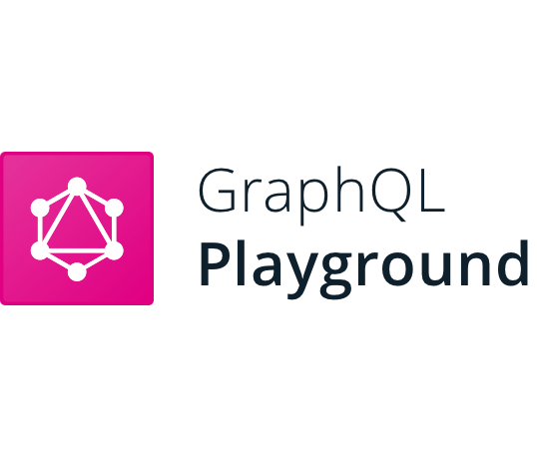

Clients for GraphQL
Banana Cake Pop
Altair GraphQL Client

Slide 13
GraphQL: Schema
A schema allows the client to understand what properties are available on your API.
GraphQL is strictly typed system
Schema syntax in GraphQL is called SDL
SDL represents the relationship between the data returned
Schema in GraphQL is stored as a string

Slide 14
GraphQL: Base Types
Query
Every GraphQL service will have a query type
The query in GraphQL represents what the client is asking for from the GraphQL API
Entry point for all queries
Mutation
GraphQL service must not include a mutation type
GraphQL mutations are used to add/update/delete data
You can think of it like a POST request in the REST world.
Subscription
A way to push data from the server to the clients that choose to listen to real-time messages from the server
Subscriptions use WebSockets, which establish a two-way interactive communication

Slide 15
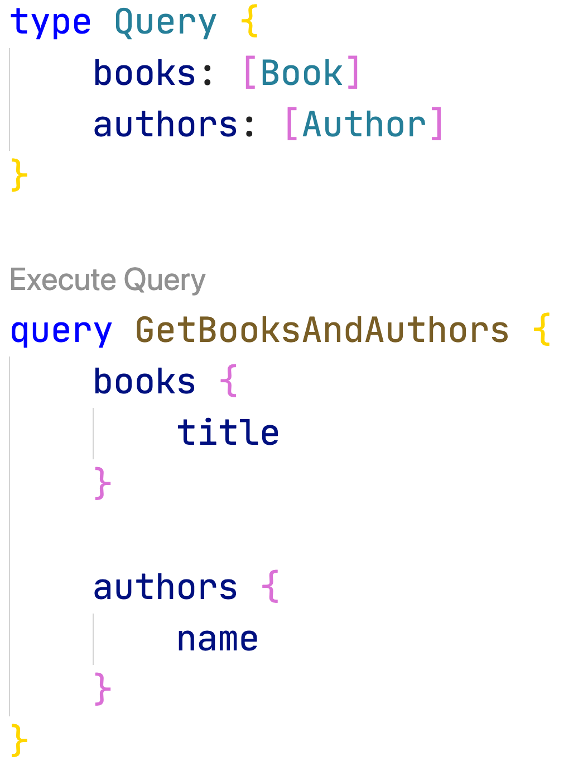
GraphQL: Query
Enables you to select only the fields they want.
Query operation is just like we use get in a REST Service. It is used to read data from a provided source

Slide 16
GraphQL: Field Definitions
Each schema type has one or more Fields
Fields can be a scalar, enum or object type
A field can return a single value/object or a list of values/objects
In GraphQL by default, each field returns NULL.
You can mark a field with ! To doesn’t return NULL.
Union Types contains different object types. A very powerful feature.

Slide 17
GraphQL: Data Types
Scalar Types
Similar to primitive types in any other programming language
Int, Float, String, Boolean & ID
Custom Scalar Types are supported
Object Types
Object type contains a collection of fields
Fields are scalar types or other object types
Enum Types
An interface specifies a set of fields that multiple object types can include.

Slide 18
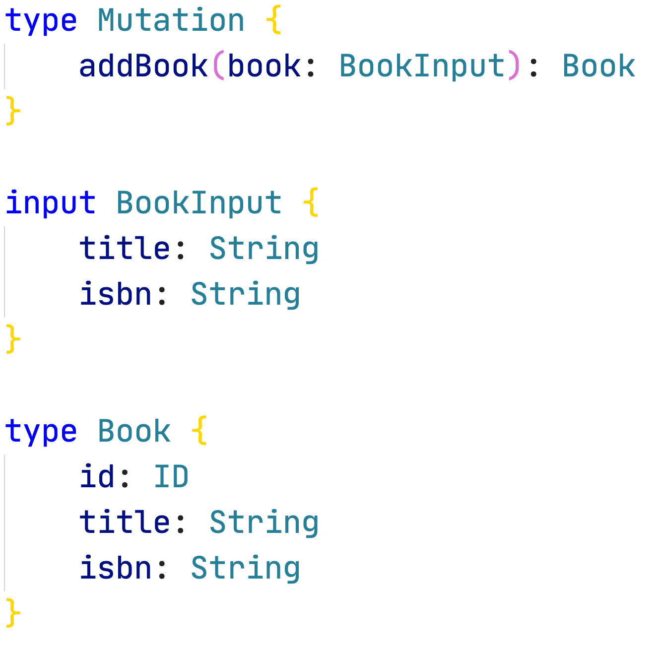
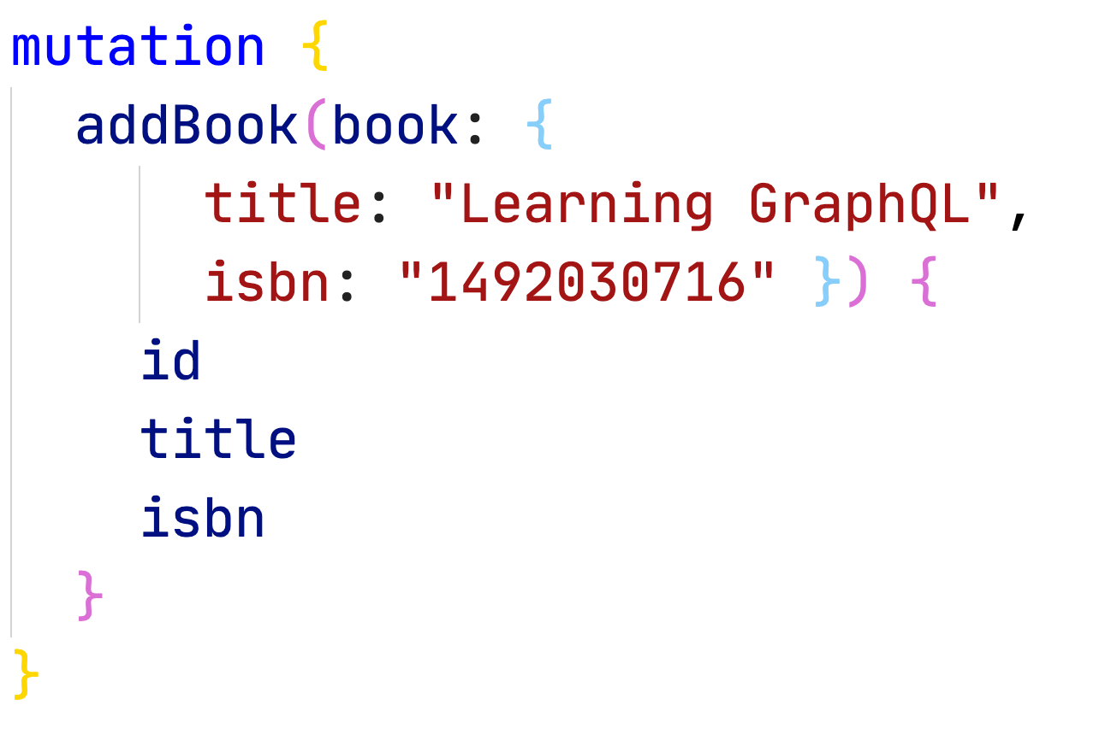
GraphQL: Mutation
Mutation is used to create, update or delete data
Mutation Type is like Query Type
Use Scalar / Input Types to modify data

Slide 19
👨‍🏫 Create GraphQL Server with Hot Chocolate
We will:
Create a new .NET 6 Project with Hot Chocolate
Implement a Query & Mutation
Execute the implementation to load and write data

Slide 20

👷‍♂️ Challenge #1: Create GraphQL Server
Now it's your turn!
In this exercise you will create a GraphQL server and implement your first queries and mutations.
https://github.com/CloudKlabauter/HotChocolateWorkshop

Slide 21
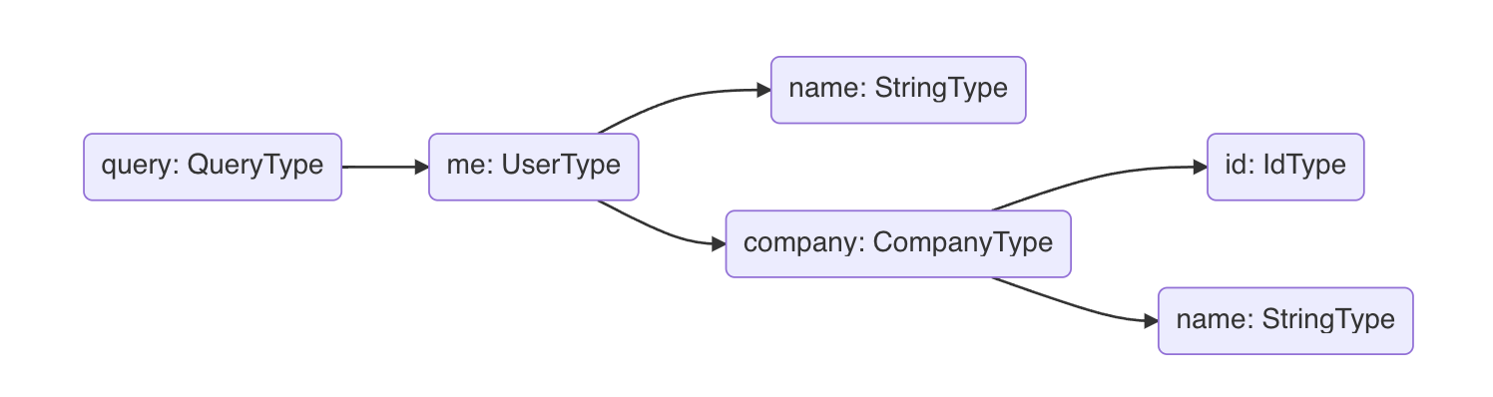
GraphQL: Resolvers
When it comes to fetching data in a GraphQL server, it will always come down to a resolver.
A resolver is a generic function that fetches data from an arbitrary data source for a particular field.
We can think of each field in our query as a method of the previous type which returns the next type.

Slide 22
GraphQL: Types of Resolvers
Regular Resolver
A regular resolver is just a simple method, which returns a value.
Async Resolver
Most fetching operations, like calling a service will be asynchronous.
Object Resolver
ObjectResolver allows to describe each field with a Fluent API and to define the behavior. For this purpose, a class of type ObjectType is created for the respective entity.

Slide 23
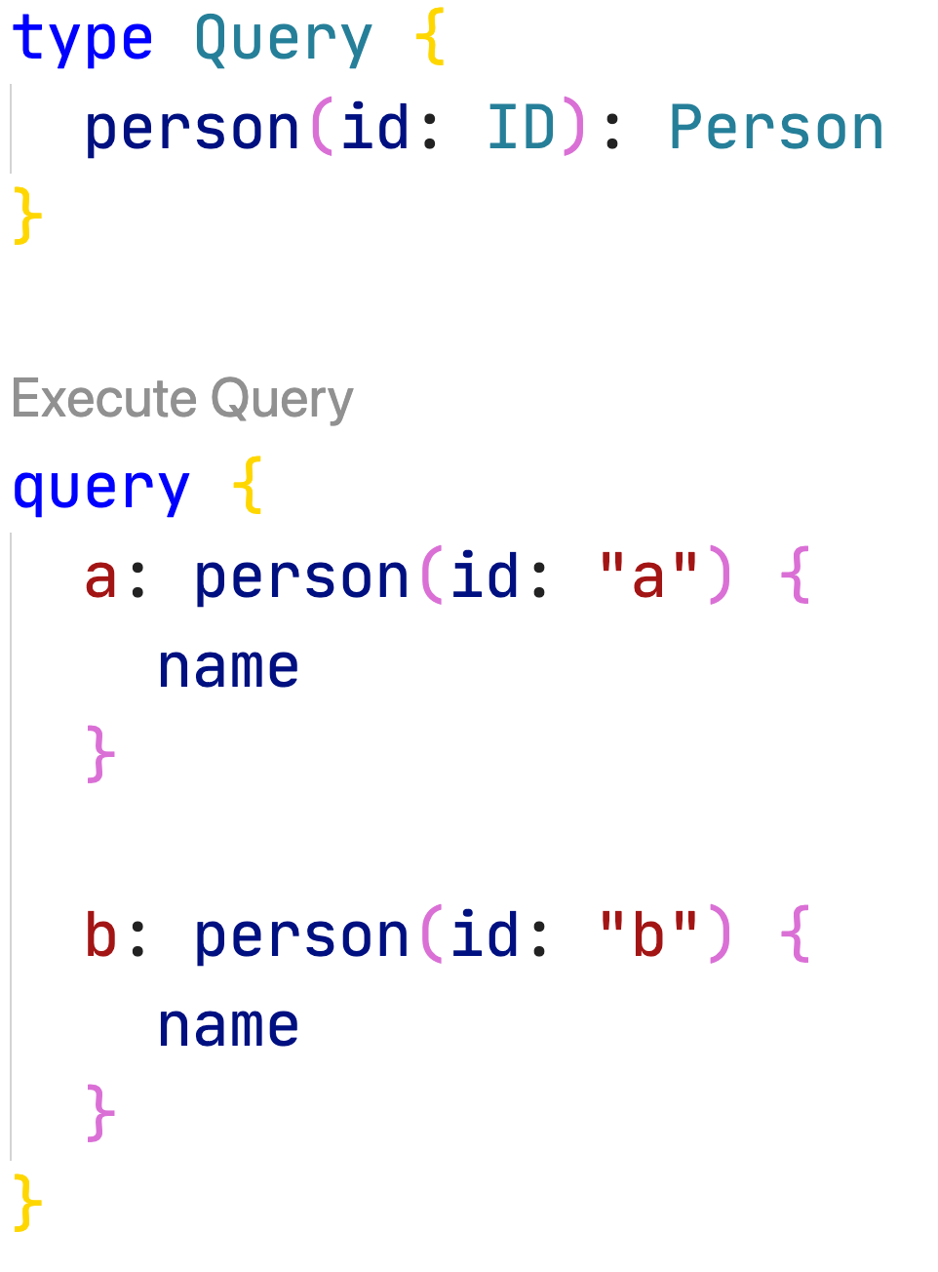
GraphQL: Data Loaders
DataLoader solve the n+1 problem.
The advantage over REST is that we only have to solve this problem once on the server and not on each client.
The idea of a dataloader is to batch multiple requests into one call to the database.

Slide 24
GraphQL: Types of DataLoaders
Batch DataLoader
Solves the One-To-One problem like multiple calls to personById
The batch data loader collects requests for entities and send them as a batch request to the data source.
Group DataLoader
Solves the One-To-Many problem like multiple calls to personByLastName
The group data loader is also a batch data loader but instead of returning one entity per key, it returns multiple entities per key.

Slide 25
👨‍🏫 How to use DataLoaders with Hot Chocolate
We will:
Implement a Batch and a Group Data Loader

Slide 26
👷‍♂️ Challenge #2: Query execution & DataLoaders
Now it's your turn!
In this exercise you will better understand how the query execution works and you will implement DataLoaders
https://github.com/CloudKlabauter/HotChocolateWorkshop

Slide 27
🍔 Lunch Time
We take a break until 12:45
Enjoy your meal!

