Slide 1



GraphQL with Hot Chocolate
Part III
Thomas Freudenberg
@thoemmi
Robert Meyer
@roeb
Alex Dörfler
@AlexDoerfler

Slide 2
Whats the plan?
In the last hours we will look at:
Subscriptions with Hot Chocolate
Strawberry Shake to get the GraphQL data to your client
Question & Get together 🍻

Slide 3
What are Subscriptions?
Subscription in GraphQL is used to add real-time capabilities to our applications.
Clients can subscribe to events and receive the event data in real-time.
Hot Chocolate implements subscriptions via WebSockets and uses the pub/sub approach of Apollo for triggering subscriptions
A subscription provider represents a pub/sub implementation used to handle events.
Following subscription providers are supported:
In-Memory Provider
Redis Provider

Slide 4
What are WebSockets?
Subscriptions are pushed by the server and use the WebSocket Protocol
WebSocket allows a communication between client (Browser) and server in both directions.
The client open a connection and the server can use the open connection to send data to the client
WebSockets, unlike HTTP, do not have headers.
WebSocket URI-Schema is ws:// or wss://

Slide 5

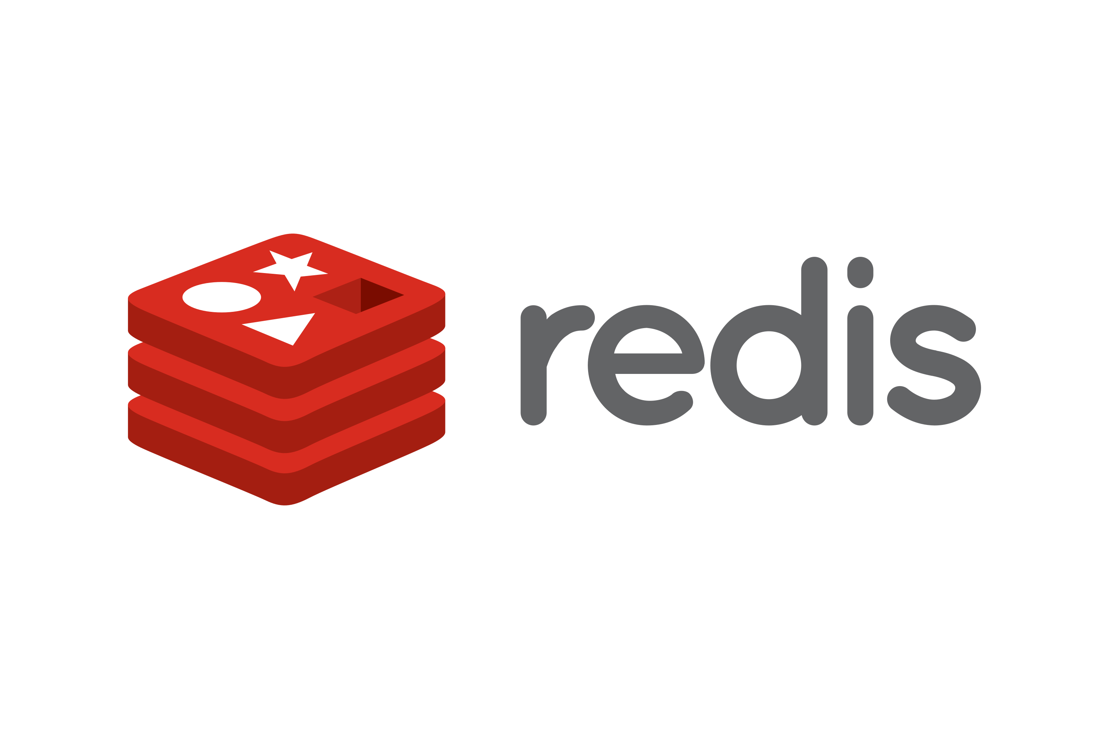

How Subscriptions work
message
message
Receive
Subscription
result
Send a mutation

Slide 6

👷‍♂️ Challenge #5: Subscriptions
Now it's your turn!
In this exercise you learn to implement subscriptions in Hot Chocolate
https://github.com/CloudKlabauter/HotChocolateWorkshop

Slide 7
Strawberry Shake
GraphQL Client library by the same team as Hot Chocolate
Supports newest GraphQL draft spec
Creates a strongly typed C# client from queries, mutations etc.
Provides caching, persisted queries and state

Slide 8
👷‍♂️ Challenge #6: GraphQL Client
Now it's your turn!
In this exercise you learn to develop a GraphQL client with Strawberry Shake
https://github.com/CloudKlabauter/HotChocolateWorkshop

Slide 9

Questions?
Do you have any questions?
You can also reach us on Twitter at any time:
Thomas Freudenberg
@thoemmi
Robert Meyer
@roeb
Alex Dörfler
@AlexDoerfler

