Slide 1
📱
Instagram & Facebook
Post Automation
Using n8n + Ayrshare
Step-by-Step procedure

Slide 2
🛠️ Tools You Need
🌐
n8n
📲
Ayrshare
Free automation tool — installed through node in command prompt
Free API to post on Instagram & Facebook — 20 posts/month free
🖼️
Post images
📸
Instagram Account
Free image hosting — gives you a public URL for your photo
Must be Professional/Creator account (switch is free)
👍
Facebook Account
Connected via Ayrshare — no Facebook Page needed!

Slide 3
STEP 1 | Create Ayrshare Account
1
Go to app.ayrshare.com in your browser
2
Click 'Sign Up Free' button
3
Enter your email and create a password
4
Check your email and click the verification link
5
You are now inside the Ayrshare Dashboard ✅
💡 Free plan gives you 20 posts per month — enough to get started!

Slide 4
STEP 2 | Connect Instagram & Facebook
📸 Instagram
👍 Facebook
1. Click 'Social Accounts' in sidebar
1. Click 'Social Accounts' in sidebar
2. Click 'Instagram' icon
2. Click 'Facebook' icon
3. Click 'Connect' button
3. Click 'Connect' button
4. Login with your Instagram
4. Login with your Facebook
5. Click 'Allow' — Done! ✅
5. Click 'Allow' — Done! ✅

Slide 5
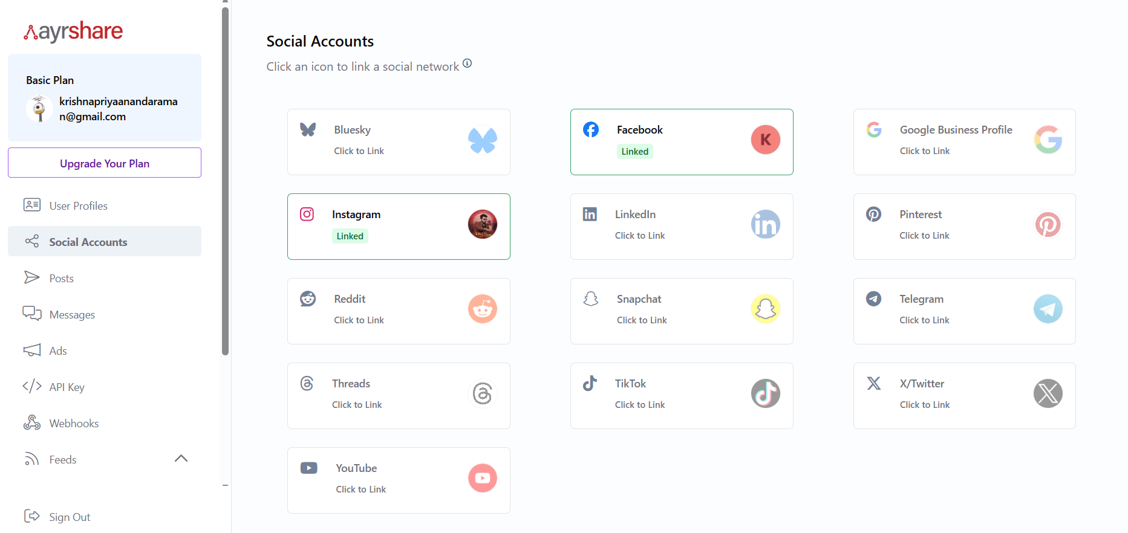

Slide 6
STEP 3 | Get Your Ayrshare API Key
1
Click 'API Key' in the left sidebar of Ayrshare dashboard
2
You will see a long code like: DDCD3E14-4F82445B-B1B1593D-21CC12D9
🔑 Your API Key: DDCD3E14-4F82445B-B1B1593D-21CC12D9

Slide 7
STEP 4 | Get a Public Image URL
Instagram needs a public image link. Use these FREE sites:
Option 1: postimages.org
Option 2: imgur.com
Go to postimages.org → Click 'Choose Images' → Upload your photo → Copy 'Direct link'
Go to imgur.com → Click 'New Post' → Upload photo → Right-click image → 'Copy Image Address'
✅ Good URL looks like: https://i.postimg.cc/xxxxx/myimage.jpg
❌ Bad URL looks like: https://www.instagram.com/p/xxxx (not direct link)
⚠️ Image URL must end in .jpg or .png and must be publicly accessible

Slide 8
STEP 5 | Build the n8n Workflow
▶
Manual
Trigger
📝
Set
Node
🌐
HTTP
Request
→
→
⬇
📸 Instagram + 👍 Facebook — POST LIVE!
How to build:
1 Open n8n → Click '+ New Workflow'
2 Click '+' → Search 'Manual Trigger' → Add it
3 Click '+' → Search 'Set' → Add it → Fill imageUrl and caption fields
4 Click '+' → Search 'HTTP Request' → Add it → Fill URL, Headers, Body
5 Connect all 3 nodes → Click 'Test Workflow'

Slide 9
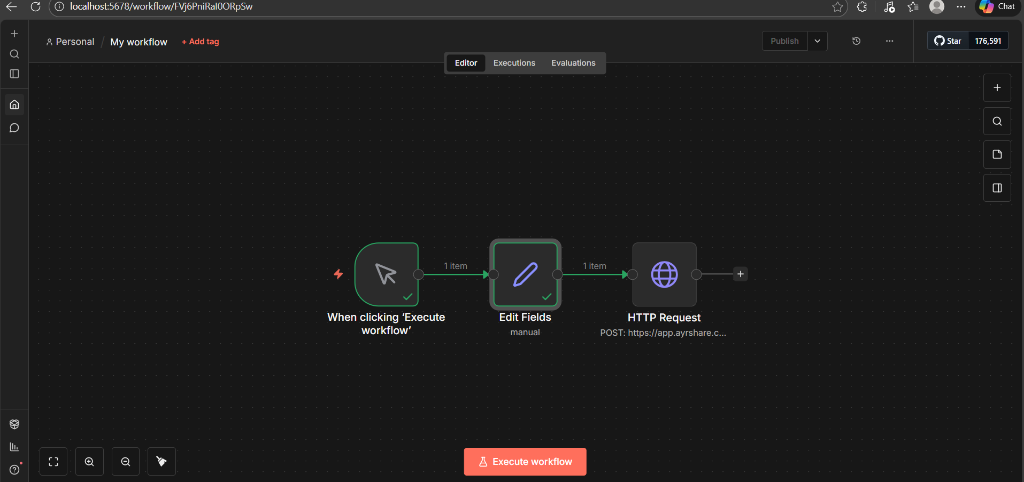

Slide 10
STEP 6 | HTTP Request Node Settings
Method
POST
URL
https://app.ayrshare.com/api/post
Header 1 — Name
Authorization
Header 1 — Value
Bearer DDCD3E14-4F82445B-B1B1593D-21CC12D9
Header 2 — Name
Content-Type
Header 2 — Value
application/json
Body (JSON):
{"post": "{{ $json.caption }}", "platforms": ["instagram","facebook"], "mediaUrls": ["{{ $json.imageUrl }}"]}

Slide 11
⚠️ Common Errors & How to Fix
🔁
ERROR: Duplicate content error
✅ FIX: Change your caption text — never reuse same text within 2 days
🖼️
ERROR: Media URL not accessible
✅ FIX: Use postimages.org or imgur.com for a proper .jpg/.png direct link
🔗
ERROR: Referenced node doesn't exist
✅ FIX: Use $json.caption instead of $('Set').item.json.caption
🔑
ERROR: 401 Unauthorized
✅ FIX: Re-copy your API key from app.ayrshare.com and paste again

Slide 12
✍️ Instagram Caption Templates
Motivational 💪
Every day is a new opportunity! 💪 #motivation #mindset #success
Personal 😊
Living my best life ✨ #lifestyle #happy #blessed #goodvibes
Travel 🌍
Exploring new places one step at a time 🌍 #travel #wanderlust #explore
Food 🍕
Made this from scratch today 😍 Recipe in bio! #food #homecooking #foodie
Question Post ❓
What's your favourite thing to do on weekends? Comment below! 👇
💡 Tip: Always change caption each time — same caption within 2 days gets blocked!

Slide 13
THANK YOU

